Slide 1
Assessing the need for Mahila Arogya Samiti in Basant Gaon and Raj Nagar Slums, New Delhi, India
Dissertation Presentation (2021-23)
Organization Name: Population Foundation of India
Student: Mahek Gupta (PG/21/053)
Mentor: Dr. Ekta Saroha
Notes:
NOTE:
To change the image on this slide, select the picture and delete it. Then click the Pictures icon in the placeholder to insert your own image.

Slide 2
Screenshot of Approval

Slide 3
CONTENTS
Introduction
Rationale
Objectives
Methodology
Results
Discussion
Limitations
Conclusion
References
Pictorial journey

Slide 4
INTRODUCTION
Mahila Arogya Samiti (MAS)
Framework for Community mobilization
Introduced by the National Urban Health Mission (NUHM) in 2013
Addresses welfare, health, and development needs of urban slums
NUHM guidelines
MAS should have 10-12 members
Cover 50-100 households
Rs. 5,000 annual untied funds deposited in MAS’s bank account to conduct health and welfare activities
The MAS members are sensitized at the area’s health center under different health program activities to be held in the community

Slide 5
INTRODUCTION
Improve awareness and access to community health services (Mumbai: MAS buy floor mats for Integrated Child Development Scheme (ICDS) Anganwadi and conduct awareness activities).
Odisha: Informed 22 slums on health-related concerns, superstitions, maternity healthcare, newborn care, and welfare programs.
Tailor health plans for communities (Chhattisgarh: 3125 MAS trained).
Society for Nature, Education, and Health (SNEH NGO, Odisha) has established MASs in 17 slums.
Prevention of violence against women (Chhattisgarh: MAS intervened in 6000 cases during 2015-16).
Encourage community participation in health promotion (Kolkata: 504 trained MAS increased use of basic eye health care and follow-up for same).

Slide 6
RATIONALE
As mentioned in the previous slide, MAS has done many interventions in other states of India whereas,
There are only 100 MAS in 11 districts of Delhi, approximately 600 slums in Delhi don’t have MAS.
The study aims to create evidence-based insights to support a community-based health program (MAS) to improve the health and well-being of residents of Delhi slums.
An assessment of Basant Gaon and Raj Nagar slums is being proposed to form MAS.

Slide 7
OBJECTIVES
General Objective:
To describe the healthcare needs and barriers to healthcare experienced by Basant Gaon and Raj Nagar slum dwellers.
Specific Objectives:
To describe the healthcare system of Basant Gaon and Raj Nagar slum dwellers.
To describe the expectations from Mahila Arogya Samiti.

Slide 8
METHODOLOGY
Study Area and Population
It is a qualitative descriptive research study.
The geographical location used in the study is Basant Gaon and Raj Nagar.
Data Collection Tools
Structured questionnaire and focus group discussion checklist.
Inclusion criteria
ANM and ASHA of both areas
Females and Males of both areas

Slide 9
METHODOLOGY
Exclusion criteria
Females and males who refuse to give a response.
Duration
February 2023- May 2023
Data Analysis
The interviews were audio-recorded and transcribed verbatim.
The data analysis was done using ATLAS.ti software.
Following the thematic approach, different themes and sub-themes are generated.

Slide 10
STUDY AREAS
Basant Gaon slum in the southeast district of Delhi with a population of 5,125.
Raj Nagar slum in the southwest district of Delhi with a population of 8,000.

Slide 11
BASANT GAON (Bhawar Singh Camp)
Characteristics | Bhawar Singh Camp
Population | 2,250
Structure of houses | Semi-pucca
Occupation of people | Unskilled Labour
Employment pattern | Irregular employment
Monthly Income of HHs | 10,000-15,000
Condition of roads | Pucca
Electricity | Individual connections
Drinking water source | Tube well/Borehole
Distance of health facility | Less than 0.5 km
Drainage system | Open pucca

Slide 12
RAJ NAGAR (J.J. Colony)
Characteristics
Population
Structure of houses
Occupation of people
Employment pattern
Monthly Income of HHs
Condition of roads
Electricity
Drinking water source
Distance of health facility
Drainage system
J.J. Colony
1,820
Pucca
Unskilled labor and homemaker
Irregular
15,000-20,000
Pucca
Individual connections
Tap water
Within 1 km
Underground

Slide 13
RESULTS: healthcare system
BASANT GAON | RAJ NAGAR
Health staff
Staff at Polyclinic Medical officers=2 Pharmacist=1 Storekeeper=1 ANMs= 5 Lab attendant=1 Dresser= 2 Nursing orderly=2 Certified documentation expert outpatient (CDEO) cum assistant=1 Sweepers cum chowkidar (SCC)=2 Vacant positions Public Health Nurse Officer Lab Technician AYUSH unit | Staff at dispensary Medical officers=3 Pharmacists=2 Storekeeper=1 ANMs=6 Lab technicians=2 Nursing orderly=1 Certified documentation expert outpatient (CDEO) cum assistant=1 Sweepers cum chowkidar (SCC)=3 AYUSH unit with Medical Officer=1, Pharmacist=1, Nursing Orderly=1 Vacant Positions Public Health Nurse Officer Dresser

Slide 14
RESULTS
 | BASANT GAON | RAJ NAGAR
Availability of Infrastructure | Designated government building Regular water and Electricity supply Well-spaced waiting area for patients No beds are available in the facility. No telephone line IEC materials on programs like Food and nutrition, the Leprosy program, Janani Suraksha Yojana, Malaria, Typhoid, and many more. | Designated government building Regular water and Electricity supply Well-spaced waiting area for patients No beds are available in the facility. No telephone line IEC material on different programs (food and nutrition, NCD, Immunization, etc.) was displayed there.
Facilities available | Basic medicines, curative services, reproductive and natal health, child care and immunization, screening for diabetes and cancer, and eye care services. There are no yoga and physiotherapy services provided. Referred Facility Madan Mohan Malviya Hospital for delivery and internal examination and treatment for gynaecologic conditions. | Basic medicines, curative services, reproductive and natal health, child care and immunization, screening for diabetes and cancer, and eye care services. There are no yoga and physiotherapy services provided. Referred Facility Dada Dev Hospital for delivery and internal examination and treatment for gynaecologic conditions.

Slide 15
RESULTS
 | BASANT GAON | RAJ NAGAR
Community Health | UHND is organized every month in a place provided by an NGO. Counseling on Nutrition, Family Planning, Sanitation, and Breastfeeding is provided by ANM, ASHA, and AWW in that area. Every Wednesday and Friday immunization takes place. The referral unit of the polyclinic is a government hospital (Safdarjung Hospital) and Madan Mohan Hospital. The proximity of the referral unit is 8-9 km. | UHND is conducted every month by ANM, ASHA, and AWW, with nutrition, family planning, sanitation, breastfeeding counseling, immunization, health talk, and screening camps conducted at Anganwadi centers. Immunization day is held every Wednesday and Friday. The referral unit of the dispensary is a government hospital (Dada Dev Hospital for deliveries and Indra Gandhi Hospital). The proximity of the referral unit is 6-8 km.
Expectations from Mahila Arogya Samiti | “If such a community group will be formed, it will help in the betterment of the area. This will improve the health status and the area's social and environmental status.” “ MAS will not only provide a platform for women to speak but also increase community understanding of locally relevant health concerns and increase community adoption of effective health practices.” | “They will support the work of community service providers and act as a platform for a holistic action on the social determinants of health concerning the slum.” “This framework will provide a channel for the community to express its health needs, experiences, and concerns about access to health care.”

Slide 16
RESULTS (Focus Group Discussion)
THEMES | SUB-THEMES | QUOTES
1. Availability of healthcare |  | “ I go to a dispensary in Basant Gaon. Soon a Mohalla clinic is also opening in our area. Other than the dispensary there is Madan Mohan Hospital nearby our vicinity.” “There is a government dispensary named Arya Samaj Dukh Niwaran Samiti. It is open 6 days a week. But we have to pay the consultation fees.” “In an emergency, for pregnant women, we have to rush to Dada Dev hospital OR Indraprastha Hospital.”
2. Accessibility of healthcare | The proximity of health facility | “I prefer going to the dispensary as it is ½-1 km away from my home.” “The nearest health facility is the polyclinic in the Basant Gaon, it’s 2 km away from the area.” “Arya Samaj Dukh Niwaran Samiti is 2-2.5 away from the area.”
 | Mode of transportation | “I go to the health facility by auto-rickshaw.” “There is also a shortcut from the jungle on the backside of the area. Most people walk or cycle through this route.” “I travel by auto-rickshaw or battery rickshaw. It is conveniently available.” “Usually men use their cycles or bikes to go to the health facility, as it takes less time to reach.”

Slide 17
RESULTS
THEMES | SUB-THEMES | QUOTES
3.Problems/Issues faced | Health facility | “There are times when I go to a dispensary and doctors don’t what spend time with only one person, they just refer me to other facilities.” “Even when we go to the referred facility, we have to wait in long queues and many times we are told to come other days as it is overcrowded.” “the doctor doesn’t examine properly; they just ask what’s the problem and write some medicines.” “they examine us from a distance, they just spend max. 5 mins per patient.”
 | Sanitation and Hygiene | “There is no MCD arrangement, we collect ₹ 40 each month and a cleaner comes to take the garbage and it is collected daily.” “Even when the cleaner comes daily for the garbage collection, people throw garbage in the park making it difficult for kids to play.” “Parks are cleaned at other places. People go there for walking, exercising and children go there to play. But here people spread garbage at that place making the surroundings polluted and unhygienic.” “We don't have a proper individual water supply in their homes. We take drinking water from the water tanker situated in community toilet management on a paid basis (1 litre- 1 Rupee).” “…the drainage system is open, so many people throw garbage there making it polluted .”

Slide 18
RESULTS
THEMES | QUOTES
4. Areas of Improvement | “if different health camps are conducted regularly, it will increase the awareness and health behavior.” “some health camps for geriatric care should be conducted in the area as the old people can’t travel dispensary. This will keep them updated about their health status regularly.” “There should be health talks organized for the adolescents, as it will make them aware and help them decide what’s right and wrong for them.” “it will be very helpful if health providers organize camps for the adolescents as at their age, they don’t openly talk with their parents. Maybe they will talk about their problems with health providers.”
5. Expectations from Mahila Arogya Samiti | “If such a community group will be formed it will help in the betterment of the area. This will improve the health status and the area's social and environmental status.” “ MAS will not only provide a platform for women to speak but also increase community understanding of locally relevant health concerns and increase community adoption of effective health practices.” “MAS will provide a platform for convergent action on socioeconomic determinants of health and all public services directly or indirectly relevant to health.” “This will give us a certain level of authority and say in the community and increases our confidence.” “This will act as a bridge between the community and health providers. We will able to convey our concerns in a better manner.”

Slide 19
DISCUSSION
The MAS is one of the primary interventions the National Health Mission uses to encourage community engagement in health at all levels, including health program development, implementation, and monitoring.
At the urban slum level, MAS is required to take collective action on topics like health, nutrition, water, sanitation, and social factors.
According to previous studies, state governments established Mahila Swasthya Sangha (MSS) and Health Committees to promote community engagement in health initiatives. Kerala's People's Plan was a successful example of this process, which involved the public in determining development.
Committees were mainly headed by the village elite, assisting pulse polio or family planning programs.

Slide 20
DISCUSSION
In Chhattisgarh, the state health resource center created a training module for Mahila Arogya Samiti and organized training in 16 cities. 3125 MASs have been trained and 3700 are working on social determinants of health, intervening in 6000 cases of violence against women in 2015-16.
The National Health Mission, Maharashtra, and SNEHA (NGO) signed a Memorandum of Understanding to create 9393 Mahila Arogya Samitis with bank accounts in 95 Urban Local Bodies (ULBs), with 5733 given bank accounts. One MAS used its funds to buy mats for ICDS Anganwadi and conduct awareness activities.
As per the results, the formation of Mahila Arogya Samiti in the above slums can help in improving the social determinants of health by conducting awareness campaigns.
Such intervention can improve health-seeking behavior through community participation.

Slide 21
LIMITATIONS
The description of the healthcare system is not compared with the government guidelines.
Status of previous MAS or other similar groups in Delhi is not studied.
The above findings, may not be generalized to other regions as different areas, has different needs.

Slide 22
CONCLUSION
Formation of a community group like Mahila Arogya Samiti will increase community mobilization and involvement in urban slum areas.
It will also boost confidence and empower women to take a step forward for the betterment of their community.
Community-based interventions like Mahila Arogya Samiti will help to enhance health and development outcomes in urban slum communities.
Formation of Mahila Arogya Samiti will increase awareness regarding different national health programs in the community.
They will also aware the community about health-seeking behavior and incorporate healthy behavior (eg, hand-washing, sanitation, and hygiene practices).

Slide 23
REFERENCES
Desiraju, K., & Gupta, A. (2014). Guidelines for ASHA and MAS in Urban Context. https://www.wbhealth.gov.in/NUHM/uploaded_files/all_files/Guidelines_for_Asha_and_MAS_in_Urban_Context.pdf
HPPI-45-2_merged (2).pdf. (n.d.). Retrieved February 27, 2023, from http://www.nihfw.org/Doc/HPPI-45-2_merged%20(2).pdf#page=37
Mahila Arogya Samiti. (n.d.). Society for Nutrition, Education & Health Action (SNEHA). Retrieved March 20, 2023, from https://snehamumbai.org/mahila-arogya-samiti/
NUHM Mahila Arogya Samiti – SOCIETY FOR NATURE EDUCATION & HEALTH. (n.d.). Retrieved February 15, 2023, from http://snehindia.org/nuhm-mahila-arogya-samiti/
Mahila Arogya Samiti Report 2015-16. (2016). https://shsrc.org/wp-content/uploads/2020/04/MAHILA_AAROGY_SAMITI_ANNUAL_REPORT_2015_16.pdf

Slide 24
THANK YOU!
ANY QUESTIONS?

Slide 25
PICTORIAL JOURNEY
FGD in Basant Gaon

Slide 26
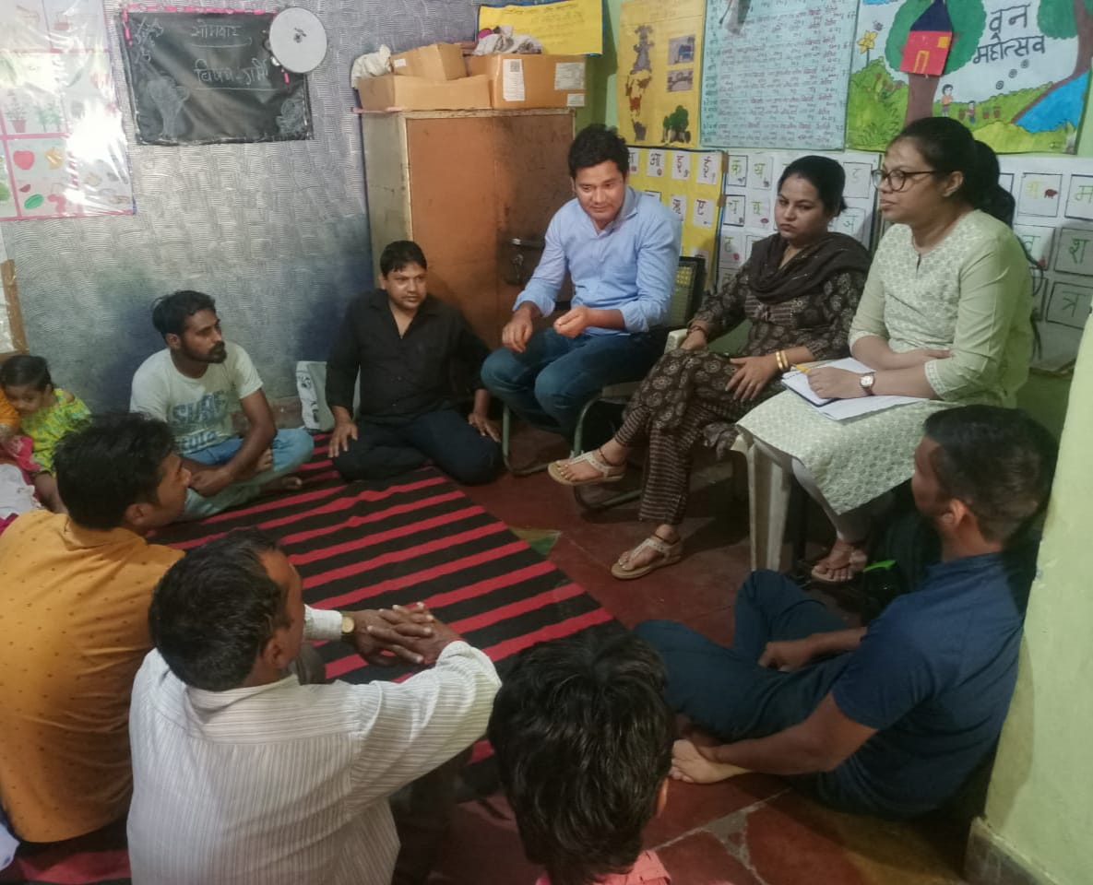
PICTORIAL JOURNEY
FGD in Raj Nagar
FGD with Males

