Slide 1


DISSERTATION PRESENTATION
PATIENT SATISFACTION SURVEY AT AN
EX-SERVICEMEN CONTRIBUTORY
HEALTH SCHEME (ECHS) POLYCLINIC
DUNDAHERA(GURUGRAM)
By
Col Manoj Singh Roll No PGDM/056/21-23
Mentor- Dr Vinay Tripathi, (IIHMR,DELHI)

Slide 2
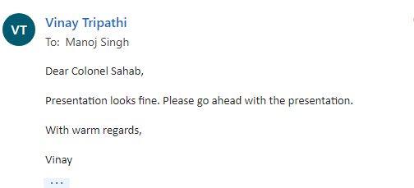
APPROVAL FROM MENTOR

Slide 3
PREVIEW
  Introduction
  Objectives of Study
  Methodology
  Result
  Discussion
  Conclusion

Slide 4
INTRODUCTION
Overview of ECHS
ECHS. Launched on 1st April 2003 for medical cover to veterans(20 years)
  Budget – Rs 5000 Cr(Approx)
  Dependents – 56 Lakhs
Under DESW, MoD & Central Org, Nation wide network of
  Regional Centre -30
  Poly Clinics (Primary contact point) - 433
  Service Hospitals
  Empanelled Hospitals
Success of ECHS System
Patient Satisfaction (Overall experience) at ECHS Polyclinics depends on :-
  Medical care
  Infrastructure
  Consultation
  Medicine

Slide 5
OBJECTIVES OF STUDY
Objective The objective of the study is to assess the patients’ satisfaction level at the ECHS Polyclinic, Dundahera
Primary Research Question. What is the satisfaction level of the patients of the ECHS Polyclinic, Dundahera?
Secondary Research Questions.
  (a) What are the aspects of ECHS scheme, with which the beneficiaries are satisfied/ happy with?
  (b) What are the aspects of the ECHS scheme, that require improvement?
  (c) Any other relevant information/ correlation which can be arrived at with respect to patient satisfaction at ECHS Polyclinic?
Rationale. After twenty years of its introduction, weather the scheme is successful in meeting the medical needs and expectations of ESM, can only be gauged by a patient satisfaction survey

Slide 6
METHODLOGY
Study Area: ECHS Polyclinic, Dundahera, Gurugram
Study Design: Cross-sectional survey
Data Collection Tools: Semi structured questionnaire
Study Population: ECHS Patients
Sample Size: 400 (With 95 % confidence level and +/-5% margin of error= 385)
Sampling Method: Convenience
Data Analysis Tool: Microsoft Excel
Data Analysis Method : Descriptive analysis for summarizing the data collection
Inclusion Criteria – Visit to OPD, Veterans
Exclusion Criteria - Consent not given/ unwilling

Slide 7
METHODLOGY(ROL)
SUB | JOURNAL | METHODOLOGY | SAMPLE SIZE | RESULTS
Towards patient-centered health services in India--a scale to measure patient perceptions of quality. Rao KD, Peters DH, BRoche K. | Int J Qual Health Care. 2006 Dec | Cross Sectional Study of OPD patients | 1869 OPD Patients in public health centers in U.P.(India) | Doctor behavior, medicine availability, hospital infrastructure, staff behavior, and medical information influence patient satisfaction in decreasing order. Variety of health setups- same scale
Outpatient satisfaction and quality of health care in North Indian medical institute. Puri N, Gupta A, Aggarwal AK, Kaushal V. | Int J Health Care Qual Assur. 2012 | Cross Sectional Study of OPD patients | 120 OPD patients | Patient satisfaction, client convenance facilites, prescription quality , doctor-patient interaction etc.(87% Satisfaction) Not using a Likert scale , Med & Surgical wards only, Ltd sample size.
What Factors Affect Patient Satisfaction in Public Hospitals Abid Hussain, Muhammad Safdar Sial and others | Int J Envmt Rescearch & Public Health Care,Mar 2019 | Cross Sectional Study of OPD patients | 554 OPD patients | Patient satisfaction , laboratory services, pharmacy services, doctor–patient communication, and physical services. Ltd sample from one geog location only
Client satisfaction in ECHS Polyclinic: Experience from India Naveen Phuyal, Ashok Jindal,YSM, Sandip Mukerji. | MJSBH Vol 14 Issue 2 Dec 2015 | Cross Sectional Study of OPD patients | 400 (Patients who had at least 3 vis) | Parking, Regn, Waiting Area Experience, Time with Dr, Lab & Pharmacy,83 %good No Likert scale, Study setting not given, Sub heads of factors not considered
Factors Identified for Survey Questionnaire (From ROL & Process Mapping) Appointment/reception, Consultation, Infrastructure & Services, Pharmacy, Referral & Claims

Slide 8
METHODLOGY(FACTORS)
PATIENT SATISFACTION
APPOINTMENT
RECEPTION
REGISTRATION
ALLIED
SERVICES
INFRA/HYGINE
SANITATION
TIMELY BILL CLEARANCE
QUALITY
DOSAGE
EXPLAINATION
EASE OF APPOINTMENT
RECEPTION
CONDUCT OF STAFF
CONSULTATION
TIME
ATTENTION
PRIVACY
PHARMACY
AVAILABILITY
EXPIRY DATE
TIME
LAB SERVICE
EMERGENCY
PHYSIOTHERAPY
REFERRAL/
BILL CLEARANCE
EASE OF
REFERRAL
FACTORS
SUB FACTORS
NOTE – 5 PONIT LIKERT SCALE WAS USED FOR EACH FACTOR/ SUB-FACTOR GRADING DURING SURVEY
EXCELLENT, GOOD, FAIR, POOR, VERY POOR,

Slide 9
RESULTS (DEMOGRAPHIC INFO)
N = 400
DEDUCTIONS
OR/Jawans are the least category of persons visiting the polyclinic (Maximum number of serving persons are Jawans)
Maximum persons(40%) visiting are JCOs
A large number of Officers visit the Polyclinic ( second highest category -36%)

Slide 10
RESULTS (DEMOGRAPHIC INFO)
N = 400
DEDUCTIONS
Maximum number of persons have 1-2 dependents (56%)
Very few persons(1%) have >5 dependets
Average number of dependents – 2.6 (Approx 3) per veteran

Slide 11
DATA SUMMARY & ANALYSIS
PARAMETER | FREQUENCY |  |  |  |  | CENTRAL TENDENCY |  |  |  | PERCENTAGE(%)
GRADE | Excellent | Good | Fair | Poor | V Poor | MODE | MEAN | % SAT |  | Excellent | Good | Fair | Poor | V Poor
 | 5 | 4 | 3 | 2 | 1 | LIKERT SCALE |  |  |  | 5 | 4 | 3 | 2 | 1
Reception | 192 | 120 | 59 | 28 | 2 | Excellent | 4.2 |  | 83.5 % | 48 | 30 | 15 | 7 | 1
Consultation | 106 | 145 | 110 | 37 | 3 | Good | 3.8 |  | 75.7 % | 26 | 36 | 28 | 9 | 1
Services | 95 | 147 | 112 | 37 | 9 | Good | 3.7 |  | 74.1 % | 24 | 37 | 28 | 9 | 2
Pharmacy | 90 | 162 | 95 | 40 | 14 | Good | 3.7 |  | 73.8 % | 22 | 41 | 24 | 10 | 3
Referral | 143 | 239 | 18 | 0 | 0 | Good | 4.3 |  | 86.3 % | 62 | 33 | 4 | 1 | 0
Overall Sat | 89 | 170 | 68 | 54 | 19 | Good | 3.6 |  | 72.8 % | 31 | 41 | 20 | 7 | 1

Slide 12
RESULT(PATIENT SATISFACTION)
Deductions
72% have graded the overall services as Good/ Excellent
Least satisfaction is wrt to Pharmacy services 13 % rated Poor/V Poor
Mode of overall Satisfaction level is Good with163 out of 400 rating it as good
Maximum frequency is for “Referral-Good” with 239/400

Slide 13
RESULT (PATIENT SATISFACTION)
N = 400
Mode- Ex
% Sat – 84
Mean- 4.2
N = 400
Mode- Good
% Sat – 76
Mean- 3.8
N = 400
Mode- Good
% Sat – 74
Mean- 3.7
N = 400
Mode- Good
% Sat – 74
Mean- 3.7
N = 400
Mode- Good
% Sat – 86
Mean- 4.3

Slide 14
RESULT (CORELATION)
BIVARIATE CORELATION BETWEEN AVERAGED AND SURVEY SATISFACTION
CORELATION COFFICIENT*
 | Avg | Svy
Avg | 1
Svy | 0.932544 | 1
MULTIIVARIATE CORELATION BETWEEN FACTORS & OVERALL SATISFACTION
Deductions
Very Strong +ve Correlation (0.93) between Averaged & surveyed satisfaction
Factors selected for Survey were correct*
Services>Referral>Pharmacy>Reception is order of relation with overall satisfaction
Strong inter-se correlation between pharmacy, consultation & services
 | Reception | Consultation | Pharmacy | Services | Referral | Overall
Reception | 1
Consultation | 0.733748 | 1
Pharmacy | 0.665954 | 0.964566 | 1
Services | 0.647175 | 0.996136 | 0.977686 | 1
Referral | 0.766133 | 0.788673 | 0.778973 | 0.868743 | 1
Overall Sat | 0.635366 | 0.877548 | 0.886358 | 0.96105 | 0.934518 | 1

Slide 15
RESULT (OOPE)
1 = less than Rs 1000 (Negligible)
2= less than Rs 5000 (Moderate)
3= More than Rs 5000 (High)
CORELATION COFFICIENT
 | Rank | Income | OOPE
Rank | 1
Income | 0.870827 | 1
OOPE | 0.685191 | 0.645 | 1
Summary
Pension is major component of Income for ESM(0.87)
OOPE is +vely related to Income(0.65)
OOPE is +vely related to Rank(0.69)
Medicines are major component of OOPE(78%)
OOPE is low among ESM due to ECHS System

Slide 16
RESULT (REFERRAL PREFERENCE)
Summary
Majority of persons prefer Service(60%)
Primary reason is proximity of BH & RR
Public hospital are least preferred
The preference may vary from polyclinic to polyclinic

Slide 17
DISCUSSION (LIMITATIONS)
Study undertaken at one Polyclinics (PCs) in NCR region. (433 PCs)
Various types of polyclinic (A to E) differ from each other considerably. Similar Facilities not available across the board
Good Empaneled Hospitals in NCR Region
Time and Duration of Study(Summers)
Approx 70 % visitors are not willing for survey, not included
Time to time variations like availability of medicines influence the overall satisfaction level
Result of Study cannot be templated across all PCs
More number & types of polyclinics needs to be included for arriving at general satisfaction level of ECHS Patients

Slide 18
CONCLUSION
One of the biggest public health scheme for veterans
Training of staff in soft skills
Consistency in policies and awareness level of veterans(JCO/OR)
Availability of infrastructure, ambulance, patient ferrying vehicle
Better & Modern Lab services
Better management & Availability of medicines
Better coordination between all agencies

Slide 19
REFERENCES
1. COECHS. History, Organization & Functioning of ECHS, Published on Official ECHS Web Portal, 2022, Available at www.https://echs.gov.in
3. Varshney Deepak, Audit of ECHS Polyclinic, Dissertation Report (Unpublished), 2021. Available at IIHMR, Delhi Library
4. Hussain Abid & Others, Measuring hospital satisfaction, Research gate, July 2019,
5. Puri N(1), Gupta A, Aggarwal AK, Kaushal V. Outpatient satisfaction and quality of health care in North Indian medical institute. Int J Health Care Qual Assur. 2012
6. Rao KD(1), Peters DH, Bandeen-Roche K. Towards patient-centered health services in India--a scale to measure patient perceptions of quality. Int J Qual Health Care. 2006 Dec
7. Naveen Phuyal, Ashok Jindal,YSM, Sandip Mukerji. Client satisfaction in ECHS Polyclinic: An Experience from India MJSBH Vol 14 Issue 2, Dec 2015

Slide 20
Thank You

Slide 21
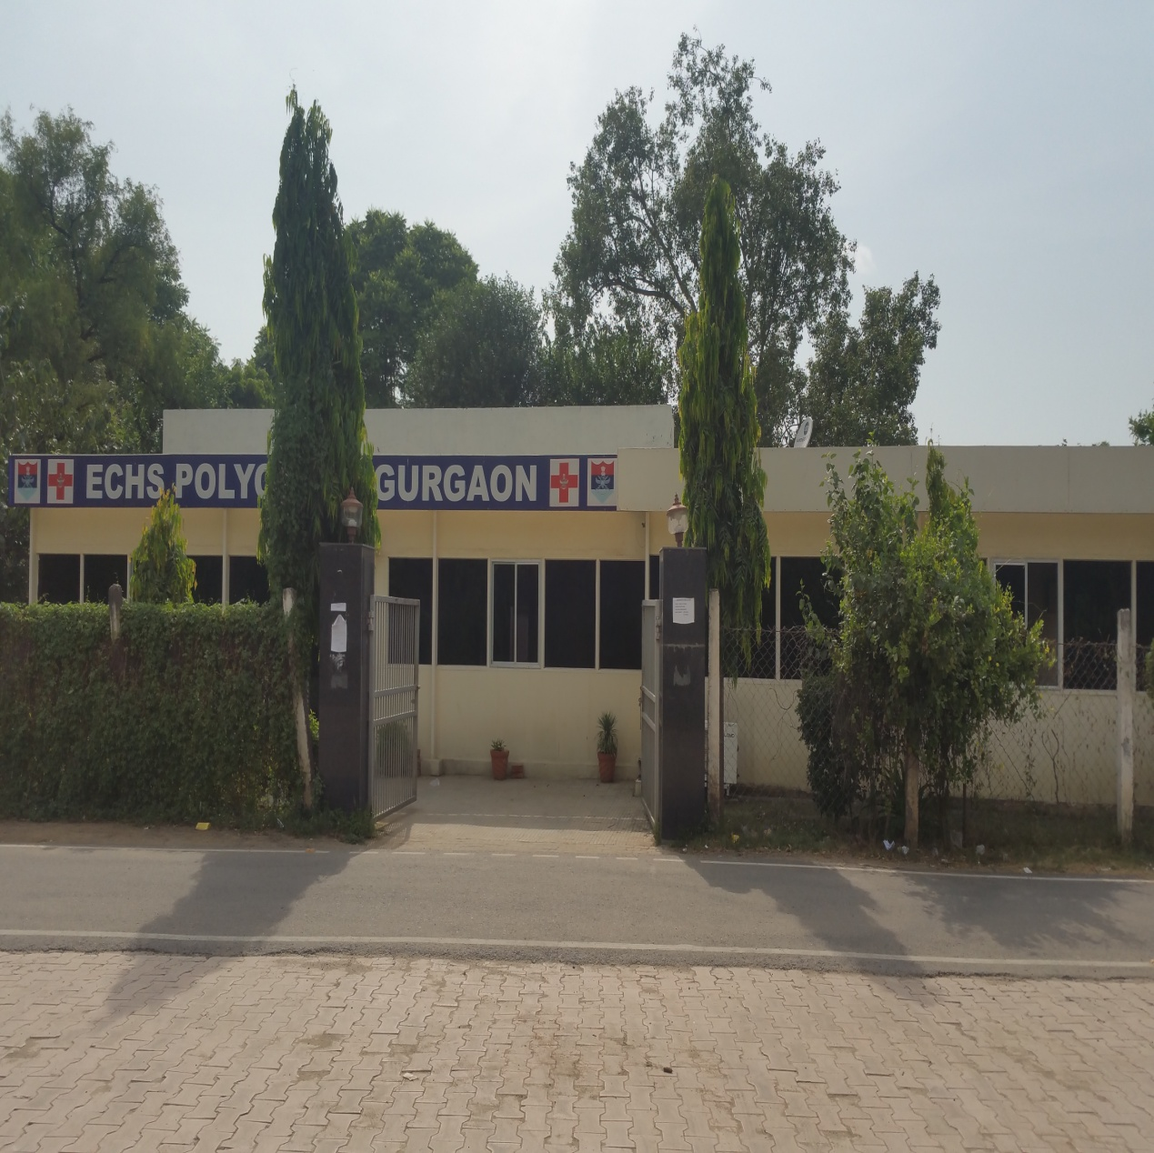
DUNDAHERA

Slide 22
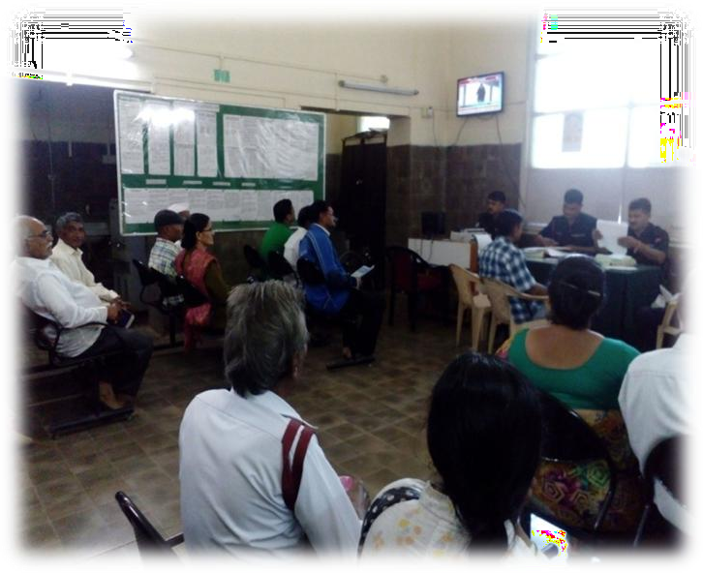
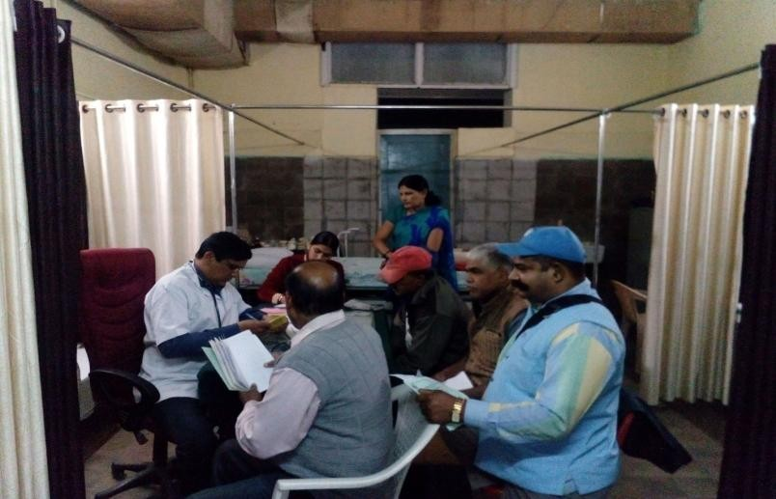
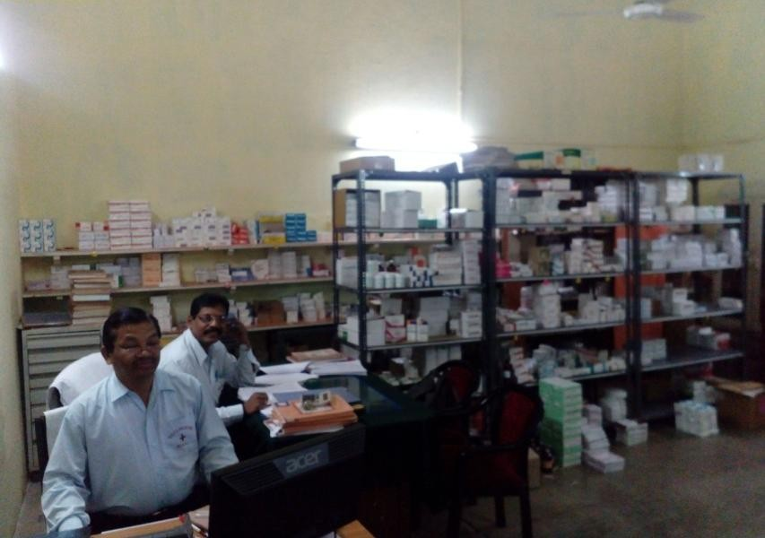
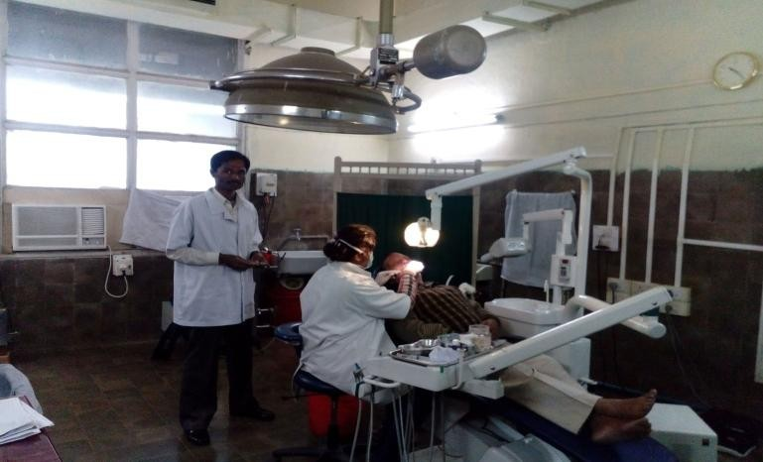

Slide 23
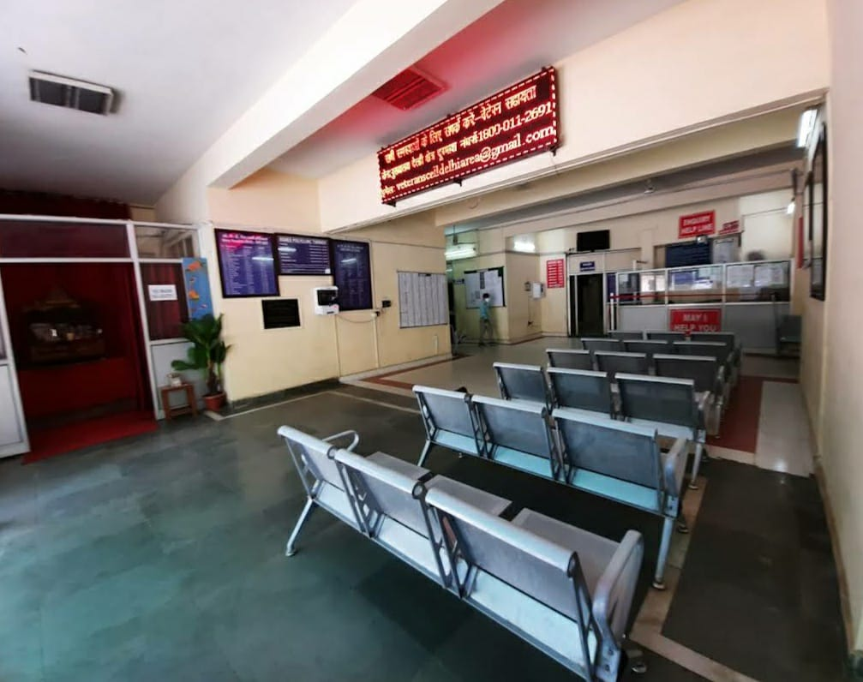
DUNDAHERA

Slide 24
SURVEY - PATIENT SATISFACTION AT ECHS POLYCLINIC
Section 1 (Demographic Information)
Gender of the Respondent-----------------M--------------F-----------Others----------
Number of dependents ◻ 1 ◻2 ◻3 ◻4 ◻5 ◻6 ◻7 ◻8
Purpose of Visit (ailment)
Average number of visits in a month
Rank --------Offr ---------------JCO ---------------OR-------------
Section 2 (Reception and Registration) Excellent / Good/ Fair /Poor /V Poor
Ease of taking appointment ◻ ◻ ◻ ◻ ◻
Experience at the Reception desk ◻ ◻ ◻ ◻ ◻
Behavior of staff in Polyclinic ◻ ◻ ◻ ◻ ◻
Experience at the Registration desk ◻ ◻ ◻ ◻ ◻
Section 3 (Consultation)
Waiting time to see the doctor* Excellent/Good/ Fair/Poor/ Very Poor
Attention given by Doctor Excellent/Good/ Fair/Poor/ Very Poor
Privacy during consultation Excellent/Good/ Fair/Poor/ Very Poor
Quality of consultation Excellent/Good/ Fair/Poor/ Very Poor
Section 4 (Services and Allied Activities) Excellent/Good/ Fair/Poor/ Very Poor
Cleanliness and hygiene at the waiting area ◻ ◻ ◻ ◻ ◻
Lab/Diagnostic test services ◻ ◻ ◻ ◻ ◻
Emergency Services (Ambulance, Oxygen) ◻ ◻ ◻ ◻ ◻
Physiotherapy Service ◻ ◻ ◻ ◻ ◻

