Slide 1
A LANDSCAPE OF POINT OF CARE diagnostic DEVICES FOR COMPREHENSIVE PRIMARY CARE IN INDIA
At- JHPIEGO (Non profit organization in new Delhi)
by Mishraba
Mentor – Dr Anandhi Ramachandran.
PGDM (HOSPITAL AND HEALTH MANAGEMENT) IIHMR DELHI
2021-2023

Slide 3
JHPIEGO:
Jhpiego is a nonprofit organization for international health, affiliated with Johns Hopkins University. The group was founded in 1973 and initially called the Johns Hopkins Program for International Education in Gynecology and Obstetrics, but is now referred to simply as Jhpiego.

Slide 4
INTRODUCTION:
Point Of Care Diagnostic Device
When a patient is being examined, point-of-care (POC) testing is done to collect specific clinical data and parameters. POC has many definitions, all of which explain the same concept—quick acquisition of test data so that the patient can begin receiving the proper care as soon as possible. Because of its user-friendly qualities, POC diagnostic devices are utilized by medical professionals, patients, and their families. As a result, the turnaround time is eventually shortened (TAT).

Slide 5
WHO ASSURED guidelines:
The ASSURED guidelines that indicate the features that should be designed into all POCT devices.
• Affordable – for those at risk of infection
• Sensitive – minimal false negatives
• Specific – minimal false positives
• User-friendly – minimal steps to carry out test
• Rapid & Robust – short turnaround time and no need for refrigerated storage
• Equipment-free – no complex equipment
• Delivered – to end users

Slide 6
Classification on the basis of their characteristics:
Characteristics
Types of POCT devices
Examples

Slide 7
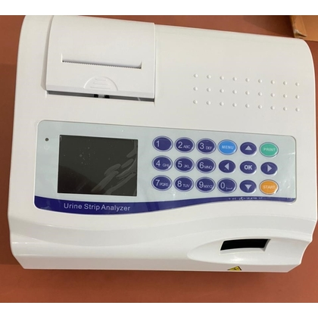

Slide 8
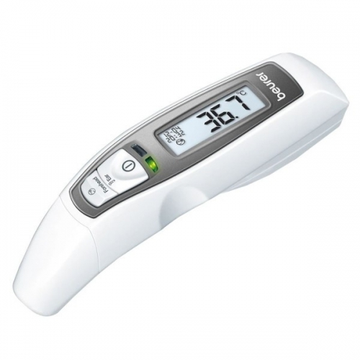
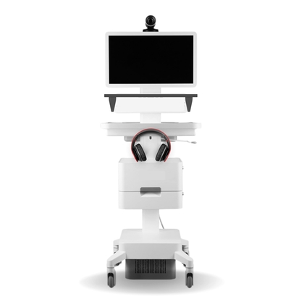

Slide 9
Types of POC Diagnostic devices according to connectivity:
Connected point of care diagnostics:
In order to increase the precision, effectiveness, and accessibility of medical diagnostic technologies and data, connected diagnostics are diagnostic systems that have been digitalized to adapt and integrate with the larger health care ecosystem.
For instance, connected diagnostics can be handheld diagnostics with internet connectivity, laboratory surveillance networks, mobile-based health applications, and more.
Non connected point of care diagnostics:
Point-of-care diagnostics are medical tests that can be performed at or near the site of patient care, without requiring the use of a centralized laboratory.
Point-of-care diagnostics that are not wirelessly connected to a central database or a healthcare practitioner are referred as non-connected.

Slide 10
Some examples of non-connected point-of-care diagnostics include
Lateral flow assays: These quick diagnostic tests use an immunochromatographic assay to find a particular analyte, like a virus or bacteria, in a patient sample. They are often used in situations requiring rapid on-site testing, such as those involving remoteness or limited resources.
Dipsticks: Dipsticks are tiny, single-use diagnostic procedures that are used to check for the presence of particular compounds in a patient sample, such as glucose or protein in urine. They are frequently utilized in hospitals and other point-of-care facilities.
Pregnancy tests: These are diagnostic procedures that detect the pregnancy-indicating hormone human chorionic gonadotropin (hCG) in a woman's urine. These straightforward, non-invasive examinations can be carried either at home or in a medical facility.
Hemoglobin meters: Portable devices called hemoglobin meters are used to gauge a patient's blood's hemoglobin level. They are often used in situations requiring ongoing hemoglobin level monitoring, such as the treatment of anemia.

Slide 11
Rationale of the Study –
Currently not much information is available related to POC devices for primary care level in India. Their availability, cost, services provided etc. need to be known so they could be easily integrated with existing workflow in the primary health care levels. This will provide a solution for reducing the cost of service and increase quality of care. Hence such information need to be identified as need of the hour.
Objective of the study –
To explore the landscape of point of care devices available in India and to identify their suitability for adoption in the health and wellness centers.

Slide 12
Study methodology:
Data Type : Secondary data
Data source: GEM Portal, India Mart, Amazon, other Ecommerce websites.
Data collection tool & method: Literature reports & websites based on checklist
Study design – Study based on secondary data analysis.
Sample size- 116 POC Diagnostic Devices. Searched till no incremental gain.
Study Duration : 3months (Feb 2023 –May 2023)
Geography – India
Search terms: point of care device, diagnostic devices, primary healthcare, health and wellness centers.

Slide 13
Identified the diagnostic need of primary Healthcare System of India
Identified Parameters, categories on the basis of 12 Health and Wellness services
Searched devices on GEM portal, India Mart, other websites.
Total devices found , (n=370)
Removed SAMD, n=270.
Record after duplication removal, n=319
Devices suitable for adoption in PHC and Health and Wellness centers. n=236
Available in Indian Market, n=116
Total devices included in the study is 116.
n=116

Slide 14
Inclusion criteria –
POC Devices adopted for PHC
POC Devices made in India and permission to sell out in India, For profit and not for profit.
Exclusions criteria –
• Devices which are used for secondary and tertiary care hospital only.
• SAMD(software as a medical devices)
Limitations –
Can not generalize the results, because market is growing day by day.
Scarcity of literature related to POC’s cost features etc.
POCs adopted for PHC and HWC centers only.

Slide 15
Expected Outcome
This landscaping review will provide an in-depth information of the type of point care devices available in the country, their features, and their suitability for adoption in the country. This would help the policy makers, and health care service providers to take decisions on utilization these POCs in for primary care in the country.

Slide 16
Results :
Portability: Among the 116 Devices 69 (59.48%) are handheld device, 44(37.93%) are portable, 2(1.72%) are wearable, and 1(0.86%) is benchtop device.

Slide 17
Count of devices by connected technology: Among 56 connected devices , 20 (36%) are mobile application based, 10(18%) are IoT devices, 7 (13%) are connected through web and mobile application, 5 ( 9%) are Bluetooth and Wi-Fi connected devices, 5 ( 9%) are connected through Bluetooth only and remaining are connected through LIS, USB, Wi-Fi, Pc etc..
Count of devices by Connectivity: Among 116 devices 56(48.28%) are connected , 60(51.72%) are unconnected devices.

Slide 18
Count of Devices by Test Parameters: Among 116 devices , 37 devices for physiological test , 21 are for general monitoring, 15 are for biochemical and 13 for urology test, 10 for Hematology , and remaining for other test.
Devices Available on Government e Marketplace (GeM Portal) : 42( 36%) devices are available on Gem portal and 74(64%) are not available on Gem portal.

Slide 19
Among total 116 devices 48 (41.37%) are approved .

Slide 20
discussion
According to the results, it is evident that in the Indian market, the majority of point-of-care (POC) diagnostic devices are handheld, while only a few are benchtop devices. In terms of integration, approximately half of the devices are connected or integrated. The most commonly used technologies in these devices include mobile applications, IoT, Bluetooth, and Wi-Fi. Some devices also utilize USB, LIS, and PC connections.
The results also indicate that the majority of POC devices are designed for physiological tests, general monitoring, biochemical tests, and hematological tests. There are relatively fewer devices available for other tests such as cardiology, urology, oncology, and radiology.
When it comes to certification, around 41.37% of POC devices have been approved by ISO and other organizations.

Slide 21
Conclusion:
In this paper, we discuss different categories of POC diagnostic devices. The difference between connected and unconnected devices is only 4%. This indicates that the Indian market offers a good variety of connected POC devices, which can facilitate the flow of primary healthcare in India. Although we are aware that portable and handheld POC Diagnostic devices which has connectivity may require some training, this training can be provided by facilitators. By using these POC diagnostic devices, healthcare provider can easily and promptly provide diagnostics and treatments, which will undoubtedly improve patient satisfaction. If healthcare providers receive fast results, they can initiate treatment within an hour. As we know, the golden hour is crucial in emergency patient care. By using such devices in emergency or life-threatening situations, healthcare providers can save more lives, thus improving the quality and efficiency of primary healthcare and health and wellness centers in India. This will also help meet the healthcare needs of India.

Slide 22
Refrences
Ma S, Sood N. A comparison of the health systems in China and India. Rand Corporation; 2008.
Peters DH, Rao KS, Fryatt R. Lumping and splitting: the health policy agenda in India. Health policy and planning. 2003 Sep 1;18(3):249-60.
Chokshi M, Patil B, Khanna R, Neogi SB, Sharma J, Paul VK, Zodpey S. Health systems in India. Journal of Perinatology. 2016 Dec;36(3):S9-12.
Ministry of Health and Family Welfare. Ayushman Bharat: comprehensive primary health care through health and wellness centers operational guidelines./ AYUSHMAN BHARAT-Comprehensive Primary Health Care through Health and Wellness Centers Operational Guidelines [Internet]. National Health Systems Resource Centre (NHSRC), New Delhi; [cited 2021 Apr 17]. Available from: http://nhsrcindia.org/sites/default/files/Operational%20Guidelines%20For%20Comprel
Ministry of Health, Family Welfare-Government of India. Infrastructure :: National Health Mission [Internet]. Gov.in. [cited 2023 Apr 13]. Available from: https://nhm.gov.in/index1.php?lang=1&level=2&sublinkid=1220&lid=190
Steps to strengthen the healthcare system in India [Internet]. Gov.in. [cited 2023 Apr 13]. Available from: https://pib.gov.in/Pressreleaseshare.aspx?PRID=1848808
Kumar R. Achieving universal health coverage in India: The need for multisectoral public health action. Indian J Community Med [Internet]. 2020 [cited 2023 Apr 18];45(1):1–2. Available from: http://dx.doi.org/10.4103/ijcm.IJCM_61_19
Derakhshani N, Doshmangir L, Ahmadi A, Fakhri A, Sadeghi-Bazargani H, Gordeev VS. Monitoring process barriers and enablers towards universal health coverage within the sustainable development goals: A systematic review and content analysis. Clinicoecon Outcomes Res [Internet]. 2020 [cited 2023 Apr 18];12:459–72. Available from: http://dx.doi.org/10.2147/ceor.s254946
Zodpey S, Farooqui H. Universal health coverage in India: Progress achieved & the way forward. Indian J Med Res [Internet]. 2018 [cited 2023 Apr 18];147(4):327. Available from: http://dx.doi.org/10.4103/ijmr.ijmr_616_18
Official website ayushman Bharat [Internet]. Gov.in. [cited 2023 Apr 18]. Available from: https://ab-hwc.nhp.gov.in/

Slide 23
Lahariya C. Health & wellness centers to strengthen primary health care in India: Concept, progress and ways forward. Indian J Pediatr [Internet]. 2020 [cited 2023 Apr 18];87(11):916–29. Available from: http://dx.doi.org/10.1007/s12098-020-03359-z
Garg S, Bebarta KK, Tripathi N. Performance of India’s national publicly funded health insurance scheme, Pradhan Mantri Jan Arogaya Yojana (PMJAY), in improving access and financial protection for hospital care: findings from household surveys in Chhattisgarh state. BMC Public Health [Internet]. 2020 [cited 2023 Apr 18];20(1):949. Available from: http://dx.doi.org/10.1186/s12889-020-09107-4
Sarwal R, Kumar A. The long road to universal health coverage [Internet]. 2021 [cited 2023 Apr 18]. Available from: https://www.niti.gov.in/long-road-universal-health-coverage
Sabanovic Z, Masic I, Salihefendic N, Zildzic M, Zunic L, Dedovic S. E-health in bosnia - starting from the ground-up. Acta Inform Med [Internet]. 2009 [cited 2023 Apr 18];17(3):135–8. Available from: http://dx.doi.org/10.5455/aim.2009.17.135-138
GIL - enabling e- Governance [Internet]. Gov.in. [cited 2023 Apr 18]. Available from: https://gil.gujarat.gov.in/ghmis
St John A, Price CP. Existing and emerging technologies for point-of-care testing. Clin Biochem Rev. 2014;35(3):155–67.
Konwar AN, Borse V. Current status of point-of-care diagnostic devices in the Indian healthcare system with an update on COVID-19 pandemic. Sens Int [Internet]. 2020 [cited 2023 Apr 26];1(100015):100015. Available from: http://dx.doi.org/10.1016/j.sintl.2020.100015
St John A, Price CP. Existing and emerging technologies for point-of-care testing. Clin Biochem Rev. 2014;35(3):155–67.
. Rakel, Robert Edwin. "diagnosis". Encyclopedia Britannica, 18 Aug. 2022, https://www.britannica.com/science/diagnosis
Wang, C., Liu, M., Wang, Z., Li, S., Deng, Y., & He, N. (2021). Point-of-care diagnostics for infectious diseases: From methods to devices. Nano Today, 37(101092), 101092. https://doi.org/10.1016/j.nantod.2021.101092

