Slide 1
A STUDY ON PATIENT SATISFACTION IN OUT PATIENT DEPARTMENT
AT
SARVODAYA HOSPITAL,GREATER NOIDA
Under the guidance of
Dr. Pankaj Talreja
IIHMR DELHI

Slide 2
INTRODUCTION
Sarvodaya Hospital, Greater Noida West is a 220-bedded tertiary care hospital that brings a multidisciplinary team of doctors and compassionate staff dedicated to providing people with quality medical facilities and optimum care.
The Current Study is a cross sectional descriptive study about assessment of patient satisfaction in out patient department at Sarvodaya hospital,Greater Noida
Patient satisfaction is an important and commonly used indicator for measuring the quality of health care

Slide 3
INTRODUCTION
Components of Patient Satisfaction
Satisfaction in terms of convenience
Satisfaction in terms of courtesy
Satisfaction in terms of quality of care

Slide 4
OBJECTIVE
The main objective of the study was to assess the level of satisfaction of the patients
To identify areas that cause low satisfaction levels and providing suggestion for a better patient experience

Slide 5
METHODOLOGY
Study Area- Sarvodaya Hospital,Greater Noida
Study Design- A cross-sectional study design was employed
Time- 2 months for data collection
Study Population-120 (No of people who responded)
INCLUSION CRITERIA-Patient who are willing to give consent
Patient who have at least visited OPD for times
EXCLUSION CRITERIA-Patient who are in IPD

Slide 6
METHODOLOGY
DATA COLLECTION-Primary data was collected using pre structured questionnaire
Link- https://forms.gle/v2KSF4qJaKvDLisr5
DATA ANALYSIS –Data collected was analyzed using Microsoft Excel

Slide 7
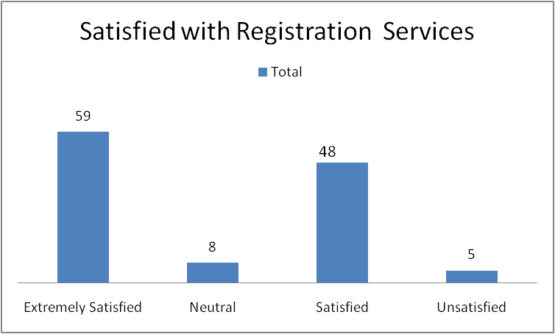
RESULTS EXPERIENCE TOWARDS REGISTRATION SERVICES
SATISFIED WITH REGISTRATION SERVICES
Row Labels | TOTAL
Extremely Satisfied | 59
Neutral | 8
Satisfied | 48
Unsatisfied | 5
Grand Total | 120

Slide 8
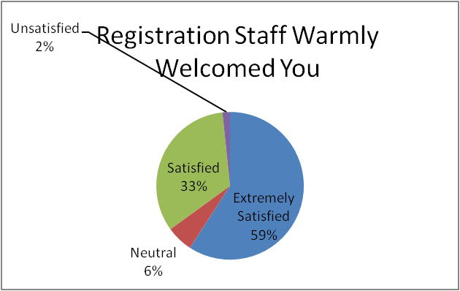
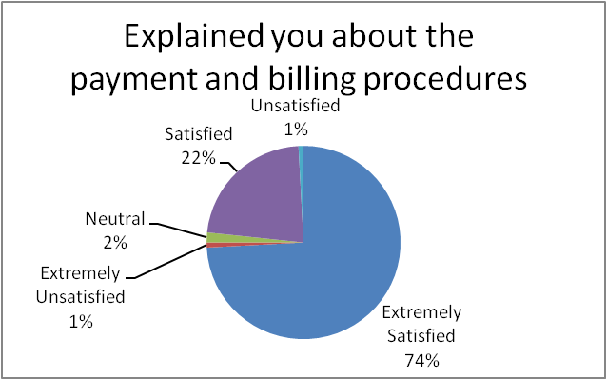
RESULTS
Registration Staff Warmly Welcomed You
Row Labels | Count of SNNO
Extremely Satisfied | 71
Neutral | 7
Satisfied | 40
Unsatisfied | 2
Grand Total | 120
Explained you about the payment and billing procedures
Row Labels | Count of SNNO
Extremely Satisfied | 89
Extremely Unsatisfied | 1
Neutral | 2
Satisfied | 27
Unsatisfied | 1
Grand Total | 120

Slide 9
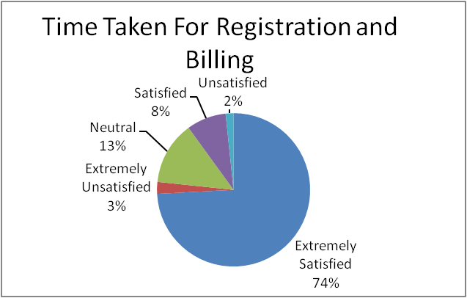
RESULTS
Time Taken For Registration and Billing
Row Labels | Count of SNNO
Extremely Satisfied | 89
Extremely Unsatisfied | 3
Neutral | 16
Satisfied | 10
Unsatisfied | 2
Grand Total | 120

Slide 10
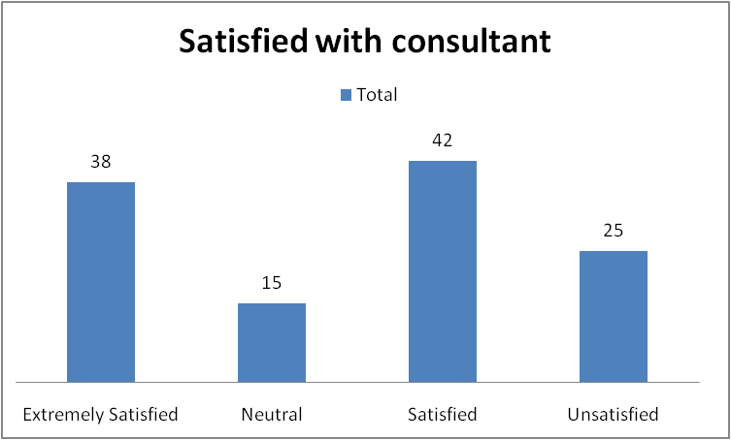
RESULTS EXPERIENCE WITH CONSULTANT
Satisfied with consultant
Row Labels | Count of SN No
Extremely Satisfied | 38
Neutral | 15
Satisfied | 42
Unsatisfied | 25
Grand Total | 120

Slide 11
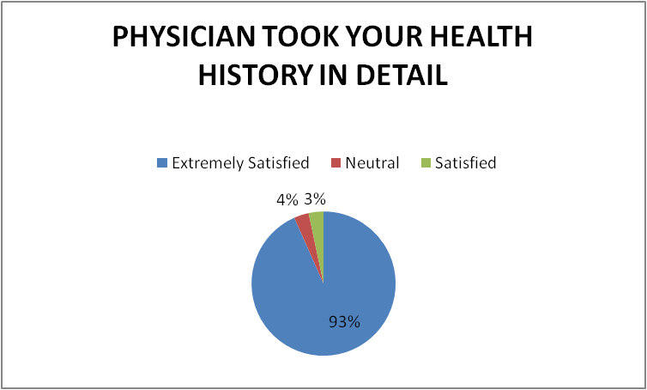
RESULTS
Physician took your health history in detail
Row Labels | Count of SNNO
Extremely Satisfied | 112
Neutral | 4
Satisfied | 4
Grand Total | 120

Slide 12
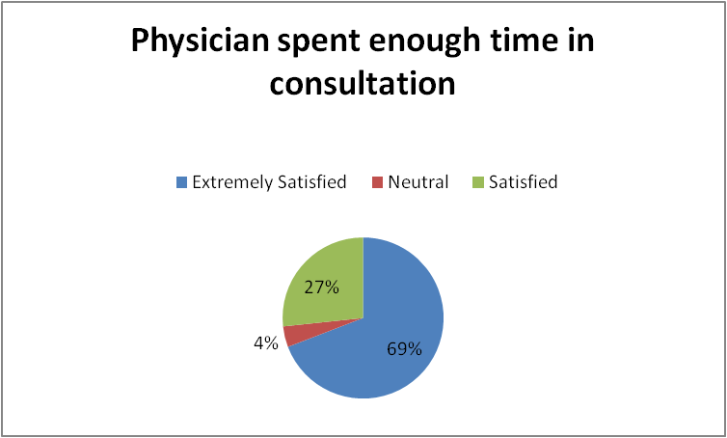
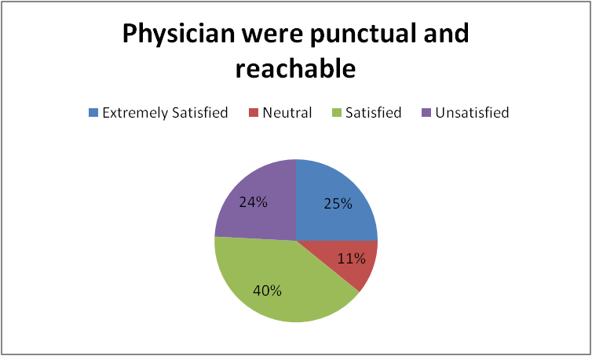
RESULTS
Physician spent enough time in consultation
Row Labels | Count of SNNO
Extremely Satisfied | 83
Neutral | 5
Satisfied | 32
Grand Total | 120
Physician were punctual and reachable
Row Labels | Count of SNNO
Extremely Satisfied | 30
Neutral | 13
Satisfied | 48
Unsatisfied | 29
Grand Total | 120

Slide 13
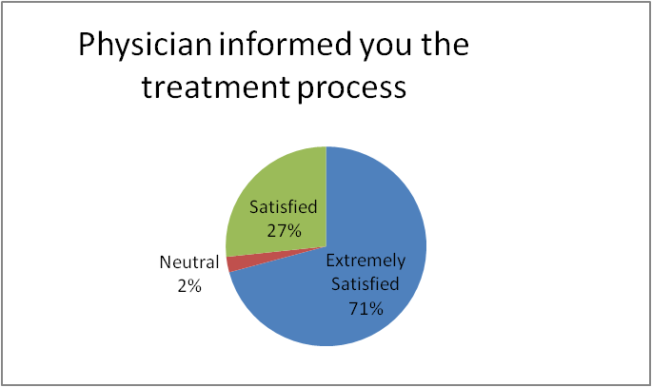
RESULTS
Physician informed you the treatment process
Row Labels | Count of SNNO
Extremely Satisfied | 85
Neutral | 3
Satisfied | 32
Grand Total | 120

Slide 14
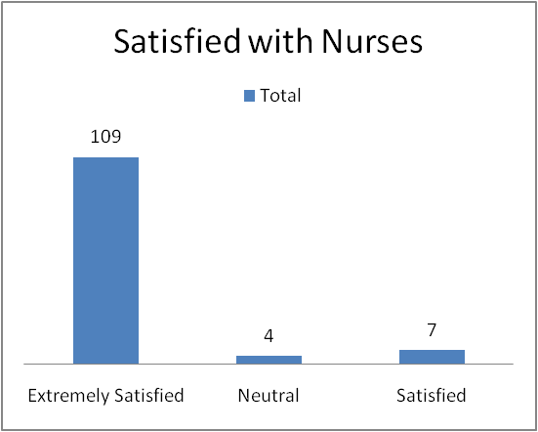
RESULTS EXPERIENCE WITH NURSES
Satisfied with Nurses
Row Labels | Count of SNNO
Extremely Satisfied | 109
Neutral | 4
Satisfied | 7
Grand Total | 120

Slide 15
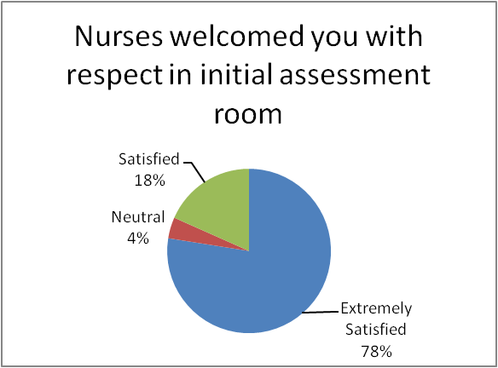
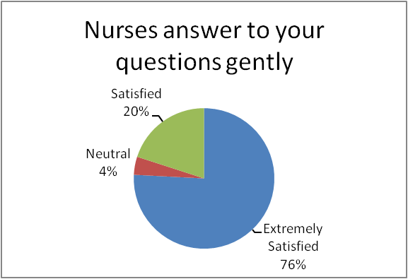
RESULTS
Nurses welcomed you with respect in initial assessment room
Row Labels | Count of SNNO
Extremely Satisfied | 93
Neutral | 5
Satisfied | 22
Grand Total | 120
Nurses answer to your questions gently
Row Labels | Count of SNNO
Extremely Satisfied | 91
Neutral | 5
Satisfied | 24
Grand Total | 120

Slide 16
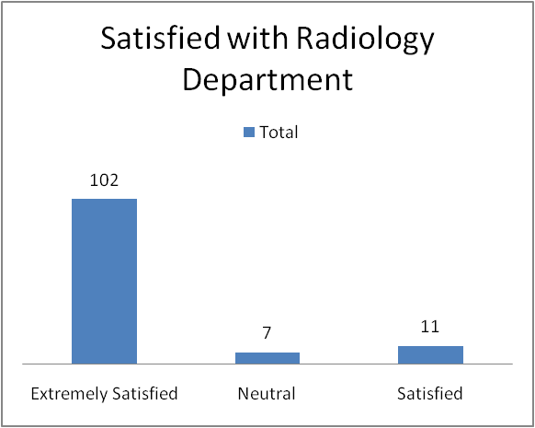
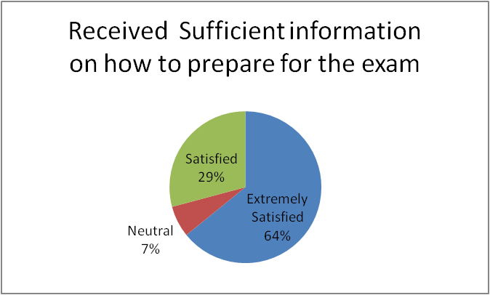
RESULTS EXPERIENCE WITH RADIOLOGY SERVICES
Satisfied with Radiology Department
Row Labels | Count of SNNO
Extremely Satisfied | 102
Neutral | 7
Satisfied | 11
Grand Total | 120
Received proper guidance and information about the procedure
Row Labels | Count of SNNO
Extremely Satisfied | 77
Neutral | 8
Satisfied | 35
Grand Total | 120

Slide 17
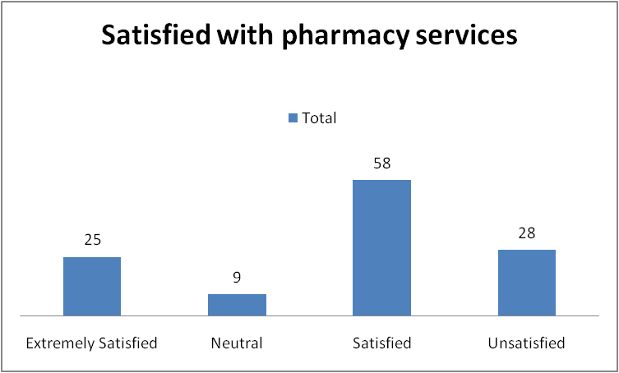
RESULTS EXPERIENCE WITH PHARMACY SERVICES
Satisfied with pharmacy services
Row Labels | Count of SNNO
Extremely Satisfied | 25
Neutral | 9
Satisfied | 58
Unsatisfied | 28
Grand Total | 120

Slide 18
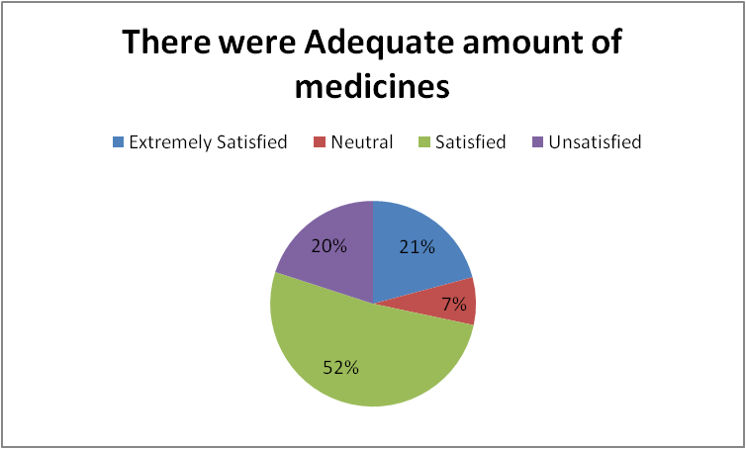
RESULTS
Pharmacist explained about the dosage intake
Row Labels | Count of SNNO
Extremely Satisfied | 77
Neutral | 5
Satisfied | 38
Grand Total | 120
There were Adequate amount of medicines
Row Labels | Count of SNNO
Extremely Satisfied | 25
Neutral | 9
Satisfied | 62
Unsatisfied | 24
Grand Total | 120

Slide 19
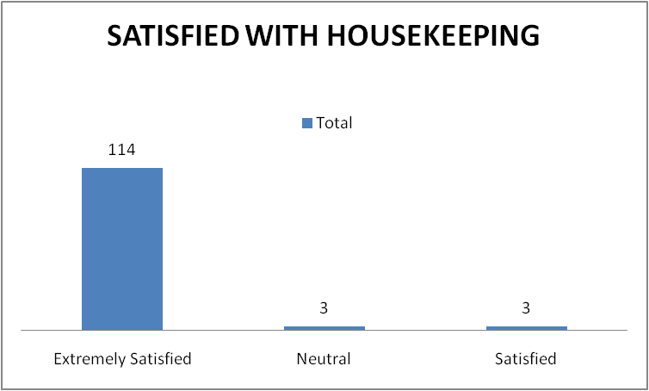
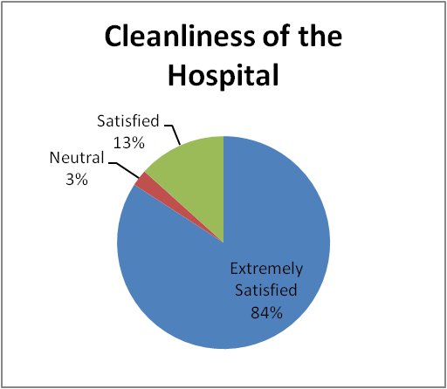
RESULTS EXPERIENCE WITH HOUSEKEEPING
Satisfied with Housekeeping
Row Labels | Count of SN No
Extremely Satisfied | 114
Neutral | 3
Satisfied | 3
Grand Total | 120
Cleanliness of the Hospital
Row Labels | Count of SN No
Extremely Satisfied | 101
Neutral | 3
Satisfied | 16
Grand Total | 120

Slide 20
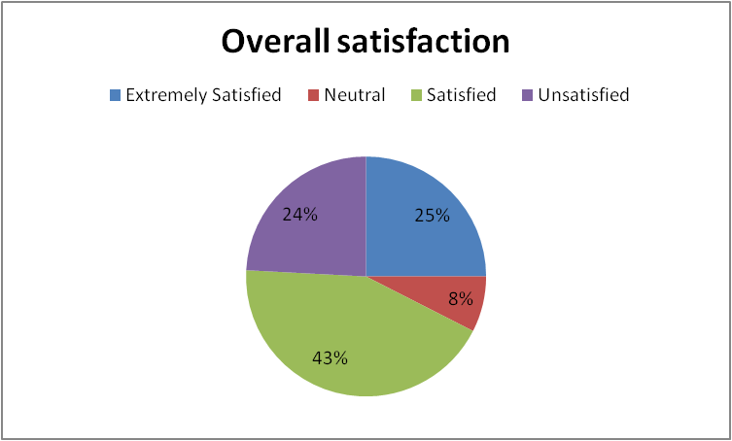
RESULTS OVERALL SATISFACTION
Overall Satisfaction
Row Labels | Count of SNNO
Extremely Satisfied | 30
Neutral | 9
Satisfied | 52
Unsatisfied | 29
Grand Total | 120

Slide 21
DISCUSSION
Patient satisfaction surveys are essential in obtaining a comprehensive understanding of the patients need and their opinion of the service. In a survey conducted by, Amin Khan Mandokhali in 2007,Thailand the level of satisfaction among 225 OPD patients was 86.67 %.Physician and nurses were perceived as good by 82.67% and 82.22 %.Access to the services was perceived as poor by 35.11%.Satisfaction level was influenced by physical facilities , physician and nurse service , registration , radiology and pharmacy service. The study indicated the areas for improvement from the respondents points of perspective
Low patient satisfaction level can lead to poor compliance with treatment and end up in poor health outcome.

Slide 22
CONCLUSION
Patient receiving each hospital service are responsible for conveying the good image of the hospital therefore , securing high satisfaction of patient attending the hospital is equally important for hospital management team
In this study , Out of 120 In the first stage of checkin registration ,59 patients were extremely satisfied with registration services. Second stage of Pre check up process(ie Initial assessment room) 101 patients were extremely satisfied with nurses. Third stage is consultation with doctor, 38 patients were extremely satisfied with physician. It is less because doctors are not available on given time.By radiology department ,102 patients were extremely satisfied,In Pharmacy Services 25 % were extremely satisfied ,It is also less because of the non availability of adequate no of medicines, In housekeeping services,114 patients were extremely satisfied with the cleanliness of the hospital.

Slide 23
CONCLUSION
The report concludes that patient satisfaction is good in out patient department Almost 68% patients are satisfied with with OPD services and talking to other 32 % about their negative response I get to know that there is need to work on few things like :
RECOMMENDATION
Non availability of the consultants should be informed prior
It is highly needed that adequate amount of drug should be available in pharmacy
Method of getting daily feedback from the patients such as creating feedback box should be enhanced
Feedback TAT should be maintained and monitored regularly as it plays important role for conversions and revenue generation

Slide 24
REFERENCES
HTTP://WWW.NARAYANAHEALTH.ORG
Hekkert K.D., Cihangir S., Kleefstra S.M., Van den Berg B., Kool R.B. (2009), Patient satisfaction revisited: a multilevel approach. Social Science & Medicine; 69:68-75.
J Cutan Aesthet Surg. 2010 Sep-Dec 3(3) 151-155 Bhanu Prakash ·
Nettleman MD Clinical Performance and Quality Health Care [01 Jan 1998, 6(1):33-37]
Redmond GM , Sorrell JM Outcomes Management for Nursing Practice [01 Apr 1999, 3(2):67-72]
Bell R , Krivich MJ , Boyd MS Marketing Health Services [01 Jan 1997, 17(2):22-29]
Rashid Al-Abri Rashid Al-Abri* and Amine Al-Balushi

Slide 25
THANK YOU !
ANY QUESTIONS?

