Slide 1
Association of child feeding practices with the nutritional status of the children in India, 2019-21. (Jindal Hospital, Panipat)
Submitted By - Dr. Shreya Malik
Under the mentorship of : Dr. Pijush Kanti Khan
IIHMR Delhi

Slide 2
Mentor Approval

Slide 3
Introduction
Breastfeeding within the first hour of life is recognized as one of the most important actions for infant survival. Yet in India, only 56.6 % of infants start breastfeeding within one hour of life. Optimal breastfeeding in the first year and complementary feeding practices together can prevent almost one-fifth of deaths in children under five years of age.⁽¹⁾
Infants who are exclusively breastfed have a lower risk of developing illnesses like pneumonia and diarrhea, which are common causes of death in children under the age of five. A baby who is not exclusively breastfed has a mortality risk from all causes that is more than 14 times higher than a baby who is. Exclusive breastfeeding reduces the risk of fever, cough, and diarrheal illnesses. ⁽²⁾
A child is the primary victim of the interaction of socioeconomic, nutritional, and health factors that contribute to malnutrition. The rapid increase in childhood malnutrition during the first two years of life is a sign of ineffective newborn feeding techniques. The nutritional status of children under the age of five is, the most sensitive indicator of development in a given area. ⁽³⁾
Global weighted prevalence in 57 LMICs from 2010 to 2018 was 51.9% for early initiation of breastfeeding, 45.7% for exclusive breastfeeding under 6 months, 32.0% for exclusive breastfeeding at 4-5 months, 83.1% for continued breastfeeding at 1 year, 56.2% for continued breastfeeding at 2 years, and 14.9% for introducing solid, semi-solid, or soft foods before 6 months and 63.1% for introducing solid, semi-solid, or soft foods at 6-8 months. ⁽⁴⁾

Slide 4
Objective
To analyse the association of feeding patterns in children on stunting, wasting, and malnourishment among children in EAG states.
Research Question
How do the different patterns of child feeding practice associate with the overall health outcome of the children?

Slide 5
Data & Method
DATA :
Data from the National Family Health Survey 5 (NFHS 5), 2019-21. has been used for the analysis. The NFHS 5 is the fifth in the series of the repeated cross-sectional Demographic and Health Surveys (DHS), conducted during 2019-21. The primary aim of NFHS 5 was to provide reliable estimates of demographic, maternal and child health (MCH) and nutrition across all states and union territories of India. A total of 6.37 lakh sample households, 7,24,115 women aged 15–49 years and 1,01,839 men aged 15–54 years were successfully interviewed during 2019-21. While maintaining comparability with earlier rounds, the NFHS 5 has included a number of new domains totalling to 131 indicators.
Study Population – women in the reproductive age group (15-49) and bearing children under 5 years of age.
Study Setting – EAG states of India.

Slide 6
Methodology
Analytical Strategy :
In order to find out the effect of feeding patterns in young children on stunting, wasting, and malnourishment among children in EAG states in India, we consider the following :
The study is conducted on all the (EAG) low performing states of India.
District of each EAG state has been taken as the unit of study. Sample Size = 291
Study of relation between the attitude of new mothers for feeding patterns & methods for children under 6 months, and children under 5 years was conducted.
To capture the study objectives, we have used –
Independent Variables :
Children under 3 years breastfed within one hour of birth (%)
Children under 6 months of age exclusively breastfed (%)
Total % children age 6-23 months receiving an adequate diet.
Dependent Variables :
Children under 5 years who are stunted (%)
Children under 5 years who are wasted (%)
Children under 5 years who are underweight (%)
Correlation has been assessed for all the independent and dependent variables.

Slide 7
Results
Comparison Of EAG States with India for Independent Variables
Comparison Of EAG States with India for Dependent Variables

Slide 8
Correlation from all EAG states combined
children under 3 years breastfed within one hour of birth (%) | Children under 5 years who are stunted % | -0.302299758
children under 3 years beastfed within one hour of birth (%) | Children under 5 years who are wasted % | -0.09175933
children under 3 years beastfed within one hour of birth (%) | Children under 5 years who are underweight | -0.200328767
Children under age 6 months exclusively breastfed (%) | Children under 5 years who are stunted % | -0.15011587
Children under age 6 months exclusively breastfed (%) | Children under 5 years who are wasted % | -0.074834291
Children under age 6 months exclusively breastfed (%) | Children under 5 years who are underweight | -0.068323456
Total children age 6-23 months receiving an adequate diet | Children under 5 years who are stunted % | -0.144819551
Total children age 6-23 months receiving an adequate diet | Children under 5 years who are wasted % | 0.024716757
Total children age 6-23 months receiving an adequate diet | Children under 5 years who are underweight | -0.043146247
 | Best Performing District | Worst Performing District
children under 3 years beastfed within one hour of birth (%) | Koraput | Bhadohi
Children under age 6 months exclusively breastfed (%) | Mungeli | Patna
Total children age 6-23 months receiving an adequate diet | jagatsinghapur | Prayagraj ,Azamgarh, Agar Malwa
Children under 5 years who are stunted % | jagatsinghapur | Paschimi singhbhum
Children under 5 years who are wasted % | Bageshwar | Arwal
Children under 5 years who are underweight | Rudraprayag | Paschimi singhbhum

Slide 9
Correlation for JHARKHAND between different variables
Correlation for MADHYA PRADESH between different variables
children under 3 years breastfed within one hour of birth (%) | Children under 5 years who are stunted % | 0.133224619
children under 3 years beastfed within one hour of birth (%) | Children under 5 years who are wasted % | 0.091055195
children under 3 years beastfed within one hour of birth (%) | Children under 5 years who are underweight | 0.159991592
Children under age 6 months exclusively breastfed (%) | Children under 5 years who are stunted % | 0.075758832
Children under age 6 months exclusively breastfed (%) | Children under 5 years who are wasted % | 0.134000507
Children under age 6 months exclusively breastfed (%) | Children under 5 years who are underweight | 0.185556887
Total children age 6-23 months receiving an adequate diet | Children under 5 years who are stunted % | -0.242853812
Total children age 6-23 months receiving an adequate diet | Children under 5 years who are wasted % | 0.355866504
Total children age 6-23 months receiving an adequate diet | Children under 5 years who are underweight | 0.029677472
children under 3 years breastfed within one hour of birth (%) | Children under 5 years who are stunted % | -0.156718209
children under 3 years beastfed within one hour of birth (%) | Children under 5 years who are wasted % | -0.132884004
children under 3 years beastfed within one hour of birth (%) | Children under 5 years who are underweight | 0.021332527
Children under age 6 months exclusively breastfed (%) | Children under 5 years who are stunted % | -0.29100782
Children under age 6 months exclusively breastfed (%) | Children under 5 years who are wasted % | -0.298699155
Children under age 6 months exclusively breastfed (%) | Children under 5 years who are underweight | -0.342886452
Total children age 6-23 months receiving an adequate diet | Children under 5 years who are stunted % | -0.01080914
Total children age 6-23 months receiving an adequate diet | Children under 5 years who are wasted % | -0.074953256
Total children age 6-23 months receiving an adequate diet | Children under 5 years who are underweight | 0.021332527

Slide 10
BIHAR
CHATTISGARH
 | Best Performing District | Worst Performing District
children under 3 years beastfed within one hour of birth (%) | Kaimur | Kishangarh
Children under age 6 months exclusively breastfed (%) | Gopalganj | Patna
Total children age 6-23 months receiving an adequate diet | Kaimur | Rohtas
Children under 5 years who are stunted % | Gopalganj | Sitamarhi
Children under 5 years who are wasted % | Paschim Chmaparan | Arwal
Children under 5 years who are underweight | Gopalganj | Arwal
 | Best Performing District | Worst Performing District
children under 3 years breastfed within one hour of birth (%) | Kabeerdham | Durg
Children under age 6 months exclusively breastfed (%) | Mungeli | Bemetara
Total children age 6-23 months receiving an adequate diet | Sukma | Balod
Children under 5 years who are stunted % | Uttar bastar | Bijapur
Children under 5 years who are wasted % | Kabeerdham | Janjgir Champa
Children under 5 years who are underweight | Gariyabad | Bijapur
JHARKHAND
MADHYA PRADESH
 | Best Performing | Worst Performing
children under 3 years beastfed within one hour of birth (%) | Lohardaga | Jamtara
Children under age 6 months exclusively breastfed (%) | Ranchi | Bokaro
Total children age 6-23 months receiving an adequate diet | Ranchi | Dhanbad
Children under 5 years who are stunted % | Dhanbad | Paschimi singhbhum
Children under 5 years who are wasted % | Dhanbad | Saraikela Kharsawan
Children under 5 years who are underweight | Dhanbad | Paschimi singhbhum
 | Best Performing | Worst Performing
children under 3 years breastfed within one hour of birth (%) | Jabalpur | Satna
Children under age 6 months exclusively breastfed (%) | Seoni | Datia
Total children age 6-23 months receiving an adequate diet | Raisen | Agar Malwa
Children under 5 years who are stunted % | Jabalpur | Katni
Children under 5 years who are wasted % | Guna | Ujjain
Children under 5 years who are underweight | Mandsaur | Bhurhanpur

Slide 11
ORRISA
RAJASTHAN
 | Best Performing | Worst Performing
children under 3 years beastfed within one hour of birth (%) | Koraput | Baleshwar
Children under age 6 months exclusively breastfed (%) | Naupada | Jajapur
Total children age 6-23 months receiving an adequate diet | jagatsinghapur | Debegarh
Children under 5 years who are stunted % | jagatsinghapur | Malkangiri
Children under 5 years who are wasted % | Kendrapara | Mayurbhanj
Children under 5 years who are underweight | jagatsinghapur | Nabarangapur
 | Best Performing | Worst Performing
children under 3 years breastfed within one hour of birth (%) | Baran | Jodhpur
Children under age 6 months exclusively breastfed (%) | Hanumangarh | Bharatpur
Total children age 6-23 months receiving an adequate diet | Jodhpur | Sirohi
Children under 5 years who are stunted % | Jhunjhunun | Baran
Children under 5 years who are wasted % | Udaipur | Jhalawar
Children under 5 years who are underweight | Sikar | Baran
UTTAR PRADESH
UTTARANCHAL
 | Best Performing | Worst Performing
children under 3 years beastfed within one hour of birth (%) | Aligarh | Bhadohi
Children under age 6 months exclusively breastfed (%) | Amethi | Chitrakoot
Total children age 6-23 months receiving an adequate diet | Jyotiba Phule Nagar | Prayagraj, Azamgarh
Children under 5 years who are stunted % | Mau | Bahraich
Children under 5 years who are wasted % | Bhadohi | Sonbhadra
Children under 5 years who are underweight | Mathura | Banda
 | Best Performing | Worst Performing
children under 3 years beastfed within one hour of birth (%) | Chamoli | Nainital
Children under age 6 months exclusively breastfed (%) | Pauri Garhwal | Nainital
Total children age 6-23 months receiving an adequate diet | Nainital | Tehri Garhwal
Children under 5 years who are stunted % | Dehradun | Chamoli ,Uttarkashi
Children under 5 years who are wasted % | Bageshwar | Almora
Children under 5 years who are underweight | Rudraprayag | Haridwar

Slide 12
Discussion
Out of all the 291 EAG districts, negative co-relation is seen for all the indicators except for the children aged 6-23 months who are receiving an adequate diet with children under years who are wasted.
In Chhattisgarh, positive Co-relation is seen for all the indicators except for that in children under 6 months of age who are exclusively breastfed with children under 5 years who are stunted.
In Jharkhand, positive Co-relation is seen for all the indicators except for that in children aged 6-23 months who receive adequate diet with children under 5 years who are stunted.
Reasons noticed for stunting, wasting and malnourishment :
Short birth intervals between children
No. of Children born to a couple
Parent working status
Child Vaccination status
Recurrent diarrhoea

Slide 13
Conclusion
District level estimates from all the EAG states of India (NFHS-5) suggest Moderate to weak relationship between the child feeding practices (exclusively breastfeeding the child for 6 months, breastfeeding within 1st hour of birth, adequate diet received for the children under 2 years) with stunting, wasting, & underweight.

Slide 14
REFERENCES
Mulatu T, Yimer NB, Alemnew B, Linger M, Liben ML. Exclusive breastfeeding lowers the odds of childhood diarrhea and other medical conditions: evidence from the 2016 Ethiopian demographic and health survey. Italian Journal of Pediatrics. 2021 Dec;47(1):1-6.
Wu H, Zhao M, Magnussen CG, Xi B. Global prevalence of WHO infant feeding practices in 57 LMICs in 2010–2018 and time trends since 2000 for 44 LMICs. EClinicalMedicine. 2021 Jul 1;37:100971.
Williams J, Kuttumuratova A, Breda J, Wickramasinghe K, Zhiteneva O, Weber MW. Improving the lagging rates of breastfeeding. The Lancet. Child & adolescent health. 2021 Sep;5(9):606-7.
Keats EC, Das JK, Salam RA, Lassi ZS, Imdad A, Black RE, Bhutta ZA. Effective interventions to address maternal and child malnutrition: an update of the evidence. The Lancet Child & Adolescent Health. 2021 May 1;5(5):367-84.
Victora CG, Bahl R, Barros AJ, França GV, Horton S, Krasevec J, Murch S, Sankar MJ, Walker N, Rollins NC. Breastfeeding in the 21st century: epidemiology, mechanisms, and lifelong effect. The lancet. 2016 Jan 30;387(10017):475-90.

Slide 15
Thank You
Any Questions

Slide 16
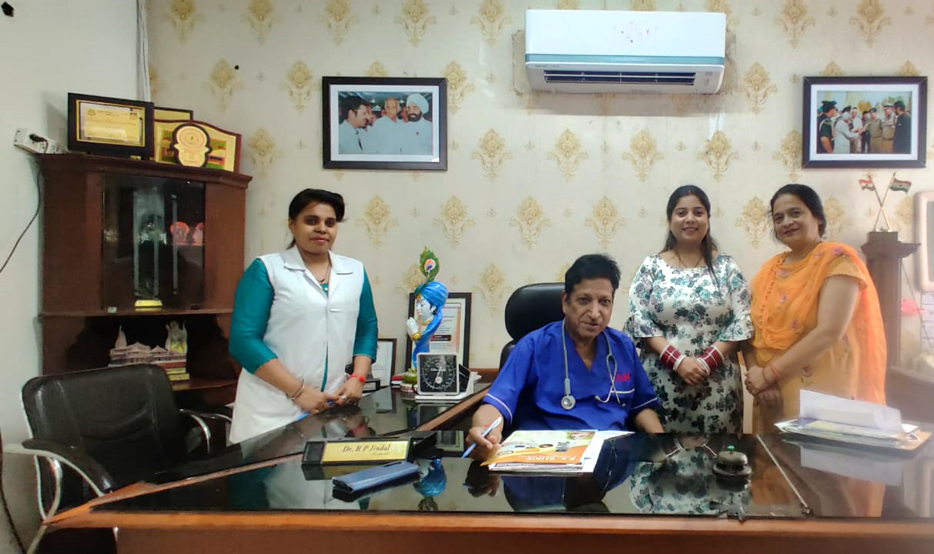
Pictorial Journey

Slide 17
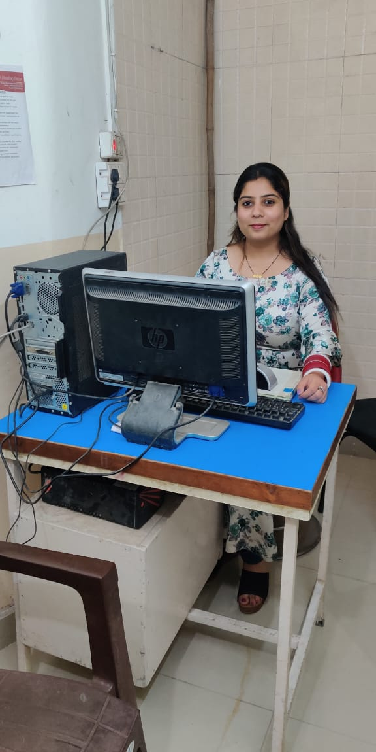
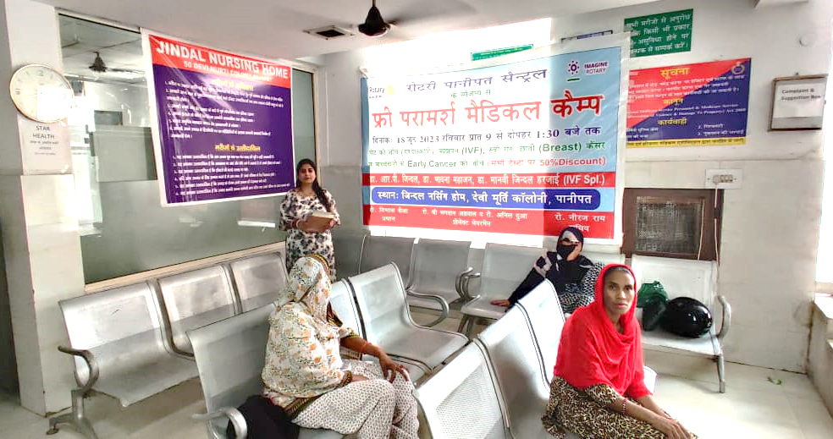
Pictorial Journey

