Slide 1
Study on knowledge and awareness about Ayushman Bharat Digital Mission among National Health Authority employees
AT
PROJECT UNDER - ERNST & YOUNG
PRESENTED BY- SUDHANSHU BATRA
PG/21/114
HEALTH IT
MENTOR - DR. ANANDHI RAMACHANDRAN

Slide 2
Mentor Approval

Slide 3
T
A
B
L
E
O
F
C
O
N
T
E
N
T
S
INTRODUCTION
OBJECTIVES OF STUDY
METHODOLOGY
RESULT
DISCUSSIONS
REFERENCES
PICTORIAL JOURNEY

Slide 4
INTRODUCTION
ABOUT ORGANISATION
Ernst & Young Global Limited (EY) is a Multidisciplinary professional services organization with worldwide services network whose headquarter is located in London, England.
It is one of the Big Four accounting firms along with Deloitte, KPMG and Price Waterhouse Coopers.
Its main services to clients include assurance (which includes financial auditing), tax, consulting, and advisory.
EY has extended beyond accounting into areas such as strategy, operations, human resources, technology, and financial services consulting.
Through these services, EY help their clients to subsidize on transformative opportunities and fulfilling regulatory requirements. They keep their investors informed and cater to all of their stakeholders' needs.
Project Location: National Health Authority (NHA ), New Delhi

Slide 5
About the Project
Current Status of ABDM
Ayushman Bharat Digital Mission
36,45,88,547
Health IDs (ABHA Number) created
ABDM
It was Launched in 6 union territories on 15th August 2020
It aims to establish a National Digital Health Ecosystem by creating an online platform enabling interoperability of health data within the health ecosystem to create longitudinal electronic health record of citizens & facilitate delivery of health services through this Digital Health Ecosystem
25,98,27,033
Total number of Health Records linked
On 27th September 2021, the national rollout of the ABDM has been announced
Over 25 crore health records of individuals have been linked digitally to Ayushman Bharat Health Account.
1,52,448
Total number of Health Facilities Registered
The digitally available health records will enable the Ayushman Bharat Health Account (ABHA) holders in availing of paperless health services across the ABDM network, a statement by the National Health Authority (NHA)
Individuals can use their Personal Health Records (PHR) apps to access their records across different health facilities like hospitals, clinics, and diagnostic labs, among others and store them in the app.
1,61,331
Total number of Healthcare Professionals Registered
There are several building blocks of ABDM including HFR, HPR, ABHA ID, PHR

Slide 6
PROBLEM STATEMENT
OBJECTIVE OF STUDY
To understand the perception of the NHA employees regarding ABDM building blocks
What is the awareness and perception level of the NHA employees regarding ABDM building blocks and implementation process?
What are the benefits of ABDM implementation as perceived by the NHA employees?

Slide 7
METHODOLOGY (1/2)
Cross sectional study design
Study
Design
Sampling
Method
Purposive Sampling
Study
Duration
Sample
Size
Project
Methodology
3 Months (Feb-April)
100
Study
Area
Study
Population
All NHA employees working in functional domain. There are approximate 500 NHA employees in functional domain in Delhi
NHA Office, New Delhi

Slide 8
METHODOLOGY (2/2)
SELECTION CRITERIA
DATA & ANALYSIS PLAN
1.Inclusion criteria - NHA employees having more then 1 month of experience and currently working in functional/operation area.
2.Exclusion criteria - NHA employees at higher official positions that include Strategy Planning, policy, Non Functional areas like Finance, HR, and Sales.
1
2
STUDY TOOL -
Semi structured questionnaire containing closed and open questions.
The tool contains all the questions related to ABDM and its building blocks,.
METHOD OF DATA COLLECTION
The Google form was circulated among the eligible participants and their responses were recorded and stored in MS Excel Spreadsheet
3
ANALYSIS PLAN
The Data Analysis was done on MS Excel

Slide 9
RESULT (1/6)
What is ABDM and When ABDM was launched?
N= 60
n= 35 people were aware about the ABDM and its launched date
n= 10 people were not aware about the ABDM and its launched date
n=15 people were wrongly answered about the launched date of ABDM
Figure 1 ABDM and Its launch

Slide 10
RESULT (2/6)
Are you aware about the Building Blocks of ABDM?
How many Building Blocks of ABDM are?
Number of respondents
Number of respondents
n = 60 (Aware)
n = 0 (Not Aware)
n = 52 (Aware)
n = 0 (Not Aware)
n = 8 (Wrongly Answered)
87%
13%
Awareness Level
Awareness level of number of building blocks
Figure 2 Awareness about the Building Blocks
Figure 3 Building Blocks of ABDM

Slide 11
RESULT (3/6)
Are you aware objectives of ABDM?
How many objectives are offered in ABDM?
Awareness level
n = 35 (aware)
n = 17 (Not aware)
n = 8 (slightly aware)
n = 30 (Correct answer)
n = 17 (Not Aware)
n = 13 (Incorrect Answer)
No. of objectives known
Figure 4 Awareness about the ABDM Objective
Figure 5 Awareness about Number of objectives

Slide 12
RESULT (4/6)
Do you know, what is the benefit of having an ABHA number? (Awareness level)
Do you have ABHA ID ?
No. of respondents
n = 52 (ABHA ID)
n = 8 (Does Not have ABHA ID)
n = 31 (Aware)
n = 17 (Not Aware)
n = 12 (Slightly Aware)
Figure 6 ABHA ID
Awareness level
Figure 7 Benefit of ABHA Number

Slide 13
RESULT (5/6)
Are you aware what is the process for becoming ABDM compliant?
Do you know, what is the process of ABDM
Implementation?
n = 10 (not aware)
n = 46 (aware)
n = 4 (slightly aware)
n = 37 (Yes)
n = 23 (No)
Figure 8 Awareness level about process of becoming ABDM compliant
Figure 9 Benefit of ABHA Number

Slide 14
RESULT (6/6)
What are the challenges occurred in the implementation of ABDM ?(Awareness level )
No. of respondents
n = 42 (Aware)
n = 10 (Not Aware)
n = 8 (Slightly Aware)
Awareness level
Figure10 Awareness about challenges

Slide 15
DISCUSSIONS
ABDM intends to create interoperability between different digital health systems. Therefore, there is no requirement for storing all the digital health records in one place or in one system
On a contrary, the data provides the information that out of 60 respondents, 35 respondents are aware about the launch of ABDM, while 52 respondents are aware about the building blocks of ABDM and 37 respondents were aware about the implementation process of ABDM
Creating ABHA is your starting point in the journey of the Ayushman Bharat Digital Mission. An ABHA allows you to store all your digital health records at one place and share these records with hospitals/doctors you visit, with your consent, with suitable applications
It has been observed that 87% of employees of NHA have ABHA ID & among then 52% were aware about the benefit of having ABHA ID.
These data from respondents gives the clear scenario about the ongoing status of awareness level of ABDM in NHA.

Slide 16
RESEARCH OUTCOME
The research indicates that out of the 60 respondents, 35 of them are aware of the launch of ABDM. This suggests that there is still a need to increase awareness among the target audience regarding the introduction of ABDM.
The data reveals that 52 respondents are aware of the building blocks of ABDM. This indicates a higher level of understanding among the employees of NHA about the different components and elements that constitute ABDM.
The research outcome shows that 37 respondents were aware of the implementation process of ABDM. This suggests that there is a need for further communication and education regarding how ABDM is being implemented to ensure a better understanding among the target audience.
It has been observed that 87% of employees of NHA have ABHA ID & among then 52% were aware about the benefit of having ABHA ID. This indicates a relatively high adoption rate of ABHA among the employees, which could be a positive sign for the overall acceptance and utilization of the Ayushman Bharat Digital Mission
Among NHA employees who have an ABHA ID, 52% of them were aware of the benefits associated with having an ABHA ID. This suggests that there is room for improvement in creating awareness about the advantages and functionalities of ABHA among the NHA workforce to maximize its potential benefits.

Slide 17
REFERENCES
Sriee G V VP, Maiya GR. Coverage, utilization, and impact of Ayushman Bharat scheme among the rural field practice area of Saveetha Medical College and Hospital, Chennai. J Family Med Prim Care. 2021 Mar;10(3):1171-1176. doi: 10.4103/jfmpc.jfmpc_1789_20. Epub 2021 Apr 8. PMID: 34041146; PMCID: PMC8140258.
Nirala SK, Kumar P, Naik BN, Pandey S, Singh C, Rao R, Bhardwaj M. Awareness and Readiness To Implement the Pradhan Mantri Jan Arogya Yojana: A Cross-Sectional Study Among Healthcare Workers of a Tertiary Care Hospital in Eastern India. Cureus. 2022 Apr 28;14(4):e24574. doi: 10.7759/cureus.24574. PMID: 35651396; PMCID: PMC9138266.
Zodpey S, Farooqui HH. Universal health coverage in India: Progress achieved & the way forward. Indian J Med Res. 2018 Apr;147(4):327-329. doi: 10.4103/ijmr.IJMR_616_18. PMID: 29998865; PMCID: PMC6057252.
Reddy NKK, Bahurupi Y, Kishore S, Singh M, Aggarwal P, Jain B. Awareness and readiness of health care workers in implementing Pradhan Mantri Jan Arogya Yojana in a tertiary care hospital at Rishikesh. Nepal J Epidemiol. 2020 Jun 30;10(2):865-870. doi: 10.3126/nje.v10i2.27941. PMID: 32874700; PMCID: PMC7423403.
Chatterjee P. India launches Ayushman Bharat's secondary care component. Lancet. 2018 Sep 22;392(10152):997. doi: 10.1016/S0140-6736(18)32284-0. Epub 2018 Sep 20. PMID: 30264714.
NHA | Official website Ayushman Bharat Digital Mission (abdm.gov.in)

Slide 18
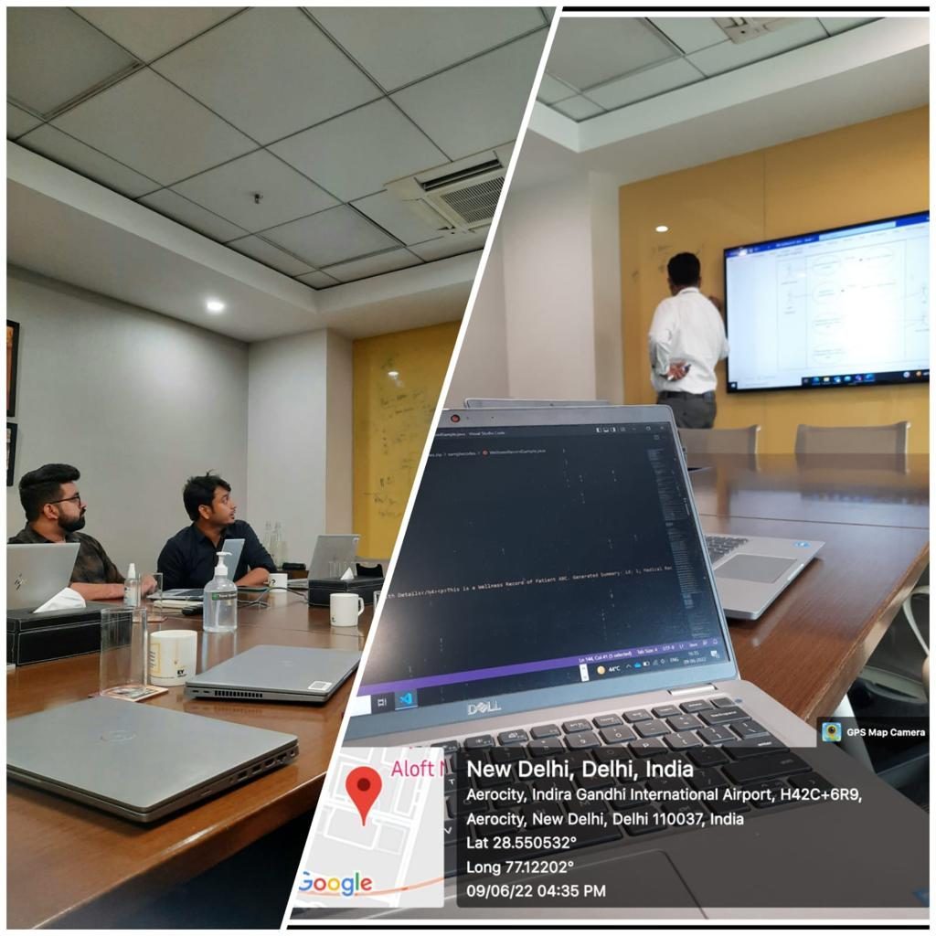
PICTORIAL JOURNEY

Slide 19
Thank You

