Slide 1
Dissertation Presentation
"A Study of TELEMANAS: Opportunities and Challenges for Successful Implementation"
Presented by: Vaibhav Kumar Singh
Enroll No.: PG/21/124
Mentored by: Dr. Anandhi Ramachandran

Slide 2
Mentor’s Approval

Slide 3
Introduction
The WHO defines mental health as “a state of well-being in which an individual realizes his or her own abilities, can cope with the normal stresses of life, can work productively, and is able to make a contribution to his or her community.”
Among other serious mental health issues, suicide is a leading cause of death among young people. 800,000 people commit suicide every year.
One in four people experience a mental health disorder at some point in their lives. However, it is noteworthy that only one in five people with a mental health disorder receives treatment.
Telemental health has been found effective in treating mental health conditions like depression, anxiety, and post-traumatic stress disorder.
Telemental health is the delivery of mental health services through electronic communication technologies.

Slide 4
Introduction
TELE-MANAS is a program introduced by the Indian government at World Mental Health Day on October 10th, 2022.
It offers tele-mental health services throughout India and is a joint effort between the National Institute of Mental Health and Neurosciences (NIMHANS) located in Bangalore and the Department of Health and Family Welfare in different states of India.
The program's primary objective is to create a network of mental health professionals across the country and provide tele-consultation services with mental health professionals.

Slide 5
Objective
The objective of this study is to identify the factors influencing adoption and implementation of Tele-MANAS Platform and also opportunities associated with telepsychiatry.

Slide 6
Methodology
Study Design: Narrative literature review
Databases to be searched: Google Scholar, JGate, PubMedSearch.
Terms: Telemental health, Telepsychiatry, E-mental health, Remote mental health care, barriers, facilitators, factors, challenges, implementation, adoption, Opportunities, India, global.
Period: From 2010 – till 2023

Slide 7
Methodology
Inclusion Criteria: English only articles, full –text articles, published, peer-review, review articles
Exclusion Criteria: Newspaper reports, news, blogs, websites
Data Analysis: A modified PRISMA methodology is used to select & extract relevant articles

Slide 8
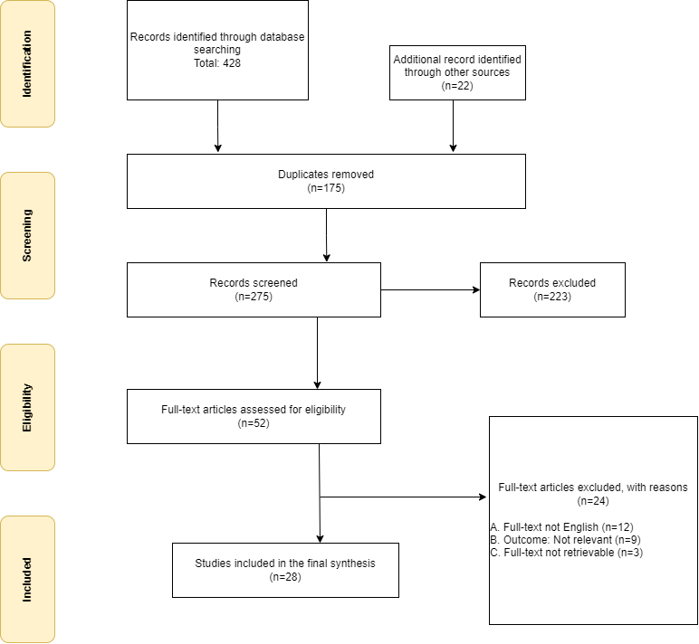
Results Thematic Analysis
Articles discussing the following themes

Slide 9
Results Thematic Analysis
Theme-1 Factors Influencing
Technological Barriers:
The efficiency and calibre of Telepsychiatry sessions might be impacted by connectivity problems such limited bandwidth, sluggish internet connections, or frequent interruptions. the lack of equal access to the internet and digital technologies.
Socio-culture Factors:
The stigma attached to mental health conditions may make people less likely to use Telepsychiatry to get care. The unwillingness to use virtual mental health services could be attributed to cultural attitudes, beliefs, and misconceptions about mental health.
Regulatory & policy factors:
Licensing requirements, privacy concerns, and compliance with existing guidelines were highlighted as crucial considerations to ensure ethical practice and protect patient privacy. Aligning with regulatory frameworks and leveraging partnerships with governing bodies.
Skilled Workforce:
A lack of adequately trained professionals was a significant barrier to the adoption of telepsychiatry in India. Ensuring that healthcare professionals receive specialized training in telepsychiatry can enhance their competence and confidence in utilizing telecommunication technologies for mental healthcare delivery.

Slide 10
Results Thematic Analysis
Theme-2 Opportunities Associated
Patient Satisfaction: It was found that there is consistently high levels of patient satisfaction with telepsychiatry. Patient satisfaction was found to be particularly high among children and adolescents, possibly because of the familiarity with technology among this age group. The patients were preferring virtual consultations because of the ease of discussing sensitive topics.
Accessibility: Telepsychiatry eliminates the need for individuals to travel long distances to access mental healthcare. This is particularly beneficial for individuals residing in underserved areas.
Affordability: Telepsychiatry has the potential to reduce healthcare costs associated with traditional in-person consultations by minimizing expenses related to transportation and missed workdays.
Outcomes: Telepsychiatry has a largely positive eﬀect on outcomes through the ability of accessing large volumes of patients.

Slide 11
Conclusion
Telepsychiatry is crucial to the field of mental health care.
Firstly, it enhances accessibility by removing geographic barriers, enabling individuals in remote areas to receive mental health services.
Secondly, it provides convenience and saves time and resources for both patients and psychiatrists through flexible scheduling of visits.
Thirdly, telepsychiatry promotes continuity of care by facilitating regular communication and treatment, particularly for individuals with chronic conditions. Moreover, it reduces stigma, improves mental health outcomes, and offers cost-effective solutions.
Additionally, telepsychiatry allows for emergency interventions and prompt assistance during critical situations.
However, there is limited research and supporting data, especially in low- and middle-income countries like India. Conducting well-designed comparative studies to assess diagnostic reliability, efficacy, and cost-effectiveness is crucial to advance the field of telepsychiatry in the country..

Slide 12
Limitations of the study
The main limitations of this review could be publication bias given the high number of positive studies in the area of telepsychiatry.
Since the descriptive studies are more likely to show positive outcomes than experimental studies.

Slide 13
References
Hilty, D. M., Ferrer, D. C., Parish, M. B., Johnston, B., Callahan, E. J., & Yellowlees, P. M. (2013). The effectiveness of telemental health: a 2013 review.
Nashkar S, Victor R. et.al. (2017) Telepsychiatry in India – Where Do We Stand? A Comparative Review between Global and Indian Telepsychiatry Programs
Gururaj G, Varghese M, Benegal V. et al. National Mental Health Survey of India 2015–16 prevalence, pattern and outcomes. Bengaluru: NIMHANS, 2017.
Ibrahim, F. A. (2021). The future of telepsychiatry in India.
Kuriakose S (2020) Telepsychiatry: Opportunities and Challenges. J Healthc Commun Vol.5
Malhotra, S., Chakrabarti, S., & Shah, R. (2013). Telepsychiatry: Promise, potential, and challenges. Indian Journal of Psychiatry, 55(1)
Shoib, S., Dass, S., De Filippis, R., & Ullah, I. (2022). Mental status via Telepsychiatry: The potential pitfalls. L'Encéphale, 48(6), 712-713
Chan, S., Hwang, T., Wong, A., & Bauer, A. M. (2017). Advances in mobile mental health: Opportunities and implications for the spectrum of E-mEntal health services. mHealth, 3, 34-34

Slide 14
Pictorial Journey

Slide 15
Open For Questions!

