Slide 1
DISSERTATION REPORT At Manipal Hospital Dwarka, Delhi. On A Descriptive Study to explore the factors contributing to patients leaving against medical advice and refusing treatment against medical advice in Manipal Hospital, Dwarka for a period of 3 months.
Name: Komal (PG/21/144)
2021-2023
Mentor: Dr. Rohini Ruhil, IIHMR Delhi.
Mentor: Yogender Singh( Head Operations)

Slide 2
Mentor Approval

Slide 3
Introduction of Organization
Dr. T.M.A. Pai founded Manipal Hospitals in 1953.
Manipal Hospitals opened its flagship hospital in Bangalore in 1991 (650 beds).
Top healthcare organization in India with 27 hospitals (approx. 7600 beds).
Manipal Hospital in Dwarka: 280 beds (118 critical care beds, 10 operation theaters, and other specialized departments.).
Compliant with international standards for radiodiagnosis, clinical procedures, and research.
Emphasizes patient care and goes above and beyond.
Emergency Department in Manipal Hospital Dwarka: 14 beds.
Staff: 3 doctors, 5 Head nurses, Head of Department, 2 Emergency doctors, 1 coordinator, 11-12 nursing staff, 3 Ground Duty Assistants (GDA), and 4 security guards

Slide 4
Introduction
LAMA - Discharge against medical advice or leave against medical advice (DAMA or LAMA) is a global phenomenon Leaving against medical advice (LAMA), is a term used when patients leave the hospital before a treating physician advises. LAMA reasons are an area of concern for all involved in the healthcare delivery system.
REFUSAL OF TREATMENT - Informed refusal is when a person has refused a recommended medical treatment based upon understanding the facts and implications of not following the treatment. Informed refusal is linked to the informed consent process, as a patient has a right to consent but may choose to refuse.
- LAMA (Leaving Against Medical Advice) accounts for 2% of hospital discharges.
- 1-3% of LAMA visits in the emergency room are due to subpar services and walkouts.
- Managing LAMA cases is challenging due to ethical and legal implications.
- Improving patient understanding and communication is crucial to reduce LAMA cases.
- LAMA is associated with increased morbidity, mortality, readmissions, and higher costs.
- Factors contributing to LAMA include financial constraints and issues with services and availability.
- Analyzing LAMA cases helps improve emergency care and minimize refusals.

Slide 5
Objectives of Your Study
Primary Objective
To assess the implementation and conversion of all the Lama and Rot Cases to analyse the contributing factors.
Secondary Objective
To find the association between the Demographic details- Age, Gender, Department, Payor, and Conversions.

Slide 6
Methodology
A Descriptive Study to explore the factors contributing to patients leaving against medical advice and refusing treatment against medical advice in Manipal Hospital, Dwarka for a period of 3 months.
Study Approach: Quantitative research
Sample no.: 244
Sampling Criteria:
Inclusion Criteria: All the patients refusing investigations and further management.
Exclusion Criteria: All other Cases.
Study Variables:
Dependent Variable: Implementation of LAMA TRACKER.
Demographic Variable: Age, Gender, Department, Payor, Time.

Slide 7
Methodology
Sampling Method: Convenient Sampling Techniques
Sample size: 100% As 24 hours of data is collected.
Data collection: Through the observation audit in the ED, through signed consent forms.
Data entry: The Data have been entered in the Master Excel sheet. A Dashboard was created to analyze the data in track care.
Analysis: The data have been recorded in the Excel sheet and analyzed by using descriptive statistics & follow-up and by calling the patient.

Slide 8
LAMA/ R.O.T TRACKER.
S.NO
MONTH
DATE
TIME
PATIENT NAME
PHONE NO.
HOSPITAL ID
DR. NAME
DEPARTMENT
Treatment Advice: Admission/Investigations
Reason for ROT
PAYOR
LAMA REASON
FOLLOW UP 1
FOLLOW UP 2
FOLLOW UP 3
Status: OPD/Admission/NI/Plan/Open/CB
CLOSING/Plan DATE
NI REASONS

Slide 9
LAMA/ROT REASONS.
Finance-Not Affordable
Not willing
Second Opinion
OPD Visit
Feeling Better
Nursing Services
Panel Issue
Room Availability
Not Responding
Panel issue

Slide 10
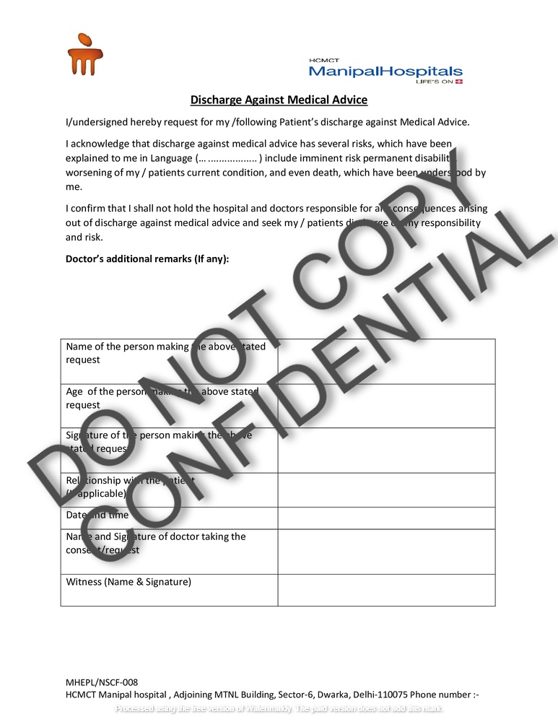
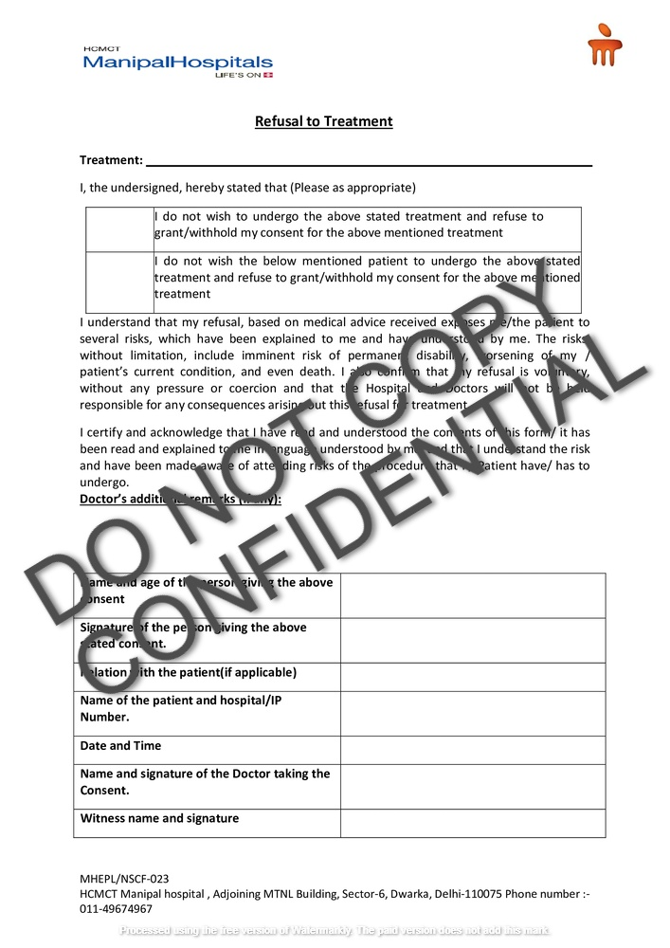
LAMA/ROT Consent form.

Slide 11
Results (Monthly Lama Cases)
MONTH | FEBRUARY | MARCH | APRIL | SUM
TOTAL NO. OF PATIENT | 1190 | 1625 | 1108 | 3923
TOTAL NO. OF LAMA CASES | 68 | 100 | 76 | 244
TOTAL IP CONVERSION/ ADMISSION | 492 | 716 | 489 | 1697
TOTAL NON-IP CONVERSION/ DISCHARGED | 630 | 809 | 543 | 1982
This table displays the total number of patients seen in the emergency room on a monthly basis.

Slide 12
In the 3 months of analysis of lama cases total lama cases were 244. In the month of February, 68 patients were lama, in March 100 patients& in April 76 were lama.

Slide 13
In the 3 months of analysis of lama cases total lama cases were 244 and males were 137 (56.15%) and females 107 (43.85).

Slide 14
In the 3 months of analysis of lama cases the total percentage of children ( 0-20 years), was 4.51%, Young Adults ( 21-30 Years), 12.70%, Middle age Adult Adults (31-50 Years), 30.04%, Old age ( 51-100 Years),52.75% of Total lama case

Slide 15
In the 3 months of analysis of lama cases, the total percentage of Cash payors was 67.62%, the highest among all the payors

Slide 16
During the 3 months that lama cases were analyzed, the department that saw the most patients was cardiology, followed by gastroenterology, internal medicine, neurology, emergency, respiratory, orthopedics, and, at the lowest levels, neurosurgery, and general surgery.

Slide 17
The top factor in the 3-month examination of lama instances was patients choosing to go to a different hospital or consulting a family doctor, followed by feeling better after receiving treatment, while some encountered financial and panel issues.

Slide 18
Result of lama cases conversions.
During the three months of examination of all cases, a total of 5.74% of patients were converted for hospitalization, and 20.90% for Opd, while 73.36% of patients showed no interest
During the three months of examination of all cases, a total of 5.74% of patients were converted for hospitalization, and 20.90% for Opd, while 73.36% of patients showed no interest.

Slide 19
In the 3 months of analysis of lama cases the total percentage of converted department was Cardiology which is the highest among all the 27.69%.

Slide 20
Discussion
Study findings highlight factors influencing LAMA decisions at Manipal Hospital.
Reasons for LAMA include opting for other hospitals and feeling better.
Patient satisfaction and effective communication can reduce seeking care elsewhere and treatment discontinuation.
Non-responsiveness and financial constraints contribute to LAMA cases.
Patient engagement, improved communication, and financial counseling can mitigate these issues.
Comprehensive approach needed to tackle LAMA cases.
Focus on improving patient satisfaction, communication, and addressing financial concerns.
Implement interventions to minimize treatment refusal and optimize patient care.

Slide 21
Discussion
LAMA is the patient's complete decision and cannot be denied by hospital staff once confirmed and is solely the decision of the patient and their attendants.
LAMA impacts patient safety and can affect the hospital's economy and reputation.
An increase in LAMA cases may indicate poor services and quality, impacting the hospital's financial status.
Consider appointing a dedicated counselor to counsel the patient and attendant.

Slide 22
Conclusion
In conclusion, a study was conducted at Manipal Hospital, which included 244 LAMA cases and 488 non-LAMA cases. The study aimed to explore contributing factors for LAMA and treatment refusal. The contributing factors identified included issues with contact information, staff dissatisfaction, feeling better, room availability, panel availability, referrals, non-responsiveness, financial constraints, choosing another hospital, and service-related issues. The highest number of patients (64) opted for another hospital. Data was collected and analyzed using an Excel sheet and a monthly dashboard. Demographic details, department-wise data, pair-wise data, and bed-wise data were collected to understand the patient flow and emergency department footfall. Patient consent was obtained, and no significant risks were involved in the study.

Slide 23
References
Eddieson Pasay-an, Mostoles R, Villareal S, Reynita Saguban. Factors Contributing to Leaving Against Medical Advice (LAMA): A Consideration of the Patients’ Perspective. 2023 Feb 9;11(4):506–6.
Gautam N, Sharma JP, Sharma A, Verma V, Arora P, Gautam PL. Retrospective Evaluation of Patients Who Leave against Medical Advice in a Tertiary Teaching Care Institute. Indian Journal of Critical Care Medicine: Peer-reviewed, Official Publication of Indian Society of Critical Care Medicine [Internet]. 2018 Aug 1;22(8):591–6. Available from: https://www.ncbi.nlm.nih.gov/pmc/articles/PMC6108296/
Gunchan P, PL G, Rubina K, S PB. Prospective Evaluation of Patients Leaving against Medical Advice of a Tertiary Care Hospital: Comparison of Emergency and Intensive Care Units. International Journal of Medicine and Public Health. 2018 Mar 12;8(1):18–23.
Hasan O, Adeel Samad M, Khan H, Sarfraz M, Noordin S, Ahmad T, et al. Leaving Against Medical Advice From In-patients Departments Rate, Reasons and Predicting Risk Factors for Re-visiting Hospital Retrospective Cohort From a Tertiary Care Hospital. International Journal of Health Policy and Management. 2019 May 18;8(8):474–9.

Slide 24
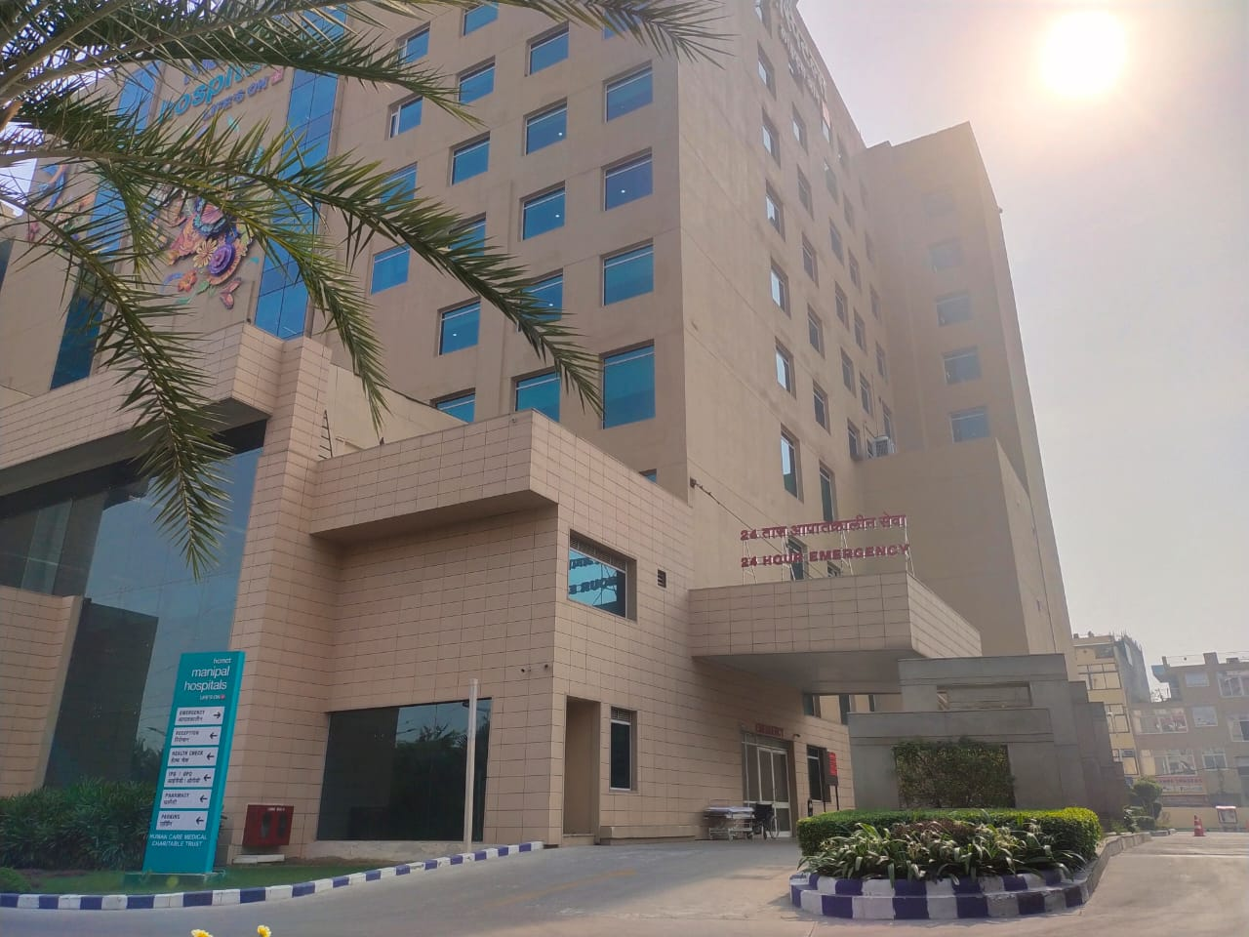
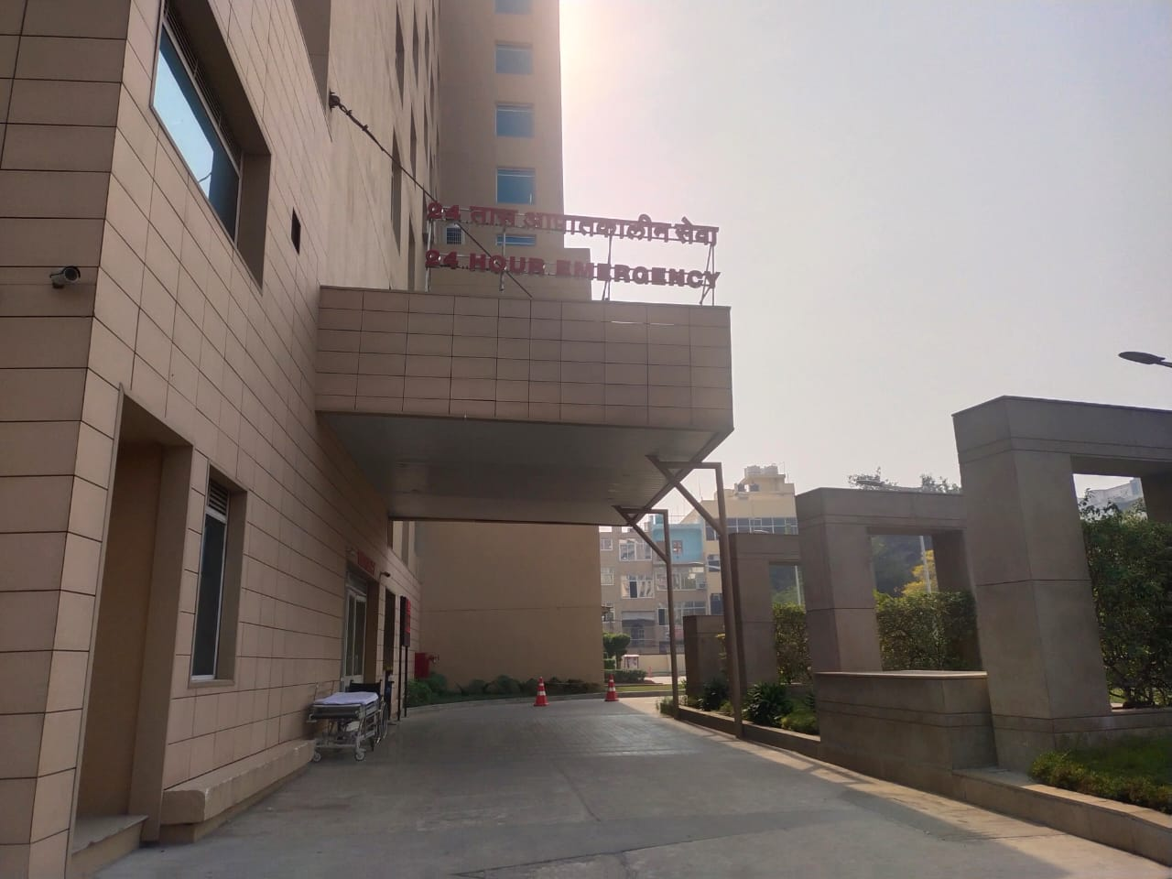
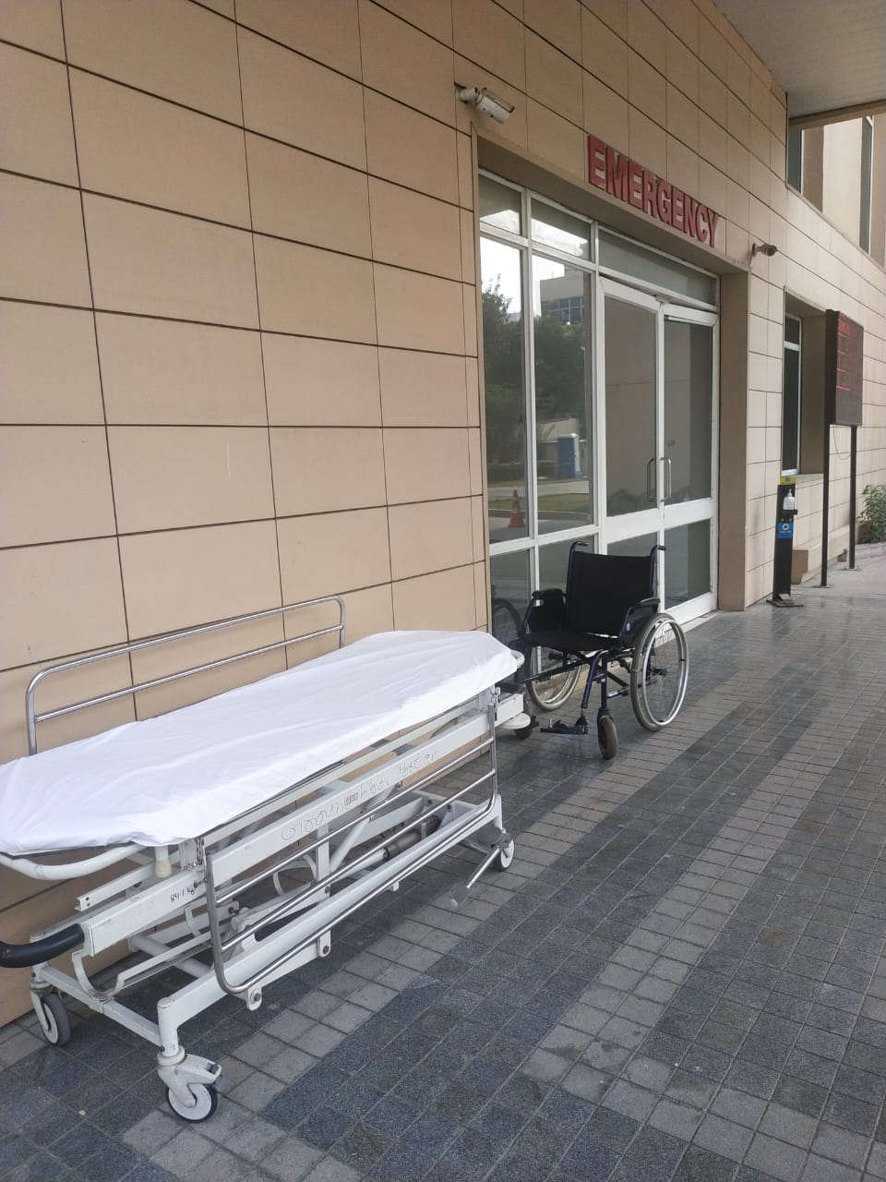
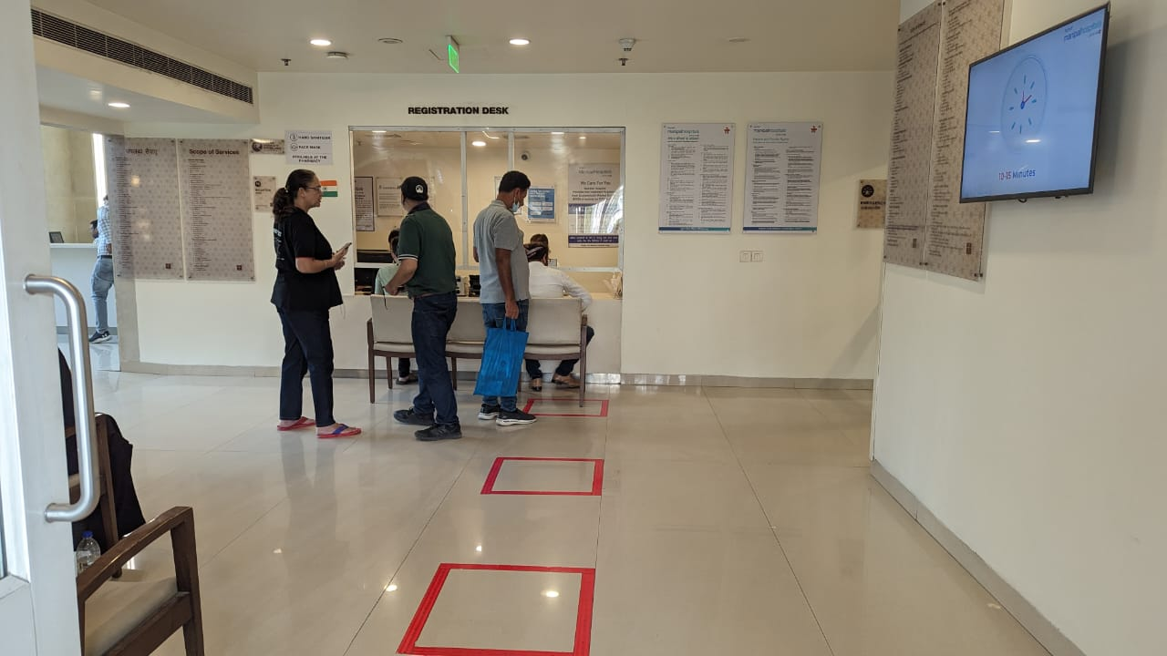
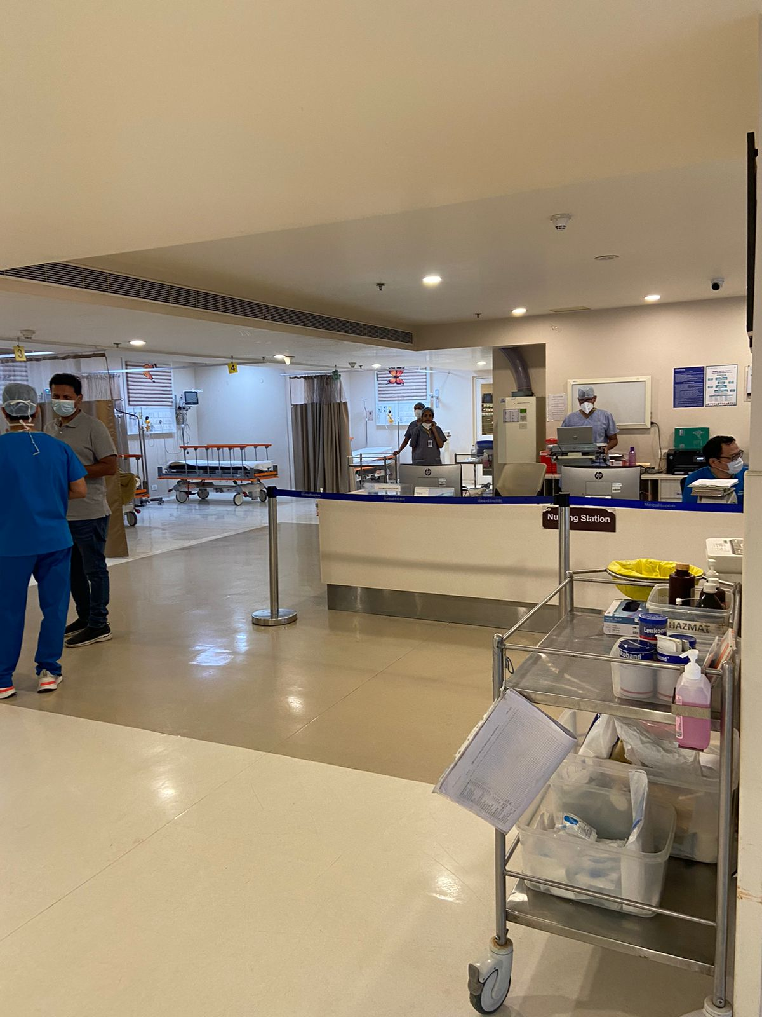
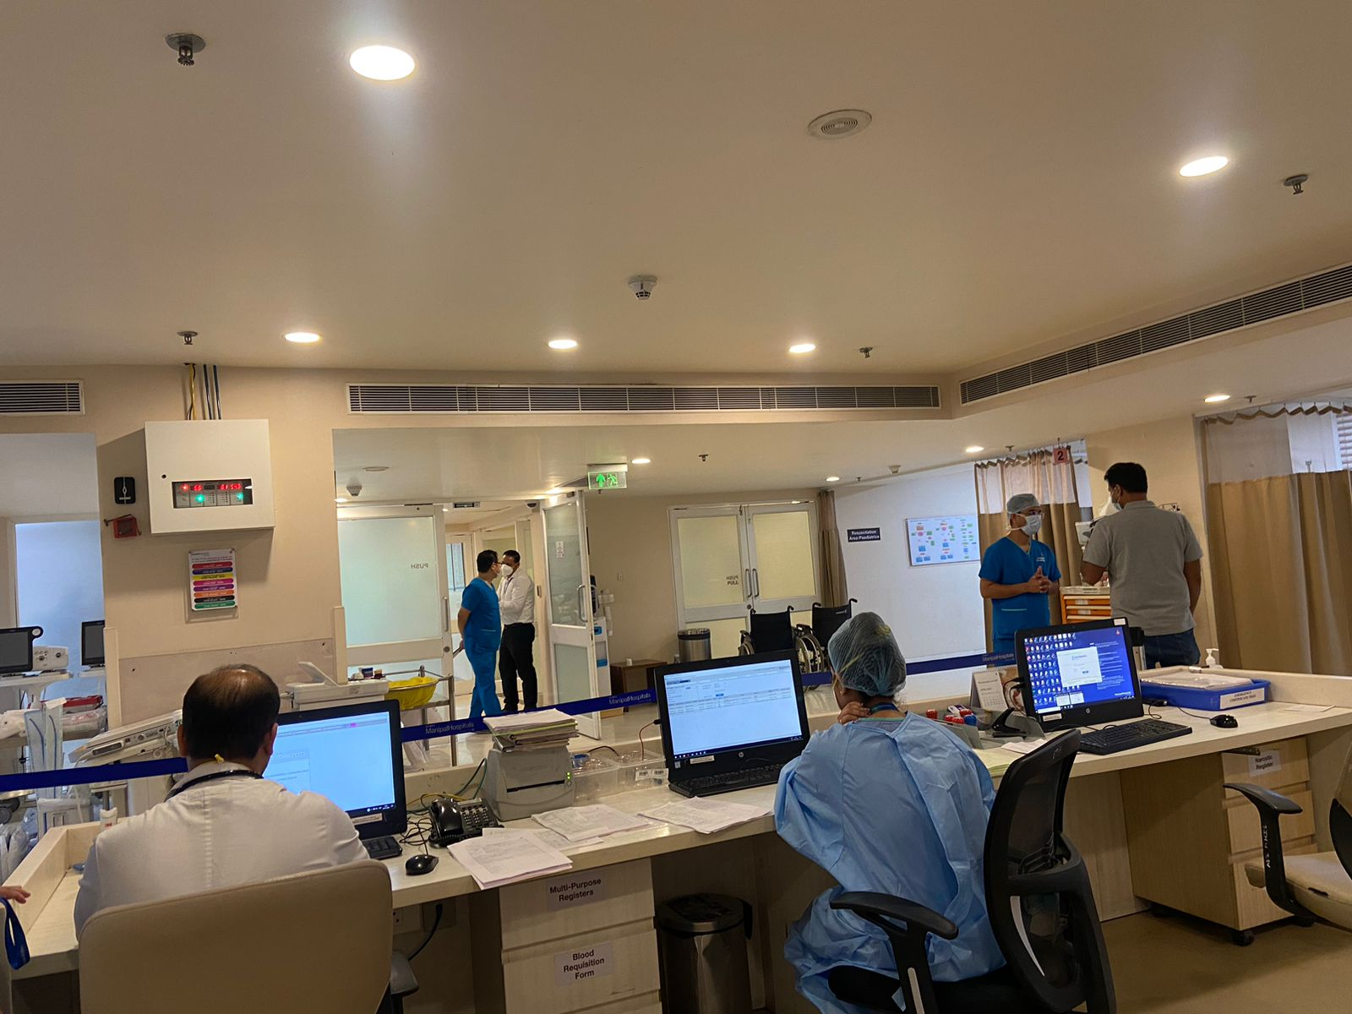
Pictorial Journey (1/2)

Slide 25
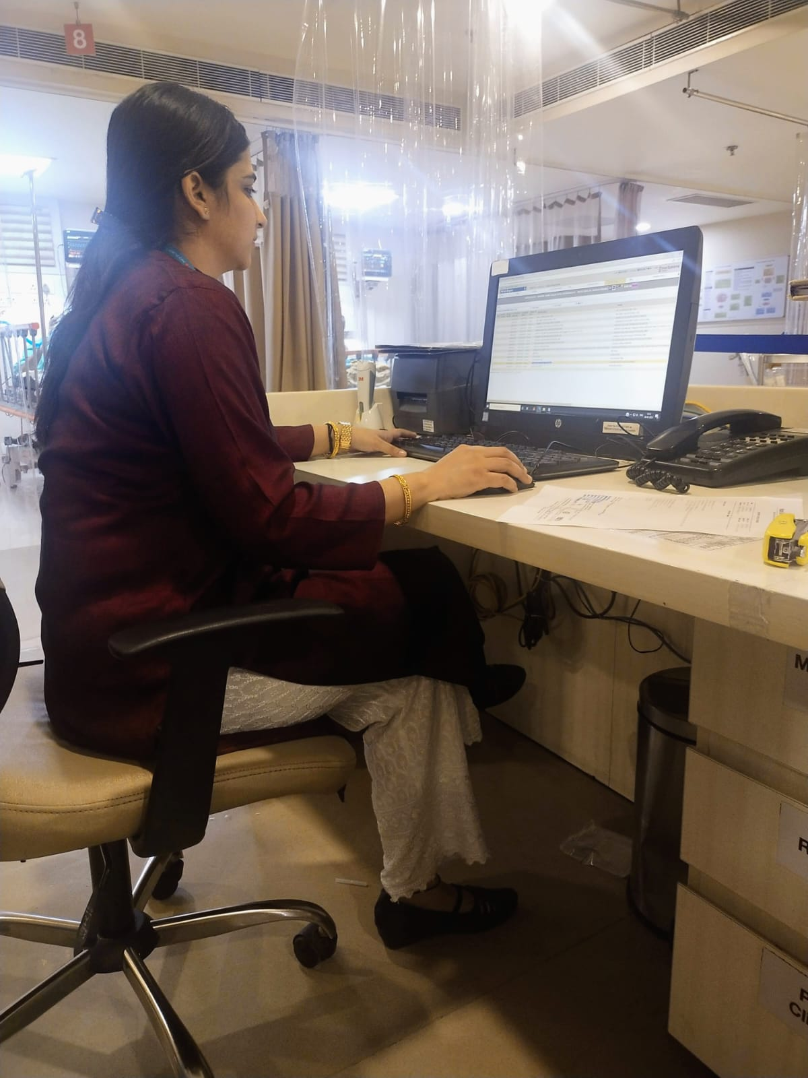
Pictorial Journey (2)

Slide 26
Thank You

