Slide 1
Use of Digital Technology as a source for Sexual and Reproductive Health Information seeking among adolescent and young adults: A Narrative Review (IPE GLOBAL)
Dr. Ankita Sharma (PG/22/008)
Faculty Mentor: Dr. Anandhi Ramachandran
IIHMR Delhi

Slide 2
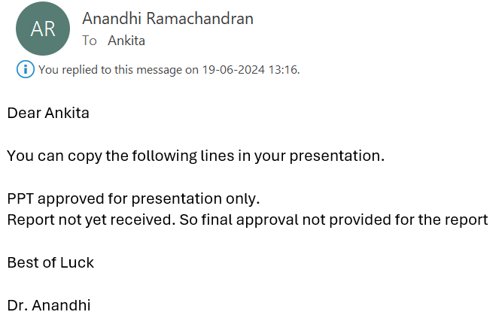
Mentor Approval

Slide 3
Introduction
India's health sector has embraced significant digitization, leveraging mHealth, Telemedicine, AI, and Robotics for advanced diagnosis and treatment capabilities.
Digital technology is integral to adolescents and young adults, offering multiple access points for information and communication.
Sexual and reproductive health (SRH) is crucial for adolescents and young adults, but embarrassment and privacy concerns often hinder access to comprehensive SRH information.
Adolescents are shifting from traditional mass media to social media platforms for SRH information.
Adolescents prefer mobile phones for their privacy, convenience, and accessibility.

Slide 4
Objectives
Primary Objective
To Identify the use of digital technology by adolescents and young adults (AYA) in India to access sexual and reproductive health related information.

Slide 5
Methodology (1/2)
STUDY DESIGN: Literature based Secondary Research
POPULATION: Adolescents and Young adults of India
SEARCH STRATEGY: A comprehensive search was conducted in electronic databases (e.g., PubMed, Google scholar, researchGate, Springer articles).
Keywords: “Digital technologies AND SRH”, “AYA AND SRH”, “Digital technology AND Adolescents”, “SRH AND India”, “Online SRH AND India”.
PERIOD OF STUDY: Starting from 2010 till April 2024

Slide 6
Methodology (2/2)
INCLUSION CRITERIA: Studies involving digital technology and/or adolescents, young adults (10-24). Studies of Indian context was included. All types of studies including qualitative, quantitative, or mixed-method designs. The studies which include use of information and communication technologies, such as the Internet, web, smartphone applications, and e-health, to meet the needs of targeted population were used.
EXCLUSION CRITERIA: Studies which are not in English language were excluded. Blogs, white paper, news reports, editorial and opinion papers were excluded. Studies that conducted nonelectronic and electronic interventions on individuals other than targeted population were excluded.

Slide 7
Results (1/3)
A total of 19 studies were fully reviewed .Studies which did not align with the objective of the study and had vague and inconclusive results were excluded.
The search terms used initially form different sources yielded 415 publications.
After inclusion criteria and time filter ( post 2010) = 98 studies
After reading titles and abstract = 19 Full articles reviewed.
After removal of duplicates = 198 studies

Slide 8
Results (2/3)
S.no | Author | Title | Objective | Result
1 | Goh, Kunshan; Contractor, Sana; Van Belle, Sara | A Realist-Informed Review of Digital Empowerment Strategies for Adolescents to Improve Their Sexual and Reproductive Health and Well-being | The study aimed to understand how digital empowerment strategies work to improve adolescent health and well-being, particularly in urban resource-constrained settings. | The review found that digital technologies enable adolescents to access health information and services independently, ensuring anonymity and safety. When adolescents receive tailored information, they can make informed decisions, improving their health outcomes by enhancing their sense of agency. The review identified two main gaps: the lack of theoretical focus on the urban environment and the socio-developmental stages of the adolescents targeted by these programs.
2 | McCammon, E; Bansal, S; Hebert, L; Yan, S; Sparrow, A; Hill, B; Gilliam, M | A game-based intervention to improve youth sexual and reproductive health in New Delhi, India | The study aimed to evaluate the effectiveness of a game-based intervention in improving youth sexual and reproductive health in New Delhi, India. | The study found that game-based interventions significantly improved adolescents' knowledge and attitudes towards sexual and reproductive health, increasing the use of condoms and contraception. It also highlighted the importance of providing a safe space for discussing sensitive topics.
3 | Rajani, N.; Akhila, A. | Social Media—Impact on Sexual and Reproductive Knowledge of Adolescents in South India | The study aimed to investigate the impact of social media on the sexual and reproductive knowledge of adolescents in South India. | The study found that frequent social media use significantly improved adolescents' knowledge of sexual and reproductive health, highlighting social media's potential as an effective tool for enhancing health knowledge among adolescents.
4 | Shankar, Lalita; Dixit, Anvita; Howard, Susan | A Design-Led Theory of Change for a Mobile Game App (Go Nisha Go) for Adolescent Girls in India: Multimix Methodology Study | The study aimed to describe the development of a design-led Theory of Change (ToC) for a mobile game app (Go Nisha Go) that aims to improve sexual and reproductive health outcomes among adolescent girls in India. | The study developed a Theory of Change (ToC) for the Go Nisha Go mobile game, hypothesizing that girls who engage with the game's immersive and challenging elements will learn to make informed decisions about sexual and reproductive health. The ToC includes four learning pathways: DISCOVER, PLAY, DECIDE, and ACT, built on the pillars of evidence, engagement, and evaluation.
5 | Bacchus, Loraine J.; Reiss, Kate; Church, Kathryn; Colombini, Manuela; Pearson, Erin; Naved, Ruchira; Smith, Chris; Andersen, Kathryn; Free, Caroline | Using Digital Technology for Sexual and Reproductive Health: Are Programs Adequately Considering Risk? | The study aimed to discuss the potential risks of digital interventions in sexual and reproductive health (SRH) and highlight the importance of considering these risks in the design and implementation of such interventions. | The study found that digital interventions in SRH pose risks such as confidentiality breaches, unintended disclosure, and perpetuation of harmful gender norms. It emphasizes careful risk management in designing and implementing these interventions, providing recommendations for mitigation.
6 | Ippoliti, Nicole B.; L’Engle, Kelly | Meet us on the phone: mobile phone programs for adolescent sexual and reproductive health in low-to-middle income countries | The study aimed to review the effectiveness of mobile phone programs in improving adolescent sexual and reproductive health in low-to-middle income countries. | The study found that mobile phone programs can be effective in improving adolescent sexual and reproductive health, particularly in low-to-middle income countries. The programs can provide access to information, support, and services that may not be available through traditional channels.
7 | Wang, Hua; Gupta, Sneha; Singhal, Arvind; Muttreja, Poonam; Singh, Sanghamitra; Sharma, Poorva; Piterova, Alice | An Artificial Intelligence Chatbot for Young People’s Sexual and Reproductive Health in India (SnehAI): Instrumental Case Study | The study aimed to examine the functional affordances of SnehAI, an AI-driven chatbot designed for social and behavioral changes in India, and to investigate user engagement patterns. | The study found that SnehAI demonstrated strong evidence across 15 functional affordances, such as accessibility, interactivity, and scalability. It effectively engaged users, particularly young men, with 8.2 million messages exchanged over 5 months. The chatbot acted as a trusted friend and mentor, providing a safe space for discussing sensitive topics.
8 | Senbekov, Maksut; Saliev, Timur; Bukeyeva, Zhanar; Almabayeva, Aigul; Zhanaliyeva, Marina; Aitenova, Nazym; Toishibekov, Yerzhan; Fakhradiyev, Ildar | The Recent Progress and Applications of Digital Technologies in Healthcare: A Review | The study aimed to review recent progress and applications of digital technologies in healthcare. | The study found that digital technologies have made significant progress in healthcare, including telemedicine, electronic health records, and artificial intelligence. These technologies have improved patient outcomes, increased access to healthcare services, and enhanced healthcare efficiency.
9 | Saha, Ananya; Dixit, Anvita; Shankar, Lalita; Battala, Madhusudana; Khan, Nizamuddin; Saggurti, Niranjan; Ayyagari, Kavita; Raj, Aparna; Howard, Susan | Study protocol for an individually randomized control trial for India's first roleplay-based mobile game for reproductive health for adolescent girls | The study aimed to develop and evaluate the effectiveness of a roleplay-based mobile game for reproductive health among adolescent girls in India. | The study found that the mobile game was effective in improving knowledge and attitudes of adolescent girls towards reproductive health. The game also increased the use of condoms and other forms of contraception.
10 | Saha, Ria; Paul, Pintu; Yaya, Sanni; Banke-Thomas, Aduragbemi | Association between exposure to social media and knowledge of sexual and reproductive health among adolescent girls: evidence from the UDAYA survey in Bihar and Uttar Pradesh, India | The study aimed to examine the association between exposure to social media and knowledge of sexual and reproductive health among adolescent girls in Bihar and Uttar Pradesh, India. | The study found that exposure to social media was significantly associated with better knowledge of sexual and reproductive health among adolescent girls. The study highlights the potential of social media as a tool for improving adolescent health knowledge.

Slide 9
Results (3/3)
11 | Chakraborty, Srilekha | Talking about gender and sexual reproductive health rights of adolescents and youth in Jharkhand | The study aimed to discuss the importance of talking about gender and sexual reproductive health rights of adolescents and youth in Jharkhand. | The study found that discussing gender and sexual reproductive health rights is crucial for improving the health and well-being of adolescents and youth in Jharkhand. The study highlights the need for a comprehensive approach to addressing the sexual and reproductive health needs of this population.
12 | Isaacs, Nazeema; Ntinga, Xolani; Keetsi, Thabo; Bhembe, Lindelwa; Mthembu, Bongumenzi; Cloete, Allanise; Groenewald, Candice | Are mHealth Interventions Effective in Improving the Uptake of Sexual and Reproductive Health Services among Adolescents? A Scoping Review | The study aimed to examine the effectiveness of mHealth interventions in improving the uptake of sexual and reproductive health services among adolescents. | The study found that mHealth interventions can be effective in improving the uptake of sexual and reproductive health services among adolescents. The interventions included text messaging, mobile apps, and online platforms. The study highlighted the potential of mHealth interventions in addressing the sexual and reproductive health needs of adolescents, particularly in low- and middle-income countries.
13 | Kanesathasan, Anjala; Cardinal, Laura J; Pearson, Erin; Gupta, Sreela Das; Mukherjee, Sushmita; Malhotra, Anju | Catalyzing Change Improving Youth Sexual and Reproductive Health Through disha, an Integrated Program in India | The program aims to address the broader context of young people's sexual and reproductive health in India. | The program has been effective in improving youth knowledge and attitudes towards sexual and reproductive health. It has also been successful in addressing specific issues such as puberty, attraction to others, reproductive systems, and family planning.
14 | Singh, Salam Michael; Garg, Shubhmoy Kumar; Misra, Amitesh; Seth, Aaditeshwar; Chakraborty, Tanmoy | SUKHSANDESH: An Avatar Therapeutic Question Answering Platform for Sexual Education in Rural India | The study aimed to develop and evaluate an avatar-based question answering platform called SUKHSANDESH to provide sexual education to rural youth in India. | The study found that the SUKHSANDESH platform was effective in providing accurate and culturally-sensitive sexual health information to rural youth. The avatar-based interface helped overcome barriers such as stigma and lack of access to information.
15 | Feroz, Anam Shahil; Ali, Naureen Akber; Khoja, Adeel; Asad, Armish; Saleem, Sarah | Using mobile phones to improve young people sexual and reproductive health in low and middle-income countries: a systematic review to identify barriers, facilitators, and range of mHealth solutions | The study aimed to identify the range of mHealth solutions that can be used for improving young people's sexual and reproductive health in low- and middle-income countries (LMICs) and highlight facilitators and barriers for adopting mHealth interventions. | The review found that mHealth interventions can be effective in improving access to sexual and reproductive health services and information for young people in LMICs. The most common mHealth applications were client education and behavior change communication, data collection and reporting, and financial transactions and incentives. The review also identified barriers such as decreased technological literacy, inferior network coverage, and lower linguistic competency.
16 | Laar, Alexander S.; Harris, Melissa L.; Khan, Md N.; Loxton, Deborah | Views and experiences of young people on using mHealth platforms for sexual and reproductive health services in rural low- and middle-income countries: a qualitative systematic review | The study aimed to qualitatively explore the experiences and perceptions of young people's use of mobile phone platforms for sexual and reproductive health services in rural low- and middle-income countries. | The study found that young people in rural low- and middle-income countries have positive views on using mHealth platforms for sexual and reproductive health services, citing convenience, privacy, and affordability as key benefits. However, they also expressed concerns about poor and limited network and electricity connectivity, limited access to mobile phones and mobile credit due to cost, influence from socio-cultural norms and beliefs, and language and literacy skills constraints.
17 | Ames, Heather MR; Glenton, Claire; Lewin, Simon; Tamrat, Tigest; Akama, Eliud; Leon, Natalie | Clients’ perceptions and experiences of targeted digital communication accessible via mobile devices for reproductive, maternal, newborn, child, and adolescent health: a qualitative evidence synthesis | The study aimed to explore clients' perceptions and experiences of targeted digital communication via mobile devices on topics related to reproductive, maternal, newborn, child, and adolescent health. | The study found that clients' experiences of targeted digital communication were mixed. Some felt that these programs provided them with feelings of support and connectedness, while others pointed to problems such as poor access to cell networks and the internet, language issues, and cost of messages. Clients also had preferences for different delivery channels and message content.
18 | Rea, Samantha; Zynda, Aaron; Allison, Bianca; Tolleson-Rinehart, Sue | Adolescent Perceptions of Technology-Based Sexual and Reproductive Health Services: A Systematic Review | The study aimed to systematically review the literature on adolescent perceptions of technology-based sexual and reproductive health services. | The study found that adolescents have mixed views on technology-based sexual and reproductive health services, citing both benefits and barriers. The benefits included increased access to information and services, while the barriers included concerns about privacy, confidentiality, and stigma.
19 | Tirado, Veronika; Chu, Josephine; Hanson, Claudia; Ekström, Anna Mia; Kågesten, Anna | Barriers and facilitators for the sexual and reproductive health and rights of young people in refugee contexts globally: A scoping review | The study aimed to identify the barriers and facilitators for the sexual and reproductive health and rights of young people in refugee contexts globally. | The study found that barriers to sexual and reproductive health and rights for young people in refugee contexts include cultural norms, lack of access to services, limited knowledge, and gender-based violence. Facilitators include community engagement, comprehensive sexuality education, and youth-friendly services that are accessible, confidential, and non-judgmental. Addressing these barriers and strengthening the facilitators requires a multi-stakeholder approach involving refugees, service providers, and policymakers.

Slide 10
Discussion (1/2)
1. USE OF DIGITAL TECHNOLOGY FOR SRH
Digital technologies have been increasingly used to improve access to sexual and reproductive health (SRH) information and services, particularly among adolescents and young adults (AYA).
It includes mobile applications, social media platforms, interactive games, and artificial intelligence chatbots.
In India, digital interventions have shown promise in enhancing the knowledge and awareness of AYA regarding SRH, providing a sense of support and community, and addressing social stigma and other barriers to accessing SRH services.
2. BENEFITS
Expanded access: Digital technologies can reach even the most marginalized and structurally excluded populations, including those living with disabilities, Indigenous people, rural populations, and refugees.
Increased information: Digital platforms can provide comprehensive SRH information, addressing stigmatized topics and delivering culturally sensitive and tailored care.
Cost-effective: Digital technologies can capitalize on efficiency and cost effectiveness within SRH interventions and programs

Slide 11
Discussion (2/2)
3. BARRIERS AND CHALLENEGES
Privacy and confidentiality concerns: There are concerns about privacy and confidentiality risks, particularly for AYA who may face stigma or other barriers to accessing SRH services.
Technical challenges: Technical issues, such as poor internet connectivity or lack of quality devices, can hinder the effectiveness of digital SRH interventions.
Stigma and social norms: Stigma and social norms can discourage AYA from seeking SRH services, even if digital platforms are available.
Shared Mobile phones: In India, Majority of adolescents use mobile phone of their parents or elder siblings.

Slide 12
Conclusion
Digital Technologies Enhance SRH Access:
Digital platforms are a valuable tool for improving access to SRH information among adolescents and young adults (AYAs) in India.
Positive impacts on knowledge, attitudes, and behaviors highlight the potential of digital platforms to contribute to better health outcomes.
Addressing Concerns:
To fully realize this potential, it is crucial to address privacy and confidentiality concerns of adolescents.
Mitigating risks associated with digital interventions is essential.
Key Strategies:
Prioritize user-centered design.
Engage young people in the development process.
Implement supportive policies.
Future Research Directions:
Evaluate the long-term impacts of digital health interventions.
Explore innovative strategies to overcome existing barriers.
Ensure equitable access to SRH information and services for all adolescents.

Slide 13
References
1. McCammon E, Bansal S, Hebert L, Yan S, Sparrow A, Hill B, et al. A game-based intervention to improve youth sexual and reproductive health in New Delhi, India. Contraception. 2018 Oct;98(4):366–7.
2. Rajani N, Akhila A. Social Media—Impact on Sexual and Reproductive Knowledge of Adolescents in South India. In: Jyothi S, Mamatha DM, Satapathy SC, Raju KS, Favorskaya MN, editors. Advances in Computational and Bio-Engineering. Cham: Springer International Publishing; 2020. p. 335–43.
3. Shankar L, Dixit A, Howard S. A Design-Led Theory of Change for a Mobile Game App (Go Nisha Go) for Adolescent Girls in India: Multimix Methodology Study. JMIR Formative Research. 2023 Apr 18;7(1):e43085.
4. Bacchus LJ, Reiss K, Church K, Colombini M, Pearson E, Naved R, et al. Using Digital Technology for Sexual and Reproductive Health: Are Programs Adequately Considering Risk? Global Health: Science and Practice. 2019 Dec 23;7(4):507–14.
5. Ippoliti NB, L’Engle K. Meet us on the phone: mobile phone programs for adolescent sexual and reproductive health in low-to-middle income countries. Reprod Health. 2017 Jan 17;14(1):11.
6. Wang H, Gupta S, Singhal A, Muttreja P, Singh S, Sharma P, et al. An Artificial Intelligence Chatbot for Young People’s Sexual and Reproductive Health in India (SnehAI): Instrumental Case Study. Journal of Medical Internet Research. 2022 Jan 3;24(1):e29969.
7. Senbekov M, Saliev T, Bukeyeva Z, Almabayeva A, Zhanaliyeva M, Aitenova N, et al. The Recent Progress and Applications of Digital Technologies in Healthcare: A Review. International Journal of Telemedicine and Applications. 2020 Dec 4;2020:e8830200.
8. Saha A, Dixit A, Shankar L, Battala M, Khan N, Saggurti N, et al. Study protocol for an individually randomized control trial for India’s first roleplay-based mobile game for reproductive health for adolescent girls. Reprod Health. 2023 Sep 14;20(1):140.
9. Saha R, Paul P, Yaya S, Banke-Thomas A. Association between exposure to social media and knowledge of sexual and reproductive health among adolescent girls: evidence from the UDAYA survey in Bihar and Uttar Pradesh, India. Reprod Health. 2022 Aug 17;19(1):178.
10. Chakraborty S. Talking about gender and sexual reproductive health rights of adolescents and youth in Jharkhand. Asian Journal of Women’s Studies. 2019 Jul 3;25(3):468–81.
11. Isaacs N, Ntinga X, Keetsi T, Bhembe L, Mthembu B, Cloete A, et al. Are mHealth Interventions Effective in Improving the Uptake of Sexual and Reproductive Health Services among Adolescents? A Scoping Review. International Journal of Environmental Research and Public Health. 2024 Feb;21(2):165.
12. Kanesathasan A, Cardinal LJ, Pearson E, Gupta SD, Mukherjee S, Malhotra A. Catalyzing Change Improving Youth Sexual and Reproductive Health Through disha, an Integrated Program in India.

Slide 14
Thank You
Any Questions

Slide 15
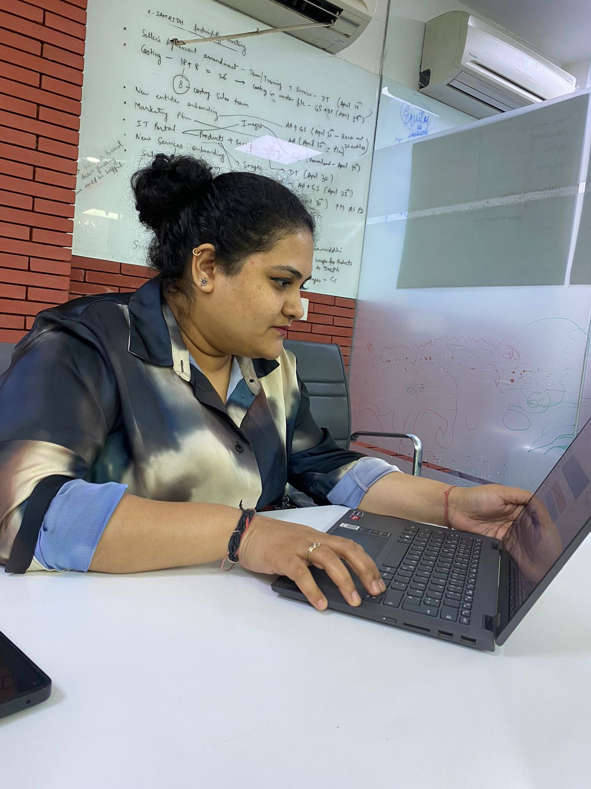
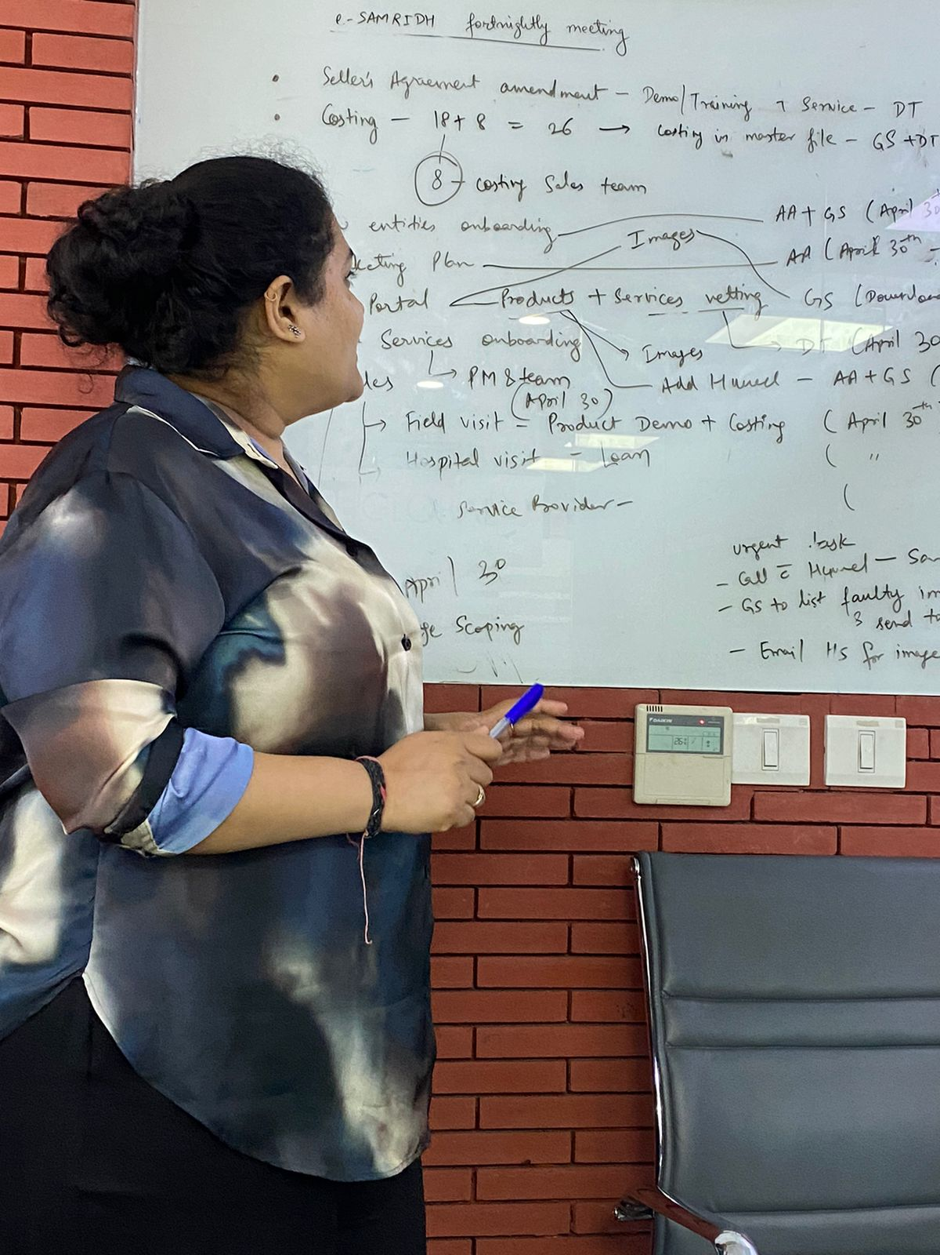
Pictorial Journey

