Slide 1
The effectiveness of digital tool-powered transition care programs in reducing hospital readmissions and improving patient outcomes compared to traditional care management approaches- A rapid review JIVI.AI
Presented By: Dr. ANUSHKA SINGH (PG/22/011)
Mentor: Dr. SUMANT SWAIN
IIHMR Delhi

Slide 2
Mentor Approval

Slide 3
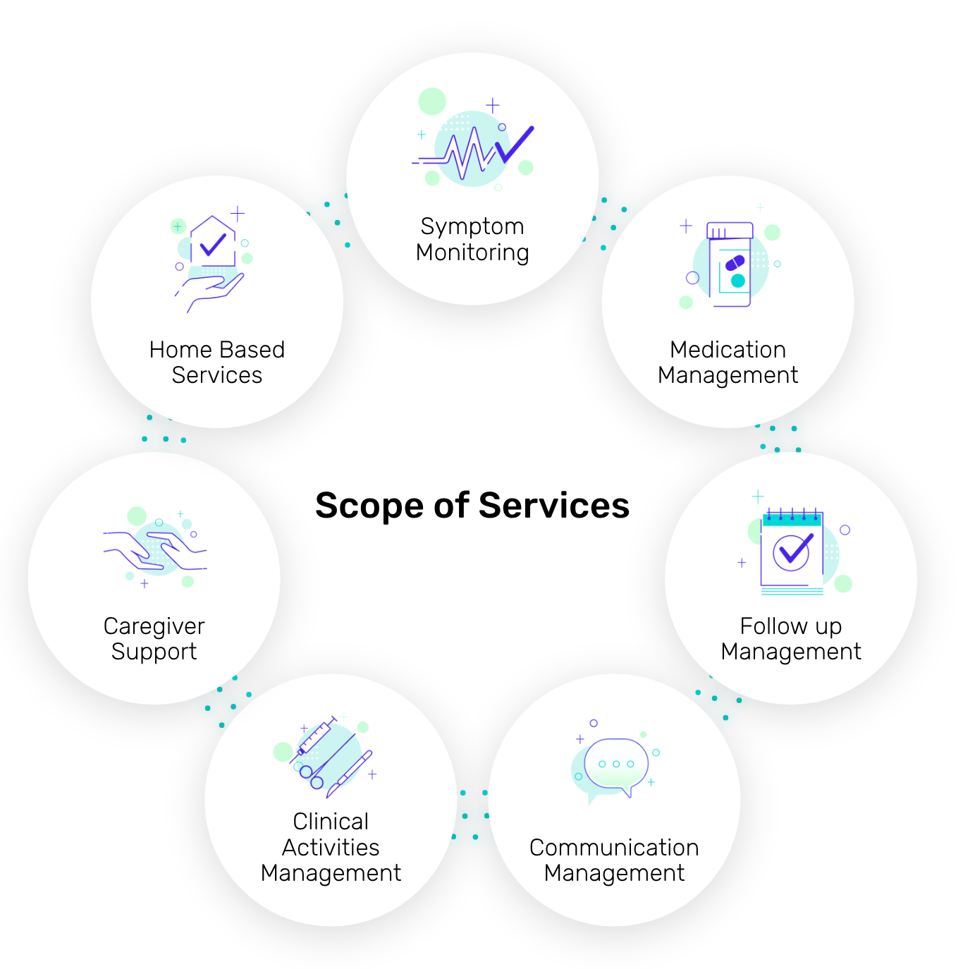
Introduction
A series of actions intended to ensure the coordination and continuity of healthcare as patients transfer between different locations or different levels of care within the same location" is the definition of a transition of care.
Coleman’s “Four Pillars” of care transition activities involves medication management, patient-centered health records, follow-up visits with providers and specialists, and patient knowledge about red flags that indicate worsening conditions or drug reactions.
To reduce costly, unnecessary hospital readmissions, emphasis must be placed on support during care transitions, including patient education and self-management.

Slide 4
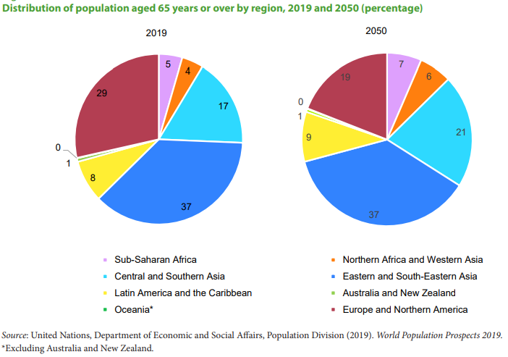
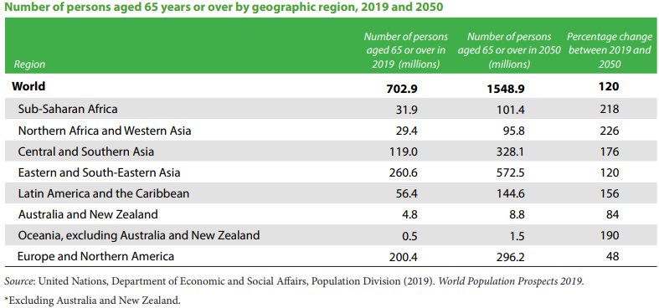
Introduction
For elderly individuals, the move from the hospital to their homes may be a delicate, taxing, and difficult time.
After leaving the hospital and returning home, older persons may need specialized care due to underlying or newly developed functional and/or cognitive impairments that may affect how well they adjust to normal life.
Rehospitalizations are common and expensive because around one-fifth of older persons return within 30 days of being discharged from the hospital due to an acute medical issue that may not have been connected during their first hospital stay.

Slide 5
Objectives of Your Study
General Objective:
The influence of digital tool-powered transition care programs in improving patient care outcomes compared to traditional care management approaches.
Specific Objectives:
To assess the impact of digital tool-powered transition care programs on the rate of hospital readmissions.
To assess the impact of digital interventions on patient satisfaction.
To assess the impact of medication adherence.
To identify gaps in the Transition care management.
To identify the gaps in the digital tool powered Technology related challenges.

Slide 6
Methodology
Inclusion Criteria's
Population:
Adults (18+) transitioning from hospital to home or other care settings.
Includes diverse clinical settings (e.g., chronic disease patients, post-surgical patients).
Intervention:
Transition care programs utilizing digital tools, such as:
Electronic health records (EHRs)
Telehealth services
Mobile health applications
Remote monitoring devices
AI-driven analytics
Comparison:
Digital tool-powered transition care vs. traditional care management
Study Design:
Randomized controlled trials (RCTs)
Cohort studies
Case-control studies
Quasi-experimental studies
Outcomes:
Primary outcomes: Hospital readmission rates.
Secondary outcomes: Patient outcomes such as quality of life, patient satisfaction, adherence to treatment, clinical indicators (e.g., blood pressure, glucose levels), and healthcare costs.

Slide 7
Methodology
Search strategy: phrases like “digital tools”, “transition care programmes”, “hospital readmissions”, “patient outcomes”, “traditional care management”, “readmission rates”, “post-discharge care”, and “digital health tools”.
Database searched: PubMed, Google scholar, Science direct.
Selection process:
Initial Screening: All identified papers' titles and abstracts were reviewed for relevance to the study topic.
Full text review: Studies that made past the first screening stage were subjected to a full-text review. Studies that met the inclusion criterias were included in this study.
Data Extraction: From the included studies, pertinent data was taken out and put into a structured format.
Synthesis and Analysis: Using digital tool-powered transition care programmes as a benchmark, the efficacy of these programmes was compared to traditional care management techniques.

Slide 8
Methodology
Prisma Flow Diagram

Slide 9
Results
Objective | Digital tool used | Comparator | Outcome measures | Results
To assess the impact of digital tool-powered transition care programs on the rate of hospital readmissions. | Artificial Intelligence | Traditional care management | 30-day rehospitalization | Following the implementation of the intervention, the average readmission rate dropped by 21%.
To assess the impact of digital tool-powered transition care programs on the rate of hospital readmissions. | EHR | Traditional care management | 30-dayrehospitalization | Following the implementation of EHR 3.4% of patients were readmitted to the hospital after 30 days, compared to 20.7% in the control group.
To assess the impact of digital tool-powered transition care programs on the rate of hospital readmissions. | Telehealth | Traditional care management | 30-dayrehospitalization | Telehealth did not show statistically significant differences in readmissions or emergency department usage when compared to traditional care.
To assess the impact of digital tool-powered transition care programs on the rate of hospital readmissions. | Tele monitoring | Traditional care management | 30-day rehospitalization | The 30-day readmission rate among high-risk patients was 17.0% in the telemonitoring group and 22.5% without the intervention, suggesting a notable improvement in outcomes with telemonitoring.
To assess the impact of digital interventions on patient satisfaction. | Telehealth | Traditional care management | Patient satisfaction | -98% of telemedicine patients expressed a willingness to continue using telehealth for managing their healthcare needs, and all telehealth patients found the intervention beneficial. -94% of surveyed individuals reported that remote patient monitoring technology was helpful.
To assess the impact of medication adherence. | Telehealth | Traditional care management | Medication adherence | -Telehealth patients were seven times more likely to adhere to their prescription regimen and showed higher rates of medication reconciliation compared to the control group.

Slide 10
Results
Author & Year | Database | Digital tool used | Comparator | Outcome measures | Results
Brown et al, 2023 | PubMed | Artificial Intelligence | Traditional care management | Rehospitalization in 30 days | - Integration of AI patient insights into existing transition of care navigation programs significantly reduced incidence of 30-day rehospitalization by 21.0%, (95% CI 0.65‒0.95). -AI-enhanced transitional care demonstrated greater effectiveness and financial efficiency.
Mansukhani et al, 2015 | PubMed | EHR/EMR | Traditional care management | Rehospitalization in 30 days Medication reconciliation | -EHRs improve provider-to-provider communications and streamline patient health histories and diagnostics. -Enhanced access to health information facilitates better informed decision-making among physicians. -Implementation of EHRs reduced medication errors significantly on both surgical (from 90% to 47%) and medical units (from 57% to 33%).
Romero-Brufau et al, 2020 | PubMed | Artificial Intelligence | Traditional care management | Rehospitalization in 30 days | -Readmission rates decreased from 11.4% to 8.1% over six months post-implementation (p < 0.001). -Control hospitals experienced a minor decrease from 9.3% to 8.8% in readmission rates (p < 0.001), highlighting the contrast with the implemented intervention's impact.
Ganefianty et al, 2024 | Science direct | Mobile Health | Traditional care management | Post discharge Outcomes of Caregivers | -M-health transitional care intervention alleviated stress and burden among caregivers of patients with moderate or severe Traumatic Brain Injury.

Slide 11
Results
Bouchand et al, 2021 | Google scholar | Medication reconciliation using EHR | Traditional care management | Rehospitalization in 30 days Medication reconciliation | -In the intervention group, 3.4% of patients were readmitted to the hospital after 30 days, compared to 20.7% in the control group. -In the intervention group, 11% of in-hospital prescription adjustments were not maintained by the PCP, while in the control group, 24% did so
Noel et al, 2020 | PubMed | Telehealth | Traditional care management | Medication Reconciliation Medication adherence Rehospitalization in 30 days Patient engagement | -Telehealth patients were seven times more likely to adhere to their prescription regimen and showed higher rates of medication reconciliation compared to the control group. -Patients using telehealth expressed excitement and confidence in technology's ability to enhance their medical care. -Telehealth did not show statistically significant differences in readmissions or emergency department usage when compared to traditional care. -98% of telemedicine patients expressed a willingness to continue using telehealth for managing their healthcare needs, and all telehealth patients found the intervention beneficial. -94% of surveyed individuals reported that remote patient monitoring technology was helpful.
Dawson et al, 2021 | PubMed | Tele monitoring | Traditional care management | 30-day hospital readmission 30-day emergency department visit | -The 30-day readmission rate among high-risk patients was 17.0% in the telemonitoring group and 22.5% in the control group, suggesting a notable improvement in outcomes with telemonitoring.

Slide 12
Results
Ben-Assuli et al, 2015 | PubMed | EHR & HIE | Traditional care management | 7-day readmission 1 day readmission | - Using the Health Information Exchange (HIE) network and an EHR Information System to access medical history decreased all patients' seven-day readmissions and single-day hospitalisations. - Including past medical history from outside sources could help with more thorough patient assessments and possibly cut down on pointless hospital stays.
Wang et al, 2022 | Scientific reports | AI predictive model | Traditional care management | 30-day readmission rate | -Prior to the app and intervention, the low-risk group's average readmission rate in 2015–2016 was 3.9%, while the high-risk groups was 15.2%. -Following the app's implementation and the intervention, the low-risk group's average readmission rate stayed constant at 3.6% from January 2017 to July 2020 (with no discernible change from 3.9%). -The average readmission rate dropped to 7.9% in the high-risk group that the app identified and that subsequently received in-hospital clinical interventions—a notable 4.8% decrease from prior statistics.

Slide 13
RESULTS
Gap Analysis
Technology related challenges
Lack of technical knowledge and expertise on the part of patients and providers
Not remembering to charge the device or forgetting log-in credentials.
Not being comfortable with technology
Technical problems pertaining to the device
Problems with Internet access
Updates to software that influence functionality
Issues with compatibility and fit
Not integrated with the organization's electronic documentation system.
Incompatible with earlier devices
Content and function of technology
The language used was too technical.
The hypertext links were distracting and unclear.
The symptom-reporting questions were too general or specific, which led to misunderstandings.
Excessive number of alerts produced "alert fatigue," which made people pay less attention to the alert or ignore it completely.

Slide 14
Discussion
The integration of digital tools such as AI-driven analytics and telehealth services significantly reduced hospital readmission rates.
AI-driven systems, in particular showed a marked reduction in 30-day readmission rates by predicting patient risks and personalizing care plans.
Telehealth services facilitated continuous patient engagement and monitoring, contributing to lower readmission rates.
Digital tools enhanced patient outcomes by enabling better medication adherence, timely follow-up care, and improved patient satisfaction.
For instance, EHRs improved provider-to-provider communication, leading to better-informed decision-making and reduced medication errors.
Mobile health applications and remote monitoring devices provided patients with real-time health information and reminders, improving their adherence to treatment plans.
The implementation of digital tool-powered transition care programs demonstrated potential cost savings by reducing hospital readmissions and optimizing resource allocation.

Slide 15
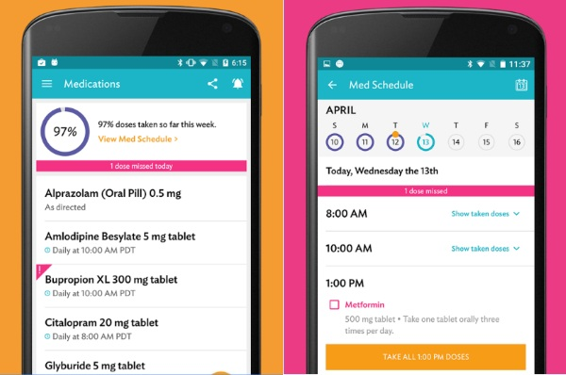
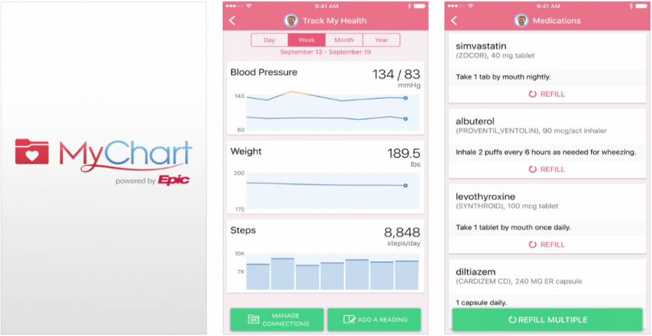
Discussion
Care zone patient portal
DayToDay
MyChart by Epic Systems

Slide 16
Way Forward
It is imperative to investigate the possibilities of digital tool-powered transition care programmes in the Indian healthcare system, considering their global success.
Numerous international studies have demonstrated the efficacy of various methods, including telehealth, electronic health records (EHRs), remote monitoring devices, mobile health applications, and artificial intelligence (AI) analytics, in mitigating hospital readmissions and enhancing patient outcomes.
Pilot Programs: To evaluate the viability and effects of digital tool-powered transition care, we need to conduct pilot programs in a range of Indian healthcare settings. These initiatives should involve varied demographics to ensure inclusivity and generalizability of the findings.
Policy Framework: A framework must be created that supports and promotes the use of digital health technology. This framework should take legal, moral, and privacy issues into account to guarantee the safe and efficient use of digital instruments.
Education and Training: Programs for education should be created to improve digital literacy and provide patients and providers the tools they need to fully utilize these tools.

Slide 17
Conclusion
The study indicate that digital tools, particularly those integrating AI and telehealth, significantly reduce readmission rates and improve patient outcomes.
For instance, AI-driven analytics can predict patient risks and personalize care plans, while telehealth services facilitate continuous patient engagement and monitoring.
However, the effectiveness of these tools is contingent on factors such as healthcare provider communication, care coordination, and patient adherence to follow-up care.
The constant challenge will be to fully improve these technologies possible while making sure all patients can use them and benefit from them.

Slide 18
References (Only Vancouver Style)
Singh H, Armas A, Law S, Tang T, Steele Gray C, Cunningham HV, et al. How digital health solutions align with the roles and functions that support hospital to home transitions for older adults: a rapid review study protocol. BMJ Open. 2021 Feb;11(2):e045596.
Dieleman JL, Campbell M, Chapin A, Eldrenkamp E, Fan VY, Haakenstad A, et al. Future and potential spending on health 2015–40: development assistance for health, and government, prepaid private, and out-of-pocket health spending in 184 countries. The Lancet. 2017 May;389(10083):2005–30.
Skou ST, Mair FS, Fortin M, Guthrie B, Nunes BP, Miranda JJ, et al. Multimorbidity. Nature Reviews Disease Primers [Internet]. 2022;8(1):1–22. Available from: https://www.nature.com/articles/s41572-022-00376-4
Brown Z, Bergman D, Holt L, Miller K, Frownfelter J, Bleau H, et al. Augmenting a Transitional Care Model With Artificial Intelligence Decreased Readmissions. Journal of the American Medical Directors Association [Internet]. 2023 Jul 1 [cited 2024 Jun 11];24(7):958–63. Available from: https://pubmed.ncbi.nlm.nih.gov/37054749/
Mansukhani RP, Bridgeman MB, Candelario D, Eckert LJ. Exploring Transitional Care: Evidence-Based Strategies for Improving Provider Communication and Reducing Readmissions. P & T : a peer-reviewed journal for formulary management [Internet]. 2015 Oct;40(10):690–4. Available from: https://www.ncbi.nlm.nih.gov/pmc/articles/PMC4606859/
Romero-Brufau S, Wyatt KD, Boyum P, Mickelson M, Moore M, Cognetta-Rieke C. Implementation of Artificial Intelligence-Based Clinical Decision Support to Reduce Hospital Readmissions at a Regional Hospital. Applied Clinical Informatics. 2020 Aug;11(04):570–7.
Ganefianty A, Songwathana P, Damkliang J, Imron A, Latour JM. An m-health transitional care intervention delivered by nurses improves post-discharged outcomes of caregivers of patients with traumatic brain injury: A randomized controlled trial. World Neurosurgery [Internet]. 2024 Jan 18 [cited 2024 Feb 20];S1878-8750(24)000913. Available from: https://pubmed.ncbi.nlm.nih.gov/38244683/
Bouchand F, Leplay C, Guimaraes R, Fontenay S, Fellous L, Dinh A, et al. Impact of a medication reconciliation care bundle at hospital discharge on continuity of care: A randomised controlled trial. International Journal of Clinical Practice. 2021 May 13;75(8).

Slide 19
Thank You
Any Questions

Slide 20
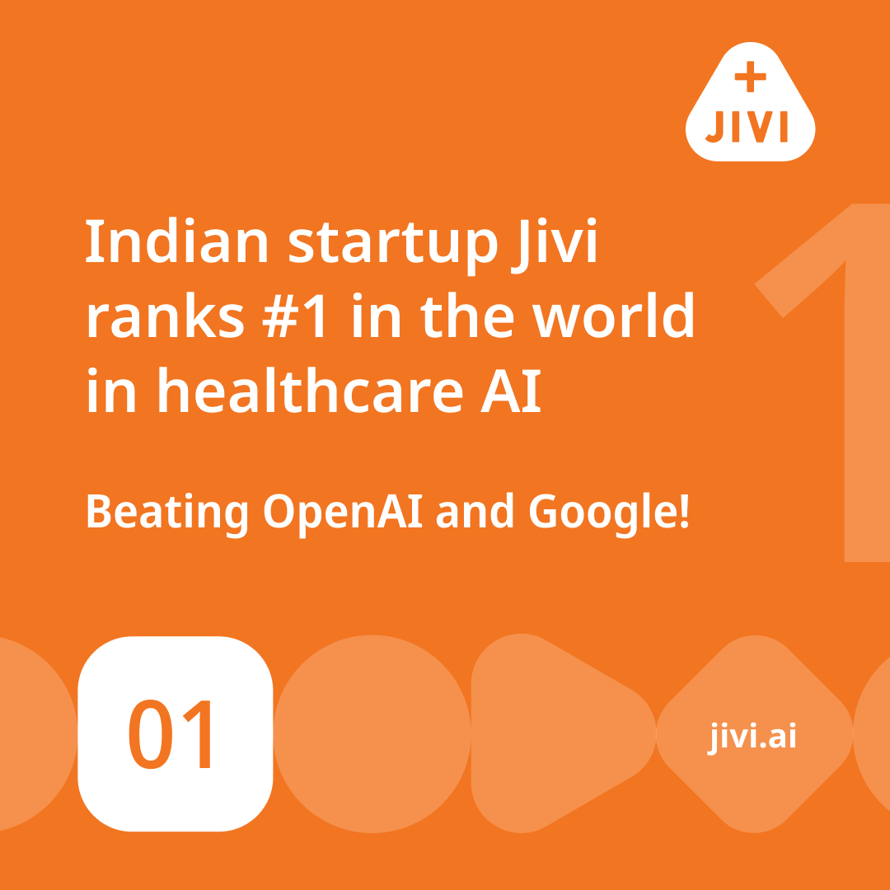
Pictorial Journey

Slide 21
Pictorial Journey

