Slide 1
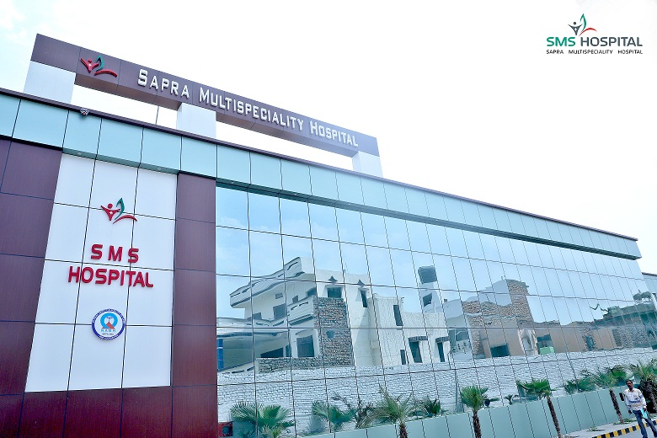
STUDY ON DISCHARGE PROCESS IN SAPRA
MULTISPECIALITY HOSPITAL, HISAR HARYANA
S
M
S
Presented By : Ms. Arju (PG/22/013)
Mentor : Dr. Anandhi Ramachandran
the topic of my disser is
HOSPITAL

Slide 2
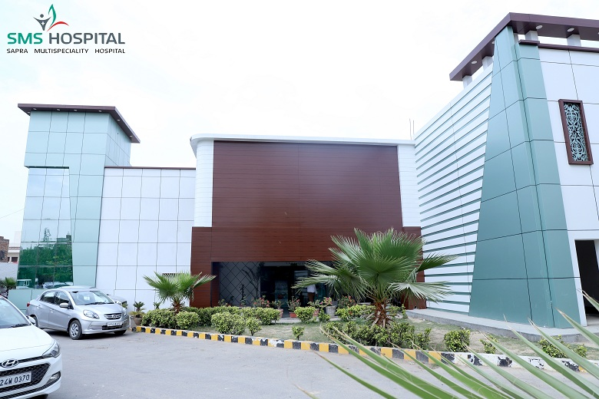
Content
1
INTRODUCTION
2
OBJECTIVES
3
RESEARCH METHODOLOGY
4
RESULTS
5
DISCUSSION
6
LIMITATIONS
7
CONCLUSION
8
REFERENCES

Slide 3
Mentor Approval

Slide 4
Introduction
Every multi-specialty hospital can provide two types of services, being outpatient or inpatient services out of which the outpatient is a person who receives ambulatory care in the hospital, which does not require an overnight hospital stay. An inpatient is a person who has been admitted to a hospital for purposes of receiving inpatient hospital services. The inpatient in a hospital must go through three different stages; admission followed by intervention and the final stage is discharge. During a discharge of patient after a necessary intervention, several procedures must take place by engaging various staff members and departments making the process complex. According to NABH, “Discharge is the process of activities that involves the patient and the team of individuals from various disciplines working together to facilitate the transfer of patient from one environment to another”. The discharge process starts when the consultant will declare discharge to the nurse. After that the nurse will tell the ward in charge and the ward in charge starts the billing process. Any delay in the discharge process affects the patient satisfaction and on the financial aspects of the hospital. The delay may be due to many reasons like late round of consultants, delay in correction of discharge summary, delay in insurance clearance, delay after billing settlement etc.

Slide 5
Background
Sapra Multi specialty Hospital, a 100 bedded hospital catering to super/multi-specialty health services and best of infrastructure was established in 1971. Despite all the facilities departments available in the hospital the discharge process is time-consuming. This has affected overall patient satisfaction despite the best the satisfaction related to medical services provided. Based on the feedback collected from the patients, the management of the hospital has decided to streamline the current procedures of hospital and modify them in such a way that maximum output of patient satisfaction is obtained from minimum input of manpower and resources. The current study has been proposed to assess the discharge process of the Sapra Multispecialty Hospital.

Slide 6
RESEARCH QUESTION
Question: What are the bottlenecks or gaps in existing process flow of Inpatient Department of 100 bedded hospital that are hindering the quality of services and overall patients’ satisfaction and roadmap for improving the quality of services?

Slide 7
Objectives
To study the current discharge process in the IPD of the Sapra Multispecialty hospital and identify the activities associated with discharge process
To map the above activities and determine the delays and their root causes.

Slide 8
Research Methodology
Study Design- Cross-sectional Study
Study Area- IPD area
Target Population – IPD Patients
Sample Size- 100 participants.
Justification: The average number of inpatients (IPD) over a period of past 3 months (Jan – March 2023) based on hospital data calculated to be 140.
Assuming 50% delay in the IPD discharge process and confidence level of 95% & margin of error of 5%, the final sample was calculated to be 103 (z is equal to 1.96).
During the data collection period ( 2 months) the no patients was observed to be 100
Inclusion Criteria- Patients getting discharged, caretakers.
All types of patients - Policy Patients, TPA patients, Insurance Patient, Cash Patients.

Slide 9
Research Methodology
Exclusion Criteria: ICU cases, daycare patients
Sample Selection: Purposive Sampling
Data Collection Tool
Semi structured feedback form used in the hospital (Patient Feedback Form)
Checklist for Process Mapping – To identify activities
Data Analysis
Ishikawa Diagram to perform Root Cause Analysis
Average Discharge process time to be calculated based on the existing SOP guideline for discharge process and the actual time calculated by measuring individual activities
o Average Discharge Time (ADT) = (Activity 1+ Activity 2+ Activity 3 + ……................)/Number of patients
o ADT will be calculated separately for different type of patients (CASH, TPA etc)

Slide 10
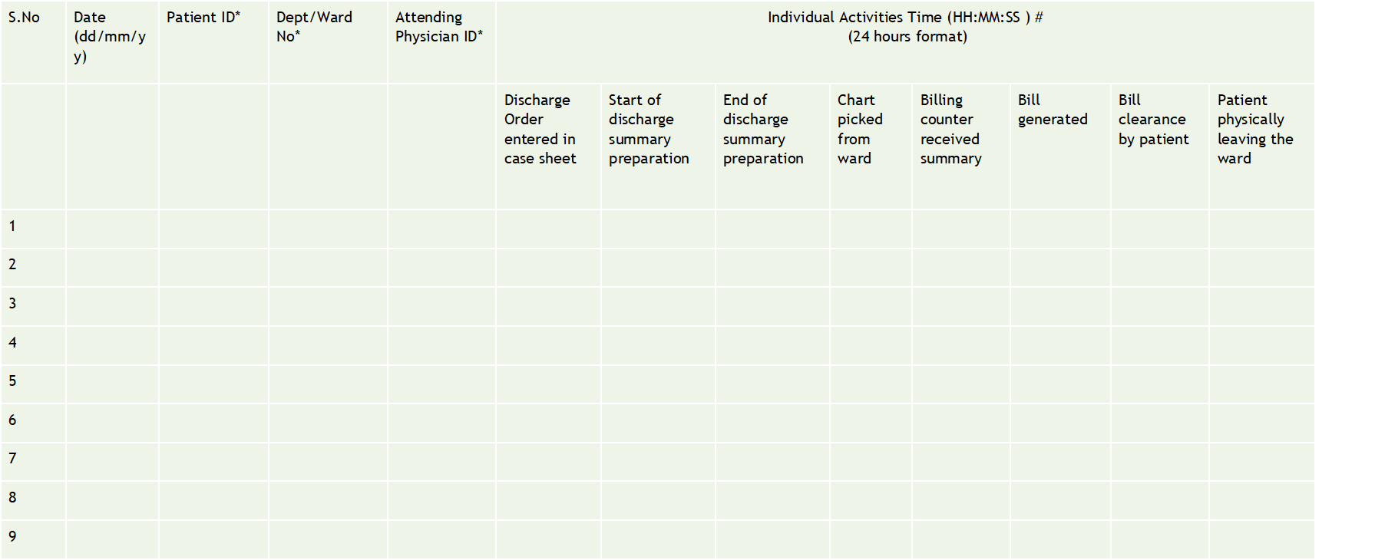
WORKFLOW PROCESS MAPPING

Slide 11
TIME PERIOD RESULTS
Result 1: From 11 April to 20 April, I observed significant waiting times in the discharge process at Sapra Multispecialty Hospital, averaging 7 hours and 20 minutes.
Result 2: From 21 April to 4 May, a Google Forms survey identified the Discharge Summary and No Dues Form as major time-consuming elements.
Intervention: With personal patient assistance reducing the average time to 6 hours and 10 minutes.
Result 3: From 4 May to 28 May, the average waiting time to 5 hours and 40 minutes.
Intervention: Directed Medical Officers to prioritize the Discharge Summary.
Result 4: Further Improvement has achieved between 28 May and 15 June, reduced the average waiting time to 4 hours 30 minutes.
Intervention: Dedicated personnel were hired to handle the No Dues Form.
Hours
TIME PERIOD

Slide 12
LIST OF ACTIVITIES
Sr. No. | ACTIVITY
1 | Discharge Order entered in case sheet
2 | Start of discharge summary preparation
3 | End of discharge summary preparation
4 | Chart picked from ward
5 | Billing counter received summary
6 | Bill generated
7 | Bill clearance by patient
8 | Patient physically leaving the ward

Slide 13
ACTIVITY BASED RESULTS
Minutes
Types of Patient
Average Discharge Time in TPA, A/B, Cash and H/G is 120 min, 150 min, 180 min and 240 min respectively. Total time without No Dues is 240 min while Total time with No Dues is 300 min.

Slide 14
Fishbone Analysis
CORPORATE DESK
ADMISSION DESK
FROM PATIENT’S SIDE
WARD
Relatives of pt. not available
Pt. Convert cash to credit
Package (cost to treatment)
Nurse Mistake
Delay in discharge process
Round not on time files
Prescription not given
No planned discharge documentation
Summary not finalized
Summary not sent on time
Incomplete
Lack of manpower
Mismanagement of file improper
CONSULTANT
SUMMARY
BILLING

Slide 15
Discussion
The commitment of top management is critical to system improvement efforts because hospitals are under many competing pressures. During the define phase the problem was defined based on the inputs captured through patient feedback forms. The study observed the discharge process in the IPD of Sapra Multispecialty Hospital. A total of 100 participants were included, based on the average number of inpatients over the past three months. The whole process consists of 8 activities which were shown above based on TPA, A/B, Cash and H/G type of patients.
The root cause analysis yielded critical issues contributing to the delay in discharge process and these includes paperwork, medication processing, and patient transportation. Semi-structured feedback forms were used to gather patient concerns and satisfaction levels. All the critical issues identified in the analyze phase was carefully evaluated and appropriate solutions were implemented. Suggested improvements include streamlining paperwork through, pre-discharge medication planning, and enhancing communication between departments. After implementation of the improvement strategies the data on discharging time was again collected. It was found that the average Discharge Time in TPA, A/B, Cash and H/G is 120 min, 150 min, 180 min and 240 min respectively. Total time without No Dues is 240 min while Total time with No Dues is 300 min.

Slide 16
Limitations
This study is focused on in Inpatient Department only.
Study period is three months only.

Slide 17
Conclusion
The results demonstrated a positive impact in reducing the patient discharge time due to the application of suggested recommendations on the Discharge Summary & No Dues Form. The patient discharge process was complex and not fully standardized and involved multi-departmental processing and sequential operations. Hence the improvement suggestions were given according to the various processes and departments. This project has provided analytic and valuable information to the top management and to take managerial decisions which can reduce the waiting time for the discharge process. Understanding process dynamics and improving collaboration between various departments ensured a significant and suitable impact on operations. Thus, this project will help us to increase the quality of services & patient's overall satisfaction.

Slide 18
References
https://www.saprahospital.com/
Pandit, A., & Prashar, S. (2019). A study of the Discharge Process of a Multi-Specialty Hospital. SCOPUS IJPHRD CITATION SCORE, 10(5), 6.
Chaudhari, P. S., Shinde, V., & Gudhe, V. A Study on Reducing the Discharge Turnaround Time of IPD Patients at AVBRH., J.Pharma Research International, 2021 - Volume 33 [Issue 60B], Study Protocol
Kumar, J. (2022). A study of the causes of delay in patient discharge process in a large multi-specialty hospital with recommendations to improve the turnaround time. QAI Journal for Healthcare Quality and Patient Safety, 3(1), 13-20.
Mundodan, J. M., Sarala, K. S., & Narendranath, V. (2019). A Study to Assess the Factors Contributing to Delay in Discharge Process in a Teaching Hospital. International Journal of Research Foundation of Hospital and Healthcare Administration, 7(2), 63-66.
Pirani, S. S. A. (2010). Prevention of delay in the patient discharge process: an emphasis on nurses' role. Journal for Nurses in Professional Development, 26(4), E1-E5.
Remy
Marsh
Everest Cantu
Drew Holloway
Morgan Maxwell
Manager
Marketing
Business Head
Manager

Slide 19
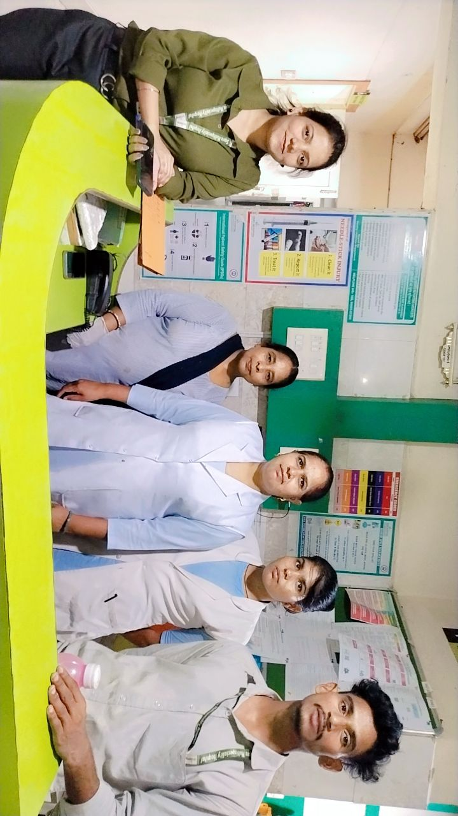
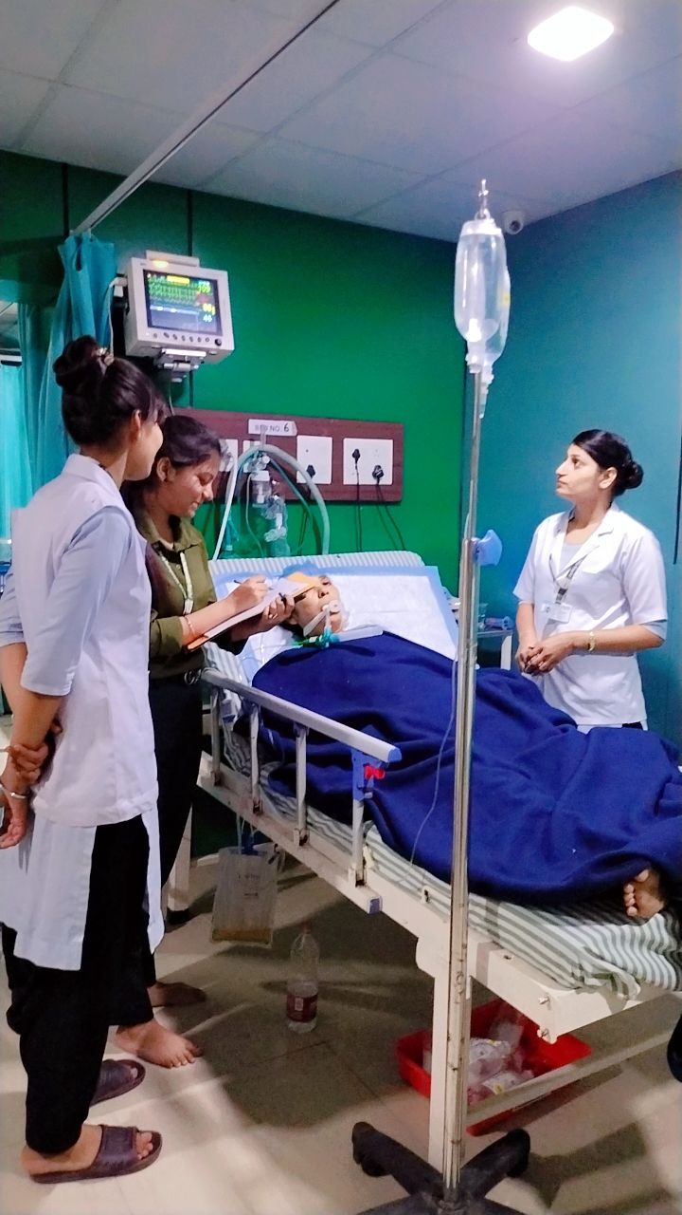
PICTORIAL JOURNEY

Slide 20
PICTORIAL JOURNEY

Slide 21
THANK YOU

