Slide 1
Role Of Digital Technology In The Health Insurance Sector A Rapid Review
Presented By: Dr. Chetna Yadav (PG/22/023)
Faculty Mentor: Dr. Sumant Swain
IIHMR Delhi

Slide 2
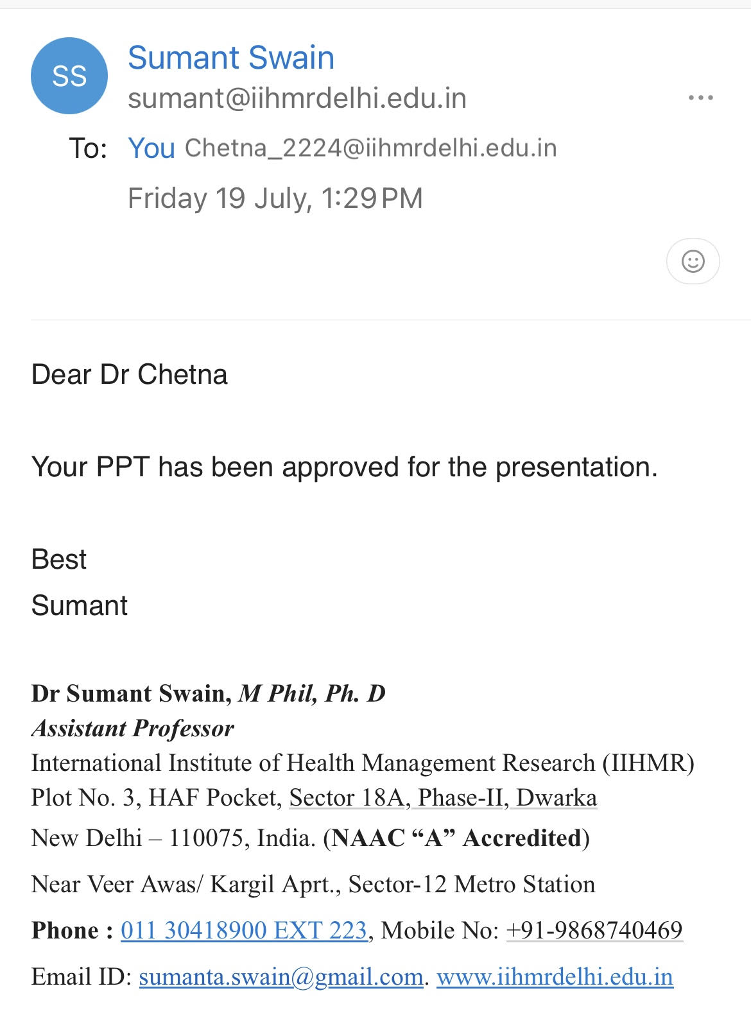
Mentor Approval

Slide 3
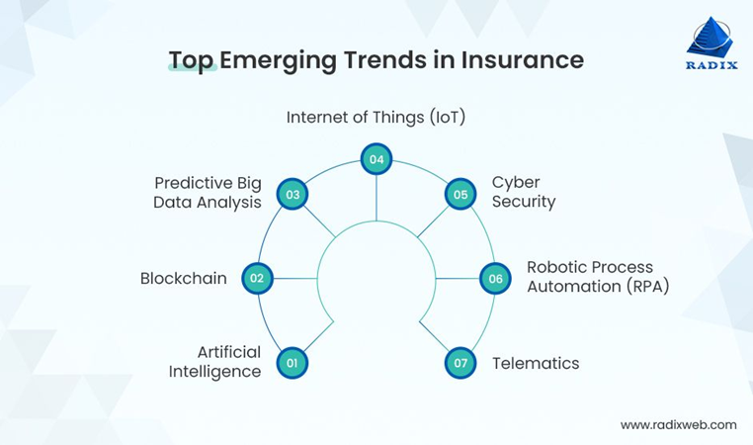
Introduction
Health Insurance is a leading contributor to the growth for the General Insurance Industry in India. Health Insurance accounts for around 29% of the total income earned in the Indian General Insurance Industry (By Researcher: Dutta et al).
Digital Technology has become a transformative force in the Health Insurance Sector, revolutionizing traditional practices.
The adoption of Digital Tools and Platforms has streamlined administrative processes, improved access to care, and empowered consumers to take more active role in managing their health insurance needs.

Slide 4
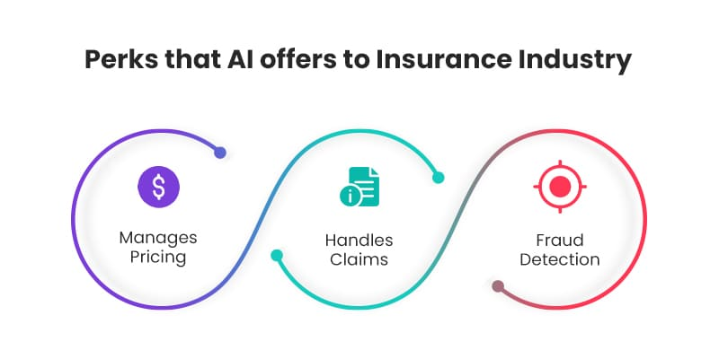
Introduction
Telemedicine and Virtual healthcare services have emerged as key components of digital health technology, enabling insurers to offer remote consultations, diagnosis, and treatment options to policyholders.
Data Analytics and Artificial Intelligence are driving innovation in health insurance, enabling insurers to leverage insights for personalized care, predictive modeling, and fraud detection.

Slide 5
Literature Review
Some studies related to Role of technology in transforming the health insurance sector are:-
Dariusz Pauch (2022) has done a study on the need for insurance firms to undergo a digital transformation due to the Covid-19 pandemic, and it is now more than just a strategic choice to enhance their offerings, boost client satisfaction, and streamline operations.
Soumya Gupta (2022) has done a study to analyze factors impacting the adoption of AI in the insurance sector using the TOE framework. This study looks at the behavioral intention of insurance sector personnel to adopt artificial intelligence (AI)-enabled applications using the technology–organization–environment framework.
A study done by Anokye Acheampong Amponsah (2022) suggested a cutting-edge approach that combines machine learning and Block chain technology to identify and stop fraud in the healthcare industry. Healthcare fraud is a worldwide issue that affects both developed and poor nations. To identify and stop healthcare fraud, the extracted knowledge is encoded into an Ethereum block chain smart contract.

Slide 6
Literature Review
Artificial intelligence is transforming the health insurance market by improving decision-making and operational effectiveness. Predictive analytics, fraud detection, and customized policy suggestions are all made possible by AI algorithms. Bresnick (2018) asserts that the use of AI in health insurance has significantly reduced costs and increased claim processing accuracy.
Block chain technology solves data integrity and fraud concerns by providing a transparent and safe method of managing health insurance data. Block chain can expedite administrative procedures and enhance transaction traceability, according to Lavanya and Viknesh (2020). Block chain lowers the possibility of fraudulent claims and builds confidence between policyholders and insurers by producing unchangeable data.
Big data analytics is enabling more individualized services and more educated decision-making, which is fundamentally changing the health insurance industry. According to Yogesh and Kumar (2020), big data tools are capable of analyzing patient data in order to spot health patterns, evaluate risk profiles, and customize insurance policies to meet specific needs. In addition to raising consumer satisfaction, this data-driven strategy aids insurers in risk management.

Slide 7
Objective Of The Study
Study Objective
General Objective: To review and analyze the role of technology in transforming Health Insurance Sector.
Specific Objectives:
To analyze Digital Trends/Recent Advancement in Health Insurance Sector.
To analyze the impact of Digital Platforms and Real-Time monitoring.
To identify challenges, and opportunities for improving use of technology in the Health Insurance Sector.

Slide 8
Methodology
Study Design: PRISMA guidelines which involved a rigorous search, selection, and synthesis of relevant literature.
Study Area: Research conducted in India and outside India.
Study Participants: The study participants were researchers, policymakers, healthcare insurance providers, and users.
Sample size: The sample size was determined by the number of relevant studies meeting the inclusion criteria for the rapid review (n=30).
Data Analysis: Data analysis involved thematic synthesis of qualitative data and quantitative analysis of the use of technology, opportunities and challenges in the insurance sector.
Ethics and Consent: Since this was a rapid review of existing literature, ethical approval and informed consent are not applicable.

Slide 9
Methodology
Search Strategy: Phrases like ‘Digital Technology’, ‘Health Insurance Industry’, ‘Digital Transformation’, ‘Fraud Detection Technology’, ‘Real-Time Monitoring’, ‘Latest Trends & Innovations’, and ‘Digital Health Tools’
Electronic Database Searched: PubMed, PsycINFO, Embase, Google Scholar, Science Direct and also grey literature
Selection Process:
Initial Screening: All identified papers titles and abstracts were reviewed for relevance to the study topic.
Full Text Review: Research articles that cleared the initial screening phase, underwent a comprehensive text analysis. Included in this analysis were studies that satisfied the inclusion criteria.
Data Extraction: From the included studies, pertinent data was taken out and put into a structured format.
Synthesis and Analysis: Thematic synthesis of qualitative and quantitative data was done to analyse technological advancement in the insurance industry.

Slide 10
PRISMA Flow Diagram
Identification of studies via Databases & Registries
Records Excluded-(n=280)
Not Relevant-(n=100)
Failing to meet the criteria for inclusion(n=180)
Records Identified by Database searching
(n=350)
Records after Duplicates removed
(n=380)
Records Screened
(n=380)
Articles assessed for Eligibility
(n=100)
Studies Included in Qualitative Synthesis
(n=30)
Additional Records through other sources 50 (n=400)
Full Text Articles excluded with reason (n= 70)
Not Published b/w 2014- 2024( n=15)
Not meeting objective (n=20)
Not using real time monitoring (n=15)
Using traditional technology (n=20)
(20 duplicates removed while screening)
Identification
Screening
Eligibility
Included

Slide 11
RESULTS

Slide 12
Results
Advancement In INSURANCE INDUSTRY
Consumers: Technological developments have increased consumer access to healthcare services. Nowadays, patients may maintain their medical data online, obtain virtual care from the convenience of their homes, and get real-time health information from wearable technology.
Healthcare Providers: The use of electronic health records by healthcare professionals has made it easier to monitor patient health outcomes and enhance inter provider care coordination. Furthermore, telemedicine may make care more accessible to individuals who otherwise might not have been able to get it.
Insurers: With more data available, insurers can now anticipate patient outcomes more precisely and adjust premiums appropriately. Furthermore, fraud may now be detected and stopped by insurers with greater ease, saving money.

Slide 13
Digital Trends in Insurance Industry
Buying
Hassle-Free
Insurance Online
With the widespread availability of internet and proliferation of smartphones, we are turning to online channels to purchase insurance. Insurers are providing user-friendly websites and mobile apps that enable customers to research, compare, and buy insurance policies conveniently from the comfort of their homes.
Al and Automation for Faster Claims
Al and automation technologies are used by insurance companies to expedite the claims process. Al algorithms can quickly assess claims, detect fraudulent activities, and automate routine tasks, leading to faster claim settlements and improved customer satisfaction.
New Customised Products for Personalisation
Insurers are introducing personalized insurance products tailored to individual needs and preferences. Using data analytics and customer insights, insurers can provide customised coverage options, flexible policy terms and personalised pricing.
Social Media
Social media platforms are becoming integral to the marketing and customer engagement strategies of insurance companies. Insurers utilize social media channels such as Facebook, Twitter, Linkedin, and Instagram to connect with customers, share educational content, promote products, and address customer queries.

Slide 14
Digital Trends in Insurance Industry
Internet of Things (loT)
IoT is reforming the insurance industry by enabling insurers to gather rear time data from connected devices such as smart home devices, wearable gadgets, and telematics sensors. loT data provides valuable insights into customer behaviour, risk factors and loss prevention opportunities.
Incentivizing Wellness Program Participants
Health insurers are offering incentives to policyholders who participate in wellness programs including nutrition counselling, gym memberships and smoking cessation programs, among. By offering these programs, insurers are helping policyholders to reduce their chances of contracting chronic diseases, which ultimately leads to fewer claims and reduced healthcare costs.
Using Application Programming Interface (API)
With this technology, insurers are employing efficient methods to integrate, access, and disseminate data. APIs make digital claims management process more efficient. Example: NHCX Model.

Slide 15
Impact of Digital Advancement in Health Insurance Sector
Cost saving in claims processing and management | Implementation in fraud detection and prevention | Reduction in healthcare policy administrative workload | Streamline complex data analytics to improve customer retention | Increase self-service options in healthcare
70% | 60% | 55% | 47% | 30%

Slide 16
Challenges Associated with Digital Insurance
Data Privacy Concerns
A significant challenge in digital insurance is the protection of customer data and privacy. With the increasing digitisation of insurance processes and the collection of vast amounts of personal data, there are concerns about data breaches, unauthorised access, and misuse of customer information. Insurers must comply with data protection laws, such as the Personal Data Protection Bill, which aims to regulate the processing of personal data and establish measures to safeguard data privacy.
Cybersecurity Risks
The digitalisation of insurance processes exposes insurers to cybersecurity risks, including phishing scams malware attacks and ransomware threats. Insurers need to establish robust cybersecurity measures to protect sensitive information, secure online transactions and protect against cyber threats. The IRDAl has issued guidelines on information and cyber security for insurers, requiring the implementation of cybersecurity frameworks, incident response plans, and routine security audits to mitigate risks effectively.
Regulatory Compliance
Ensuring regulatory compliance poses a challenge for insurers operating in the digital space. Insurers must adhere to various regulatory requirements set forth by the IRDAI, including licensing requirements, product approval processes, disclosure norms and reporting obligations. Strict adherence to anti-money laundering (AML) and know-your-customer (KYC) regulations is essential for digital customer onboarding processes to prevent financial crimes.
Technology Infrastructure
Building and maintaining robust technology infrastructure capable of supporting digital insurance operations is another challenge. Insurers need to invest in scalable, secure, and interoperable IT systems, digital platforms and data analytics to deliver seamless customer experiences, automate processes and ensure regulatory compliance.

Slide 17
Potential Solutions
Enhanced Customer Engagement
• Insurers can improve customer engagement by offering personalised communication, interactive digital tools, and self service options. Using chatbots, virtual assistants and mobile apps.
Agility and Flexibility
• Insurers should adopt agile methodologies and flexible models to promptly adapt to changing market dynamics and evolving customer preferences.
Ecosystem Partnerships
• Insurers can leverage partnerships with Insurtech start-ups, technology firms and ecosystem players to drive innovation and expand their digital capabilities.
Investment in Technology and Talent
• Insurers should invest in cutting edge technologies, such as Al, machine learning, blockchain and loT, to enhance digital capabilities and stay competitive in the digital age. Likewise, allocating resources towards talent acquisition and training programs.

Slide 18
NHCX platform is a single-window digital platform which enables standardized and faster claims processing for better patient experience with reduced operations costs
Developed By: NHA and Union Ministry of Health & Family Welfare
Initiative Under: Ayushman Bharat Digital Mission
NHCX PLATFORM
Joint Network Group: IRDAI and NHA
Exclusive Focus On Cashless Claims
Communication Between: Payers and Providers
Benefits For Insurance: Lower Operational Costs and Fraud Detection
Benefits For Hospital: Easier Administrative Tasks and Less Errors
Impacts On Insured: Faster Pre-authorization, Direct Link to ABHA Number and Insurance Information, Cheaper Premiums

Slide 19
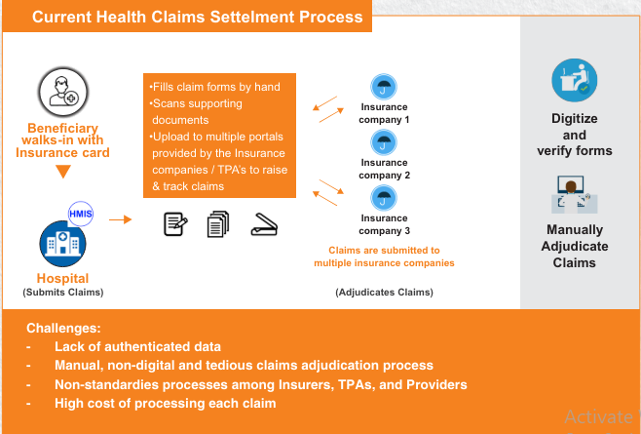
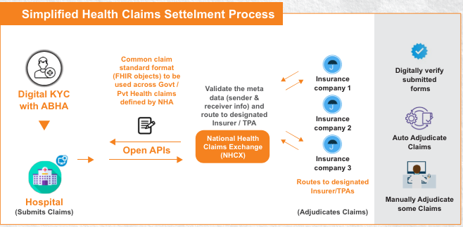
NHCX MODEL
Parthanil Ghosh, Director and CBO at HDFC Ergo said on Tuesday, July 9, 2024, that they have successfully processed its first claim through the NHCX platform which will enhance customer experience by building a cohesive technology-driven system. Source: Economic Times

Slide 20
Discussion
The integration of digital tools such as AI-driven analytics have services significantly reduced claims processing costs, fraud cases, administrative workload and increased self-service options in healthcare leading to improved customer satisfaction.
Emerging technologies such as AI-driven systems, blockchain for securing data management, telemedicine for remote healthcare delivery.
While these technological advancements present immense opportunities for innovation and improvement in the health insurance industry, addressing associated challenges will be crucial.
These include concerns about data security and privacy, interoperability issues among different technological platforms, regulatory compliance, and the need for ongoing investment in IT infrastructure and skilled workforce.

Slide 21
Conclusion
The study indicate that Health Insurance Providers have embraced new technology with great speed, increasing efficiency and convenience. Digital tools, particularly those integrating Block chain, AI and automation significantly prevent frauds, expedite claims processing, cost reduction, improve employees efficiency and enhanced customer experience.
For instance, AI-driven analytics can predict patient risks and personalize care plans, while telehealth services facilitate continuous patient engagement and monitoring.
However, the effectiveness of these tools is contingent on factors such as healthcare provider communication, care coordination, and patient adherence to follow-up care.
The constant challenge will be data privacy and cyber security to protect customer data and to improve these technologies while making sure all patients can use them and benefit from them.

Slide 22
References
Kose I, Gokturk M, Kilic K. An interactive machine-learning-based electronic fraud and abuse detection system in healthcare insurance. Applied Soft Computing. 2015 Nov;36:283–99.
El-Samad W, Atieh M, Adda M. Transforming Health Insurance Claims Adjudication with Blockchain-based Solutions. Procedia Computer Science [Internet]. 2023 Jan 1 [cited 2024 May 24];224:147–54. Available from: https://www.sciencedirect.com/science/article/pii/S1877050923010694
Pauch D, Bera A. Digitization in the insurance sector – challenges in the face of the Covid-19 pandemic. Procedia Computer Science. 2022;207:1677–84.
Cosma S, Rimo G. Redefining insurance through technology: Achievements and perspectives in Insurtech. Research in International Business and Finance [Internet]. 2024 Jun 1;70:102301. Available from: https://www.sciencedirect.com/science/article/pii/S0275531924000941
Gupta S, Ghardallou W, Pandey DK, Sahu GP. Artificial intelligence adoption in the insurance industry: Evidence using the technology–organization–environment framework. Research in International Business and Finance. 2022 Dec;63:101757.

Slide 23
References
Rawat S, Rawat A, Kumar D, Sabitha AS. Application of machine learning and data visualization techniques for decision support in the insurance sector. International Journal of Information Management Data Insights. 2021 Nov;1(2):100012.
Nayak B, Bhattacharyya SS, Krishnamoorthy B. Explicating the role of emerging technologies and firm capabilities towards attainment of competitive advantage in health insurance service firms. Technological Forecasting and Social Change. 2021 Sep;170:120892.
Amponsah AA, Adekoya AF, Weyori BA. A novel fraud detection and prevention method for healthcare claim processing using machine learning and blockchain technology. Decision Analytics Journal. 2022 Sep;1(2):100122.
Hong B, Lu P, Xu H, Lu J, Lin K, Yang F. Health insurance fraud detection based on multi-channel heterogeneous graph structure learning. Heliyon [Internet]. 2024 May 15;10(9):e30045. Available from: https://www.sciencedirect.com/science/article/pii/S2405844024060766
Bian W, Ge T, Ji Y, Wang X. How is Fintech reshaping the traditional financial markets? New evidence from InsurTech and insurance sectors in China. 2023 Aug 1;80:102004–4.

