Slide 1
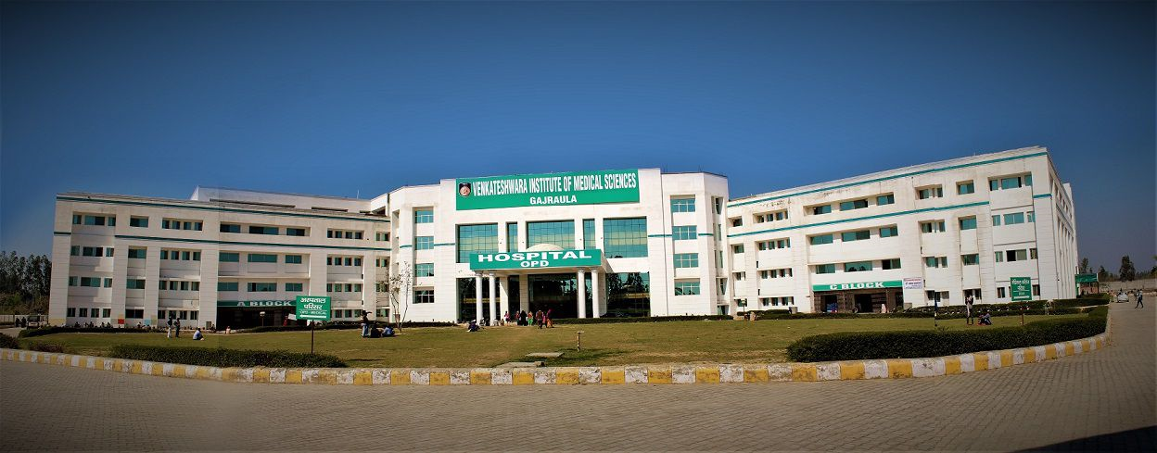
An observational study to analyze the NABH compliance of TAT (turnaround time) for patients in wards and ICUs for initial assessments in Venkateshwar Hospital
Name- Harshit Sharma
Faculty Mentor- Dr. Vinay tripathi
IIHMR Delhi

Slide 2
Mentor Approval

Slide 3
Introduction
.
Cornerstone for treatment decisions and interventions.
Identifies the cause and nature of the patient's issues comprehensively.
Establishes database for informed patient care decisions
Crucial in conditions like incontinence for stability and timely intervention.
Significantly improves patient outcomes and reduces morbidity/mortality rates.
Recognition of Physiological Abnormalities:
Identifies changes in vital signs and other indicators.
Helps uncover underlying health issues promptly.

Slide 4
Timely Interventions:
Detailed evaluation enables immediate actions to prevent negative outcomes.
Facilitates timely interventions to optimize patient care.
Turnaround Time (TAT) Standards:
Ensures timely and efficient assessment in ICUs (within 30 minutes) and wards (within 60 minutes).
Initial evaluation reports include medical history, physical exam findings, vital signs, and allergies.

Slide 5
Objectives of the Study
Primary Objective: To assess the TAT for the initial assessment of patients in ICUs and wards according to guidelines in Venkateshwar Hospital.
Secondary Objective:
1. To perform a process gap analysis using the data acquired.
2. To identify the factors responsible for the existing scenario in the hospital.

Slide 6
Methodology
Study design: Observational, descriptive study.
Data Source: Secondary data was provided by the Venkateshwar Hospital through observation, and patient files were used to conduct the research.
Study Variable: TAT (turnaround time) for initial assessment of patients in ICUs and wards, and patient flow in wards and ICUs.
Data analysis: First, the data collected through secondary sources were arranged in order to produce a structured self-list. The sample consists of 190 patients from wards and 50 from ICUs. Data analysis was conducted through advanced Microsoft Excel features.
Convenient Sampling was used due to operational restrictions within a hospital.

Slide 7
Results

Slide 8
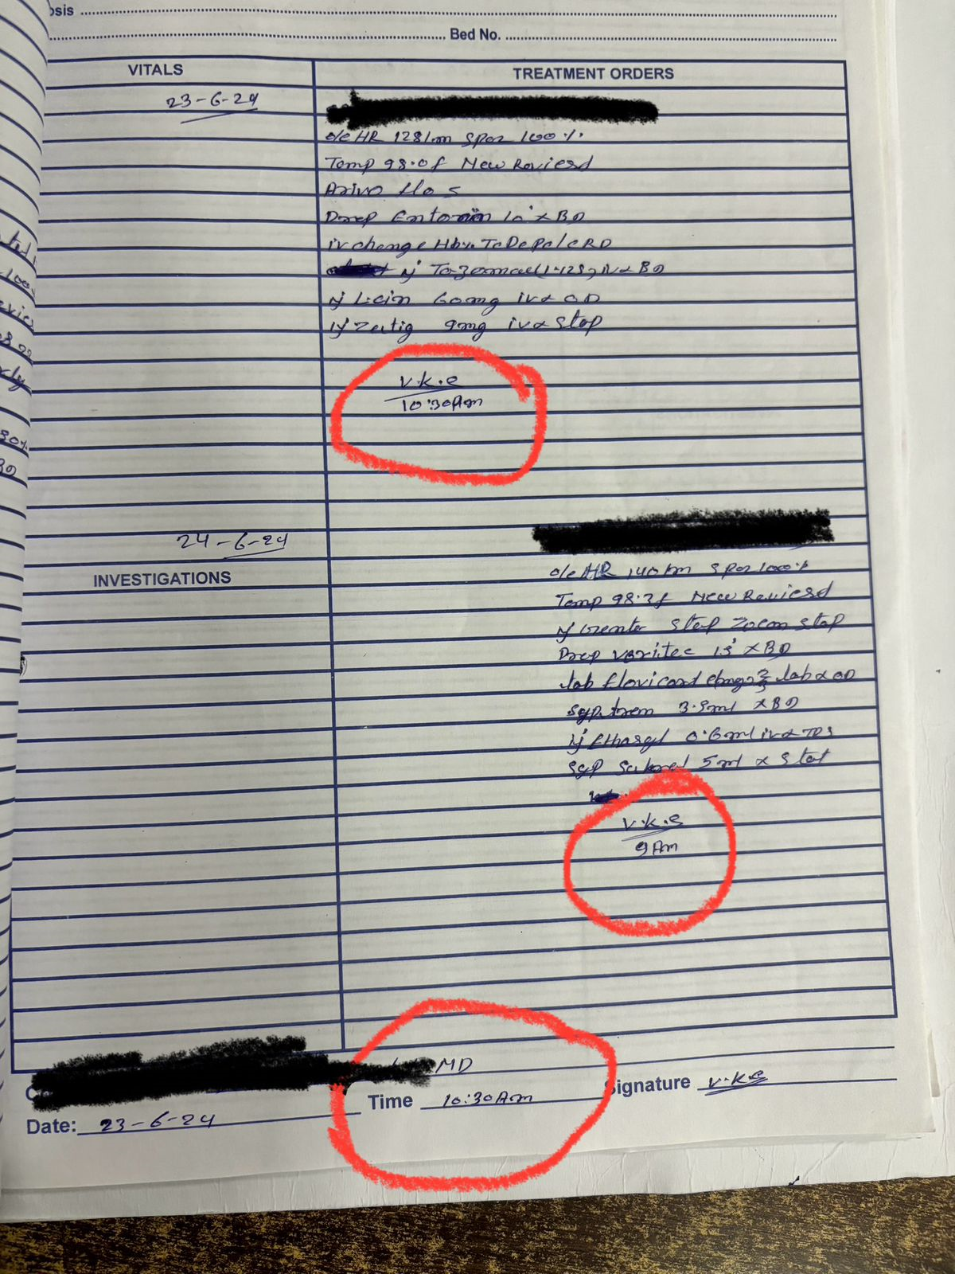
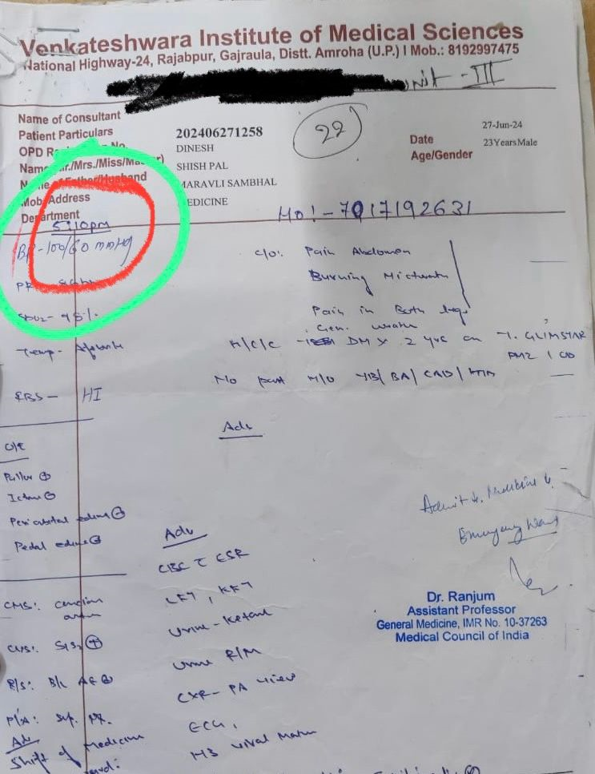
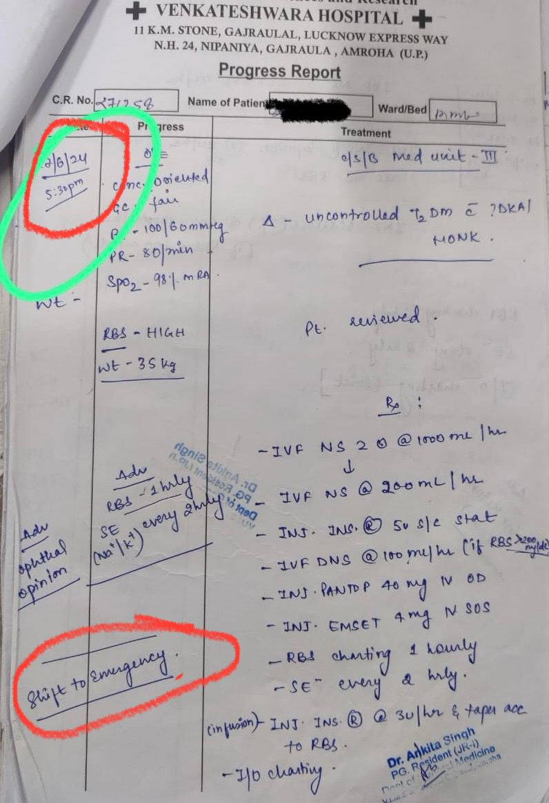
Results

Slide 9
Results
Causes that delayed the initial assessment Turnaround time of patients in wards and ICUs were –
Lengthy duration since doctors were frequently preoccupied with other patients.
Poor communication between the medical and nursing staff.
Single doctor appointed for two floors.

Slide 10
Discussion
TAT for ICU needs more attention as it acts as a critical center for patients requiring immediate attention.
Optimizing these factors would reduce the initial assessment turnaround time (TAT) to an optimal level.
Resolving these issues would bring the first assessment TAT down to its ideal level.
Wards and ICUs should have regular doctor rounds.
Each level should be staffed with dedicated doctors, as recommended by experts.
Improved communication between nursing and medical staff will help achieve the desired outcomes.

Slide 11
Conclusion
In conclusion, addressing the turnaround time (TAT) for ICU assessments is crucial, given its role as a critical center for patients needing urgent care. Optimizing these factors can significantly reduce the initial assessment TAT to an optimal level, enhancing efficiency and patient outcomes. Implementing regular doctor rounds in both wards and ICUs, along with assigning dedicated doctors at each level as recommended, is essential. Furthermore, fostering improved communication between nursing and medical staff is paramount for achieving desired outcomes in patient care and treatment.

Slide 12
References
nabh.co. Available from: https://www.nabh.co/Announcement/AYUSH%20Hosp%20Entry%20Level.pdf
ncbi.nlm.nih.gov. Available from: https://www.ncbi.nlm.nih.gov/books/NBK493211/
dialremedy.com. Available from: https://www.dialremedy.com/blog/sample-policy-initial-re-assessment-policy
researchgate.net. Available from: https://www.researchgate.net/publication/7641746_Ways_to_reduce_patient_turnaround_time_and_improve_service_quality_in_emergency_departments
study.com. Available from: https://study.com/learn/lesson/initial-assessment

Slide 13
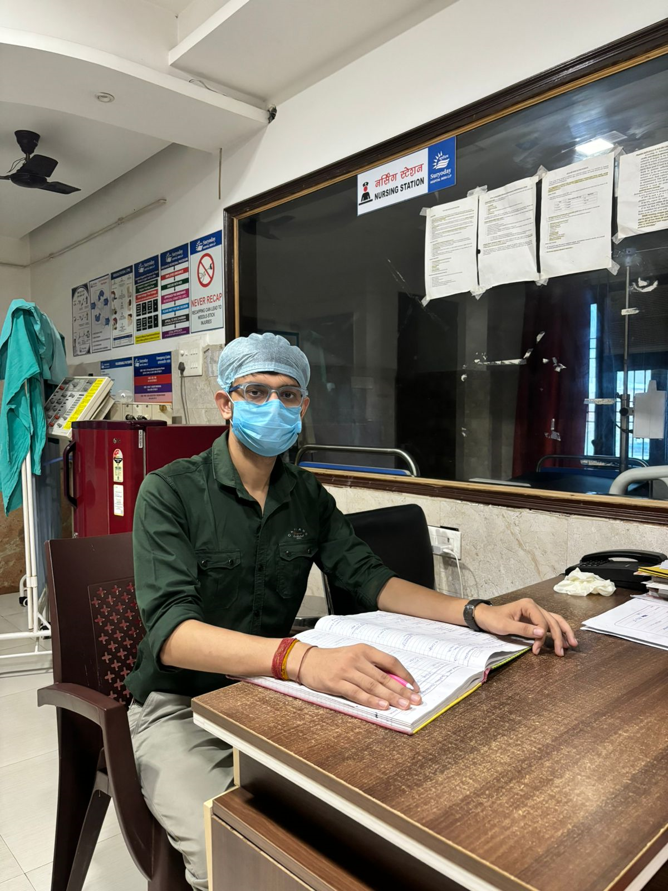
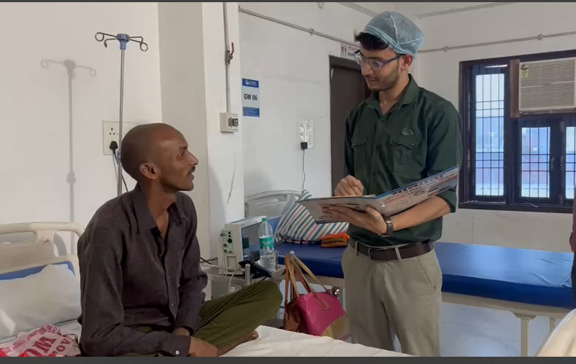
Pictorial Journey

Slide 14
Thank You

