Slide 1
Topic : Assessment of Drinking Water Quality in Public Drinking Points in Hauz Khas Subdivision, South Delhi District of National Capital Region
Presented by:
Dr Nancy Chakma
PG/22/056
Mentor:
Dr Punit Yadav
IIHMR, Delhi

Slide 2
Screenshot of approval

Slide 3
Introduction
Access to safe and reliable drinking water is a fundamental human right and a critical component of public health, and ensuring the quality of drinking water in public spaces is essential for the well-being of the community.
its quality can vary significantly depending on the region and the level of contamination
The Govt of India launched the Jal Jeevan mission to provide tap water to rural and urban households in the country. framework has outlined basic water quality parameters which include 16 measures.
The quality of drinking water in India's state capitals is a major concern. Delhi depends heavily on neighboring states like Haryana, Uttar Pradesh, and Himachal Pradesh to fulfill its drinking water needs, with around 40% of its raw water supply coming from the Yamuna river through Haryana.

Slide 4
Objective
The objective of this study is to assess the water quality at various public drinking sources in Hauz Khas Sub Division of South Delhi District and determine the compliance to water quality standards as laid down by BIS .

Slide 5
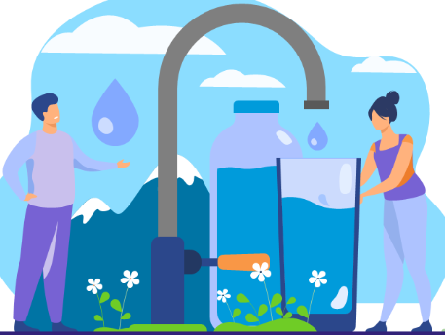
Methodology
General Setting: The study was conducted in a community setting in South Delhi.
Place of Study: Hauz Khas Sub – Division of South Delhi District, National Capital Region The data would be collected from various sources of drinking water points of MCD and institutions like hospitals , government offices , police stations etc.
Study Design: An observational and analytical study.
Timeline: The duration of the study is one month
Sampling Technique: Purposive sampling technique was adopted to collect water samples from the subdivision areas of District.

Slide 6
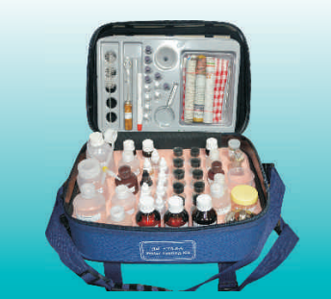
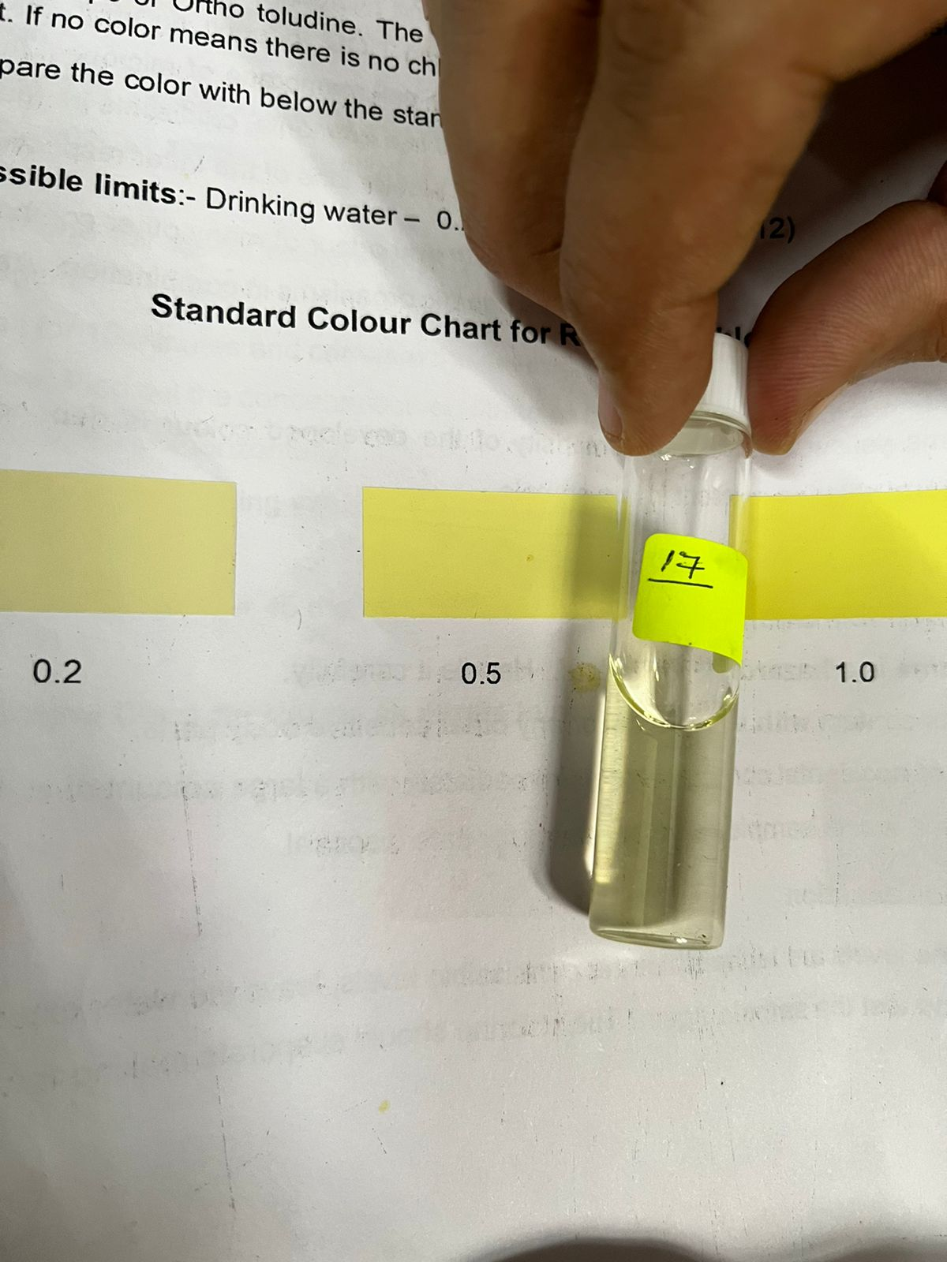
Data Analysis
- The data was analysed using the commercially available Jal TARA Standard Water Testing Kit-14
Used 5 parameters, they are :
Flouride
Ammonia
Residual Chlorine
pH
Nitrate
Iron.
BIS (IS 10500:2012

Slide 7
Methodology
Exclusion Criteria: Household water sources, drinking water points by communities or charitable agencies, water fountains, ponds, and open stagnant water sources which are unfit for drinking will be excluded from this study.
Scales of Measurement: Following quality parameters will be tested- pH, Residual chlorine, fluoride, iron, nitrate, residual chlorine, ammonia, and the presence of coliform bacteria.

Slide 8
Results (1/2)

Slide 9
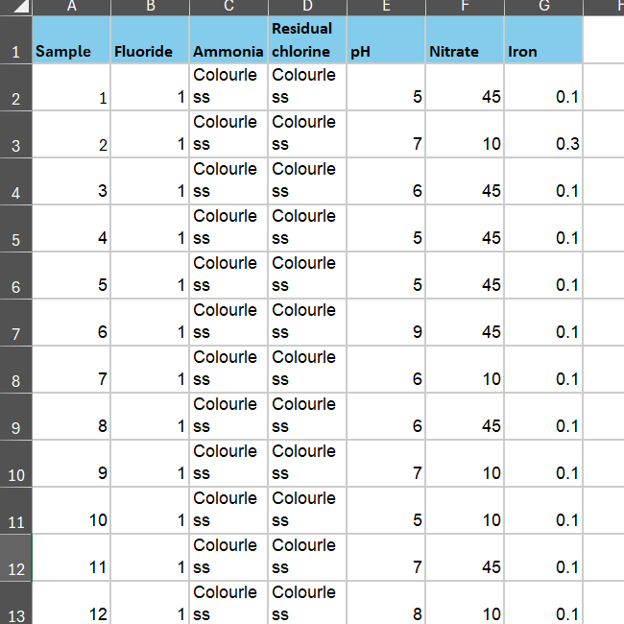
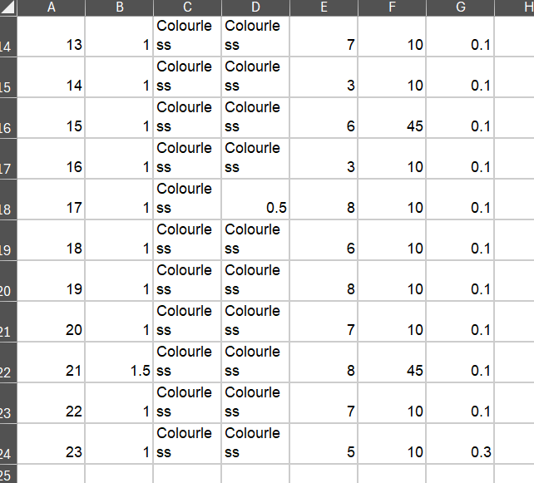

Slide 10
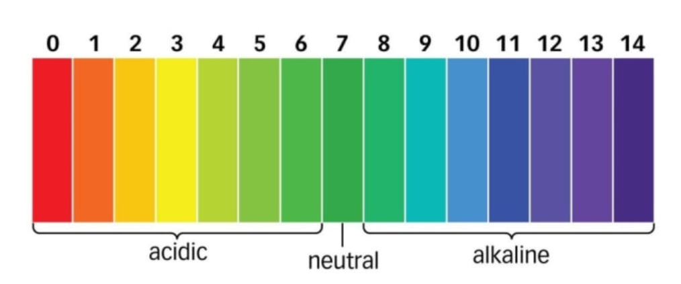
pH Scale

Slide 11
Conclusion/Discussion
Based on the findings of the study , conducted on potable water samples, most of the parameters were within the permissible range, but some levels crossed the desirable limits.
According to the guidelines of BIS (Bureau of Indian Standards), it was found that the pH, nitrate , ammonia, residual chlorine, chloride ion, and total hardness of almost all the water samples analyzed was within the desirable and permissible range.
Addressing water quality challenges will mean deploying real-time, low-cost, rapid, and reliable management technologies and building capacity and expertise in sustaining our lifeline. Management of water quality is essentially of great importance for the nation's overall growth. Also, proper evaluation is important to understand its true impact on the health of mankind.
The Biological parameters need to be checked on regular basis in the water samples for analysing the overall quality of water .

Slide 12
Refrences
. Guidelines for drinking-water quality, 4th edition [Internet]. Who.int. World Health Organization; 2011 [cited 2024 Apr 7]. Available from: https://www.who.int/publications/i/item/9789241548151
. https://sdgs.un.org/goals/goal6
. https://cpcb.nic.in/who-guidelines-for-drinking-water-quality/
. https://www.indiawaterportal.org/faqs/everything-you-want-know-about-drinking-water
. https://www.frontiersin.org/journals/water/articles/10.3389/frwa.2022.848018/full
. https://jalshakti-ddws.gov.in/sites/default/files/WQMS-Framework.pdf
. https://worldpopulationreview.com/world-cities/delhi-population
. Orfonline.org. [cited 2024 Apr 7]. Available from: https://www.orfonline.org/research/water-supply-in-delhi-five-key-issues/
. https://delhijalboard.delhi.gov.in/
. https://www.researchgate.net/publication/361600426_Water_Problems_and_Challenges_A_ Case_Study_of_Delhi_NCR
. https://www.semanticscholar.org/paper/Integrated-urban-water-management-in-India-%3A-the-of-Singh-Singh/004fa77c95efa6fc8d8b59cf9f008fbd55e34e63
. http://taraenviro.com/certificates.aspx.
https://dmsouth.delhi.gov.in/sdm-hauz-khas/

Slide 13
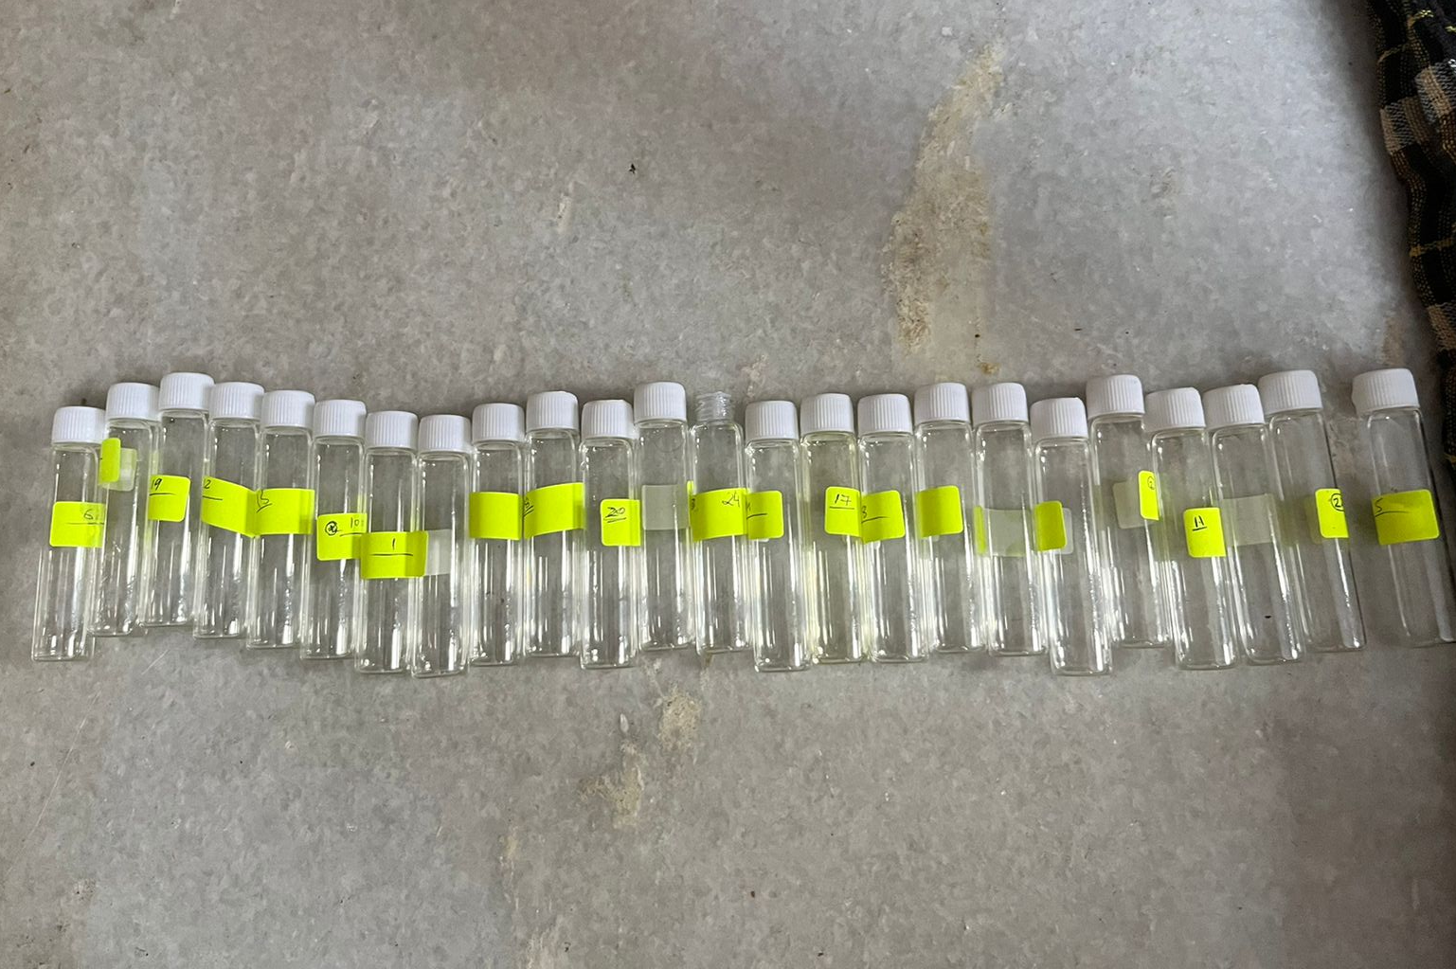
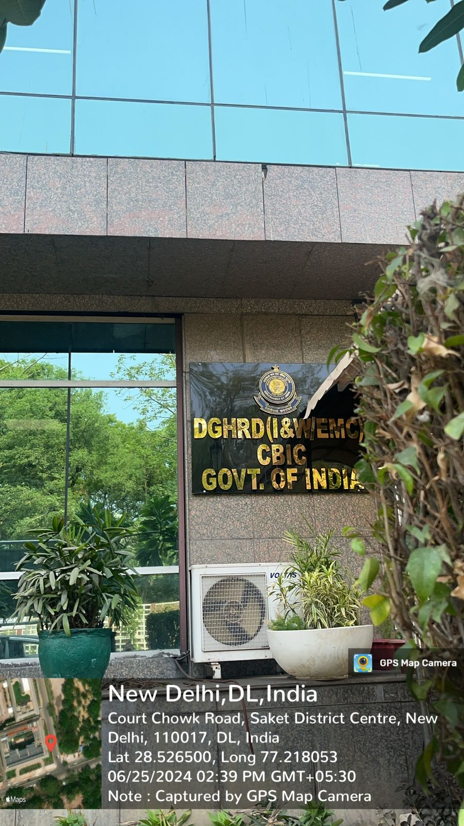
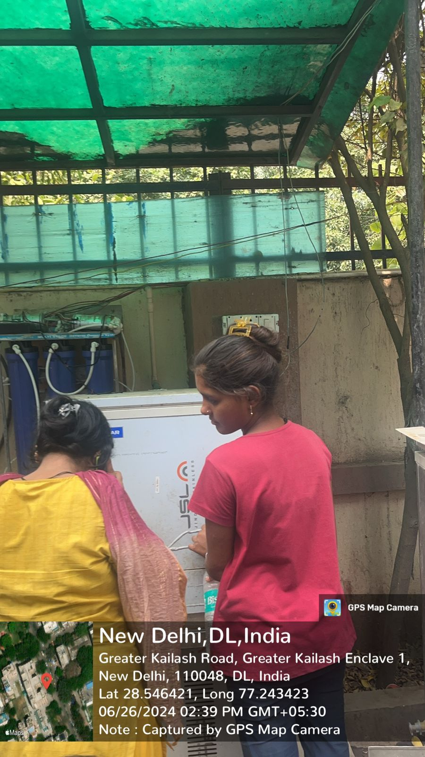
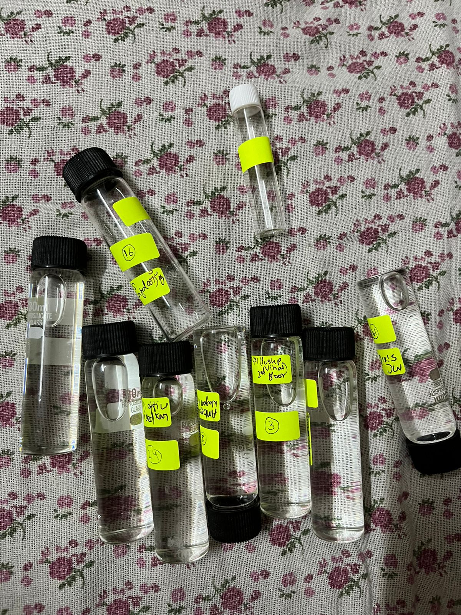
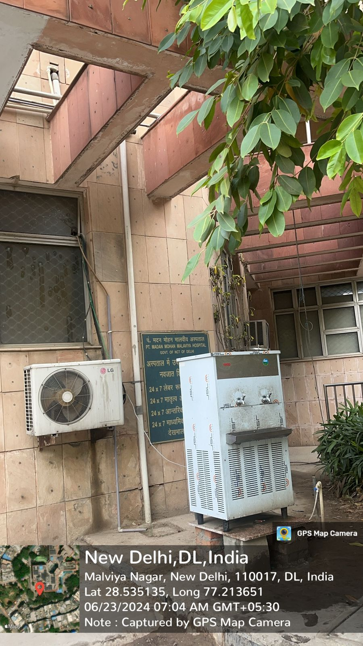
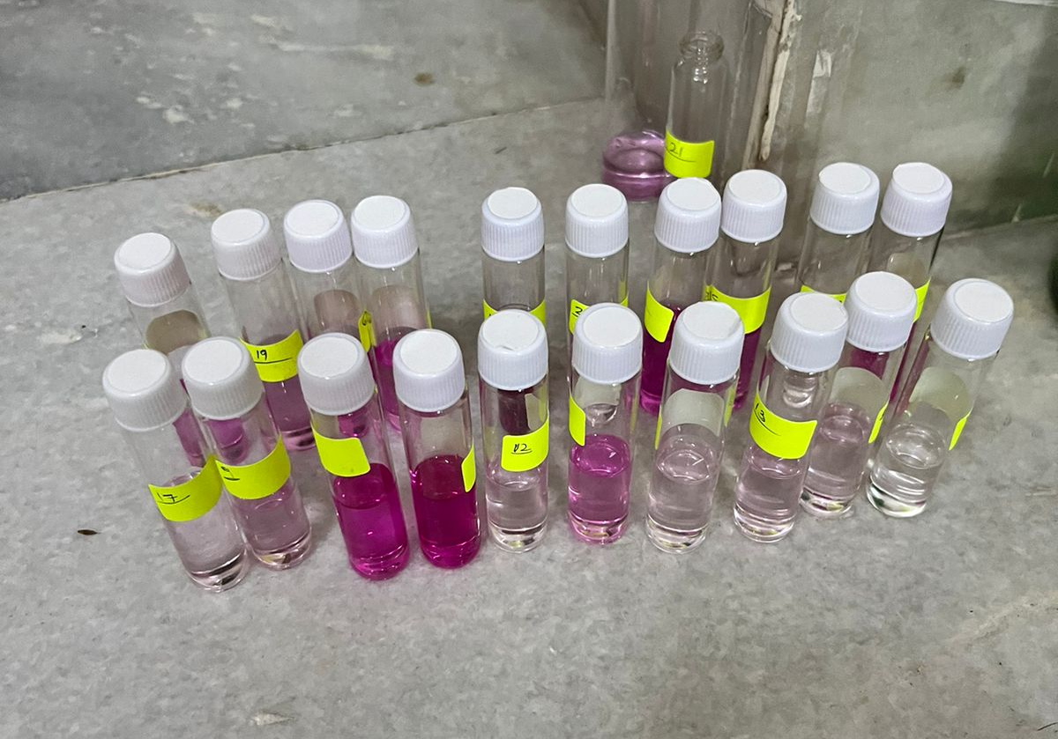
Pictorial Journey

