Slide 1
Study on Catheter-Associated Urinary Tract Infections (CAUTI) Sarvodaya hospital Faridabad, sec-8
By- Palak Mundra
Mentor- Dr Punit Yadav
IIHMR Delhi

Slide 2
Mentor Approval

Slide 3
Introduction (1/2)
UTIs as prevalent healthcare-associated infections
Catheterisation contributes to 75% of hospital-acquired UTIs.
15-25% of hospital patients require catheterization.
There were 3.08 pooled CAUTI prevalence cases for every 1,000 urinary catheter days.
At Sarvodaya Hopital ,The incidence rate of CAUTI for catheterisation in Emergency room in last one year was 7 per 1000 patient.

Slide 4
Objectives of Your Study
Primary Objective
Assess the compliance to CAUTI insertion bundle for emergency catheterization in the Emergency Room in a hospital in NCR
Secondary Objective
Estimate the incidence of CAUTI amongst patients who underwent emergency catherisation in ER

Slide 5
Methodology (1/2)
General Settings: Hospital-based study
Place of Study: Multi-speciality Hospital in Delhi NCR
Study Design: Observation based
Study Duration: Two months
Study Population: Adult patients (18+ years) requiring catheterization in the ER

Slide 6
Methodology (1/2)
Phase 1 Observation
Monitor catheterization procedures for 2 month.
Send 2 urine cultures of each patient –
One right after catheterization
And 2nd Urine cultures after 72-hour catheterization .
Intervention
Staff training on CAUTI bundle and checklist.

Slide 7
Sample Size and Inclusion Criteria
Population- 178
Sample size – 122 with 95% ci
Inclusion Criteria All adults of 18 years of age and above Insertion of Indwelling Foley catheter in the ER Catheter in place for at least 48 hours

Slide 8
Exclusion criteria
Documented UTI within the last 2 weeks before insertion
Pre-existing UTI at ER visit
Recent antibiotic treatment (last 2 weeks)
Instruments CDC Checklists on CAUTI Bundle. Patient Demographics Format.

Slide 9
Results
Observation Phase
Total population- 122
Loss of follow up – 43
Remaining patients - 79

Slide 10
Results
 |  | Compliance
Preparation | Assessment of need documented | 61.90
 | Seal is intact | 100
 | Size appropriation | 100
 | Assistance | 100
 | Sterile tray | 76.19
 | Hand hygeine | 85.71
Peri care | Prepare area with betadine properly | 80.95
 | Sterility maintained | 85.71
 | Pre inflation of baloon not done | 100
 | Hand hygeine | 61.90
Catheterisation | Insertion till appropriate length | 100
 | Urine flow checked before inflation | 71.43
 | Inflation | 100

Slide 11
Results
Major non-compliance – document of need of assesment and handhygeine post peri care
Out of the remaining 79 patients , 5 presented with symptoms of CAUTI
There urine culture also showed the presence of CAUTI infection.
In urine routine , an elevation in the lymphocyte numbers was seen
In the microscopy ,most common finding was gram negative bacterial growth was seen ,most common being the enteobacteriase
Based on the results the ER staff were trained for insertion bundle of CAUTI .

Slide 12
Discussion (1/2)
The study's findings highlight the importance of strict adherence to evidence-based practices
such as proper hand hygiene and the implementation of the CAUTI bundle of care, in preventing catheter-associated urinary tract infections (CAUTIs) in the emergency room setting.
The observed major non-compliance with hand hygiene practices after peri-care suggests a potential gap in staff training and compliance monitoring, which could contribute to increased CAUTI rates.

Slide 13
Conclusion
The study’s findings underscore the critical need for stringent adherence to evidence-based practices, such as proper hand hygiene and the implementation of the CAUTI bundle of care, in preventing catheter-associated urinary tract infections (CAUTIs) in healthcare settings.
The observed non-compliance with hand hygiene practices after peri-care highlights the necessity for ongoing education, training, and monitoring of healthcare personnel to reinforce the importance of following recommended guidelines and protocols.

Slide 14
References (Only Vancouver Style)
Letica-Kriegel AS, Salmasian H, Vawdrey DK, Youngerman BE, Green RA, Furuya EY, et al. Identifying the risk factors for catheter-associated urinary tract infections: a large cross-sectional study of six hospitals. BMJ open. 2019;9(2):e022137.
2. Rosenthal VD, Yin R, Abbo LM, Lee BH, Rodrigues C, Myatra SN, et al. An international prospective study of INICC analyzing the incidence and risk factors for catheter-associated urinary tract infections in 235 ICUs across 8 Asian Countries. American Journal of Infection Control. 2024;52(1):54-60.
3. Asmare Z, Awoke T, Genet C, Admas A, Melese A, Mulu W. Incidence of catheter-associated urinary tract infections by Gram-negative bacilli and their ESBL and carbapenemase production in specialized hospitals of Bahir Dar, northwest Ethiopia. Antimicrobial Resistance & Infection Control. 2024;13(1):10.
4. Tenke P, Kovacs B, Bjerklund Johansen TE, Matsumoto T, Tambyah PA, Naber KG. European and Asian guidelines on management and prevention of catheter-associated urinary tract infections. International journal of antimicrobial agents. 2008;31 Suppl 1:S68-78.
5. Chenoweth C, Saint S. Preventing catheter-associated urinary tract infections in the intensive care unit. Critical care clinics. 2013;29(1):19-32.
6. Shuman EK, Chenoweth CE. Recognition and prevention of healthcare-associated urinary tract infections in the intensive care unit. Critical care medicine. 2010;38(8 Suppl):S373-9.
7. Warren JW. Catheter-associated urinary tract infections. International journal of antimicrobial agents. 2001;17(4):299-303.
8. Chenoweth CE. Urinary Tract Infections: 2021 Update. Infectious disease clinics of North America. 2021;35(4):857-70.
9. Siddiq DM, Darouiche RO. New strategies to prevent catheter-associated urinary tract infections. Nature reviews Urology. 2012;9(6):305-14.
10. from: BSA. Guentzel MN. Escherichia, Klebsiella, Enterobacter, Serratia, Citrobacter, and Proteus. Medical Microbiology. 1996; 4th edition. Galveston (TX):Chapter 26.

Slide 15
Thank You
Any Questions

Slide 16
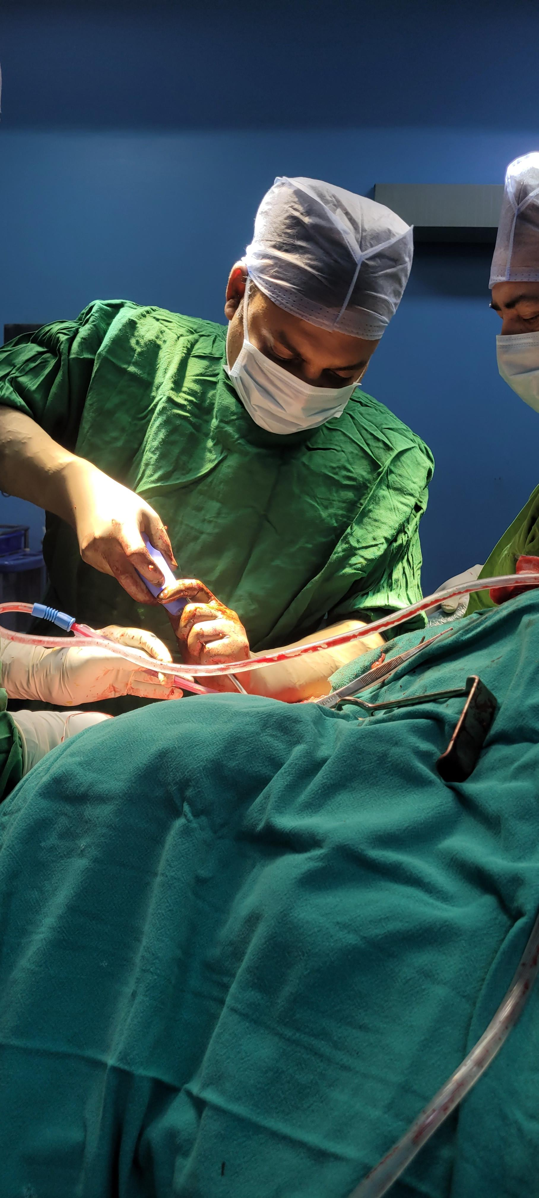
Pictorial Journey (1/2)

