Slide 1
BRIDGING THE TECHNOLOGICAL DIVIDE: ANALYZING THE CHALLENGES AND BENEFITS OF DIGITAL HEALTH TOOLS FOR MATERNAL CARE DELIVERY BY AUXILIARY NURSE MIDWIVES (ANMs) AND COMMUNITY HEALTH OFFICER (CHOs) IN MADHYA PRADESH, WITH A FOCUS ON ANMOL
By: Dr. Prateeksha Khambra
Under the Guidance of: Dr. Ratika Samtani
IIHMR Delhi

Slide 2
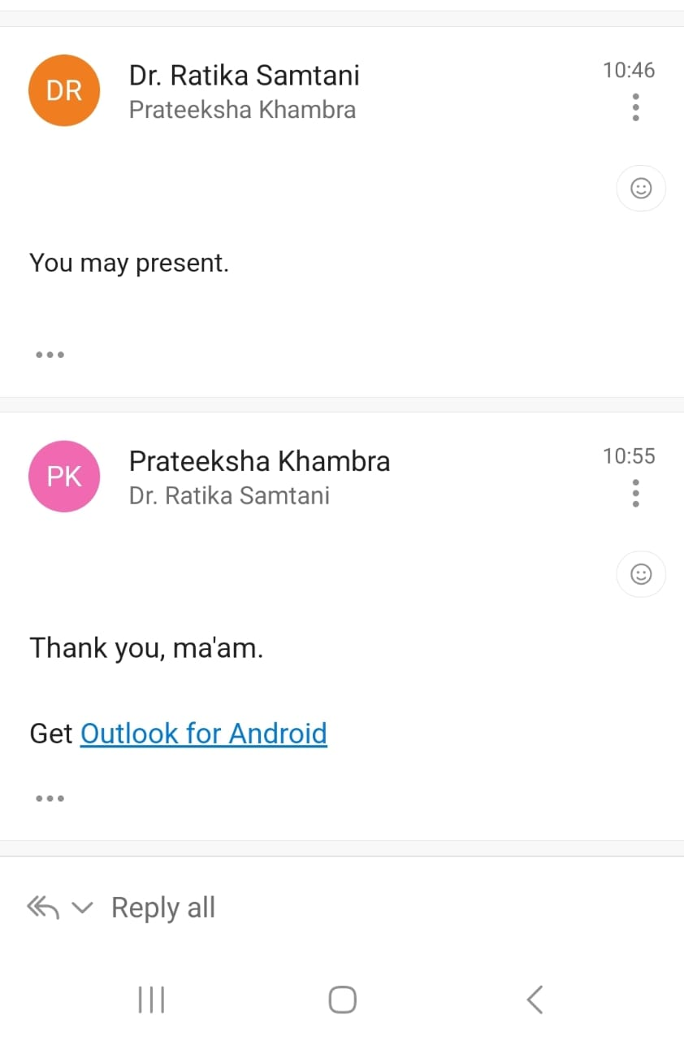
Mentor Approval

Slide 3
INTRODUCTION
Maternal health services are crucial for reducing maternal mortality and improving health outcomes. Auxiliary Nurse Midwives (ANMs) play a vital role in implementing mobile health (mHealth) programs, which have shown promise in various aspects of maternal and child health (MCH) care, including data management, antenatal tracking, and health worker training.
In India, ANMs use an Android-based application called ANMOL (ANM Online), which replaces traditional paper records with digital data collection and transmission. ANMOL improves services like beneficiary identification, management, and timely referrals while tracking pregnancy outcomes and postnatal care. Understanding the challenges and benefits of ANMOL is key to its effective use.

Slide 4
Madhya Pradesh has adapted the ANMOL application to MPANMOL, customizing its facility module for service providers at health facilities ranging from Sub-Health Centers (SHCs) and Health and Wellness Centers (HWCs) to medical colleges. The state has also developed a tracking mechanism for high-risk pregnancies,based on data collected in MPANMOL. This highlights the significance of MPANMOL data for successfully implementing these tracking mechanisms.

Slide 5
OBJECTIVES OF THE STUDY
To Identify challenges faced by ANMs and CHOs, in using the Anmol application for maternal health services.
To Assess the usability of the Anmol application, focusing on navigation, data entry, and overall satisfaction.
To Explore perceived benefits of the Anmol application, including improved data management and service accessibility.

Slide 6
METHODOLOGY
Type of study: Cross Sectional and Quantitative study
Study area: SHCs of Madhya Pradesh
Duration of the study: 3 months
Study population: A sample size of 30 ANMs and 30 CHOs is targeted for inclusion in the study.
Sampling method: Purposive sampling

Slide 7
METHODOLOGY
Study design: Cross Sectional quantitative approach
Tool: Structured Questionnaire
Data analysis: Quantitative data obtained from the questionnaire will be analyzed using descriptive statistics to summarize responses and identify trends.

Slide 8
QUESTIONNAIRE OVERVIEW
Frequency of ANMOL app usage
Satisfaction with usability and technical support
Challenges faced with the application
Training effectiveness
Preference for ANMOL vs. paper-based methods

Slide 9
FREQUENCY OF USE
FREQUENCY | ANM | CHO | TOTAL
Daily | 15 | 5 | 20
Weekly | 14 | 23 | 37
Rarely/Monthly | 1 | 2 | 3
Total | 30 | 30 | 60

Slide 10
INTERPRETATION
The bar chart indicates that ANMs use the ANMOL app more frequently on a daily basis compared to CHOs, who tend to use it more on a weekly basis. Overall, the app is actively used by both groups, but there is a clear difference in their usage patterns.

Slide 11
SATISFACTION WITH USABILITY:
SATISFACTION | ANM | CHO | TOTAL
Satisfied | 1 | 4 | 5
Neutral | 18 | 26 | 44
Dissatisfied | 11 | 0 | 11
Total | 30 | 30 | 60

Slide 12
INTERPRETATION:
Satisfaction with the app's usability is notably low across both groups, with only 5 out of 60 participants expressing satisfaction.
A majority of users (44 out of 60) have a neutral stance, indicating that while the app may not be significantly problematic, it also fails to stand out in terms of user experience.
Dissatisfaction is relatively more pronounced among ANMs compared to CHOs.

Slide 13
CHALLENGES :
CHALLENGES | ANM | CHO | TOTAL
Technical Issues | 24 | 18 | 42
Connectivity Issues | 18 | 19 | 37
Feature Issues (HRP, Editing) | 7 | 6 | 13
Lack of Training | 1 | 1 | 2

Slide 14
INTERPRETATION:
Technical and Connectivity Challenges:
Feature Issues (HRP, Editing):
Both ANMs and CHOs face significant technical and connectivity issues, impacting their ability to use the app effectively. Addressing these challenges is crucial for improving the app's reliability and user satisfaction.
ANMs reported 7 specific issues, while CHOs reported 6, totaling 13 cases related to HRP management and data editing.
These challenges impact data accuracy and workflow efficiency crucial for maternal health reporting.
Addressing these issues through user-centered design improvements and user feedback integration can streamline workflows and enhance data accuracy.

Slide 15
TRAINING EFFECTIVENESS:
EFFECTIVENESS | ANM | CHO | TOTAL
Effective/Satisfactory | 15 | 29 | 44
Needs Improvement | 14 | 1 | 15
Insufficient | 1 | 0 | 1
Total | 30 | 30 | 60

Slide 16
INTERPRETATION:
The training effectiveness analysis highlights significant differences between ANMs and CHOs
CHOs show higher satisfaction, with 29 instances reporting effective or satisfactory training outcomes, compared to 15 instances by ANMs.
Addressing these disparities through targeted training programs and continuous improvement efforts can enhance user proficiency and overall app effectiveness in maternal health data management.

Slide 17
FREQUENCY OF TECHNICAL ISSUES:
FREQUENCY | ANM | CHO | TOTAL
Rarely/Sometimes | 19 | 28 | 47
Often | 11 | 2 | 13
Total | 30 | 30 | 60

Slide 18
TECHNICAL SUPPORT
Rating | ANM | CHO | Total
Good | 5 | 5 | 10
Fair | 21 | 25 | 46
Poor | 1 | 0 | 1
Total | 27 | 30 | 57

Slide 19
INTERPRETATION:
Both ANMs and CHOs predominantly rated technical support as "Fair", suggesting moderate satisfaction but also indicating significant room for improvement.
With only 10 "Good" ratings (5 from each group), it's clear that the current technical support system needs enhancements to meet user expectations better.
The presence of just 1 "Poor" rating indicates that while major dissatisfaction is low, there is still a need to elevate the overall support quality.
Improving technical support services based on this feedback can significantly boost satisfaction and app effectiveness

Slide 20
PREFERENCE: PAPER VS ANMOL
PREFERENCE | ANM | CHO | TOTAL
ANMOL | 24 | 27 | 51
Paper/No Preference | 6 | 3 | 9
Total | 30 | 30 | 60

Slide 21
INTERPRETATION:
The data shows a clear preference for the ANMOL app over paper-based methods among both ANMs and CHOs, with 85% (51 out of 60) favoring the digital approach.
This indicates successful digital adoption among the majority of users.
However, the 15% (9 out of 60) who prefer paper or have no preference highlight the need for continued support and potential enhancements to ensure full adoption and satisfaction with the ANMOL app.

Slide 22
CONFIDENCE IN USING ANMOL:
CONFIDENCE | ANM | CHO | TOTAL
High | 8 | 21 | 29
Moderate | 19 | 9 | 28
Low | 3 | 0 | 3
Total | 30 | 30 | 60

Slide 23
INTERPRETATION:
The data shows a clear difference in confidence levels between ANMs and CHOs using the ANMOL app. While a majority of CHOs exhibit high confidence, most ANMs fall into the moderate confidence category. Additionally, 3 ANMs report low confidence, suggesting they may need targeted support and training.
These findings indicate a need for enhanced training programs, particularly for ANMs, to elevate their confidence levels.

Slide 24
CONCLUSION
Frequency of Use and Technical Issues: ANMs use the app more frequently and report more technical issues, indicating a need for robust technical support and regular maintenance.
Satisfaction with Usability and Tablets: ANMs are less satisfied with the app’s usability and the provided hardware. User-centered design improvements and hardware upgrades are essential.
Training Effectiveness: CHOs rate training more positively than ANMs, highlighting the need for enhanced and targeted training programs for ANMs.
Data Entry and Confidence: CHOs find data entry easier and report higher confidence in using the app. Simplifying data entry and providing continuous support can boost ANMs’ confidence.

Slide 25
RECOMMENDATIONS
Targeted Training for ANMs: Develop ongoing training specifically for ANMs to boost their confidence and effectiveness.
Continuous Learning: Provide continuous support and resources to keep users updated.
User-Centered Design: Implement design improvements based on ANM feedback to enhance usability.
Upgrade tablets to reduce hardware-related issues.
Establish a dedicated helpline and prompt issue resolution.

Slide 26
Regular Maintenance: Schedule regular updates to ensure smooth app functionality.
Streamline Processes: Simplify data entry to reduce errors and increase efficiency.
Feedback Integration: Regularly update features based on user feedback.
Continuous Support: Address ANMs' specific challenges to enhance their confidence.

Slide 27
REFERENCES
1) Acceptance of mHealth technologies among Auxiliary Nurse Midwives in Andhra Pradesh, India: A mixed method study by Prakash Babu Kodali1∗, Shankar Das2.
2) Capasso A, Colomar M, Ramírez D, Serruya S, de Mucio B. Digital health and the promise of equity in maternity care: A mixed methods multi-country assessment on the use of information and communication technologies in healthcare facilities in Latin America and the Caribbean. PLoS One. 2024 Feb 27;19(2): e0298902. doi: 10.1371/journal.pone.0298902. PMID: 38412170; PMCID: PMC10898739.
3) Srinidhi V, Karachiwala B, Iyer A, Reddy B, Mathrani V, Madhiwalla N, Periodi V, Sreevathsa A, Viswanatha L, Sen G. ASHA Kirana: when digital technology empowered front-line health workers. BMJ Glob Health. 2021 Sep;6(Suppl 5):e005039. doi: 10.1136/bmjgh-2021-005039. PMID: 34548289; PMCID: PMC8458334.
4) Gandhi P A, Kathirvel S, Chakraborty S. Rural community health workers' readiness for mobile-phone based telemedicine uptake in India. J Rural Med. 2022 Jul;17(3):166-170. doi: 10.2185/jrm.2021-044. Epub 2022 Jul 1. PMID: 35847763; PMCID: PMC9263958.

Slide 28
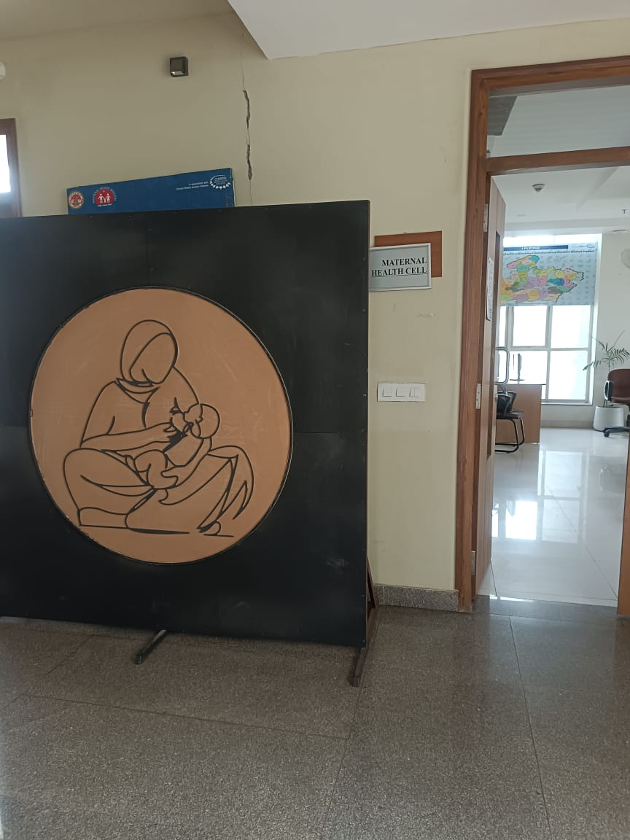

Slide 29
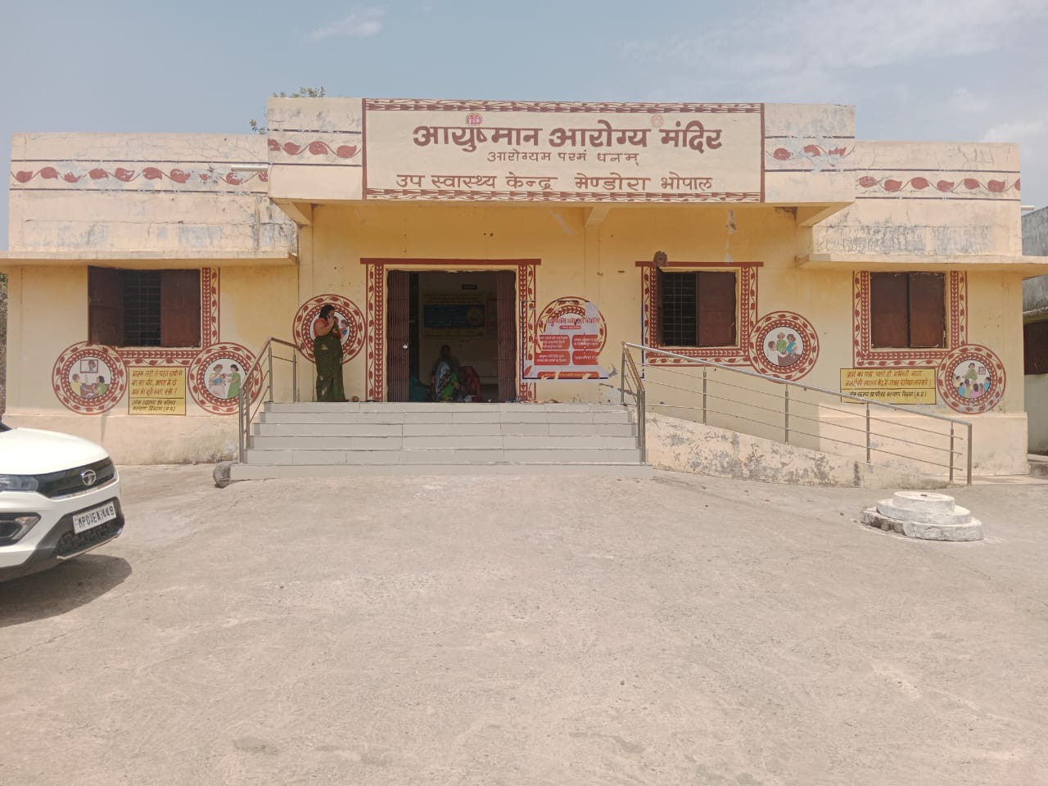

Slide 30
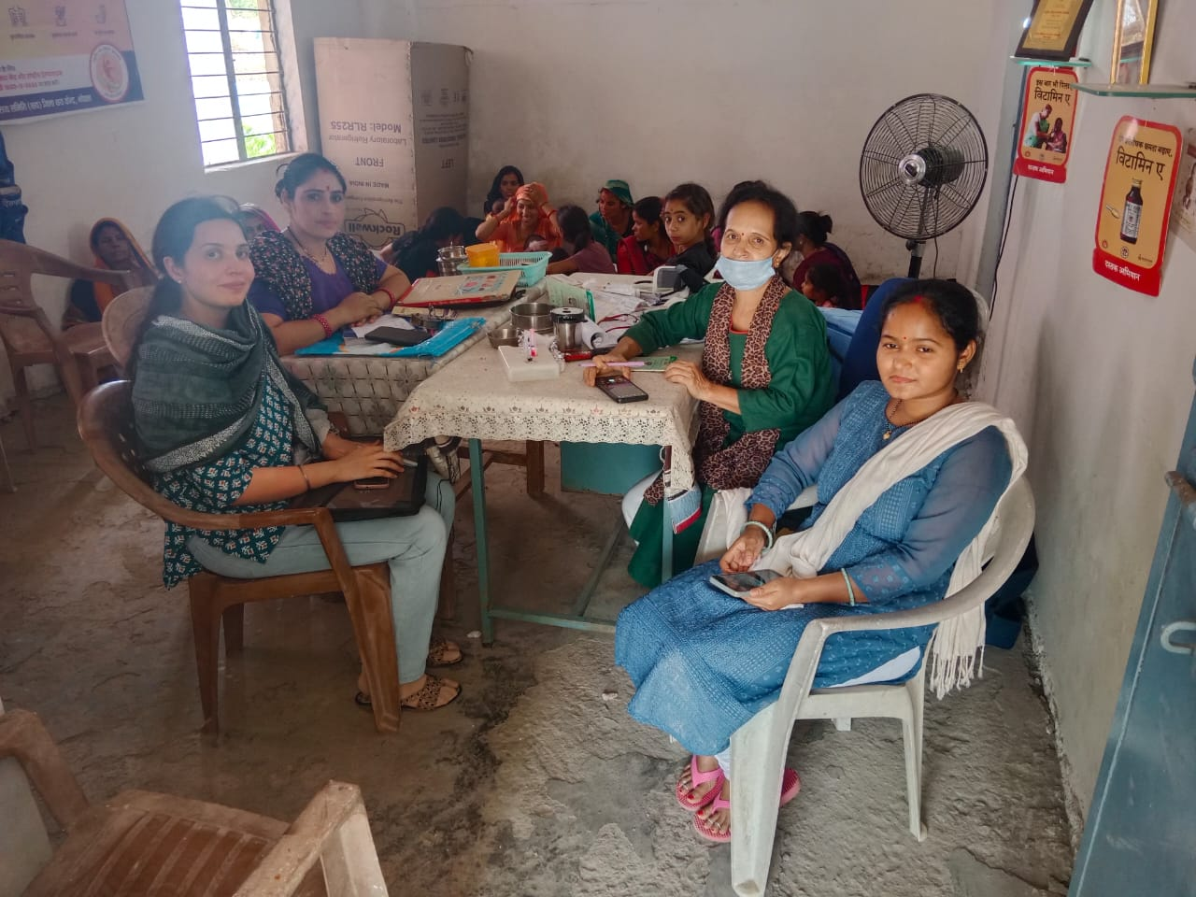

Slide 31
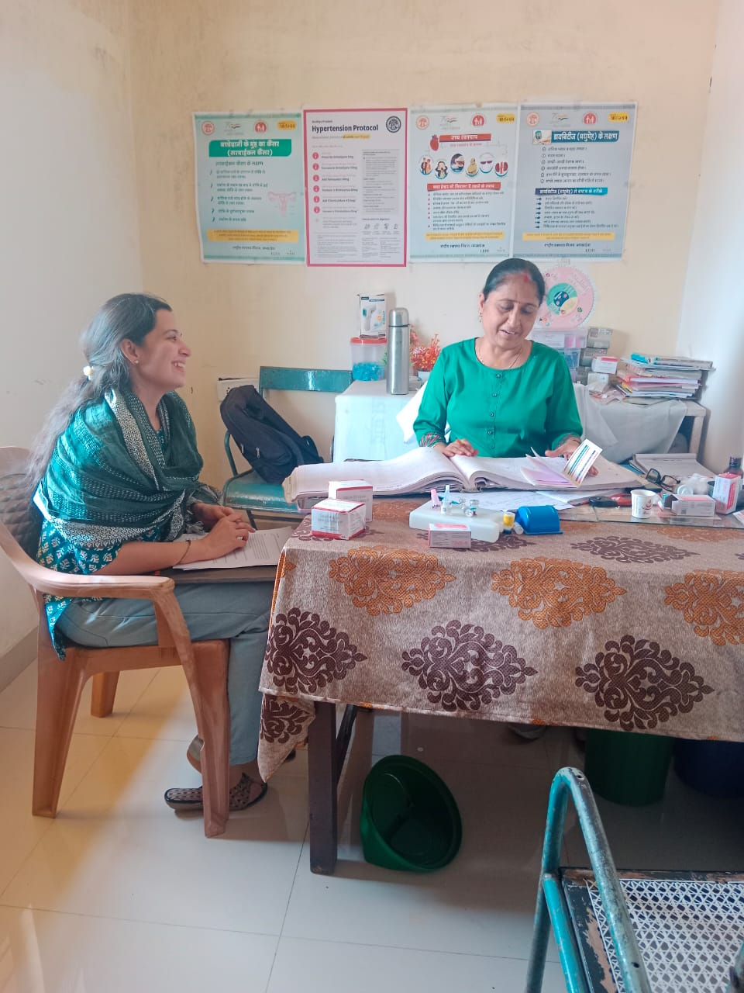

Slide 32
Thank You
Any Questions

