Slide 1


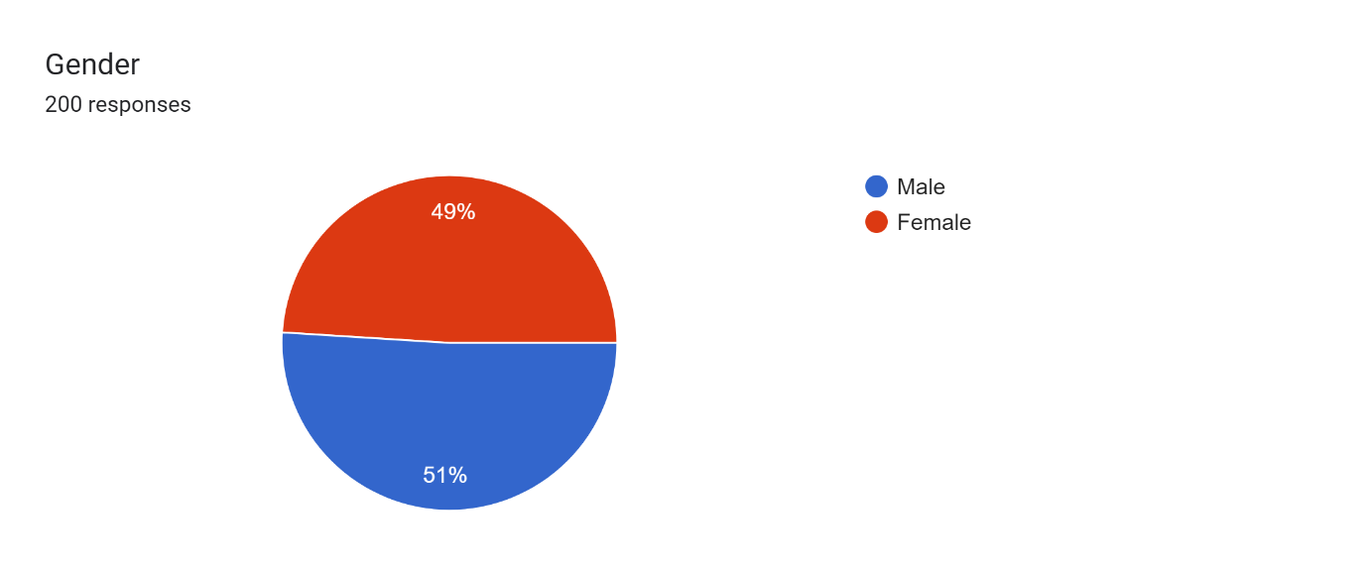
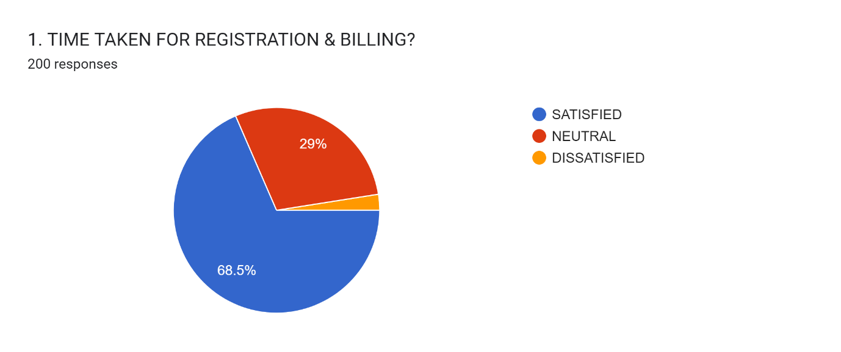
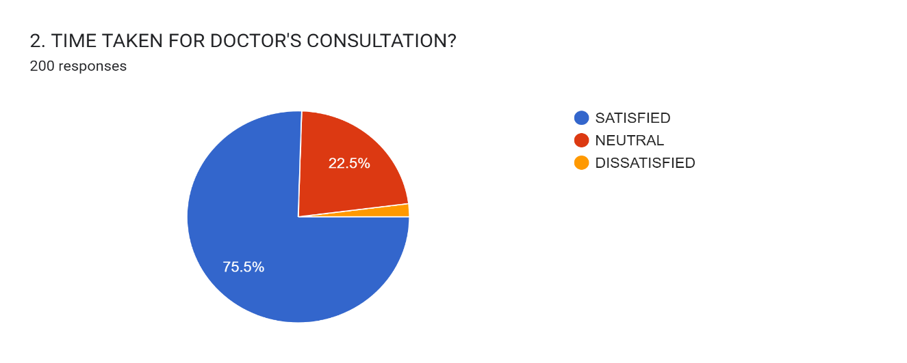
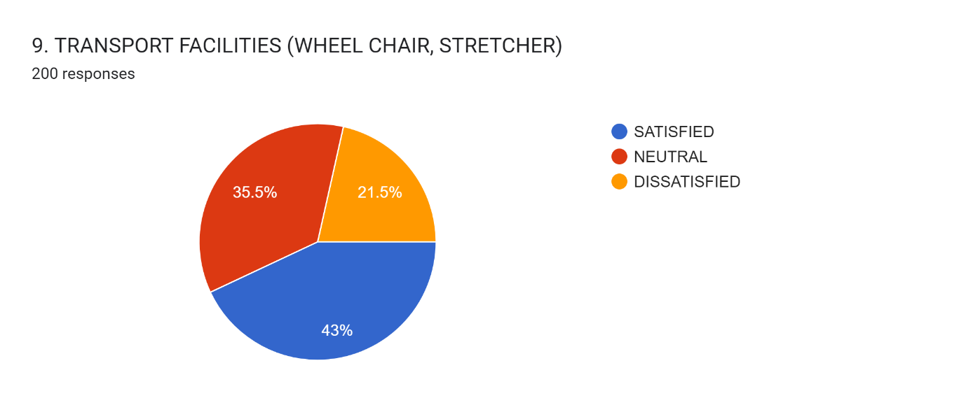
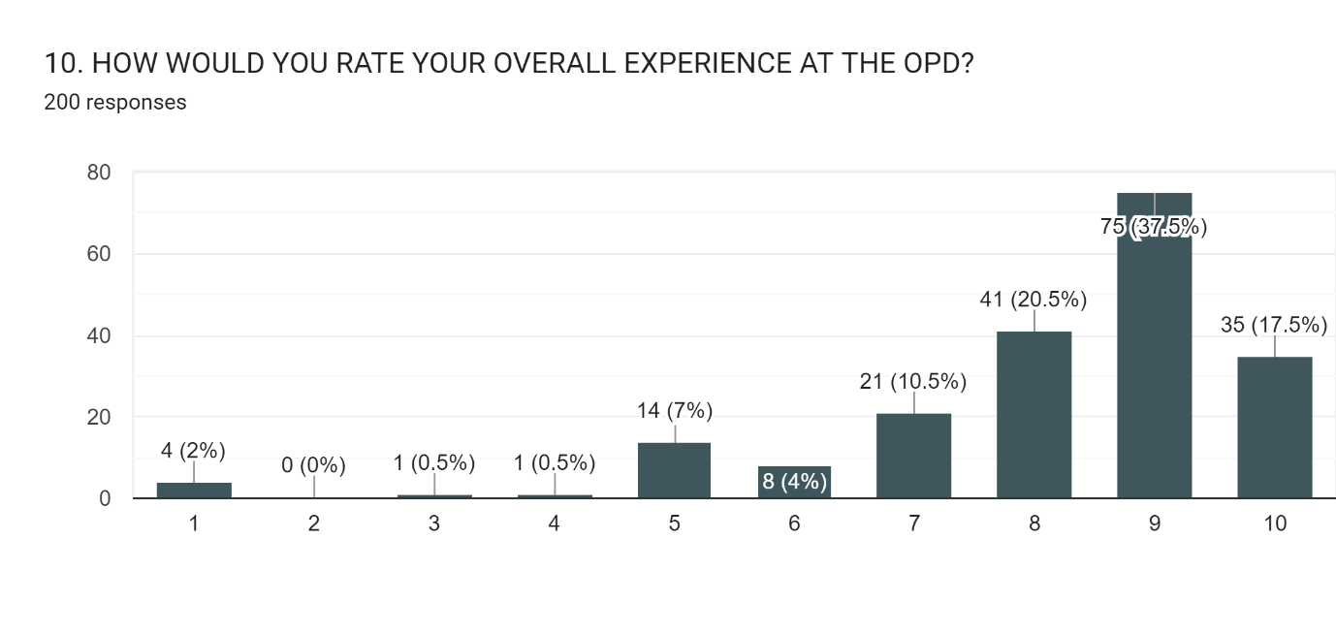
A STUDY ON PATIENT SATISFACTION IN OPD.
CHETTIKINDI HARSHAVARDHAN PG/23/037
GUIDED BY: ANANDHI RAMACHANDRAN CO GUIDE: UGENDHAR REDDY
INTRODUCTION
METHODOLOGY
DATA ANALYSIS
CONCLUSION
Patient satisfaction of quality improvements is deemed to be one of the important factors which determine the success of health care facility. It is easier to evaluate the patient’s satisfaction towards the services provided than to evaluate the quality of medical services that they receive. The health care system depends on availability, affordability, efficiency, feasibility and other factor. Consumer satisfaction regarding medical care organization like our tertiary care hospital is important in the provision of services to patients. This study was therefore undertaken with the aim to find out the level of patient satisfaction of quality improvements related to different parameters of quality of health care.
Study design
The present study will be cross-sectional
study.
Study population
The target population of this study included
patients who had utilized health services at
the OPD of a apollo hospital in Month of
April- June.
Sample size
A sample of 200 out-door patients had been
taken on random basis.
Sample techniques
Simple random sampling technique was
used to select the sample of study.
Study Settings
Study had been conducted in the Apollo
hospital, jubilee hills, Hyderabad ,
Telangana India.
Method of Data Collection
Data had been collected from those patients who visited the mentioned OPD’s of the Hospital. During the waiting time of patients, researcher had taken formal survey with patients. The data had been checked on the spot, errors rectified, and missing data incorporated in the forms.
Tools of Data Collection
The data had been collected by survey forms
patients who had utilized health services in
out-patient services (OPD).
Study population
Those patients who had visited the hospital and utilized the health services in OPD in hospital in particular month.
Sex wise distribution of patients attending the OPD Sex Male Percent 51% Female 49% .
The above figure shows 138 patients are satisfied 57 neutral and 5 patients are dissatisfied regarding time taken for registration and billing.
The above figure Shows 151 patients satisfied 45 neutral and 4 are dissatisfied regarding time taken for doctor consultation
Majority of patients using out-patient services were satisfied with the health care received, and with facilities such as clean toilets. Majority of participants felt that the consultation time given by doctors was adequate. However, most of the patients were dissatisfied with transport facilities. The registration process needs to be streamlined to reduce the waiting period. Similarly, some of the participants reported that behaviour of hospital staff was neutral. This highlights the need of reorientation training in communication and interpersonal skills for all categories of health care staff. OPD services are an essential part of health care services in a hospital that need to be improved by developing patient feedback system. Patients are the bread runner of health care system so they must be given highest priority for making the health care system more efficient and effective.
OBJECTIVE
The main objective of the study is to find patient satisfaction among OPD patients.
RECOMMENDATIONS
No of housekeeping staff should be increase.
Female changing room should be situated near the procedure room.
No of billing counter as well as billing staff should be recruited.
There should be a specific report delivery counter.
Toilets should be clean regularly.
Public holidays & doctors on leave should be clearly displayed on the notice board for the convenience of the patient.
No of chairs in reception area should be increase.
Dustbins should be provided nearby opd’s.

