Slide 1
The Impact of Gender Bias in Artificial Intelligence: A Scoping Review and Framework for Promoting Opportunities for Women Empowerment and Representation in AI
A Scoping Review
Presented by-
Sadiya Siddiqui
(PG/22/098)
Mentor: Dr. Rupsa Banerjee, IIHMR Delhi

Slide 2
Mentor Approval

Slide 3
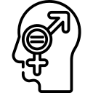
Introduction
What is Gender and Gender Bias
Artificial Intelligence
Gender Bias in AI
Gender refers to the socially constructed roles, behaviors, expressions, and identities of various genders, including girls, women, boys, men, and gender diverse individuals.
Gender bias is the unfair treatment of individuals or groups based on their perceived gender, resulting in stereotypes, social expectations, discrimination, and unequal access to opportunities.
Artificial intelligence (AI) has rapidly transformed numerous aspects of our lives. AI systems are essentially computer programs trained on massive datasets to learn and make intelligent decisions. Artificial Intelligence (AI) has the potential to revolutionize various aspects of our lives, but concerns remain regarding potential biases within these systems.
Gender bias in AI refers to the tendency of AI systems to reflect and amplify societal prejudices against particular genders.

Slide 4
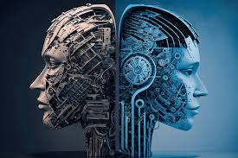
Introduction
The technology sector has been a significant contributor to global growth, but gender disparity remains a significant issue.
Women are underrepresented in the technology sector due to limited education access and societal biases.
Initiatives like Women in Analytics Initiative, Women in Tech India, and GATI aim to encourage female participation.
Challenges include bias, discrimination, lack of mentorship, and demanding schedules.
Global gender gaps persist in leadership, technology access, and AI participation.
India's significant gender gap in AI development and implementation is highlighted.
Despite efforts to address gender bias in AI, significant challenges persist, necessitating further investigation and action. This scoping revies aims to analyze the impact of gender bias in AI on opportunities for women's empowerment and representation.

Slide 5
Introduction
To identify and categorize common forms of gender bias in AI and its applications
Objectives
To understand how different genders interact with technology, including access, usage patterns, and preferences between genders.
To summarize existing policies, initiatives, and practices for promoting gender inclusivity in technology

Slide 6
Methodology (1/2)
PubMed, Google Scholar, Medline open access source were used to gather relevant research articles, conference papers, and reviews related to AI and gender bias in AI.
Articles published in non-academic sources (e.g., blogs, news articles, journals, press release) were also considered.
List of references of retrieved articles was searched for relevant literature
Terms related to gender bias were also explored:
Gender Bias and AI
Women Empowerment
Gender Representation in Technology
Gender Stereotypes
Women’s Rights
Gender gap in digital skills
Gender Participation in AI
Women’s Participation in AI
Initiatives for Women in Tech
Gender Bias in facial recognition
Gender Equality or Women
Terms related to AI and its applications were explored:
Artificial Intelligence
Machine Learning
Algorithm Bias
Mobile phone usage patterns
Digital gap
Facial Recognition
STEM Education and workforce development
Access to technology
Initiatives in Tech
Fairness and Bias in Artificial Intelligence
Source
Search Terms
Search Terms

Slide 7
Methodology (1/2)
Research articles published in academic journals were reviewed.
Articles that directly addressed the impact of gender bias in AI on women's empowerment and representation were selected.
Studies employing qualitative, quantitative, or mixed methods research designs were included.
Non-academic sources like blogs, news articles, journals were also conducted.
Published post-1980s.
Analysis was done using narrative analysis method:
●This involves summarizing and organizing the findings from the included studies.
●Evidence was summarized based on research questions.
●Tables, figures, and text were used to present key findings and identify any gaps in knowledge.
Articles written in languages other than English (unless translations are readily available) were excluded.
Exclusion Criteria
The study was conducted for the period of 3 months (Mid-Feb to Mid-May)
Study Duration
Data Analysis
Inclusion Criteria

Slide 8
PRISMA FLOWCHART
Identification of Studies through Databases
Identification
Records Identified through Database Searching(vis Google Scholar & Pubmed)=60
Additional Records Identified through other sources= 20
Total Records after Duplicates Removed= 70
Screening
Citation Screened after Duplicates Removed= 70
Retrieved Articles after inclusion and exclusion criteria=50
Included
Report Included= 50

Slide 9
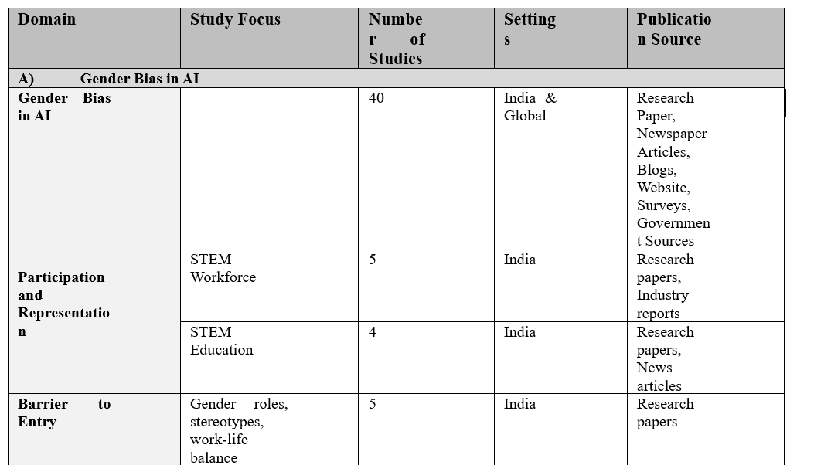
Qualitative Overview(1/4)

Slide 10
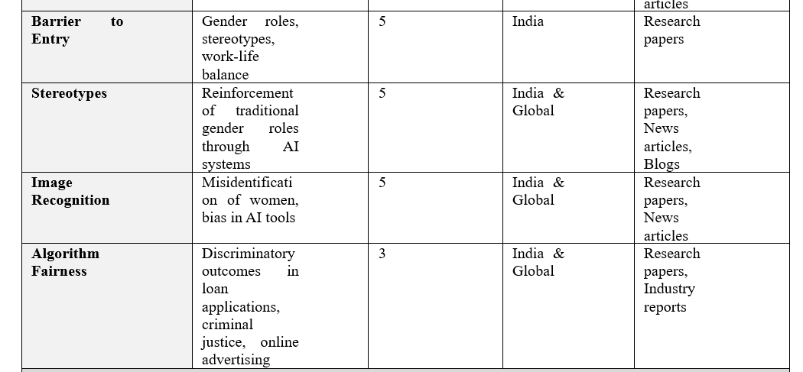
Qualitative Overview(2/4)

Slide 11
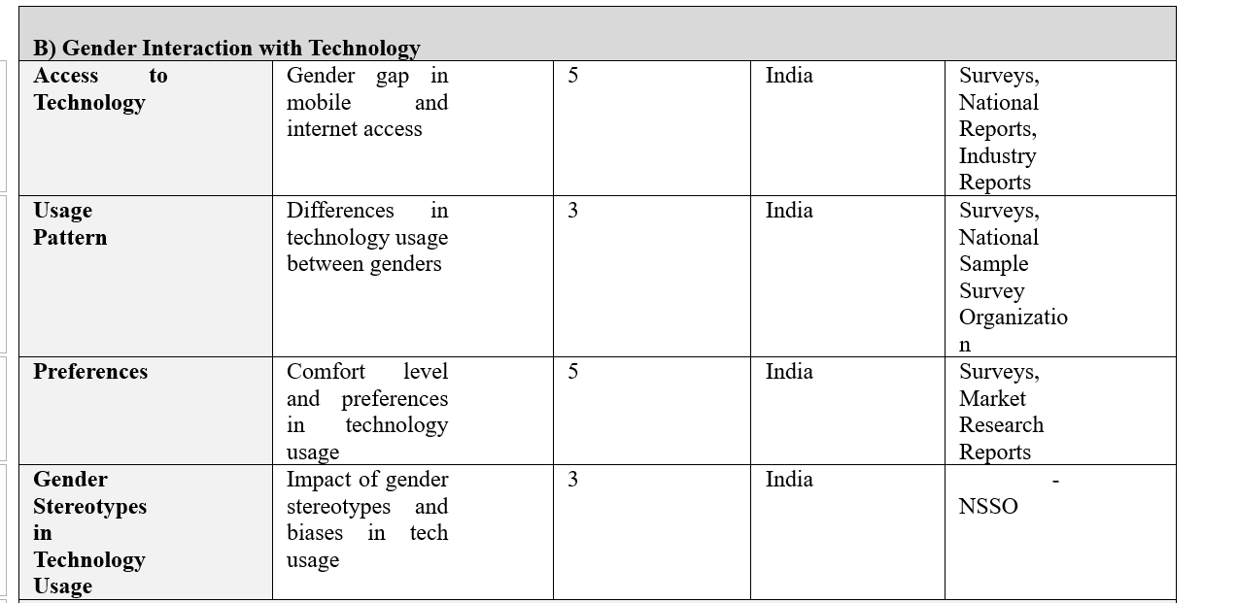
Qualitative Overview(3/4)

Slide 12
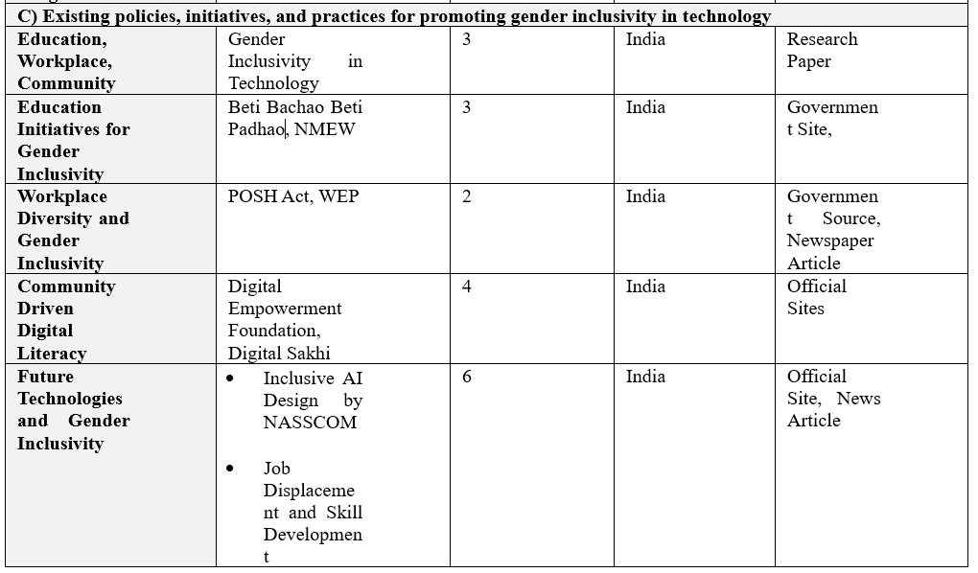
Qualitative Overview(4/4)

Slide 13
Results (1/6)
Gender Bias in AI
This review explores gender bias in Artificial Intelligence (AI) applications, analyzing 40 articles, blogs, research papers, and industry reports. It categorizes biases, into five categories: participation and representation, Barrier to Entry, Stereotypes, Image Recognition and Algorithm Fairness.
A) Participation and Representation
B) Barriers to Entry
STEM Workforce
• Women make up nearly half of total workforce but only represent 26%.
• In 2016, 59% of workforce comprised of women, 30% at major tech companies.
• India's tech industry underrepresents women, with only 7% holding executive positions.(Chaturvedi, A. (2023, December 11)
• Low girls' participation in computer science courses hinders women's tech career progression.(Second edition. State of AI in India [Internet]. Deloitte.com. [cited 2024 Jun 18].)
STEM Education
Despite efforts in STEM education, women are still a minority.
Gender and generational gap widens in lower-middle-income countries (internet access: 21% women vs 32% men).(Gender imbalances remain in digital skills and STEM careers [Internet]. Unesco.org. 2023)
Women Outperform in Education, Underperform in Careers (Jetir.org. [cited 2024 Jun 18])
Women's research in AI offers valuable perspectives. Highlighting female researchers in STEM, especially AI, is crucial.(Valls A, Gibert K. Women in artificial Intelligence. Appl Sci (Basel) [Internet]. 2022)
India's Tech Sector Barriers to Women's Representation
• Stereotypes and gender bias.
• Lack of female role models.
• Work-life balance issues.
• Discouragement from STEM education.
• Societal beliefs about gender roles.
(Wakdikar S. WOMEN IN STEM [Internet]. Res.in.)
*ICT-Information and Communications Technology- technology that supports activities involving information. Such activities include gathering, processing, storing and presenting data. Increasingly these activities also involve collaboration and communication.

Slide 14
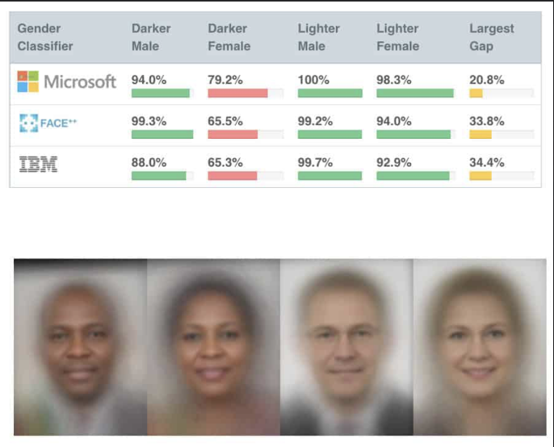
Results (2/6)
Gender Bias in AI
C) Stereotypes
D) Image Recognition
Stereotyping in AI systems reinforces traditional gender roles, perpetuating societal biases. Research by Harvard Business Review highlights gender bias in NLP systems like Alexa and Siri, which associate "man" with "doctor" and "woman" with "nurse.“
Image recognition bias occurs when AI systems disproportionately misidentify or fail to recognize images of women compared to men.
Facial recognition systems have higher error rates for women, particularly those of color, with up to 34.7% errors for identifying darker-skinned women. *
Social media photo tagging algorithms often misclassify or fail to recognize women, indicating a bias in the training data used.**
Virtual Assistants
Chat Bots
Language Models
Image 1- Gender Bias in Facial Recognition System
(Fighting algorithmic bias in artificial intelligence – [Internet]. Physics World. 2021)
(Atay M, Gipson H, Gwyn T, Roy K. Evaluation of gender bias in facial recognition with traditional machine learning algorithms [Internet]. Nsf.gov.)
(Researchgate.net.)
NLP- Natural Language Processing -a machine learning technology that gives computers the ability to interpret, manipulate, and comprehend human language.

Slide 15
Results (3/6)
Gender Bias in AI
E) Algorithm Fairness
Domain | Potential Bias | Impact
Loan Applications | Algorithmic bias against female entrepreneurs | Difficulty obtaining funding for businesses
Criminal Justice System | Facial recognition software misidentifying women | Unjust incarceration or harsher sentencing
Online Advertising | Targeting based on gender stereotypes | Limited career opportunities or exposure to relevant information
Table 1- Potential Impact of Algorithmic Bias on Women
(September 29. HeForShe summit discusses gender bias in AI and how to encourage male feminist allies [Internet]. UN Women – Headquarters.)

Slide 16
Results (4/6)
Gender Interaction with Technology
A) Access to Technology
B) Usage Pattern
Digital Gender Divide in India
Less internet access for women due to
Economic limitations
Social norms
Lack of digital literacy training
Mobile Internet Usage Gap (2022)
Men: 65% subscribed to mobile services
Women: 49% subscribed to mobile services.
Gender Divide in Internet Use (2022)
Men: 62% use mobile internet
Women: 35% use mobile internet.(BestMediaInfo Bureau. 759 million Indians active internet users, to reach 900 million by 2025: IAMAI-Kantar report [Internet]. BMI. 2023 )
Tech Use and Gender Stereotypes
Women less likely in coding and gaming. (Gsma.com).
Activity | Male (%) | Female (%)
Work-Related Tasks | 60 | 50
Social media | 20 | 30
Entertainment | 15 | 10
Education and Learning | 5 | 10
Figure 1- Subscription to Mobile Services (BestMediaInfo Bureau. 759 million Indians active internet users, to reach 900 million by 2025: IAMAI-Kantar report [Internet]. BMI. 2023 )
Table 2- Internet Usage patterns of different gender (Gsma.com).

Slide 17
Results (5/6)
C) Preferences
Activity | Male | Female
Work-Related Tasks | High | Moderate
Social media | High | High
Entertainment | Moderate | Moderate
Education and Learning | Low | Moderate
Communication Tools | Moderate | High
E-Commerce | High | Low
Table 3- Gender Differences in Internet Usage Patterns (India)
(Gsma.com).

Slide 18
Results (6/6)
Existing policies, initiatives, and practices for promoting gender inclusivity in technology
A) Education
B) Workplace Diversity
C) Community Driven Initiatives
Beti Bachao Beti Padhao (Save the girl child and educate the girl child)
National Mission for Empowerment for Women (NMEW)
Skill India Mission
The Sexual Harassment of Women at Workplace (Prevention, Prohibition and Redressal) Act, 2013
Schemes like the "WEP" (Women Entrepreneurship Platform) by NITI Aayog
Organizations like "Digital Empowerment Foundation" and "India STEM Foundation"
Digital Sakhi
Women in Tech India
D) Future technologies and gender inclusivity
The rise of AI and automation presents both opportunities and challenges for gender inclusivity. NASCOM emphasizes inclusive AI design principles and ethical practices. IoT and automation raise job displacement concerns for women, but also offer opportunities for skill development. India's efforts require collaboration between government, industry, academia, and civil society.
(Wikipedia contributors. Algorithmic bias [Internet]. Wikipedia, The Free Encyclopedia. 2024).

Slide 19
Discussion
Gender Bias in AI and Its Impact
1. Gender Bias in AI
• Biased data: AI systems trained on biased data perpetuate and amplify gender stereotypes.
• Algorithmic discrimination: AI systems disproportionately affect one gender over another, as seen in Amazon's recruitment algorithm
• Gendered representations in AI applications: Research shows facial recognition systems have higher error rates for women and people of color compared to white men.
2. Gender Interactions with Technology
• Disparities in access, usage patterns, and preferences: Women have less access to digital technologies compared to men, affecting their participation in the digital economy.
• Different usage patterns: Men and women use technology differently, influenced by social and cultural factors.
3. Policies, Initiatives, and Practices for Gender Inclusivity
• Organizations and governments have implemented measures to address gender bias in AI and technology.
• Initiatives like the Women in AI network and diversity and inclusion programs by companies like Google and IBM focus on recruiting, retaining, and advancing women in tech roles.
4. Comparison with Previous Studies
• Findings align with previous studies, emphasizing the need for systemic changes in AI systems design and deployment.
• The review provides a comprehensive framework for addressing gender bias in AI, emphasizing intersectional approaches considering other forms of discrimination.

Slide 20
Study Limitations
Broad Scope
Limited Analysis
Lack of Intersectionality
Limited Generalizability
Notes:
Broad Scope: Scoping reviews cover a wide range of research, making in-depth analysis of individual studies difficult. Limited Analysis: They focus on summarizing the existing research rather than offering a critical appraisal of the studies' methodologies and findings. Lack of Intersectionality: They might not explore how gender bias interacts with other forms of discrimination, like race or socioeconomic status. Limited Generalizability: The focus on broad categories may miss the specific challenges faced by marginalized groups within a broader demographic (e.g., rural women, LGBTQ+ women in tech).

Slide 21
Conclusion
AI & Gender Bias:
Skewed data sets
Algorithmic discrimination
Gendered representations in AI systems
Perpetuates inequality, limits women's opportunities
The Gender-Tech Gap:Digital divide:
Women have less access and use technology differently.
Understanding usage patterns is key for inclusive AI design.
Initiatives for Gender Equality in Tech:
Existing efforts offer hope but require continuous improvement.
Moving Forward:
Intersectionality: Consider how gender interacts with other biases.
Collaboration & Inclusive Design: Develop a more equitable AI landscape.
Empower women & ensure AI benefits everyone.

Slide 22
References
"Government of Canada. What is gender? What is sex? [Internet]. Canadian Institutes of Health Research. 2023. Available from: https://cihr-irsc.gc.ca/e/48642.html
jhpiego. Gender Concepts and Definitions | Gender Analysis Toolkit For Health Systems | Jhpiego [Internet]. Gender Analysis Toolkit For Health Systems | Jhpiego. 2019. Available from: https://gender.jhpiego.org/analysistoolkit/gender-concepts-and-definitions/
Stamarski CS, Son Hing LS. Gender inequalities in the workplace: The effects of organizational structures, processes, practices, and decision makers’ sexism. Frontiers in Psychology [Internet]. 2015 Sep 16;6(2). Available from: https://www.frontiersin.org/journals/psychology/articles/10.3389/fpsyg.2015.01400/full
Bringsjord S, Govindarajulu NS. Artificial Intelligence (Stanford Encyclopedia of Philosophy) [Internet]. Stanford.edu. 2018. Available from: https://plato.stanford.edu/entries/artificial-intelligence/
Closing the leadership gap: gender equity and leadership in the global health and care workforce [Internet]. www.who.int. Available from: https://www.who.int/publications-detail-redirect/9789240025905
Closing the leadership gap: gender equity and leadership in the global health and care workforce [Internet]. www.who.int. Available from: https://www.who.int/publications-detail-redirect/9789240025905
Mariscal J, Mayne G, Aneja U, Sorgner A. Bridging the gender digital gap. Econ Open-Access Open-Assess E-J [Internet]. 2019;13(1). Available from: http://dx.doi.org/10.5018/economics-ejournal.ja.2019-9
Gsma.com. [cited 2024 Jun 18]. Available from: https://www.gsma.com/r/wp-content/uploads/2022/06/The-Mobile-Gender-Gap-Report-2022.pdf
OECD AI policy observatory portal [Internet]. Oecd.ai. [cited 2024 Jun 18]. Available from: https://oecd.ai/en/wonk/closing-the-gender-gap
Mariscal J, Mayne G, Aneja U, Sorgner A. Bridging the gender digital gap. Econ Open-Access Open-Assess E-J [Internet]. 2019;13(1). Available from: http://dx.doi.org/10.5018/economics-ejournal.ja.2019-9
Chaturvedi A. MPW 2023: Women’s representation in tech still lags even as newer technologies pose fresh challenges [Internet]. Business Today. 2023 [cited 2024 Jun 18]. Available from: https://www.businesstoday.in/magazine/deep-dive/story/mpw-2023-womens-representation-in-tech-still-lags-even-as-newer-technologies-pose-fresh-challenges-408909-2023-12-11
Women, minorities, and persons with disabilities in science and engineering: 2019 [Internet]. Nsf.gov. [cited 2024 Jun 18]. Available from: https://ncses.nsf.gov/pubs/nsf19304/
Second edition. State of AI in India [Internet]. Deloitte.com. [cited 2024 Jun 18]. Available from: http://www2.deloitte.com/content/dam/Deloitte/in/Documents/Consulting/in-State-of-AI-in-India-2022-noexp.pdf

Slide 23
References
Gender imbalances remain in digital skills and STEM careers [Internet]. Unesco.org. 2023 [cited 2024 Jun 18]. Available from: https://uis.unesco.org/en/blog/gender-imbalances-remain-digital-skills-stm-careers
Gender imbalances remain in digital skills and STEM careers [Internet]. Unesco.org. 2023 [cited 2024 Jun 18]. Available from: https://uis.unesco.org/en/blog/gender-imbalances-remain-digital-skills-stm-careers
Jetir.org. [cited 2024 Jun 18]. Available from: https://www.jetir.org/papers/JETIRK006023.pdf
Europa.eu. [cited 2024 Jun 18]. Available from: https://op.europa.eu/en/publication-detail/-/publication/84bd6dea-2351-11e8-ac73-01aa75ed71a
Valls A, Gibert K. Women in artificial Intelligence. Appl Sci (Basel) [Internet]. 2022 [cited 2024 Jun 18];12(19):9639. Available from: https://www.mdpi.com/2076-3417/12/19/9639
Wakdikar S. WOMEN IN STEM [Internet]. Res.in. [cited 2024 Jun 18]. Available from: https://niscpr.res.in/includes/images/eresources/women-in-STEM.pdf
Cavalin P, Ribeiro VHA, Appel AP, Pinhanez C. Improving out-of-scope detection in intent classification by using embeddings of the word graph space of the classes [Internet]. Aclanthology.org. [cited 2024 Jun 18]. Available from: https://aclanthology.org/2020.emnlp-main.324.pdf
Mehrabi N, Morstatter F, Saxena N, Lerman K, Galstyan A. A survey on bias and fairness in machine learning. ACM Comput Surv [Internet]. 2022;54(6):1–35. Available from: http://dx.doi.org/10.1145/3457607
Schlesinger A, O’Hara KP, Taylor AS. Let’s Talk About Race: Identity, Chatbots, and AI. In: Proceedings of the 2018 CHI Conference on Human Factors in Computing Systems. New York, NY, USA: ACM; 2018.
xxiii. Atay M, Gipson H, Gwyn T, Roy K. Evaluation of gender bias in facial recognition with traditional machine learning algorithms [Internet]. Nsf.gov. [cited 2024 Jun 18]. Available from: https://par.nsf.gov/servlets/purl/10358566
xxiv. Axios.com. [cited 2024 Jun 18]. Available from: https://www.axios.com/2024/02/23/google-gemini-images-stereotypes-controversy
xxv. Fighting algorithmic bias in artificial intelligence – [Internet]. Physics World. 2021 [cited 2024 Jun 18]. Available from: https://physicsworld.com/a/fighting-algorithmic-bias-in-artificial-intelligence/
xxvi. Researchgate.net. [cited 2024 Jun 18]. Available from: https://www.researchgate.net/publication/228934881_Image_tagging_and_search_a_gender_oriented_study
September 29. HeForShe summit discusses gender bias in AI and how to encourage male feminist allies [Internet]. UN Women – Headquarters. [cited 2024 Jun 18]. Available from: https://www.unwomen.org/en/news-stories/feature-story/2023/09/heforshe-summit-discusses-gender-bias-in-ai-and-how-to-encourage-male-feminist-allies

Slide 24
References
xxviii. Women in business and management [Internet]. International Labour Organization. 2017 [cited 2024 Jun 18]. Available from: https://www.ilo.org/resource/other/women-business-and-management
xxix. BestMediaInfo Bureau. 759 million Indians active internet users, to reach 900 million by 2025: IAMAI-Kantar report [Internet]. BMI. 2023 [cited 2024 Jun 18]. Available from: https://bestmediainfo.com/2023/05/759-million-indians-active-internet-users-to-reach-900-million-by-2025-iamaikantar-report
xxx. BestMediaInfo Bureau. 759 million Indians active internet users, to reach 900 million by 2025: IAMAI-Kantar report [Internet]. BMI. 2023 [cited 2024 Jun 18]. Available from: https://bestmediainfo.com/2023/05/759-million-indians-active-internet-users-to-reach-900-million-by-2025-iamaikantar-report
xxxi. Gsma.com. [cited 2024 Jun 18]. Available from: https://www.gsma.com/r/wp-content/uploads/2023/10/State-of-Mobile-Internet-Connectivity-2023-South-Asia.pdf
xxxii. Gsma.com. [cited 2024 Jun 18]. Available from: https://www.gsma.com/r/wp-content/uploads/2022/06/The-Mobile-Gender-Gap-Report-2022.pdf
xxxiii. Worldbank.org. [cited 2024 Jun 18]. Available from: https://documents1.worldbank.org/curated/en/896971468194972881/pdf/World-development-report-2016-digital-dividends.pdf
Gov.in. [cited 2024 Jun 18]. Available from: https://msde.gov.in/sites/default/files/2019-09/Women%20get%20a%20special%20focus%20under%20Skill%20India%20Mission.pdf
WEP [Internet]. Gov.in. [cited 2024 Jun 18]. Available from: https://wep.gov.in/
xxxvi. Digital empowerment foundation, DEF | [Internet]. Digital Empowerment Foundation, DEF. [cited 2024 Jun 18]. Available from: https://www.defindia.org/
Making STEM education accessible to all [Internet]. India STEM Foundation. 2023 [cited 2024 Jun 18]. Available from: https://indiastemfoundation.org/
Ltfs.com. [cited 2024 Jun 18]. Available from: http://ltfs.com/docs/default-source/default-document-library/digitalsakhi.pdf?sfvrsn=1bfed88e_1
NCW launches Digital Shakti 4.0 focussing on making women digitally skilled and aware [Internet]. Gov.in. [cited 2024 Jun 18]. Available from: https://www.pib.gov.in/PressReleasePage.aspx?PRID=1876462
Women in Tech India - Women in tech® [Internet]. Women in Tech®. Women in Tech; 2021 [cited 2024 Jun 18]. Available from: https://women-in-tech.org/in/
Wikipedia contributors. Algorithmic bias [Internet]. Wikipedia, The Free Encyclopedia. 2024. Available from: https://en.wikipedia.org/w/index.php?title=Algorithmic_bias&oldid=1229495685
Weforum.org. [cited 2024 Jun 18]. Available from: https://www3.weforum.org/docs/WEF_Future_of_Jobs_2020.pdf
Bolukbasi T, Chang K-W, Zou J, Saligrama V, Kalai A. Man is to Computer Programmer as Woman is to Homemaker? Debiasing Word Embeddings [Internet]. arXiv [cs.CL]. 2016 [cited 2024 Jun 18]. Available from: http://arxiv.org/abs/1607.06520
Mehrabi N, Morstatter F, Saxena N, Lerman K, Galstyan A. A survey on bias and fairness in machine learning. ACM Comput Surv [Internet]. 2022;54(6):1–35. Available from: http://dx.doi.org/10.1145/3457607

Slide 25
References
Hardesty L. Study finds gender and skin-type bias in commercial artificial-intelligence systems [Internet]. MIT News | Massachusetts Institute of Technology. [cited 2024 Jun 18]. Available from: https://news.mit.edu/2018/study-finds-gender-skin-type-bias-artificial-intelligence-systems-0212
Bridging the gender divide [Internet]. ITU. [cited 2024 Jun 18]. Available from: https://www.itu.int/en/mediacentre/backgrounders/Pages/bridging-the-gender-divide.aspx
Duggan M. It’s a woman’s (social media) world [Internet]. Pew Research Center. 2013 [cited 2024 Jun 18]. Available from: https://www.pewresearch.org/short-reads/2013/09/12/its-a-womans-social-media-world/
Women in AI (#WAI) [Internet]. Women in AI (WAI). [cited 2024 Jun 18]. Available from: https://www.womeninai.co/
Ohchr.org. [cited 2024 Jun 18]. Available from: https://www.ohchr.org/sites/default/files/Documents/Issues/Women/WRGS/GenderDigital/WWW_Foundation.pdf
Trauth EM, Quesenberry JL. Handbook of gender and technology: Environment, identity, individual. Cheltenham, England: Edward Elgar Publishing; 2023.

Slide 26
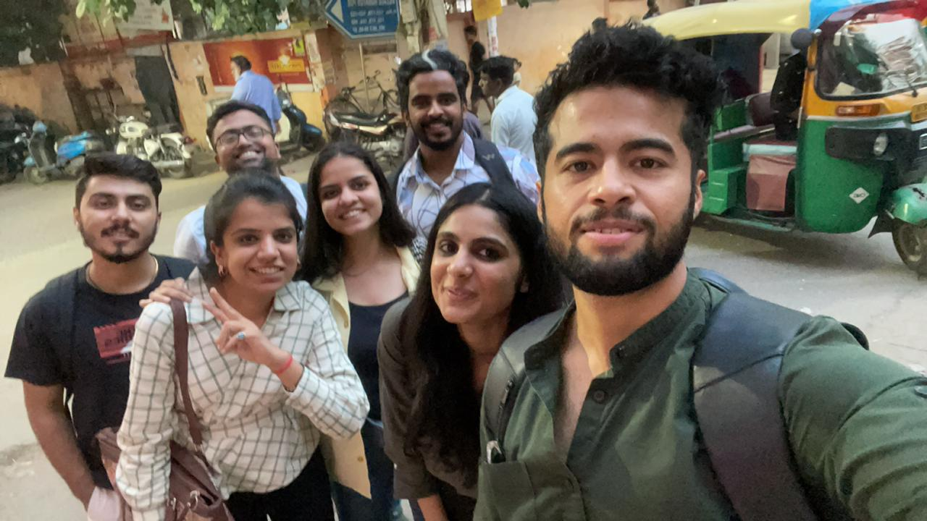
Pictorial Journey
Notes:
Source:
Noncommunicable diseases country profile 2018. https://apps.who.int/iris/handle/10665/274512
Source: WHO Best buys’ and other recommended interventions for the prevention and control of noncommunicable diseases. https://apps.who.int/iris/handle/10665/259232

Slide 27
Pictorial Journey

Slide 28
T
H
A
N
K
Y
O
U
Impact Of Different Work-Office Models on Corporate Employees’ Mental, Physical, and Social Wellbeing in Hindustan Times Building, K.G. Marg, New Delhi”
Notes:
Source:
Noncommunicable diseases country profile 2018. https://apps.who.int/iris/handle/10665/274512
Source: WHO Best buys’ and other recommended interventions for the prevention and control of noncommunicable diseases. https://apps.who.int/iris/handle/10665/259232

Slide 29
Results (1/6)
Gender Bias in AI
This review explores gender bias in Artificial Intelligence (AI) applications, analyzing 40 articles, blogs, research papers, and industry reports. It categorizes biases, into five categories: participation and representation, Barrier to Entry, Stereotypes, Image Recognition and Algorithm Fairness.
A) Participation and Representation
B) Barriers to Entry
STEM Workforce
Women in STEM fields make up nearly half of the total workforce but only represent 26%. In 2016, they made up 59% of the workforce but only 30% at major technology companies. India's tech industry faces significant underrepresentation, with only 7% of women holding executive positions. Low girls' participation in computer science courses restricts women entering tech careers. Despite a six-fold increase in AI talent availability, the rise in female representation remains gradual.
STEM Education
Despite efforts to promote STEM education, women remain underrepresented in the tech sector. The gender and generational gap is particularly concerning in lower middle-income nations, where 21% of women are online compared to 32% of men and 39% of young people use the internet. Despite outperforming boys in most STEM subjects at graduate level, women's participation in the ICT and digital sector is not improving significantly. Women's research in AI is particularly valuable, and it is crucial to highlight the valuable work of female researchers in various STEM sectors, particularly in AI.
India's tech sector faces barriers to women's representation, including stereotypes, gender bias, lack of female role models, and work-life balance issues. These factors discourage girls from pursuing STEM education and careers in technology. Societal beliefs about gender roles and expectations around childcare and household responsibilities further complicate the situation.
*ICT-Information and Communications Technology- technology that supports activities involving information. Such activities include gathering, processing, storing and presenting data. Increasingly these activities also involve collaboration and communication.

Slide 30
Results (4/6)
Gender Interaction with Technology
A) Access to Technology
B) Usage Pattern
India's digital landscape is marked by a significant gender gap in technology, particularly in internet access and usage. Women have lower access to the internet compared to men due to economic limitations, social norms, and lack of digital literacy training. In 2022, 65% of men subscribed to mobile services, while 49% of women subscribed to mobile services. The same gap exists in internet usage, with 62% of men using mobile internet compared to 35% of women. Men use technology for entertainment, information seeking, and communication, while women use it for education, online payments, and government services. Gender stereotypes also influence technology use, with women being less likely to engage in fields like coding and gaming.
Activity | Male (%) | Female (%)
Work-Related Tasks | 60 | 50
Social media | 20 | 30
Entertainment | 15 | 10
Education and Learning | 5 | 10
Figure 1- Subscription to Mobile Services Source1 Source2
Table 2- Internet Usage patterns of different gender Source

Slide 31
Conclusion
This scoping review has shed light on the concerning issue of gender bias in Artificial Intelligence (AI) and its applications. The analysis identified prevalent forms of bias, including skewed data sets, algorithmic discrimination, and gendered representations within AI systems. These biases can have significant ramifications, perpetuating existing societal inequalities and limiting opportunities for women.
The review also explored the interaction between genders and technology, highlighting the digital divide that disproportionately affects women's access and utilization of technology. Understanding these different usage patterns is crucial for designing inclusive AI systems that cater to diverse needs and preferences.
Furthermore, the study examined existing policies, initiatives, and practices aimed at promoting gender inclusivity in technology. These efforts by governments, organizations, and corporations offer a glimmer of hope in addressing the gender gap in AI and related fields. However, there's a need for continuous evaluation and improvement of these initiatives to ensure their effectiveness.
In moving forward, a crucial takeaway from this review is the importance of adopting intersectional approaches that acknowledge the interplay of gender with other forms of discrimination. By fostering collaboration between stakeholders and implementing inclusive design principles, we can work towards developing a more equitable and representative AI landscape. This will not only empower women but also ensure that AI serves as a tool for progress, benefiting all members of society.

Slide 32
Discussion (1/2)
The impact of gender bias in Artificial Intelligence (AI) and its applications has become a critical area of study, given the increasing reliance on AI across various sectors. This chapter discusses the findings of a scoping review on gender bias in AI, comparing and contrasting them with previous studies. The objectives of the research were to identify common forms of gender bias in AI, understand gender interactions with technology, and summarize policies and initiatives promoting gender inclusivity in technology.
Gender Bias in AI
The review identified several common forms of gender bias in AI, including biased data, algorithmic discrimination, and gendered representations in AI applications. Biased data often stems from historical and societal biases that are ingrained in the datasets used to train AI models. For instance, Bolukbasi et al. (2016) demonstrated that word embedding models trained on large text corpora exhibit gender stereotypes, associating men with professions like "doctor" and women with "nurse”. This aligns with findings by Mehrabi et al. (2021), who noted that AI systems trained on biased data perpetuate and even amplify these biases.
Algorithmic discrimination occurs when the decision-making processes of AI systems disproportionately affect one gender over another. A notable example is Amazon's recruitment algorithm, which was found to downgrade resumes that included words typically associated with women, such as "women's chess club captain”. Similarly, research by Buolamwini and Gebru (2018) highlighted that facial recognition systems exhibit higher error rates for women and people of color compared to white men, raising concerns about the fairness and equity of these technologies.
Gender Interactions with Technology
Understanding how different genders interact with technology reveals disparities in access, usage patterns, and preferences. The digital divide remains a significant issue, with women in many parts of the world having less access to digital technologies compared to men. According to a report by the International Telecommunication Union (ITU), the global internet user gender gap stood at 17% in 2019, with the gap being more pronounced in developing countries. This gap affects women's ability to leverage digital tools and resources, hindering their participation in the digital economy.
In terms of usage patterns, studies have shown that men and women use technology differently, influenced by social and cultural factors. For example, a study by Pew Research Center found that women are more likely to use social media platforms for communication and networking, while men are more inclined towards using technology for information and entertainment. These differences necessitate the design of gender-sensitive technologies that cater to diverse needs and preferences.

Slide 33
Discussion (1/2)
Policies, Initiatives, and Practices for Gender Inclusivity
The review also summarized existing policies, initiatives, and practices aimed at promoting gender inclusivity in technology. Various organizations and governments have implemented measures to address gender bias in AI and technology. For instance, the European Commission's Horizon 2020 program includes specific actions to integrate gender perspectives into research and innovation processes. Additionally, initiatives like the Women in AI (WAI) network work towards increasing the representation and participation of women in AI through mentorship, advocacy, and education.
Corporate practices also play a crucial role in promoting gender inclusivity. Companies like Google and IBM have established diversity and inclusion programs that focus on recruiting, retaining, and advancing women in tech roles. These programs often include bias training, mentorship opportunities, and policies aimed at creating an inclusive workplace culture.
Comparison with Previous Studies
The findings of this research are consistent with previous studies that highlight the pervasive nature of gender bias in AI. For instance, the work of West et al. (2019) corroborates the presence of gender biases in AI applications, emphasizing the need for systemic changes in the way AI systems are designed and deployed. Furthermore, the recognition of differential access and usage patterns aligns with earlier research by the World Wide Web Foundation, which reported significant gender gaps in digital access and skills.
However, this review extends the discourse by providing a comprehensive framework for addressing gender bias in AI, emphasizing the importance of intersectional approaches that consider other forms of discrimination, such as race. This is crucial for developing holistic solutions that promote gender inclusivity in AI and technology.
Notes:
Source:
Noncommunicable diseases country profile 2018. https://apps.who.int/iris/handle/10665/274512
Source: WHO Best buys’ and other recommended interventions for the prevention and control of noncommunicable diseases. https://apps.who.int/iris/handle/10665/259232

