Slide 1
Project Report
Integrating Natural Language Processing with Clinical Decision Support System: A Scoping Review
Sheetal Garg
Organization - Healthficial
Enrollment no- PG/22/109
Name of the mentor: Dr. Anandhi Ramachandran
Submitted to: International Institute of Health Management Research [IIHMR], Delhi.

Slide 2
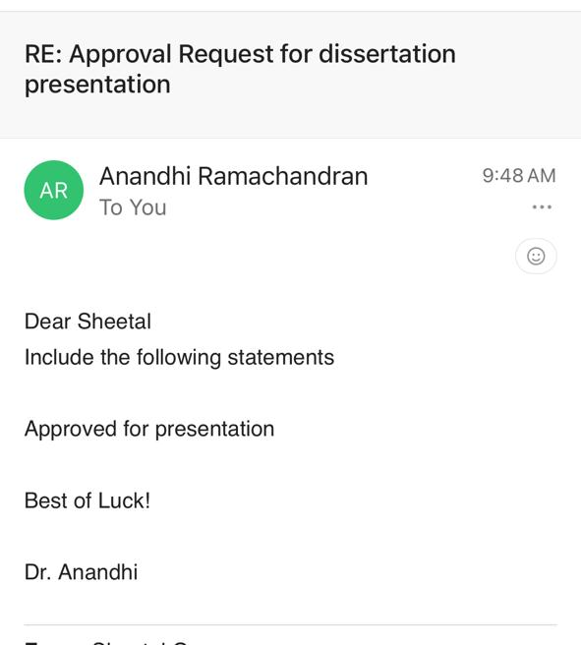
MENTOR APPROVAL

Slide 3
BACKGROUND
HealthFicial is the forefront in providing Digitalised Healthcare solutions to measurably improve the quality, safety, and efficiency of patient care. Our Company is aiming to make a difference in the lives of patients and care providers globally.
Their aim is to build tech-driven products and become a key part in the dramatic improvement in healthcare not only in India but across the globe. Our solution uses integrated AI technology, Deep tech, Innovation to shift traditional ways into the digital Healthcare Ecosystem in India and Beyond

Slide 4
INTRODUCTION
Clinical Decision Support Systems (CDSS) play a crucial role in modern healthcare by providing evidence-based recommendations to clinicians at the point of care. However, traditional CDSS interfaces can be cumbersome and require complex coding or menu navigation.
Natural Language Processing (NLP) offers a promising solution by enabling more natural and interactive communication with the system.

Slide 5
RATIONALE
Natural Language Processing (NLP) aids in analyzing unstructured medical data, enhancing data interpretation, efficiency, and real-time patient consultation in clinical settings. Integrating NLP into Clinical Decision Support Systems (CDSS) can improve healthcare delivery, especially in diagnostics and therapeutics. Research on NLP integration in CDSS is limited, but with platforms like chatbots using NLP, understanding the holistic picture is crucial.

Slide 6
OBJECTIVES
To comprehensively review existing research on the integration of NLP with CDSS functionalities.
To analyze the potential impact of NLP on clinician workflow, information retrieval efficiency, and decision-making processes.

Slide 7
RESEARCH QUESTION
How does the integration of Natural Language Processing (NLP) with Clinical Decision Support Systems (CDSS) impact clinician workflow efficiency, information retrieval?
Decision-making processes in healthcare, and what are the potential benefits, limitations, and ethical considerations associated with this integration?

Slide 8
METHODOLOGY (1/3)
Study Design: Secondary study using a scoping review approach. Search Strategy: To conduct this scoping review, a comprehensive and systematic search strategy was employed across multiple academic databases. The databases included PubMed, Google Scholar, ScienceDirect, Emerald Insight, IEEE Xplore, JGate, and Web of Science. The search terms were carefully selected to capture the relevant literature on the integration of NLP with CDSS. Search Terms: The following search terms were used- NLP Natural Language Processing, CDSS Clinical Decision Support System, Machine Learning, NLP models These terms were used in combination with Boolean operators (AND, OR) to refine the search and ensure comprehensive coverage of the relevant literature.

Slide 9
METHODOLOGY (2/3)
Article Retrieval The initial search yielded a total of 245 articles. These articles were then subjected to a rigorous screening process to ensure their relevance and quality.
Duplicate Removal: 45 duplicate articles were identified and removed. Articles remaining after duplicate removal: 200 Inclusion and Exclusion Criteria: Inclusion Criteria: Peer-reviewed research articles published within the last 5-10 years. Studies investigating the integration of NLP with CDSS functionalities. Government reports on CDSS adoption in India focusing on user needs and preferences. Exclusion Criteria: Non-English publications. Editorials, commentaries, or opinion pieces. Studies conducted outside of India. Conference abstracts or unpublished dissertations.

Slide 10
METHODOLOGY (3/3)
Eligibility Assessment: After applying the inclusion and exclusion criteria, 150 articles were excluded for various reasons such as being out of scope, non-peer-reviewed, or conducted outside the geographical focus area. Articles remaining after eligibility assessment: 50 Full-Text Review: The full texts of the remaining 50 articles were reviewed for relevance and quality. 30 articles were further excluded based on the full-text review as they did not meet the research objectives or lacked sufficient data on NLP-CDSS integration. Final Selection: The final selection included 20 articles that were deemed highly relevant and of sufficient quality to address the research question. List of Finally Selected Articles
Study duration: 3 months ( 15 March- 15 June 2024)

Slide 11
List of Finally Selected Articles
Das, S., & Murthy, V. (2018). "Adoption of Clinical Decision Support Systems in India: User Needs and Preferences.“
Garg, A. X., et al. (2005). "Effects of computerized clinical decision support systems on practitioner performance and patient outcomes: A systematic review.“
Gristock, A., et al. (2011). "Using NLP to interpret complex clinical guidelines on ventilator weaning.“
Huang, Y., et al. (2019). "Improving clinician workflow with NLP-powered information retrieval.“
Kawamoto, K., et al. (2007). "Improving clinical practice using clinical decision support systems: a systematic review of trials to identify features critical to success.“
Meystre, S. M., et al. (2008). "Extracting information from textual documents in the electronic health record: A review of recent research.“
Mitra, P., & Murthy, V. (2018). "Design considerations for NLP integration in clinical decision support systems.“
Shahar, Y., et al. (2001). "A framework for knowledge-based temporal abstraction in clinical domains.“
Shapiro, M., et al. (2018). "Assessing the impact of NLP-powered CDSS on long-term patient outcomes.“
Sweeney, L., et al. (2010). "The role of NLP in automating clinical tasks: A case study in medication reconciliation.“
Wu, S., et al. (2019). "Identification of key findings in radiology reports using natural language processing."

Slide 12
RESULTS (1/4)

Slide 13
RESULTS (2/4)
Thematic Analysis
A thematic analysis was conducted on the extracted data based on the pre-defined themes aligned with the research objectives. The main themes identified were:
User Needs and Preferences for NLP-CDSS Integration:
Studies exploring CDSS adoption in India to understand clinician preferences and potential barriers to NLP integration.
Key insights into user interface design considerations and training needs.
Impact on Clinician Workflow and Information Retrieval Efficiency:
Evaluation of how NLP functionalities improve clinician workflow and expedite access to relevant patient data.
Assessment of time saved and efficiency gains through task automation.
Potential Benefits and Limitations of NLP Integration in CDSS Decision-Making:
Analysis of NLP's role in interpreting clinical guidelines and providing evidence-based recommendations.
Identification of potential biases in NLP algorithms and the need for strategies to mitigate them.
Long-term impact on patient outcomes and the need for further research.

Slide 14
RESULTS (3/4)
Potential Benefits of NLP-CDSS Integration
Benefit | Description | Example
Improved Workflow Efficiency | Automates tasks, reduces time spent searching for information | NLP can automate medication reconciliation, freeing up clinician time.
Enhanced Information Retrieval | Facilitates faster access to relevant patient data | NLP can extract key findings from progress notes, making it easier for clinicians to find the information they need.
Real-Time Decision-Making Support | Provides evidence-based recommendations tailored to individual patients | NLP-powered CDSS can analyze patient data and suggest treatment options.
Improved Interpretation of Guidelines | Translates complex clinical guidelines into actionable recommendations | NLP can simplify complex guidelines, making it easier for clinicians to adhere to best practices.
Limitations and Challenges of NLP-CDSS Integration
Limitation/Challenge | Description | Potential Solution
Limited Long-Term Outcome Data | More research needed to confirm impact on patient outcomes | Conduct studies to investigate the long-term effects of NLP-CDSS on mortality rates, readmission rates, etc.
Potential for Bias in NLP Algorithms | Algorithms can inherit biases from training data, leading to inaccurate recommendations | Develop and implement strategies to mitigate bias in NLP algorithms used in CDSS.
User Needs and Preferences | Clinicians may require training and user-centered design for optimal utilization | Conduct user studies to understand clinician needs and preferences. Design NLP-CDSS with a focus on usability and ease of integration into existing workflows.
Data Privacy Concerns | Use of patient data in NLP algorithms raises privacy concerns | Implement robust data security measures and obtain informed consent from patients regarding data usage.

Slide 15
RESULTS (3/4)
The review identifies several key themes:
Improved Workflow and Efficiency: NLP can automate tasks and provide quick access to critical information, enhancing clinician efficiency.
Enhanced Decision-Making Support: NLP-powered CDSS can offer real-time, evidence-based recommendations tailored to individual patients.
User-Centered Design and Training: Successful implementation requires understanding user needs and providing comprehensive training.
Need for Further Research: More studies are needed to understand the long-term impact on clinical outcomes, cost-effectiveness, and ethical considerations related to bias and data privacy.

Slide 16
DISCUSSIONS
Discussion Based on Selected Articles
Improved Workflow Efficiency:
NLP automates routine tasks like medication reconciliation and information extraction from clinical notes, significantly reducing the time spent on these tasks (Sweeney et al., 2010; Huang et al., 2019).
Enhanced workflow efficiency allows clinicians to focus more on patient care and complex decision-making processes.
Enhanced Decision-Making Support:
Real-time evidence-based recommendations provided by NLP-powered CDSS improve clinical decision-making accuracy and speed (Garg et al., 2005).
NLP helps in the interpretation of complex clinical guidelines, making it easier for clinicians to adhere to best practices (Gristock et al., 2011).
User-Centered Design and Training:
The success of NLP-CDSS integration depends on user-centered design that aligns with existing clinical workflows (Mitra & Murthy, 2018).
Comprehensive training programs are necessary to ensure clinicians understand and effectively utilize NLP capabilities (Das et al., 2019).

Slide 17
CONCLUSION
Integrating NLP with CDSS has the potential to significantly enhance healthcare delivery by improving workflow efficiency, decision-making, and access to critical information. However, addressing user needs, mitigating biases, and conducting further research are crucial for the successful implementation and long-term benefits of NLP-CDSS in clinical practice.
Integrating NLP with CDSS has the potential to revolutionize healthcare delivery by improving workflow efficiency, decision-making, and access to information. However, addressing user needs, mitigating biases, and conducting further research are essential for successful implementation.
Conduct Comprehensive Training Programs: To ensure optimal utilization of NLP-CDSS, clinicians need to be trained on the capabilities and limitations of NLP.
Focus on User-Centered Design: Design NLP-CDSS systems that integrate seamlessly with existing clinical workflows.
Address Data Privacy and Bias: Implement robust data security measures and strategies to mitigate bias in NLP algorithms.
Further Research: Conduct studies to investigate the long-term effects of NLP-CDSS on patient outcomes, cost-effectiveness, and ethical implications.

Slide 18
REFERENCES
Ahmed, U., Iqbal, K., & Aoun, M. (2023). Natural Language Processing for Clinical Decision Support Systems: A Review of Recent Advances in Healthcare. Journal of Intelligent Connectivity and Emerging Technologies, 8(2), 1-16.
·Schopow, N., Osterhoff, G., & Baur, D. (2023). Applications of the Natural Language Processing Tool ChatGPT in Clinical Practice: Comparative Study and Augmented Systematic Review. JMIR Medical Informatics, 11, e48933.
·Shah, S., Ghomeshi, H., Vakaj, E., Cooper, E., & Fouad, S. (2023). A review of natural language processing in contact centre automation. Pattern Analysis and Applications, 26(3), 823-846.
·van de Burgt, B. W., Wasylewicz, A. T., Dullemond, B., Grouls, R. J., Egberts, T. C., Bouwman, A., & Korsten, E. M. (2023). Combining text mining with clinical decision support in clinical practice: a scoping review. Journal of the American Medical Informatics Association, 30(3), 588-603.
·Kumar, A., & Gond, A. (2023). Natural Language Processing: Healthcare Achieving Benefits Via Nlp. ScienceOpen Preprints.

Slide 19
THANK YOU

