Slide 1
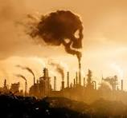
Clean Air for Delhi: An Analysis of Barriers to NCAP Targets and Recommendations for Improvement
Presented by : Dr. Shreya Srivastava ( PG/22/117) Mentor: Dr. Ratika Samtani
Organisation : IIHMR, Delhi

Slide 2
Mentor’s approval

Slide 3
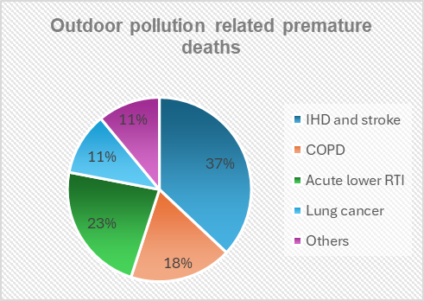
Introduction
Air pollution is a serious global concern with significant consequences to both environmental health and human health.
According to WHO , ambient and household air pollution causes 6.7 million premature deaths annually all over the globe.
2019 – 4.2 million premature deaths due to ambient air pollution ; 89% deaths contributed by low income and middle-income countries
Key pollutants : CO, SO2, NO, Volatile organic compounds, O3 and particulate matter.
PM 2.5 is the most dangerous as it can penetrate through the lungs and further enter the body through the blood stream, affecting all major organs.
PM 2.5 exposure claimed 238,000 & 253,000 premature deaths in 2020 and 2021 respectively in EU-27.

Slide 4
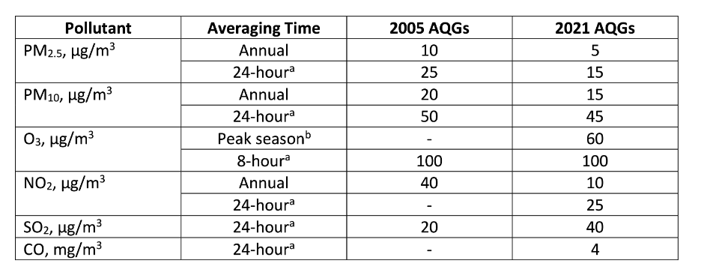
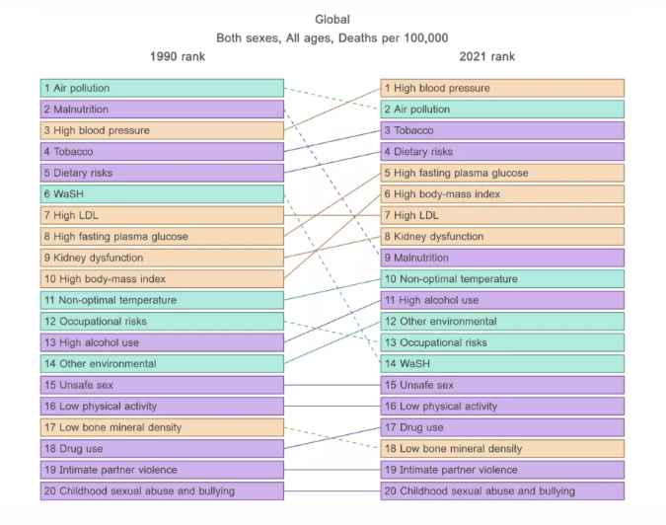
According to global burden of disease 2021, air pollution is the second leading cause of death ,surpassed only by high blood pressure.
Central and South Asia regions are worst affected by air pollution and India is one of them .
The WHO Air quality guidelines are a set of evidence-based recommendations of limit values for specific air pollutants developed to help countries achieve air quality that protects public health.
The WHO Air quality guidelines recommend levels and interim targets for common air pollutants: PM, O3, NO2, and SO2.

Slide 5
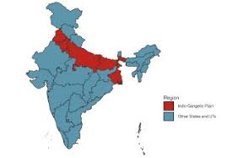
India was the Third most polluted country in the world in 2023.
In 2019, 0.98 Million premature deaths were claimed by ambient air pollution and 0.61 Million by indoor air pollution.
Out of top 50 most polluted cities in the world, 42 belonged to India.
Cities located on Indo-Gangetic plains and metropolitan cities like Chennai, Mumbai and Kolkata are most affected.
17.8% of total deaths in 2019
Loss of economy
$38.6B ~1.3% of GDP
Life expectancy decreased by 5.3 years

Slide 6
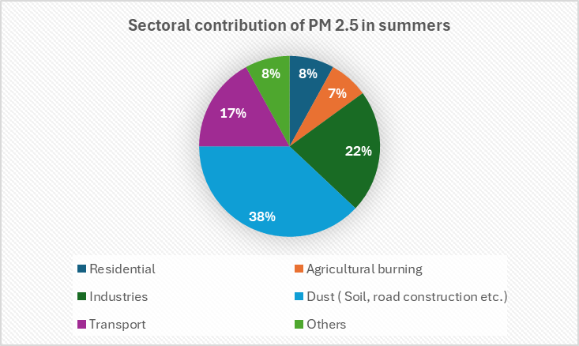
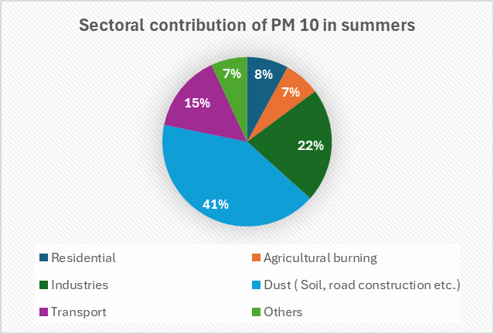
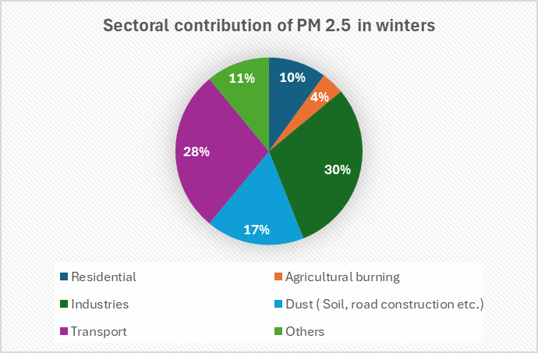
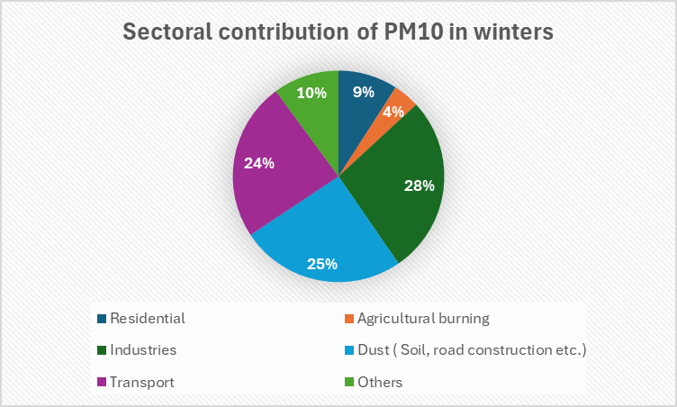
Delhi's air quality consistently ranks poorly on global air pollution indices.
IQAir's World Air Quality Report - Delhi has topped the charts in being world’s most polluted capital city consistently since 2018 to 2023.
In latest 2023 report, Delhi was ranked as the world's most polluted capital city and the third most polluted city overall.
Analysis of IQAir’s data by Greenpeace South Asia reveals that PM2.5 air pollution claimed approximately 54,000 lives in India’s national capital in 2020
Estimated economic loss of around $8.1 billion per year, which is approximately 13% of the city's annual GDP.
Notes:
https://www.greenpeace.org/india/en/press/10991/1800-deaths-per-million-estimated-due-to-pm2-5-air-pollution-in-delhi-reveals-a-new-finding-by-greenpeace-and-iqair/
https://cpcb.nic.in/displaypdf.php?id=RGVsaGkucGRm

Slide 7
Government initiatives
1. | National Air Quality Monitoring Program (NAMP) | Nation-wide program for ambient air quality monitoring to monitor 4 pollutants i.e. SO2, NO, PM10, PM2.5. The objectives is to determine the status and trends of ambient air quality, ascertain whether the prescribed ambient air quality standards are violated, identify non-attainment cities, obtain the knowledge and understanding necessary for developing preventive and corrective measures, and understand the natural cleansing processes undergoing in the environment through pollution dilution, dispersion, wind-based movement, dry deposition, precipitation, and chemical transformation of the pollutants generated.
2. | National Ambient Air Quality Standards (NAAQS) | These are the standards for ambient air quality with reference to various identified pollutant notified by the CPCB under the Air (Prevention and Control of Pollution) Act, 1981.The major objectives are to specify the required air quality levels and safety limits to safeguard vegetation, human health and property; serve as a uniform national benchmark for air quality assessment; and determine the scope and requirements for air quality monitoring programs across the country.
3. | National Air Quality Index (AQI) | Tool for the effective communication of air quality status to people in terms, which are easy to understand. It transforms complex air quality data of various pollutants into a single number (index value), nomenclature and colour.
4. | Environment Protection(Prevention and Control) Authority | It is a central government constituted committee for the National Capital Region (NCR) in compliance with the Environment Protection Act, 1986 to address air pollution. EPCA's primary role is to monitor and manage air quality in the NCR region, which includes issuing directions to the states, conducting site inspections, and imposing fines for non-compliance.

Slide 8
5. | 42 Action points | The CPCB has issued a comprehensive set of directions under Section 18 (1) (b) of Air (Prevention and Control of Pollution) Act, 1986, for the implementation of 42 measures to mitigate air pollution in the major cities, including Delhi and NCR comprising action points to counter air pollution, which include control and mitigation measures related to vehicular emissions, re-suspension of road dust and other fugitive emissions, bio-mass/municipal solid waste (MSW) burning, industrial pollution, construction and demolition (C&D) activities, and other general steps
6. | Graded Response Action Plan (GRAP) | The government has notified a graded response action plan for Delhi and the NCR region, which comprises the graded measures for each source framed according to the AQI categories.
7. | Other measures | Advanced vehicle emission and fuel quality standards– BSIV from 2017 and BS-VI from 2020. Introducing a National Electric Mobility Mission Plan 2020. Introducing gas as an automotive fuel in many cities. Introduction and enhancement of the metro-rail and bus-based public transport systems in selected cities. Ujjawala scheme to accelerate the LPG penetration programme for cooking in households. Electrification to reduce kerosene consumption for lighting. Introducing an energy-efficiency labelling programme for energy-intensive home appliances such as air conditioners. Notifying new stringent standards for diesel generator sets for standby power generation.

Slide 9
Research Question
Despite the implementation of the government's comprehensive National Clean Air Program (NCAP) for five years, why has Delhi remained a non-attainment city, failing to achieve the dedicated targets set by the program to reduce air pollution?
Objectives
To shed light on the government's comprehensive National Clean Air Program (NCAP)
To identify key factors hindering Delhi's achievement of the National Clean Air Programme (NCAP) set targets.
To provide some evidence-based actionable recommendations that can be implemented in Delhi to combat air pollution and achieve set targets.

Slide 10
Methodology
Study design : Narrative literature review
Study population : Delhi, Seoul , Beijing
Data type : Secondary data including published papers and articles, Official websites and portals of government, statistical reports, reports by various government and non- government organisations, Press release documents by government, relevant articles.
Duration : 3 months ( 1 March 2024 to 31 May 2024)
Search engines : Google, Google scholar, PubMed, Scopus,
Key words : "Air pollution Delhi," "Ambient air pollution India," "NCAP India," "PM2.5," "PM10," "Climate change," "Smog," "Air quality," "Indoor air pollution," "respiratory diseases," "Vehicular emissions,"

Slide 11
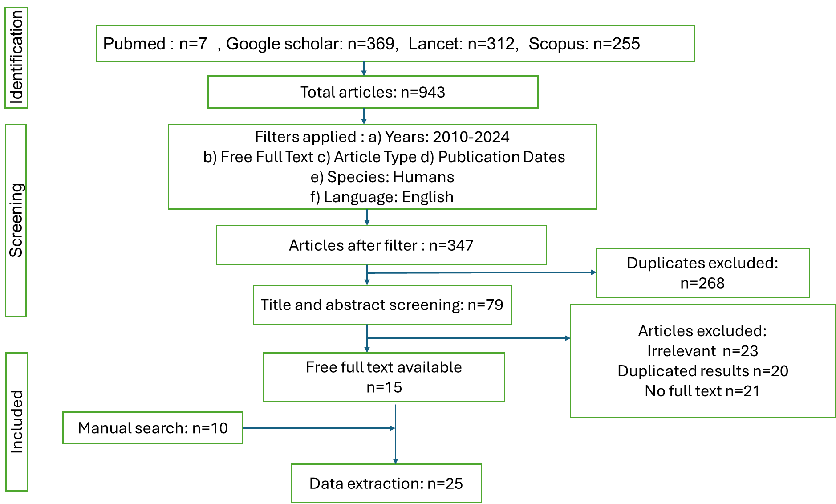

Slide 12
Launched in 2019 by MoEFCC, aiming to improve air quality of cities , states and UTs’
Results
1
2
3
4
Target
National level target
of 20-30% reduction
of PM2.5 and PM10
concentration by 2024.
Tenure
Mid-term five (5) years action plan to begin with keeping 2019 as base year.
Further extendable to 20-25 years in long-term after mid-term review of the outcomes.
Objective
Stringent implementation of mitigation measures for prevention, control and abatement of air pollution.
Augment and strengthen air quality monitoring network across the country.
Augment public awareness and capacity building measures
Approach
Multisectoral and collaborative
Mainstreaming and integration into the existing policies and programmes of GoI including NAPCC.
Use SMART city framework to launch NCAP in the 43 smart cities falling in the list of 102 non-attainment cities

Slide 13
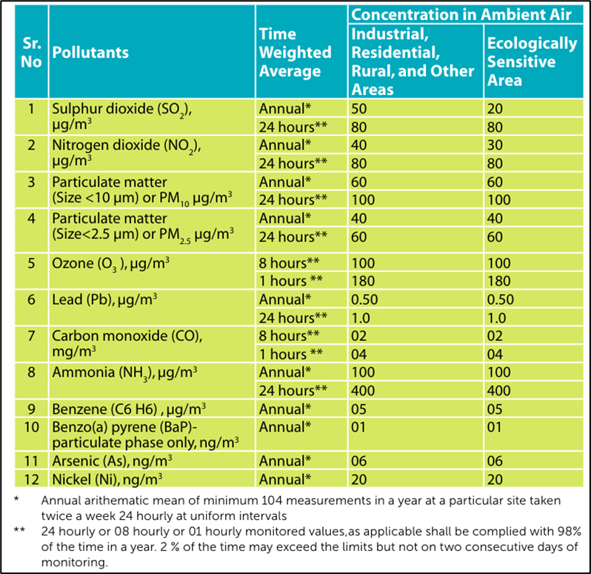
Goal
to meet the prescribed annual average ambient air quality standards at all locations in the country in a stipulated timeframe (long-term).
Stakeholders
Ministry of Road Transport and Highway,
Ministry of Petroleum and Natural Gas,
Ministry of New and Renewable Energy,
Ministry of Heavy Industry,
Ministry of Housing and Urban Affairs,
Ministry of Agriculture,
Ministry of Health,
NITI Aayog,
CPCB,
experts from the industry, academia
civil society.

Slide 14
Action plan
1
2
3
Knowledge and database augmentation
Mitigation actions
Institutional strengthening
1.Public Awareness and Education:
2.Training and Capacity Building:
3.Setting up Air Information Centre:
4.Certification System for Monitoring Instruments:
5.Air Quality Forecasting System:
6.Network of Technical Institutions - Knowledge Partners:
7.Technology Assessment Cell:
8.Institutional Framework
1.Air Quality Monitoring Network:
2.Extend source apportionment studies to all 102 non-attainment cities
3.Undertake air pollution health and economic impact studies
4.Establish international cooperation and sharing of best practices
5.Review ambient air quality standards and emission standards periodically
6.Formalize a comprehensive National Emission Inventory
1.Stringent enforcement through three-tier monitoring, assessment, and inspection system
2.Extensive plantation drive, especially at pollution hotspots
3.Support for clean technologies through R&D, pilots, and implementation
4.Formulate regional and transboundary plans
5.Sectoral interventions:

Slide 15
Amount of ~Rs 9650 Cr has been released to the identified 131 cities from FY 2019-20 till FY 2023-24 (till 15th Dec) under NCAP.
Out of ~ Rs 9650 Cr, an amount of Rs 1292.50 Cr has been released to cities which are funded under NCAP, out of which Rs 480.92 Cr has been utilised (till 15th Dec)
Rs 8357.51 Cr has been released to the cities that are funded under Fifteenth Finance Commission (XV-FC), out of which Rs5835.03 Cr (till 15th Dec) has been utilised for improvement in air quality.
Pre-requisites to release funds
Budget allocation
100% utilisation of funds released during 2019-20 till 2021-22;
Minimum 75% utilisation of funds released during FY 2022-23;
Submission of proposals under Nagar Van Yojana
Submission of proposals under SBM2.0
Incorporation of Mission LiFE activities under City Action Plan and Annual Action Plan
Preparation of Annual Action Plan for FY 2023-24
Incorporation of establishment of Automatic Testing Stations (ATS) and Registered Vehicle Scrapping Facilities (RVSF) in State and City Action Plans (1 RVSF each in 52 cities; 1 ATS in 127 cities)
Utilisation of funds under Swachh Vayu Sarvekshan provided for FY 2022-23 and 2023-24;
State-wise report card was presented regarding status of submission Annual Action Plans

Slide 16
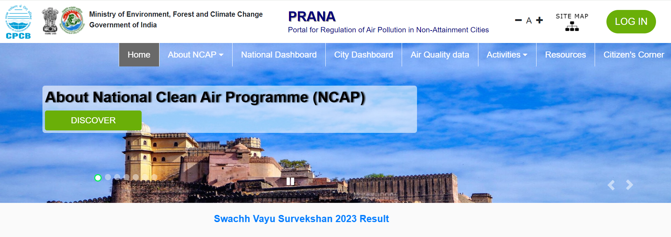
Monitoring of NCAP
The PRANA (Portal for Regulation of Air-pollution in Non-Attainment cities) portal has been instrumental in combating Delhi's air pollution crisis.
It facilitates tracking the implementation of the National Clean Air Programme (NCAP) and city-specific action plans, ensuring transparency and accountability.
The portal enables real-time data collection and analysis of pollution sources, aiding in formulating effective policies.

Slide 17
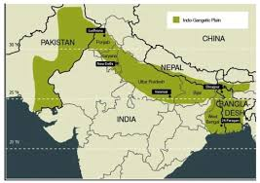
Factors causing hinderance in achieving targets
Geographic and meteorological conditions
Delhi's geographical location in the Indo-Gangetic Plain, surrounded by the Himalayas to the north, the Aravalli hills to the south, and the Thar Desert to the west, creates a "bowl" effect that traps pollutants, preventing their natural dispersal and causing them to accumulate.
This issue is exacerbated by north-westerly winds from Rajasthan, Pakistan, and Afghanistan that carry dust and pollutants into the region, where they are trapped by the Himalayas.
The situation worsens in winter when cold air settles over northern India, preventing warm air from rising and dispersing pollutants, thereby trapping pollution near the surface and increasing its impact on human health.
Seasonal variations also affect pollution sources: during winter, the contribution from vehicles, biomass burning, municipal solid waste burning, firecrackers, stubble burning, construction activities, and secondary particles increases, while in summer, road dust, fly ash, and biomass burning are more influential.
The Indo-Gangetic Plain's geographical disadvantages, compounded by its landlocked nature and dry alluvial soil, contribute significantly to wind-blown dust and air pollution, creating a persistent and severe air quality challenge for Delhi.

Slide 18
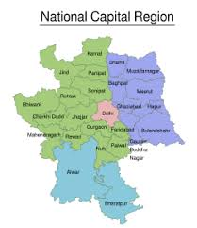
Cross border non- coordination
This is particularly evident in the case of Delhi, where the issue of stubble burning in the neighboring states of Punjab, Rajasthan, and Uttar Pradesh contributes significantly to the city's air pollution woes.
The inconsistent implementation of the program across different cities and states further exacerbates this problem, leading to disparities in air quality improvement efforts. While some cities have effectively utilized their allocated funds, others have fallen behind, creating a patchwork of progress that ultimately undermines the overall goals of the program.
Moreover, the absence of a legal mandate for implementing clean air plans hinders accountability and enforcement. Without a clear legal framework, the implementation of NCAP plans is often delayed or incomplete, further compounding the challenges posed by regional non-coordination.

Slide 19
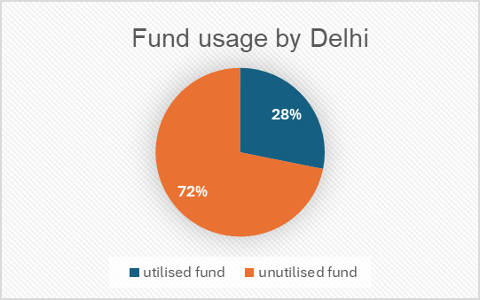
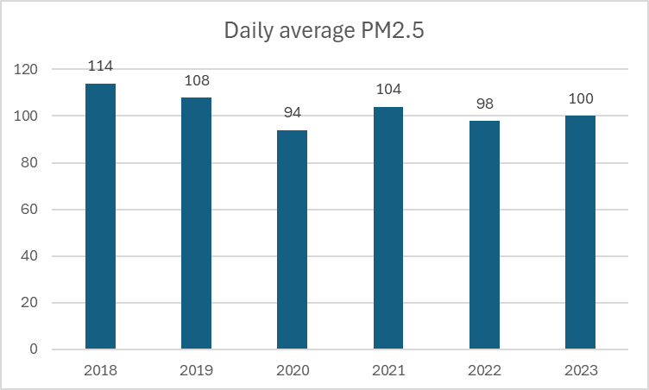
Underutilization of allocated funds
According to the press release by government of India, despite being allocated ₹38.21 crore, Delhi has only utilized 28%, amounting to ₹10.77 crore.
Specifically, the city has spent just 23.32% of funds earmarked for air quality monitoring, a critical component of NCAP.
This financial inefficiency directly impacts Delhi's ability to meet its air quality goals, as evidenced by its high annual average PM2.5 concentration of 102 µg/m3 in 2023, the highest among 92 cities in India.
In contrast, other cities like Mumbai and Kolkata have effectively utilized 72.48% and 93% of their NCAP funds, respectively.
The underutilization in Delhi is attributed to bureaucratic delays and inefficiencies, such as issues with tendering processes, procurement, and lack of standard operating procedures. This financial mismanagement not only hampers progress towards cleaner air but also endangers public health, exposing residents to severe pollution-related health risks, especially those with pre-existing respiratory conditions.

Slide 20
Case Study – Beijing’s war against pollution
Situation
Solution
China's high population, rapid industrialization, status as the world's largest automobile producer and consumer, and dependency on coal energy have led to alarmingly high levels of air pollution in the country.
In capital city Beijing in 2013, the average PM2. 5 concentration was seventeen times the amount the World Health Organization (WHO) considers safe.
Clean air action plan 2013-2017
Coal combustion reduction
Industrial restructuring
Residential sector inventions
Vehicular emission control
Coordination with surrounding areas – Teinjin and Heibei
Collaborative planning
Unified standards
Joint emergency response procedure
Real time data sharing
Increased Budget
Beijing's budget for air pollution control increased tenfold, from 1.7 billion Yuan in 2009 to 18.22 billion Yuan in 2017.
Results
Decreased pollutants
Regional improvement
Increased life expectancy
Sharp decline in pollutants- SO2 by 83%, Nox by 43%, PM2.5 by 55% and VOCs by 42%
Annual average PM2.5 concentration in BTH and surrounding areas decreased by 25%
Increase of 4.6 years of life expectancy of the local residents.
Long-Term Trends: From 1998 to 2018, Beijing achieved continuous improvements in air quality, with annual average concentrations of SO2, NO2, and PM10 decreasing by 93.3%, 37.8%, and 55.3%, respectively.

Slide 21
Case study – Seoul has lifted its smog
Situation
Solution
Rapid industrialization, urbanization, manufacturing growth, vehicle emissions, and coal dependence led to severe air pollution in Seoul.
The dense urban environment, high population density, and critical pollution levels by the 1990s prompted government and public attention toward addressing Seoul's air quality crisis.
The smog was so bad that the white shirts wore in the morning turn black by the evening.
1. Regulatory and Policy Measures
Special Act on the Improvement of Air Quality in the Seoul Metropolitan Area (2005):
Comprehensive Plan for Air Quality Improvement (2006): Focused on reducing emissions from key sectors like industry and transportation.
Air Pollutant Emission-Cap Regulation (2007, expanded in 2009): Provided total emission allowances to businesses and implemented an emissions trading system.
2. Transition and Technological Measures
Transition from Coal to Natural Gas
Stricter Emissions Standards
Promotion of Public Transportation and Green Technologies
3. Investments and Monitoring
Air Quality Monitoring Networks
Investment in Air Quality Management: Between 2007 and 2020, approximately $9 billion was invested in air quality management
Public Engagement and Evidence Generation
4. Specific Initiatives
Promotion of Environment-Friendly Driving Culture
Facilitation of Low Carbon, Eco-Friendly Modes of Transport:
International and Domestic Cooperation:
Reduction of Fine Particulate Matter (PM2.5):
Subway Air Quality Improvement:
Results
Reduction in particulate mater
Reduction in CO and NO2
Reduction in premature deaths
30-40% decline in Pm10 and 19% decline in PM2.5
16.9% decline in Co and 16.4% decline in NO2
Between 2006-2015, substantial reduction in mortality attributed to PM2.5
Notes:
Air pollution | Smog is lifting over greater Seoul (unep.org)

Slide 22
Discussion
The NCAP is a comprehensive initiative that adopts a multi-pronged approach, targeting various sources of air pollution. It encompasses a wide range of strategies, including stringent emission norms, promotion of clean technologies, and public awareness campaigns.
However, the study revealed some hindrances that Delhi needs to address in order to achieve the targets set under the National Clean Air Programme (NCAP).
Beijing and Seoul, previously grappling with severe air pollution, have successfully improved their air quality through strategic measures targeting emissions from multiple sources, serving as examples for other polluted cities. The factors hindering the target achievement of Delhi are seen already mitigated in these countries, which can be a major learning for Delhi.
Air quality management is a regional issue. Hence , collaboration and joint support of the regional areas is a necessity for the program to be effective.
This study can be continued further by studying and introducing new age concepts like how artificial intelligence can be incorporated to reduce air pollution.

Slide 23
Recommendations
Adequate utlisation of allocated funds
Mandating the utilization of a certain minimum percentage of the allocated funds within a given financial year, promoting timely and efficient spending.
Dividing the annual fund allocation into quarterly instalments, encouraging a consistent and systematic approach to fund utilization throughout the year.
Dedicating a specific portion of the allocated funds solely for the maintenance and upkeep of previously implemented measures, ensuring the long-term sustainability and effectiveness of existing pollution control initiatives
Continuous monitoring and evaluation of the effectiveness of the utilized funds should be undertaken, accompanied by a comprehensive assessment and identification of emerging issues that necessitate the implementation of new measures to address air pollution effectively.
Meteorological and geographical factors
Introducing high smog towers and vertical forests can help in reducing pollution levels by acting as air purifiers and green lungs within the city.
Increasing the number of Air Quality Index (AQI) monitoring stations, akin to Beijing's extensive network of 1000 stations, would enhance real-time data collection for better decision-making.
Incorporating artificial intelligence (AI) for early prediction and management of high smog or bad air quality days can enable proactive measures.
scaling up afforestation projects would not only increase oxygen production but also stabilize soil, thereby reducing dust in the air.
Additionally, accelerating trials of cloud seeding and cloud bursting techniques could offer potential solutions to mitigate severe air pollution episodes.

Slide 24
Cross border coordination
Establishing a collaborative committee with authorities from Delhi and the three surrounding states.
Developing unified planning and policies applicable across all neighboring regions.
Creating a common portal for sharing data and providing technical and financial support.
Implementing joint responses to heavy pollution episodes.
Coordinating efforts to control vehicle pollution, including joint inspections and penalties for violations outside the vehicle's registered city.
Public awareness and participation
Promoting car sharing and offering incentives for public transport usage.
Raising awareness about economic and environmentally friendly driving practices.
Encouraging reduction of car idling to minimize emissions.
Providing incentives for scrapping old vehicles and promoting the use of clean fuel vehicles.
Educating residents about eco-friendly methods of stubble clearing and offering incentives for their adoption.

Slide 25
Sustainability and optimization of infrastructure and vehicles
1.Infrastructure optimization:
Dust-free roads through regular cleaning and maintenance.
Replacing gravel roads by concrete
Pressure washing of roads
Expansion of public transport fleet and metro rail routes to encourage modal shift.
2.Strict Regulations:
Stringent regulations against construction and demolition activities to mitigate dust emissions.
Strict emission standards and periodic checks for pollution-causing vehicles.
Implementation of low-emission zones and vehicle restrictions in highly polluted areas.
3.Sustainable Transportation:
Incentives for the adoption of electric vehicles and promotion of shared mobility services.
Development of dedicated cycling infrastructure and pedestrian-friendly zones.
Expansion of public transport infrastructure powered by renewable energy.

Slide 26
Conclusion
Air pollution has not only affected public health but also has tarnished Delhi’s international reputation. Reducing air pollution will improve its global image as a sustainable metropolis.
As urbanization accelerates and population density increases, it becomes more crucial to control rising pollution levels, as a larger population leads to higher consumption of fossil fuels, resulting in more people falling ill and increased mortality rates.
The National Clean Air Programme (NCAP) plays a pivotal role in this transformation by setting ambitious targets and implementing comprehensive strategies to curb pollution sources such as vehicular emissions, industrial activities, and agricultural practices. Effectively implementing NCAP will significantly benefit the health of Delhi's residents.
The case studies of Beijing and Seoul effectively demonstrate that the targets set by the National Clean Air Programme (NCAP) are achievable if the government and citizens collaborate and cooperate effectively.

Slide 27
Sustainable practices promoted under NCAP, such as renewable energy adoption and green technologies, also spur innovation and entrepreneurship, further boosting the economy.
By prioritizing air quality improvement, Delhi can emerge as a leading global city that balances growth with environmental stewardship, ultimately benefiting present and future generations alike.

Slide 28
References
Darbari S, Block. D Final Report Source Apportionment of PM2.5 & PM10 of Delhi NCR for Identification of Major Sources Prepared for Department of Heavy Industry Ministry of Heavy Industries and Public Enterprises, New Delhi The Energy and Resources Institute [Internet]. 2018. Available from: https://www.teriin.org/sites/default/files/2018-08/Report_SA_AQM-Delhi-NCR_0.pdf
NCAP NATIONAL CLEAN AIR PROGRAMME [Internet]. Available from: https://moef.gov.in/wp-content/uploads/2019/05/NCAP_Report.pdf
National Clean Air Programme (NCAP) to improve air quality in 131 cities by engaging all stakeholders [Internet]. Gov.in. [cited 2024 Jun 19]. Available from: https://pib.gov.in/PressReleaseIframePage.aspx?PRID=1909910
Promise of Seoul [Internet]. Iclei.org. [cited 2024 Jun 19]. Available from: https://e-lib.iclei.org/promise-of-seoul/
Goodwill Ambassadors. Once enough to stain shirt collars, smog is lifting over greater Seoul [Internet]. UNEP. United Nations Environment Programme; 2024 [cited 2024 Jun 19]. Available from: https://www.unep.org/news-and-stories/story/once-enough-stain-shirt-collars-smog-lifting-over-greater-seoul
‌Government launches National Clean Air Programme (NCAP) [Internet]. Gov.in. [cited 2024 Jun 19]. Available from: https://pib.gov.in/pressreleaseiframepage.aspx?prid=1559384

Slide 29
References
Ambient (outdoor) air pollution [Internet]. Who.int. [cited 2024 Jun 19]. Available from: https://www.who.int/news-room/fact-sheets/detail/ambient-(outdoor)-air-quality-and-health
Premature deaths due to exposure to fine particulate matter in Europe [Internet]. Europa.eu. [cited 2024 Jun 19]. Available from: https://www.eea.europa.eu/en/analysis/indicators/health-impacts-of-exposure-to
Health impacts of air pollution in Europe, 2022 [Internet]. European Environment Agency. 2022 [cited 2024 Jun 19]. Available from: https://www.eea.europa.eu/publications/air-quality-in-europe-2022/health-impacts-of-air-pollution
India G. 1800 deaths per million estimated due to PM2.5 air pollution in Delhi, reveals a new finding by Greenpeace and IQAir [Internet]. Greenpeace India. [cited 2024 Jun 19]. Available from: https://www.greenpeace.org/india/en/press/10991/1800-deaths-per-million-estimated-due-to-pm2-5-air-pollution-in-delhi-reveals-a-new-finding-by-greenpeace-and-iqair/

Slide 30
References
Guttikunda S, Ka N, Ganguly T, Jawahar P. Plugging the ambient air monitoring gaps in India’s national clean air programme (NCAP) airsheds. Atmos Environ (1994) [Internet]. 2023;301(119712):119712. Available from: http://dx.doi.org/10.1016/j.atmosenv.2023.119712
Garg A, Gupta NC. The great smog month and spatial and monthly variation in air quality in ambient air in Delhi, India. J Health Pollut [Internet]. 2020 [cited 2024 Jun 19];10(27). Available from: http://dx.doi.org/10.5696/2156-9614-10.27.200910
Sharma D, Mauzerall D. Analysis of Air Quality Data in India between 2015 and 2019. Aerosol and Air Quality Research. 2022;22(2):210204.
Guttikunda SK, Dammalapati SK, Pradhan G, Krishna B, Jethva HT, Jawahar P. What is polluting Delhi’s air? A review from 1990 to 2022. Sustainability [Internet]. 2023;15(5):4209. Available from: http://dx.doi.org/10.3390/su15054209
Tyagi B. India’s economic growth and disease burden in relation to air pollution. Lancet Reg Health Southeast Asia [Internet]. 2022;7(100081):100081. Available from: http://dx.doi.org/10.1016/j.lansea.2022.100081

Slide 31
Thank you
Thank you

