Slide 1
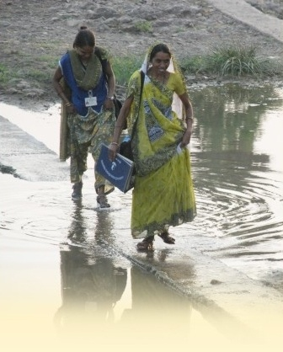
“Competency Assessment of the ASHAs in the four tribal blocks of Vadodara district, Gujarat”
Presented by:-
Gursimran Alagh

Slide 2
Reflection from the Internship
Mission:-
To create an enabling and sustainable environment among rural communities. We envisage a world free of distress, disease, deprivation, exploitation and subjugation, thus ensuring the overall well being of the family, society and community with special focus on women and children.
Organizational Objectives:-
To promote practices for safe motherhood and child survival
To make available health and pre-school education services to the rural poor
To ensure livelihood through dairy cooperatives and savings groups
To provide relief and rehabilitation services during disasters

Slide 3
Rationale for the study
In 2005, the Foundation started an intervention project “Safe motherhood and Child Survival” (SMCS).
Deepak Foundation trained more than 700 Village Level Health Workers (VLHWs) during the period of 2005 -2007.
After the introduction of NRHM in 2007 in Gujarat, these VLHWs were absorbed as Accredited Social Health Activists (ASHAs).
The District Health Society recognized Deepak Foundation as the Training Resource Agency for ASHA training programs in the Vadodara district.

Slide 4
Objectives of the study
General objective :-
To evaluate the Competency and Performance of the ASHAs in the four tribal blocks of the Vadodara district at different levels.

Slide 5
Specific objectives :-
To assess the trainings imparted to the ASHAs under the standard NRHM guidelines based on their Knowledge, Awareness and Practices.
To assess the perception of the different stakeholders and beneficiaries on the effectivity and efficiency of the working of the ASHAs
To evaluate the ability of the ASHAs to track and maintain database of all pregnant and nursing mothers in their operational areas
To identify the gaps in the capacity building of the ASHAs
To assess the need for ASHAs refresher training module on the basis of the perceptions at different levels.

Slide 6
METHODOLOGY
Type of study : Descriptive (Observational)
Study design : Cross-sectional
Study area : 4 tribal blocks (Kawant, Chhota Udepur, Nawadi and Pavi Jetpur)

Slide 8
Study unit : ASHAs, ANMs/FHWs, MOs, VHSC members and Beneficiaries
Sampling : Blend of purposive and random sampling
Scheme of sample selection :
Scheme and tools of data collection :

Slide 9
Sno. | Stage of selection | Method of selection | No. of units | Remarks
1 | Block | Purposive | 4 | Out of the 12 blocks in Vadodara district, four tribal blocks were chosen for the study
2 | MO’s | Purposive | 26 | All the MO’s (PHC’s) in the 4 blocks
3 | ANM’s | Purposive | 190 | All the ANM’s (SC’s) in the 4 blocks
4 | ASHA’s | Purposive | 780 | All the trained ASHA’s in the 4 blocks
5 | VHSC’s | Random | 72
6 | Beneficiaries | Random | 12 | 2 in each block ( 1 pregnant and 1 lactating mothers)

Slide 10
Sno. | Level of data collection | Respondents | Method of data selection | Instrument used | Method of data collection
1 | PHC | MO | Purposive | In-depth interview | Semi-structured interview schedule
2 | Sub-centre | ANM | Purposive Random | Questionnaire In-depth interviews | Semi-structured Semi-structured interview schedule
3 | Village | VHSC ASHA | Random A) Purposive B) Random | FGD A) Questionnaire B) In-depth interviews | Guidelines A) Semi-structured B) Semi-structured interview schedule

Slide 11
STUDY FINDINGS
1.) ASHAs

Slide 13
2.) ANMs/FHWs

Slide 16
3.) MOs

Slide 20
4.) FGDs with VHSC members
Objectives of conducting FGDs :
To understand the perception of VHSC members regarding the role of ASHAs in:-
a.) The social mobilization and voicing the health concerns of the community.
b.) Availing and accessing the public health services.
c.) Coordination with various government stakeholders to address the health concerns.

Slide 21
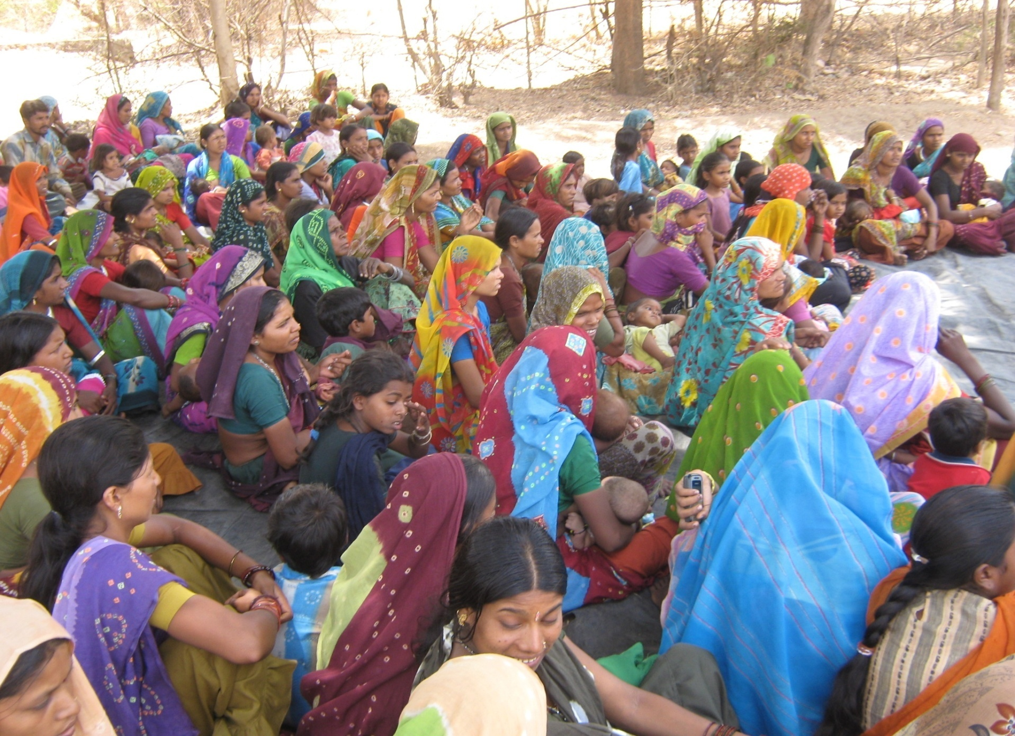
5.) Beneficiaries

Slide 22
RECOMMENDATIONS
Background characteristics
Population coverage
Roles and responsibilities
Trainings required
Role in VHSC
Infrastructural developments
Incentives
Logistics – medicine kit
Communication and coordination
Community mobilization

Slide 23
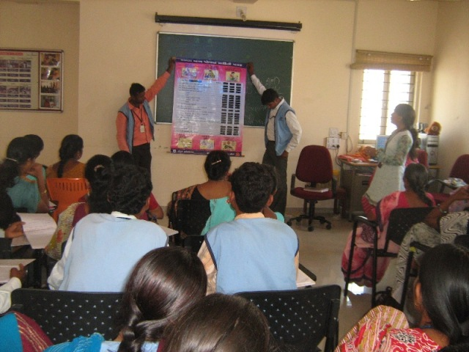
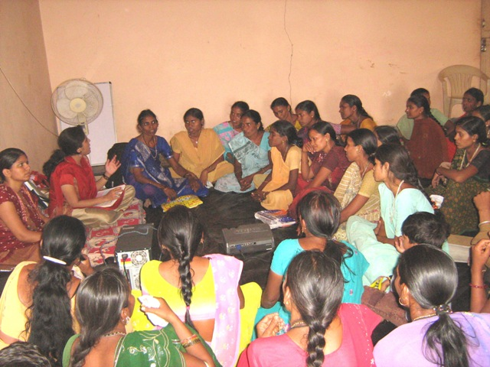
es
Trainings

Slide 24
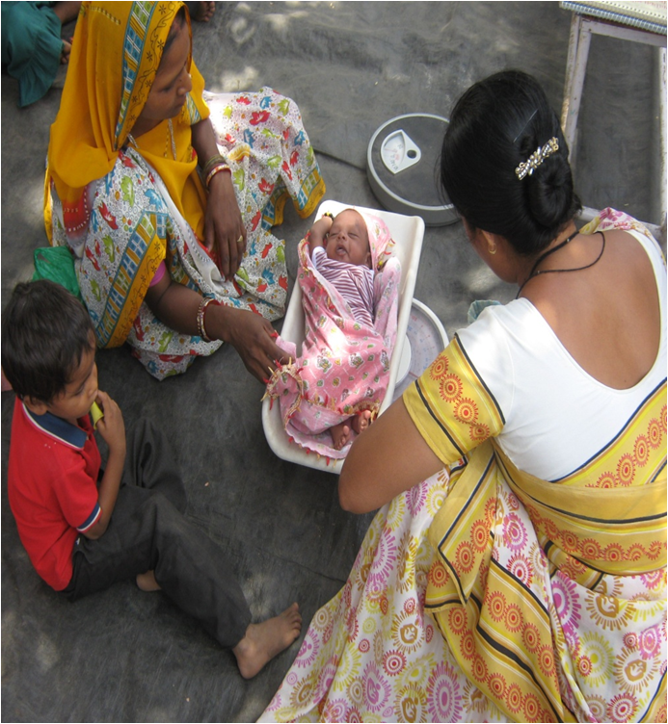
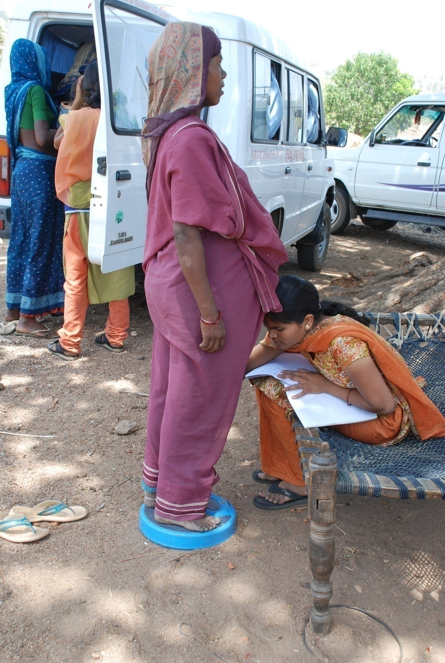

Slide 25
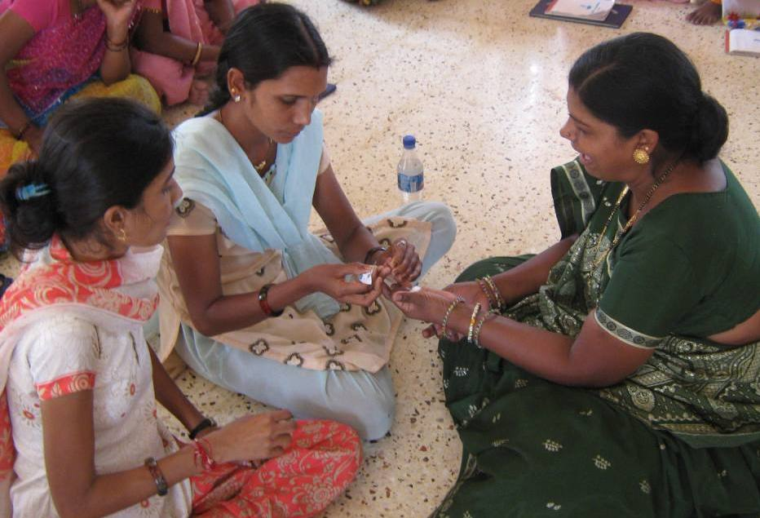

Slide 26
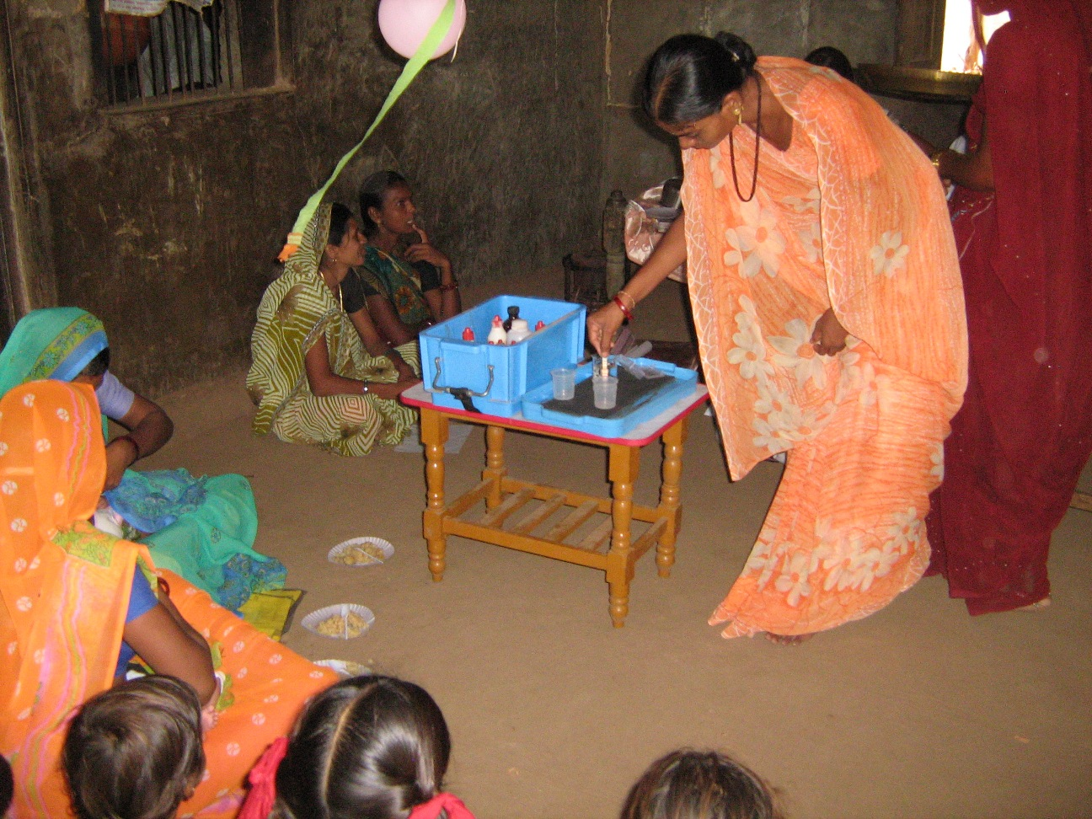

Slide 27
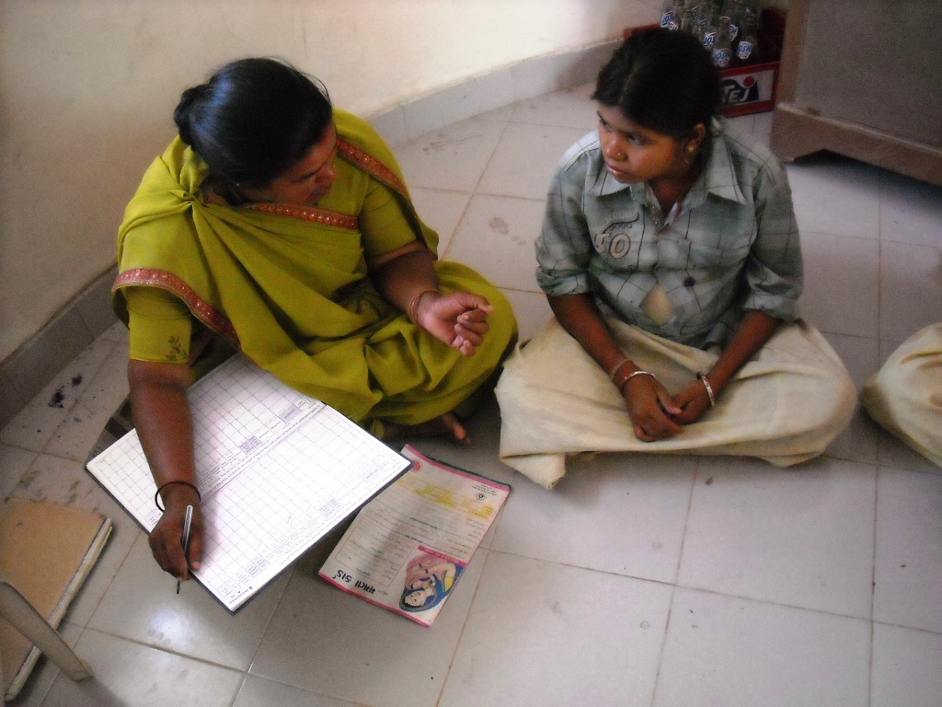

Slide 28
