Slide 1
DISSERTATION PRESENTATION: ROOT CAUSE ANALYSIS OF ISSUES IN PATIENT REGISTRATION DEPARTMENT OF AN EMR IMPLEMENTED IN U.S. HEALTHCARE FACILITIES
By:
Dr. Nabeela Ilyas
PG/14/038
Under the guidance of: Dr. Anandhi Ramachandran

Slide 2
ROAD MAP
Organization Profile And Learning
Problem Statement
Objectives
Constraints
Methodology
Results And Analysis
Conclusion
Recommendations

Slide 3
ORGANIZATION PROFILE AND LEARNING
ORGANIZATION PROFILE
Deloitte Consulting Pvt. Ltd. is a member firm of Deloitte Touche Tohmatsu Limited (DTTL). Deloitte’s India offices of the US are a region within the Deloitte U.S. organization, with offices across four cities in India – Hyderabad, Mumbai, Delhi and Bengaluru.
It is consistently rated and ranked by industry analysts as one of the leading tech service providers in the world, delivering support to clients, ranging from strategic advisory services to implementation and operations assistance. They offer industry expertise and follow an integrated approach to provide the clients with executable strategy recommendations and implementation assistance.
LEARNING
During my internship I learned about various things such as:
US health care system and how providers and payors work together in health care industry
Brief knowledge about HIPAA and meaningful use
Underwent EMR specific trainings and other trainings related to healthcare industry
Completed trainings for various processes followed in the organization

Slide 4
PROBLEM STATEMENT
Registration being the first and the most important step of the EMR workflow, affects all the consecutive processes.
Any problem arising during this step can have a domino effect on the whole hospital functionality.
Users usually have concerns even after successful implementation of the EMR system. A myriad questions and issues arise –some trivial and some substantial, but all can lead to disenchantment and disillusionment if not handled appropriately.
The issues arising in the patient registration department of an EMR need to be analyzed to find out the problem areas and resolve the root cause of issues, even before they crop up, in order to save money and time.

Slide 5
OBJECTIVES
General: To carry out root cause analysis of major issues (identified by various service restoration incidents) raised by end users for patient registration module
Specific:
Understand the workflow of the patient registration module
Categorize and analyse the different types of issues faced by the user
Identify major causes of the incidents occurring in the patient registration module.
Identify the areas in the workflow where the issues crop up
Recommendations to minimize the issues

Slide 6
CONSTRAINTS
Confidentiality clause of the software company in the IT organization
Anonymizing the data for usage
Restricted and monitored access of the database
Pre-allotted time period of 6 months for sample data by the organization
Inability to interact with the end user due to access restrictions
Time constraint

Slide 7
METHODOLOGY
Duration of Data Collection: October, 2015 to March, 2016
Research Design: Retrospective Descriptive Research
Sample Design
Sample Unit: Issue
Sample Size: 405
Sampling Technique: Purposive Sampling
Sampling Area: Hospitals and clinics in USA
Data Collection
Source: Secondary Data
Data was collected from the system database
Tools: The data was collected through incident management tool and analyzed through MS Excel
Data Analysis: Root Cause analysis
Techniques: Frequency Tables, Pareto analysis

Slide 8
INCIDENT INTAKE PROCESS
End user faces some problem
End user calls service help desk
Service desk prioritizes the incident as per the importance:
Critical/High/Medium/Low
Service desk raises a service restoration ticket

Slide 9
INCIDENT RESOLUTION PROCESS
If the incident is critical
Analyst receives a call
Analyst acknowledges the incident
If the incident is high/medium/low
Analyst gets an e-mail
Analyst calls or e-mails the user
Analyst collects all the required information from the end user
Analyst starts working on the incident
Analyst calls back the user and gives the resolution
Analyst closes the incident with proper documentation
Analyst collects all the required information from the end user
Analyst starts working on the incident and gives resolution to the user
Analyst closes the incident with proper documentation

Slide 10
RESULTS AND ANALYSIS

Slide 11
NUMBER AND PERCENTAGE OF ISSUES ACCORDING TO PRIORITY
No. of issues
N=405

Slide 12
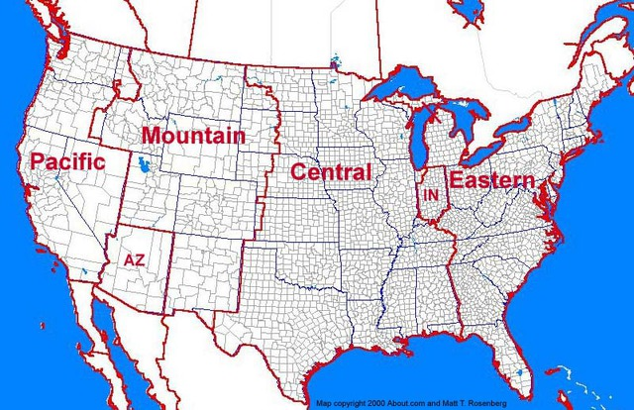
NUMBER OF ISSUES ACCORDING TO PRIORITY AND REGION
No. of issues
N_{C}=254
N_{P}=151

Slide 13
COMPARISON OF ISSUES ACCORDING TO PRIORITY IN CENTRAL AND PACIFIC TIME ZONE

Slide 14
ROOT CAUSE ANALYSIS OF THE OVERALL ISSUES
No. of issues
N=405

Slide 15
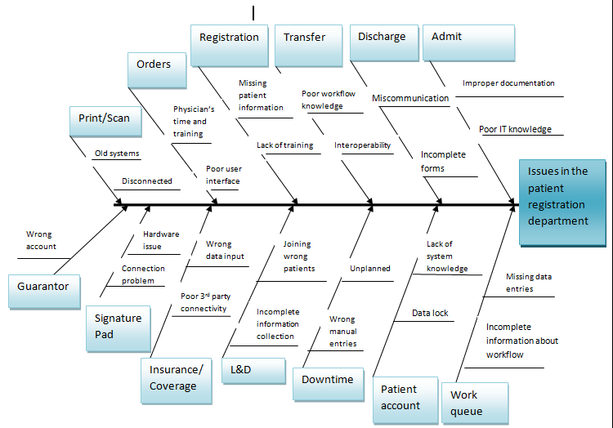
FISHBONE DIAGRAM

Slide 16
PARETO ANALYSIS OF ALL THE USER SERVICE RESTORATIONS BASED ON TYPES OF ISSUES FROM OCTOBER’2015-MARCH’2016
No. of issues
Cumulative % of issues

Slide 17
PARETO ANALYSIS OF ALL THE USER SERVICE RESTORATIONS BASED ON TYPES OF ISSUES ARISING FROM THE CENTRAL REGION
No. of issues
Cumulative % of issues

Slide 18
PARETO ANALYSIS OF ALL THE USER SERVICE RESTORATIONS BASED ON TYPES OF ISSUES ARISING FROM THE PACIFIC REGION
No. of issues
Cumulative % of issues

Slide 19
CONCLUSION
In the study it was found that user training was the major reason of the problems faced by the patient registration department, followed by system issues.
The reasons which contributed towards these incidents were categorized broadly into following buckets: Admit, Discharge, Registration, Transfer, Print/scan, Coverage, Bed planning, Signature Pad, Insurance issue, Order, Patient account, Labor & Delivery, Guarantor, Patient Class, Downtime and Work queue.
Users didn’t have required knowledge regarding exact workflows, which made them face problems during patient care.
Lack of updated software and systems also contributed towards the cropping up of issues.

Slide 20
RECOMMENDATIONS
Most of the issues can be taken care of by giving proper user training or
by tweaking the workflows.
A trickle down effect can be used. This will save time and cost.
Elbow support should be encouraged, as one user’s inefficiency can affect the whole system.
Tip sheets should be frequently updated and ensured that they are being followed.
For electronic insurance confirmation, we can work together with the third party. Regular updates and simultaneous installations of patches can be asked for.
New updated systems can be procured by the organizations.
Re-train the trainers in a way that they address the users at behavioral level during the trainings.
Gather on-the-floor information about the problems, and their reasons, being faced.
Prepare and circulate proper documentation of the build changes.
Standard Operating Procedure of the workflows needs to be re-designed and strictly adhered, with proper re-training and implementation for the same.
A handbook can be created and distributed amongst the analysts to help them solve the issue with ease.

