Slide 1
A Study of Treatment Compliance of Directly Observed Treatment Short course (DOTS) for Tuberculosis in Morbi District, Gujarat
PRESENTED BY:
NIDHI MUDGIL
PG/14/041

Slide 2
INTRODUCTION
Tuberculosis is an infectious disease caused by Mycobacterium tuberculosis. It spreads through the air by a person suffering from TB. A single patient can infect 10 or more person in a year.
Globally 9 million people are suffering from TB.
In India 2.1 million people are suffering from TB therefore India accounts for 1/3 of the global cases.
In Gujarat there are 21332 patients suffering from TB and in district Morbi there were 1509 patient of TB.

Slide 3
OBJECTIVES
General Objective
To study the various aspects of compliance to the treatment of Tuberculosis.
Specific Objectives
To analyse the effect of socio economic factors on Treatment compliance.
To analyse the effect of literacy levels on compliance of treatment.
To calculate the No. of Defaulters and No. of Deaths due to TB.

Slide 4
METHODOLOGY
Study design- Cross sectional and descriptive.
Study area- 2 Tuberculosis units in Morbi district, Gujarat.
Sampling technique - Purposive sampling.
Sample size- 256 patients enrolled for DOTS in second quarter.
Sampling tool- Questionnaire and secondary data
Time period of study- 3months

Slide 5
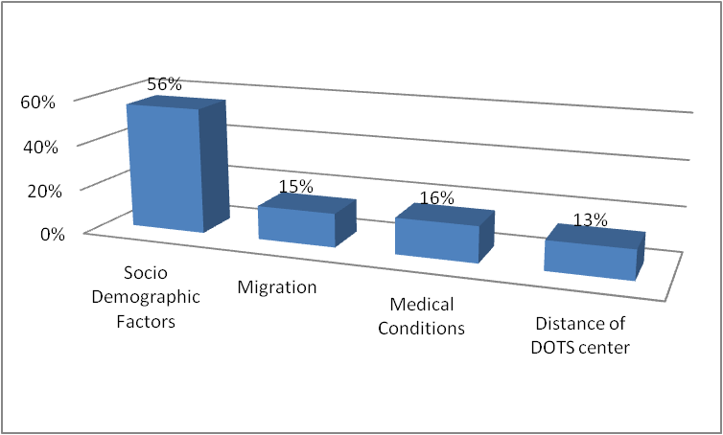
OBSERVATION
Factors affecting compliance to DOTS

Slide 6
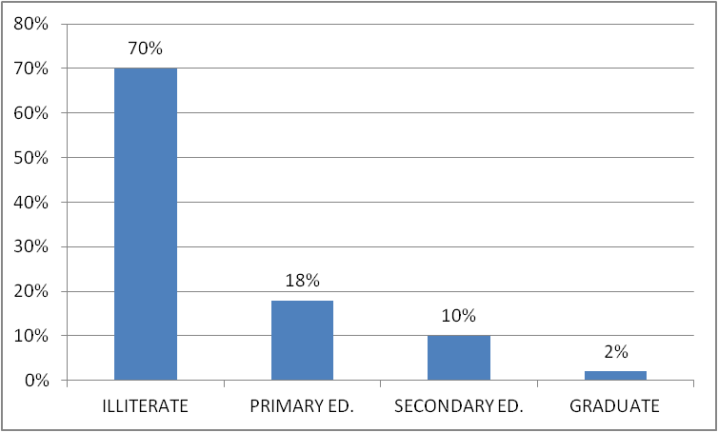
Literacy levels affecting DOTS

Slide 7
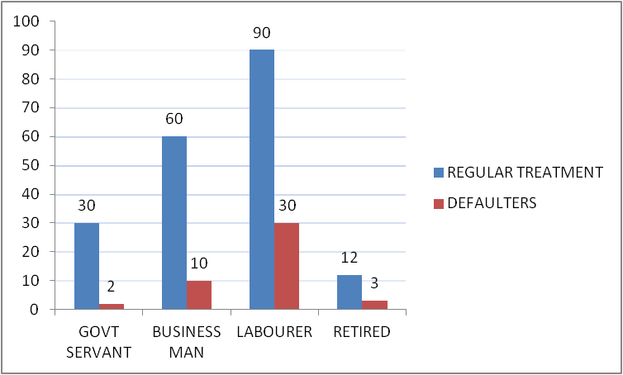
Socio-economic factors affecting DOTS

Slide 8
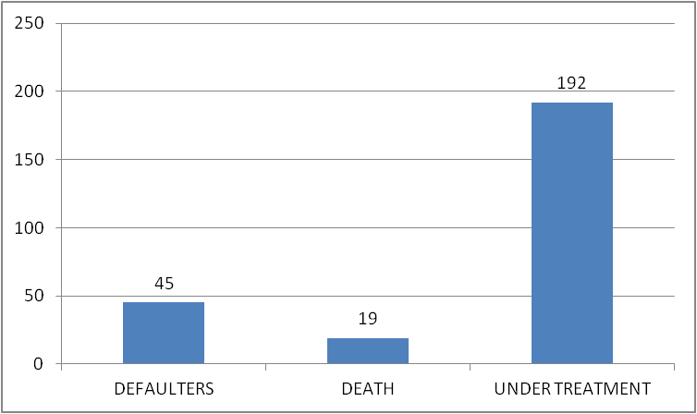
No. of Defaulters, Deaths and patients Under treatment

Slide 9
CONCLUSION
Calculations showed that 192 patients (80%) of the patients are taking regular treatment. 45 patients defaulted the treatment and 19 patients died during the second quarter.
The reason of defaulting the treatment were disappearing of symptoms 48% , red urination due to rifampicin 10% and allergic to some drugs 42%.
Out of the patients who were defaulting the treatment, 80% were having DOTS centre available in the radius of 5km from their home.

Slide 10
Labourer class were involved with low income who left the treatment midway that is 55.5%.
70% of the people were illiterate in the defaulters list

Slide 11
Recommendations
Involvement of health staff should be enhanced.
Reporting from the urban sector should be increased.
Basic information about the disease to be given to the general population.
Counselling of the patients should be done to minimize defaulters.
The Best example from the previous cases should be projected to encourage people to continue the treatment despite of all the odds.

Slide 12
THANK YOU!

