Slide 1
Study on Gap Assessment of USG Machine availability & utilization in Public Health Facilities of Gujarat.

Slide 2
Gujarat Demographic & Health Facility Profile
Description | 2011 |  | Description | 2011
Female | 28,901,346 |  | Estimated Population | 6.03 Crore
Sex Ratio | 918 |  | Actual Population | 60,383,628
% of total Populat. | 4.99% |  | Population Growth | 19.17%
Literacy | 79.31 |  | Area km2 | 196,024
Male Literacy | 87.23 |  | Area mi2 | 75,685
Female Literacy | 70.73 |  | Density/km2 | 308
Total Literate | 41,948,677 |  | Density/mi2 | 798
Male Literate | 23,995,500 |  | Male | 31,482,282
Female Literate | 17,953,177
Sr. No. | District | Total Population (Census 2011) | Yr work-load for ANC(Source MCTS, 2015-16) | SC | PHC | CHC | S DH | DH
GUJARAT |  | 60383628 | 1451600 | 8953 | 1297 | 322 | 33 | 22

Slide 3
Title of Research Project:
An Gap Assessment of USG Machine availability & utilization in Public Health Facilities of Gujarat (FRU - CHC, GIA, SDH, DH, MCH).
Rational:
To understand the availability & utilization of USG machine in Public Health Facilities.
To improve the Health Service coverage to all pregnant womens of Gujarat.
Scope of Study:
This Assesment will be able to provide current scenario of availability & utililizaion of USG Machines in Public health facilities. Also this will be utilized for strengthening services to hgh risk pregnant womens services in prompt diagnosis and well medical management.
Research Question:
1. How many USG machines are available & utilized in Public Health Facilities.
2. What are the training gap to strengthen USG services in the Public Health Facilities.
Objective:
To Identify the critical gaps in USG services in Public Health Facilities for pregnant womens.

Slide 4
Methodology:
Type of Study : Cross-sectional prospective study
Study Area: Public Health Facilities of Gujarat (CHC & above)
Area Name | Participant / stake holders
FRU - CHC, GIA, SDH, DH, MCH of Gujarat State | CHC Supritendent SDH Supritendent DH Supritendent MCH Supritendent
Study design: Exploratory non experimental design.
Sample Size: FRU CHC (23), SDH(33), GIA (8), DH(22), MCH(17)
Sampling technique : Purpusive sampling (Covering all Government USG facilities)

Slide 5
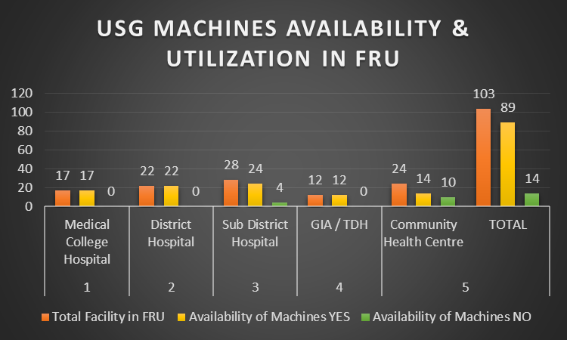
Conclusion:
USG MACHINES AVAILABILITY & UTILIZATION IN FRU
SN | Level Of Facility | Total Facility in FRU | Availability of Machines |  | Utilization of Machines (Sonography Services)
 |  |  | YES | NO | YES | NO
1 | Medical College Hospital | 17 | 17 | 0 | 17 | 0
2 | District Hospital | 22 | 22 | 0 | 13 | 9
3 | Sub District Hospital | 28 | 24 | 4 | 16 | 8
4 | GIA / TDH | 12 | 12 | 0 | 12 | 0
5 | Community Health Centre | 24 | 14 | 10 | 4 | 10
 | TOTAL | 103 | 89 | 14 | 62 | 27

Slide 6
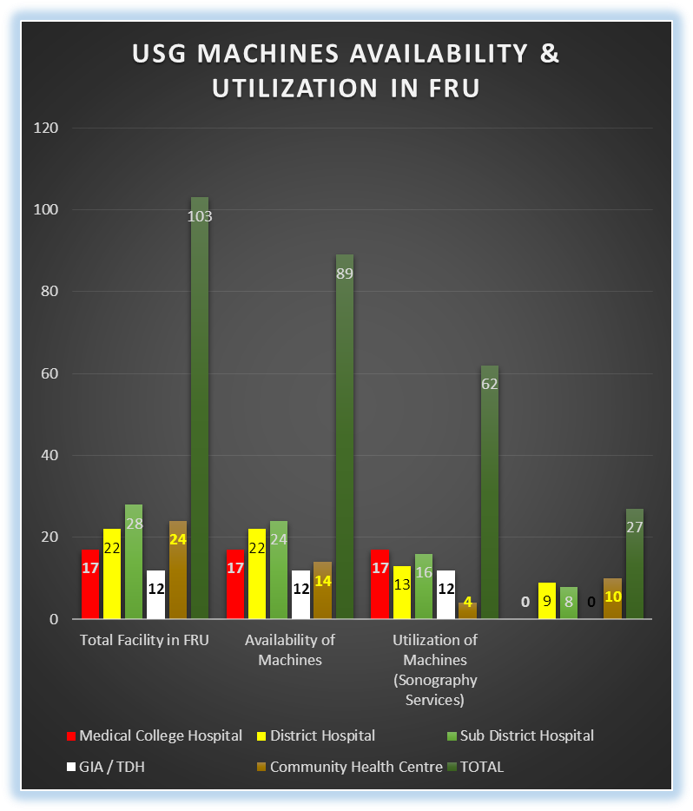

Slide 7
Results;
Out of 103 First Referral Unit in Gujarat 89 FRU have sonography machines available with them, out of 89 also only in 62 facilities are functional with sosnography services.

