Slide 1
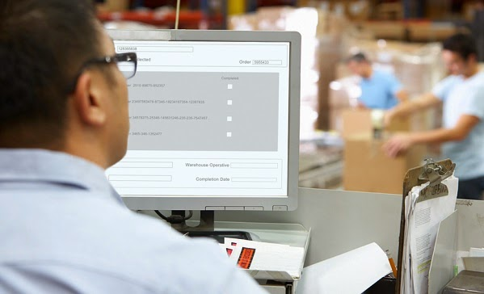
ROLE OF INFORMATION TECHNOLOGY IN SUPPLY CHAIN MANAGEMENT
E-Aushadhi (DVDMS)
Submitted By-
Dr. Deepika Bhati
PG/14/018
(Hospital Batch)

Slide 2
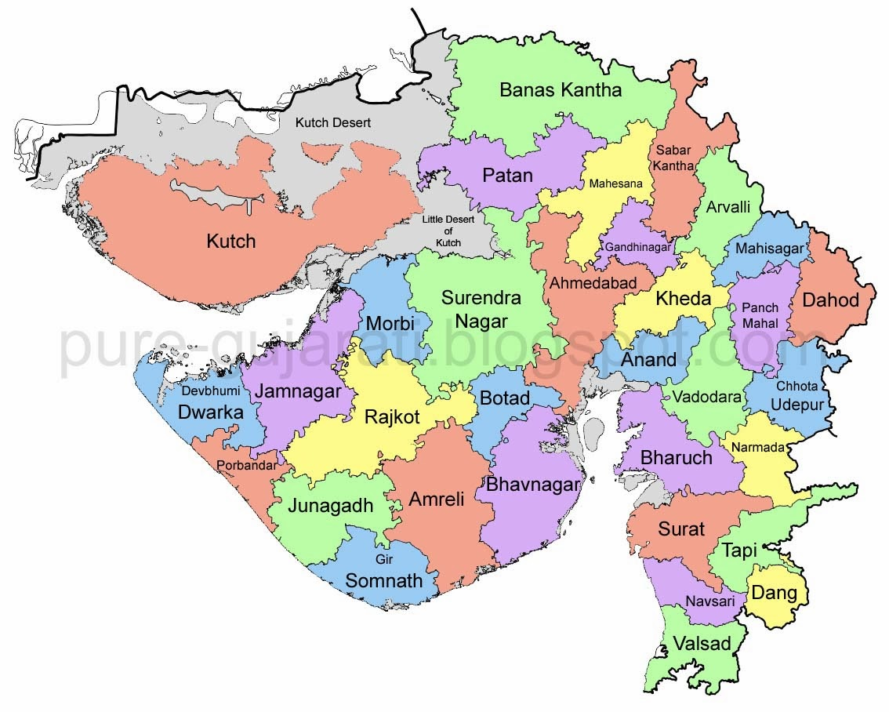
S.NO. | PARTICULARS | NUMBER
1. | Districts District Hospitals | 33 23
2. | Sub- district hospitals | 34
3. | Community Health Centre | 341
4. | Primary Health Centre | 1300
5. | Sub- centre | 7274

Slide 3

The Gujarat Medical Services Corporation Ltd. (GMSCL) is a Govt. Company started functioning in the state of Gujarat in August, 2012 replacing the ‘The Central Medical Stores Organization” (CMSO) established under the Health & Family Welfare Department working since 1978 in Gujarat.
The procurement and supply of medicines and other hospital requisites for the government health care facilities in the state.
To buy, sell, supply, store, maintain and deal in all kinds and varieties of generic and patent / non-patent medicines, drugs, mixtures, formulations, tablets, pills, powders, pharmaceuticals and medical products, needles, syringes, injectable, and surgical dressing, kits and instruments.

Slide 4
To act as nodal agency for Government of Gujarat to implement any scheme and programs as may be assigned or transferred by the Government of Gujarat, and also any scheme / program of Government of India, WHO, UNICEF, or any other regional, national, international or bilateral agencies in the health and family welfare sector.
Procurement of essential, lifesaving quality medicines, surgical goods & Insecticides and their timely availability by creating high storage capacity & distribution network.
Procurement of quality medical equipment/Instrument and its maintenance for entire product life cycle.

Slide 5
SUPPLY CHAIN MANAGEMENT IN GMSCL
Supply chain management is the management of the flow of goods and services.
It includes the movement and storage of raw materials, work-in-process inventory, and finished goods from point of origin to point of consumption.
Available Drug Warehouses
SR. NO. | NAME | DISTRICT COVERED
1 | Adalaj | Ahmedabad, Anand, Dahod, Gandhinagar, Kheda, Panchmahal, Surendranagar, Mahisagar
2 | Amreli | Amreli, Bhavnagar, Junagadh, Botad, Gir-Somnath
3 | Jamnagar | Jamnagar, Kutch, Porbandar, DevbhumniDwarka
4 | Patan | Banaskantha, Mehsana, Patan, Sabarkantha, Aravalli
5 | Surat | Dang (Ahwa), Navsari, Surat, Tapi, Valsad
6 | Vadodara | Vadodara, Bharuch, Chhota-Udaipur, Narmada
7 | Rajkot | Rajkot, Morbi

Slide 6
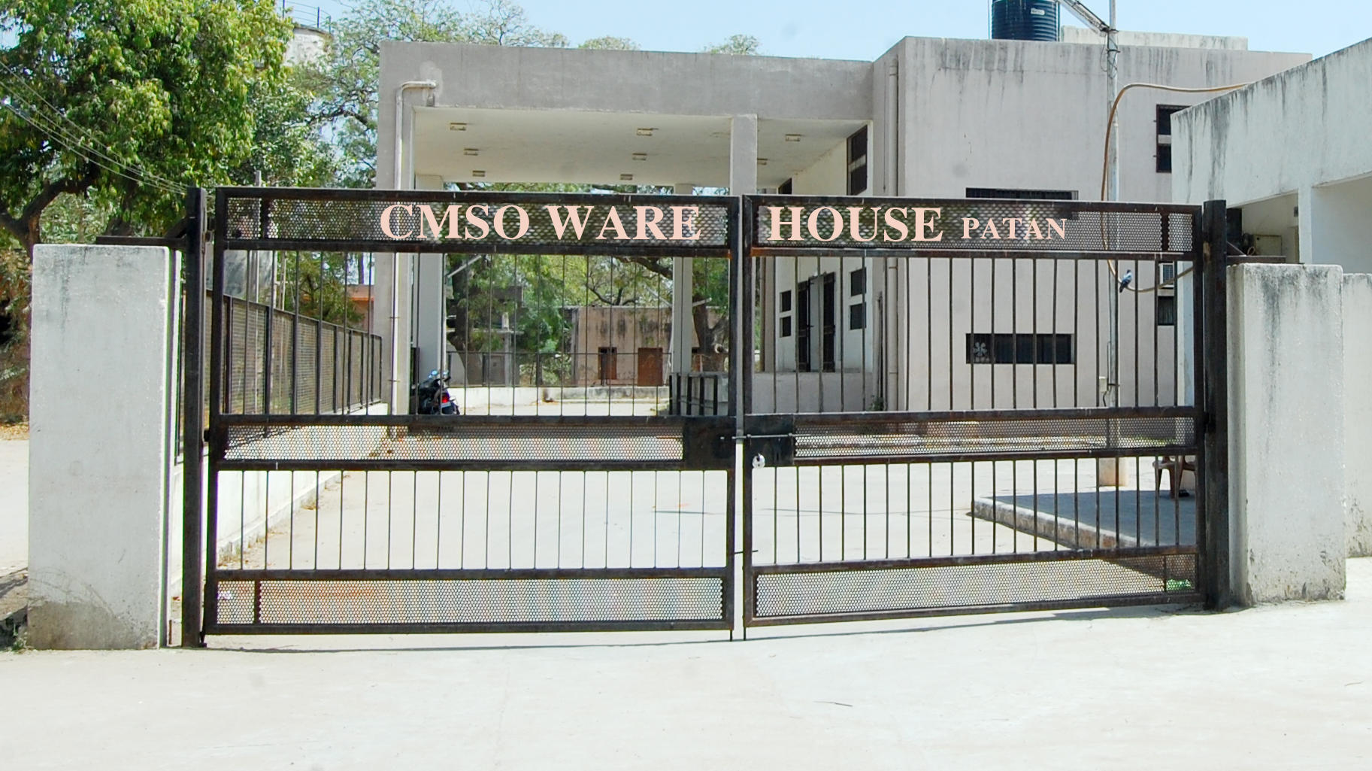
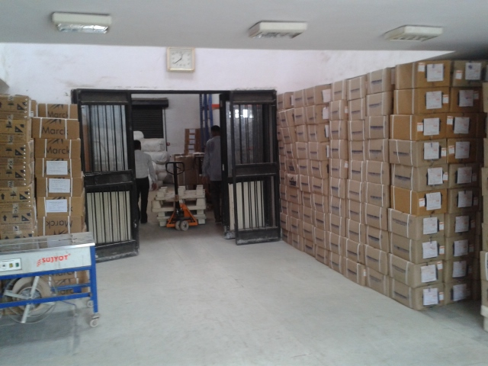
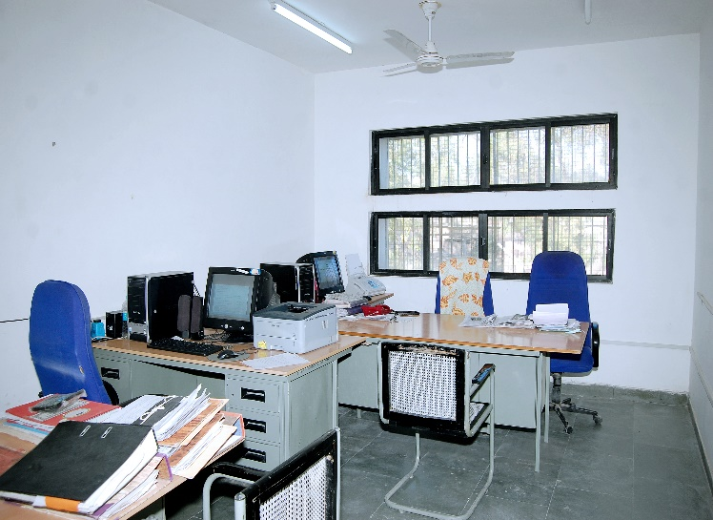
Contd…
Upcoming warehouses:
Bhuj
Bharuch
Dahod
Himmatnagar
Valsad
PATAN WAREHOUSE

Slide 8
PROCUREMENT OF DRUGS
GMSCL issues a circular to all Districts Demanding Officers (DDO) to raise the Regular special/supplementary demand for central purchase as per the budget availability HOD wise for procurement.

Slide 9

SUPPLIER RATE CONTRACT AND PURCHASE ORDER
Process Flow:
Head quarter compiles the annual demand
↓
Headquarter tendering & final Rate contract
↓
Proposal for the procurement of medicines
↓
Proposal approval by the competent authority
↓
Purchase order issue to supplier

Slide 10
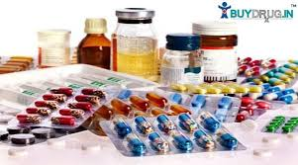
RECIEVAL OF MEDICINES
Process Flow:
Warehouse in charge receives the medicines
↓
Pharmacist verifies the order quantity as per the purchase order
↓
Certain parameters like GMSCL logo, MRP printing, test report, and package as per specification, different color etc are checked
↓
Entry is made on daily register
↓
Stock register is entered only if the drug received is passed from the quality check

Slide 11
QUALITY ASSURANCE OF DRUGS
Pre-Dispatch Test
Process Flow:

Slide 12

DRUG AND COSMETIC ACT,1940
Process Flow:
Random sampling by drug inspector at the warehouse
↓
Samples sent to government laboratory
↓
If QC report is NOSQ (Not of standard quality)
↓
Concerned authorities are informed for condemnation
↓
Supplier is informed about the QC findings
↓
Action is taken as per tender conditions

Slide 13
Medicine distribution from Drug warehouse to sub store
Process Flow:
Drug warehouse
↓
Quality check passed drugs are issued to sub store
↓
Drugs received by the hospital are updated in their respective stock registers

Slide 14
BILL PROCESSING
Process Flow:
Delivery challan and invoice is sent from the warehouse to GMSCL along with a certificate of receipt of drugs
↓
Payment is processed for each invoice that reaches the headquarter
↓
Finance department prepared summary sheet of payment value calculation, testing charge, risk purchase recovery and NOSQ recovery
↓
Prepared payment order of invoice details and payment calculations along with deductions
↓
Prepared voucher for the payment of supplier against all processed invoices.

Slide 15
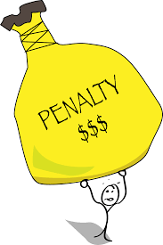
PENALTY AND RECOVERY
Late Delivery (LD) is imposed on the supplier if delivery of medicines is made after the specified delivery period with following calculations:
0 to 3 days – no penalty
4 to 10 days – 0.5% of the invoice value
11 to 17 days – 1.0% of the invoice value
18 to 24 days – 1.5% of the invoice value
25 to 31 days – 2.0% of the invoice value
32 to 33 days – 2.5% of the invoice value
After 33 days – 10.0% of the invoice value

Slide 16
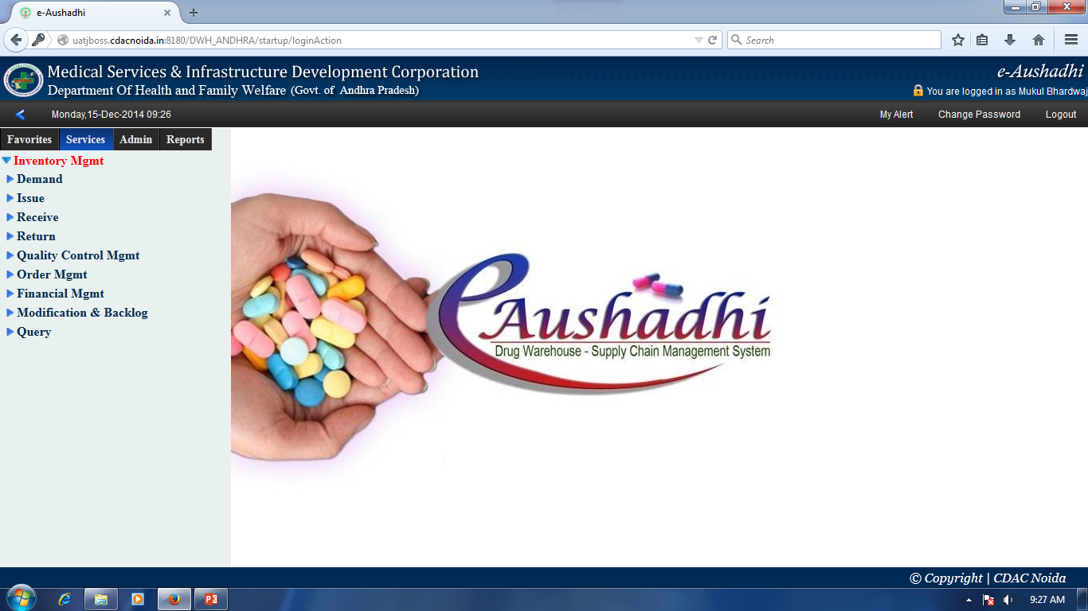
A COMPLETE SOLUTION OF DRUG WAREHOUSE AND SUPPLY CHAIN MANAGEMENT SYSTEM

Slide 17
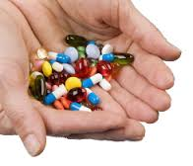
About E-Aushadhi…
e-Aushadhi is a web based application which deals with the management of stock of various drugs, sutures and surgical items required by various Regional Warehouse, DH, SDH, ADHO, CDHO, CHC, PHC & UPHC of state.
"e-Aushadhi" helps in determining the needs of various Sub-stores such that all the required drugs are constantly issued by RWH to its Sub-store, to Patient by DDC without delay.

Slide 18
KEY FUNCTIONALITIES
Monitor Drugs information
Define the items into Groups, Sub groups, Categories, Codification of Drugs.
Search items using a number of search criteria
Indent generation
Transfer of Drugs among Drug Warehouses
Drug Distribution to Patients
Maintains level of drugs at Stores
Link all drug warehouse hierarchically
Maintain control (such as quantity tracking) on stocks and their replenishment.
Reserve items within District WH / CHC / PHC.
Record transactions while moving items from one location to another.
Alarming Expiry Drugs at all levels
Dash Board Facility for the Senior Management

Slide 19
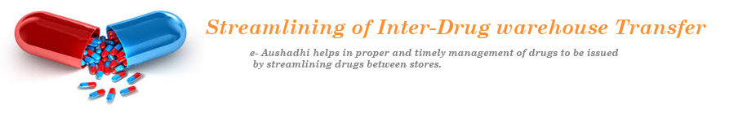
BENEFITS OF E-AUSHADHI
Better Planning, executing and controlling.
Online Tracking of Drug Inventory.
Streamlining of Inter-Drug warehouse Transfer.
Efficient control of Inventory.
Multi user, Multi location storage.
Customizable Reports

Slide 20









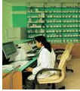
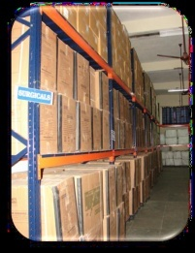



e-Aushadhi Work Flow ….
Annual Demand
Annual demand received from DWH stores
Laboratory
Quality Testing & update status
Contract signed b/w Suppliers and HQ
Rate Contract
Sample sent to HQ for Quality assurance
A purchase order is generated for DDWH as consinee
Approval from HQ Laboratory
PO Generation (drug-wise)
Drug is ready for Issue
PO Received
Challan Generation
and Drug send to DDWH
Drug Recieve

Slide 21


e-Aushadhi Work Flow…..
GUJARAT MEDICAL SERVICES CORPORATION LIMITED
Indent for Issue
Sub-store
DH
SDH
CHC
PHC
Medical College
Receive after approval
Drugs Issue to DDC
Drug distribution
Drugs distributed to patients
Final Consumption by Patients

Slide 22
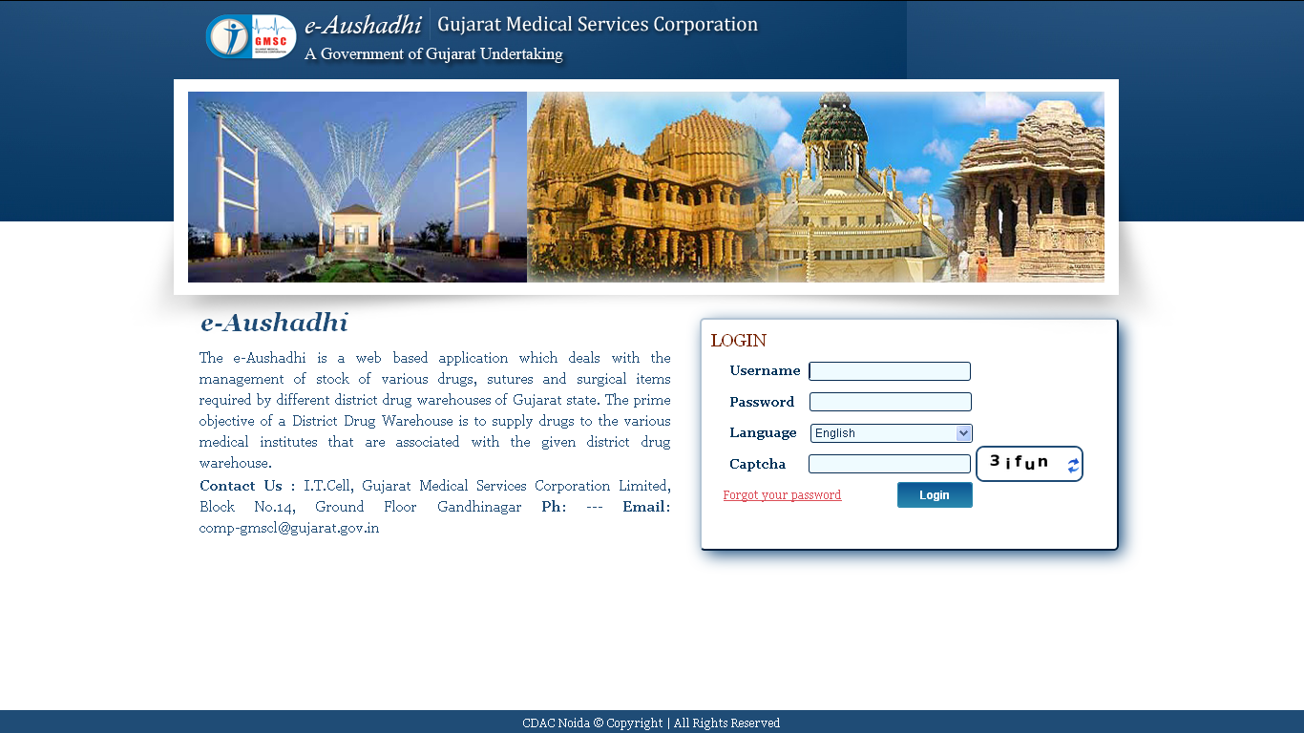
APPLICATION
Login Screen
Mozilla Fire fox .
Need Internet connection to access
Separate user level login/ password will be provided to access

Slide 23
ANNUAL PURCHASE DEMAND DESK
RATE CONTRACT DESK

Slide 24
PURCHASE ORDER GENERATION DESK
CHALLAN PROCESS DESK

Slide 25

OBJECTIVES
General objective: To ascertain the needs and monitor the constant availability and supply of drugs to the various facilities of districts at all hierarchical levels in Gujarat state through e-Aushadhi application and assessing the attitude of various users of e-Aushadhi software.
Specific Objectives:
To monitor the MIS reports of various drugs, injections, surgical items through e-Aushadhi application at depot level.
To determine the level of satisfaction of e-Aushadhi among the users at depot level.

Slide 26

METHODOLOGY
Sample design: Observational study and Descriptive cross sectional study
Sampling method: Convenience random sampling
Sample size: 20
Duration of study: 3 months (15th February 2016 – 15th May 2016)
DATA COLLECTION TOOLS AND TECHNIQUES
Primary data collection: Telephonic interview
Secondary data collection: Existing records and Internet

Slide 27

DATA ANALYSIS
Graphical representation of the annual demand placed by all the Direct Demanding Officers (DDO’s) for the current financial year (2016-2017)

Slide 28
GRAPHICAL REPRESENTATION OF THE TOTAL NUMBER OF PURCHASE ORDERS PLACED FOR THE FINANCIAL YEAR 2016-2017

Slide 29
TOTAL DRUG VS AVAILABLE DRUGS AT WAREHOUSES

Slide 30
NUMBER OF DRUGS BELOW REORDER LEVEL QUANTITY AT WAREHOUSES

Slide 31
PRIMARY DATA ANALYSIS

Slide 32
Contd…

Slide 33
Contd…

Slide 34

CHALLENGES
Limited computer proficiency
Requirement gathering created an issue owing to non-cooperation
Limited internet connectivity
Limited manpower
Many customizations required in the application
Limited IT support at various level

Slide 35

CONCLUSION
Supply chain automation of the drug management system provides an accurate view of state of drugs warehouse and inventories across the state.
Information Technology is a very important step in streamlining the Supply Chain Management of the any organization.
Through Information system (e-Aushadhi), the process can be made more transparent and chances of data manipulation and wrong information can be prevented.
Though there are many hindrances related to the implementation of e-Aushadhi such as proper infrastructure is not available to support the application at many levels which needs to be noticed and rectified.

Slide 36
Interdisciplinary journal of contemporary research in business copy right 2011 institute of interdisciplinary business research 489 december 2011vol 3,no 8.
International Journal of Production Economics ,Volume 122, Issue 1, November 2009, Pages 133–149 Transport Logistics and Physical Distribution Interlocking of Information Systems for International Supply and Demand Chains Management ICPR19
Prof. Himanshu ,S. Moharana,Dr. J.S. Murty, Dr. S. K. Senapati ,Prof. K. Khuntia- Importance of Information Technolgy for effective supply chain management IJMERVol. 1, Issue .2,pp-747-751
WEB REFERNCES
http://www.journal-archieves13.webs.com/489-496.pdf
http://www.sciencedirect.com/science/article/pii/S0925527309001716
http://ehealth.eletsonline.com/2015/12/e-aushadhi-launched-in-jammu-and-kashmir/
http://www.hindustantimes.com/dehradun/u-khand-govt-to-streamline-drug-purchase-via-online-app-e-aushadhi/story-2NJyNO2AY4DYr6D2ru4HhK.html
http://www.nhp.gov.in/e-health-initiatives-in-gujarat-_pg
REFERENCES

Slide 37


