Slide 1
Application Support Model and its Challenges in EMR Healthcare Accounts
- Dr. Ashwini Sushir

Slide 2
Contents
Introduction
Functions of support team
Problem statement
Scope of project
Survey
Analysis
Recommendations
Conclusion
.

Slide 3
Introduction
Support refers to a plethora of services by which enterprises provide assistance to users of technology products ,Software, healthcare IT support services or other electronic or mechanical goods.
It is a range of customer services to assist customers in making cost effective and correct use of a product.
It includes assistance in Planning, Installation, Training, Troubleshooting, Maintenance and Upgrading.

Slide 4
Levels of support
Support Level 1 | Support Level 2 | Support level 3
Ticket registration | Status upgrade logger | Performance tuning
FAQ support | Detailed issue tracking | Remote trouble shooting
Installation support | Hardware and software interoperability | Development escalations
Configuration control | Check integration issues | Change management
Ticket confirmation to issue logger | Reaching to vendor to solve issues | Knowledge updating
Basic trouble shooting | Knowledge to level 3
Escalation to level2

Slide 5
Functions of Support team
Application support services
L1/L2/L3
Application support
Operation
support
User support
Application support
New developments
enhancements
Apply patches
Software release
Operation support
Capacity planning
System administration
Database administration
Network administration
End user support
User manuals
Training material
Knowledge portal
Trouble shooting
Change requests,FAQ

Slide 6
Functions of Application Support team as observed on floor
Request management
Incident management
Problem management
Change management
Monitoring

Slide 7
Objective
The objective is to study the support team workflow and to identify the challenges faced by them in a Healthcare IT company.
Scope of Project
Studying the support model and its challenges will be helpful in -
Decreasing the turn around time for solving the tickets thereby increasing the work efficiency of the support team ,streamlining the work process.

Slide 8
Survey Details
A survey was conducted to study the challenges faced by the support team in the organization.
Time span
- 8 Feb – 29 April 2016
Interview method
- On floor Observation
- Personal interviews (convenient sampling)
- Sample size - 40
Analysis -Tools used
- Percentage analysis
- Fishbone diagram

Slide 9
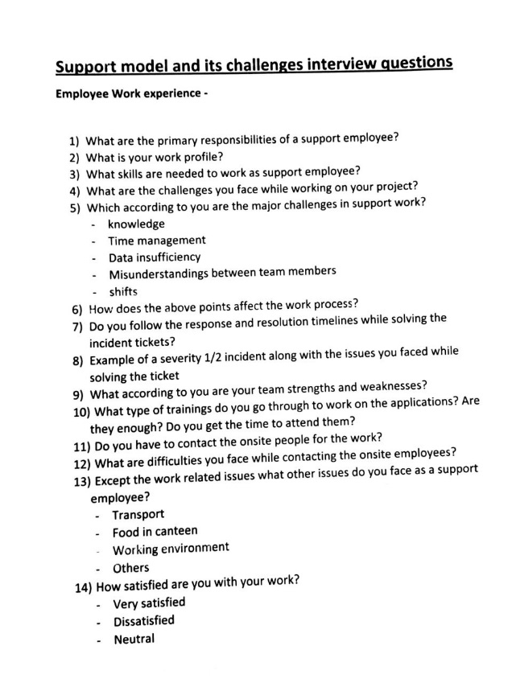
Support Team challenges Survey Questions

Slide 10
Analysis - Percentage Response to the survey
Challenges | %Response
Time management | 70%
Incomplete Data | 55%
Network and hardware issues | 47.50%
Attrition | 42.50%
Lack of deep Expertise | 37.50%
Communication issues | 32.50%
Transport and shifts | 27.50%
Workload | 22.50%

Slide 11
Fishbone Diagram representing challenges of Support Employees
People
Process
Lack of deep expertise
Time management
Incomplete data
Attrition
Communication issues
Sporadic occurrence of incidents
Challenges faced by the support team
Transport
Facilities
Food
Slow Ticketing Tool
Interface and printing issues
Lack of skilled trainers
Network and Hardware issues
Other Problems
Logistics
Time zone issues

Slide 12
Recommendations
Lack of depth in expertise in specific cases and mismatch in expectations
Compulsory trainings on applications
Incomplete Data
Creating templates with all necessary details for extracting all data at once
Time management
Setting priorities of work setting goals to complete the work
Network issues and Hardware issues –
Switch to data network cards, timely check on the hardware by the IT support team
.
NOTE*Recommendations are Based on my limited knowledge as I am not an expert on the subject.

Slide 13
Sporadic occurrence of incidents-
Support team should diligently handover the tickets to onshore Team when their shifts are over.
Handling resources (Shifts) –
Shifts and leaves should be managed as per the workload, and employees Should have the mutual understandings to manage their timings.
Attrition- Backup should be planned in the teams , Induction plan, and knowledge sharing.
Communication issues – Mutually solved ,Good Rapport with onshore team.
Transport issues in case of female employees – The frequency of cabs should be increased.
Availability of food and facilities on weekends – Regular committee meetings, adding
variety of food ,meeting with facilities.

