Slide 1
Dissertation on To project the operational cost savings for a period of five years and hence analyze the cost and manpower benefit by effective utilization of PTS and AWLS
Guided by: Presented by:
Dr. Sumesh Kumar Damini

Slide 2
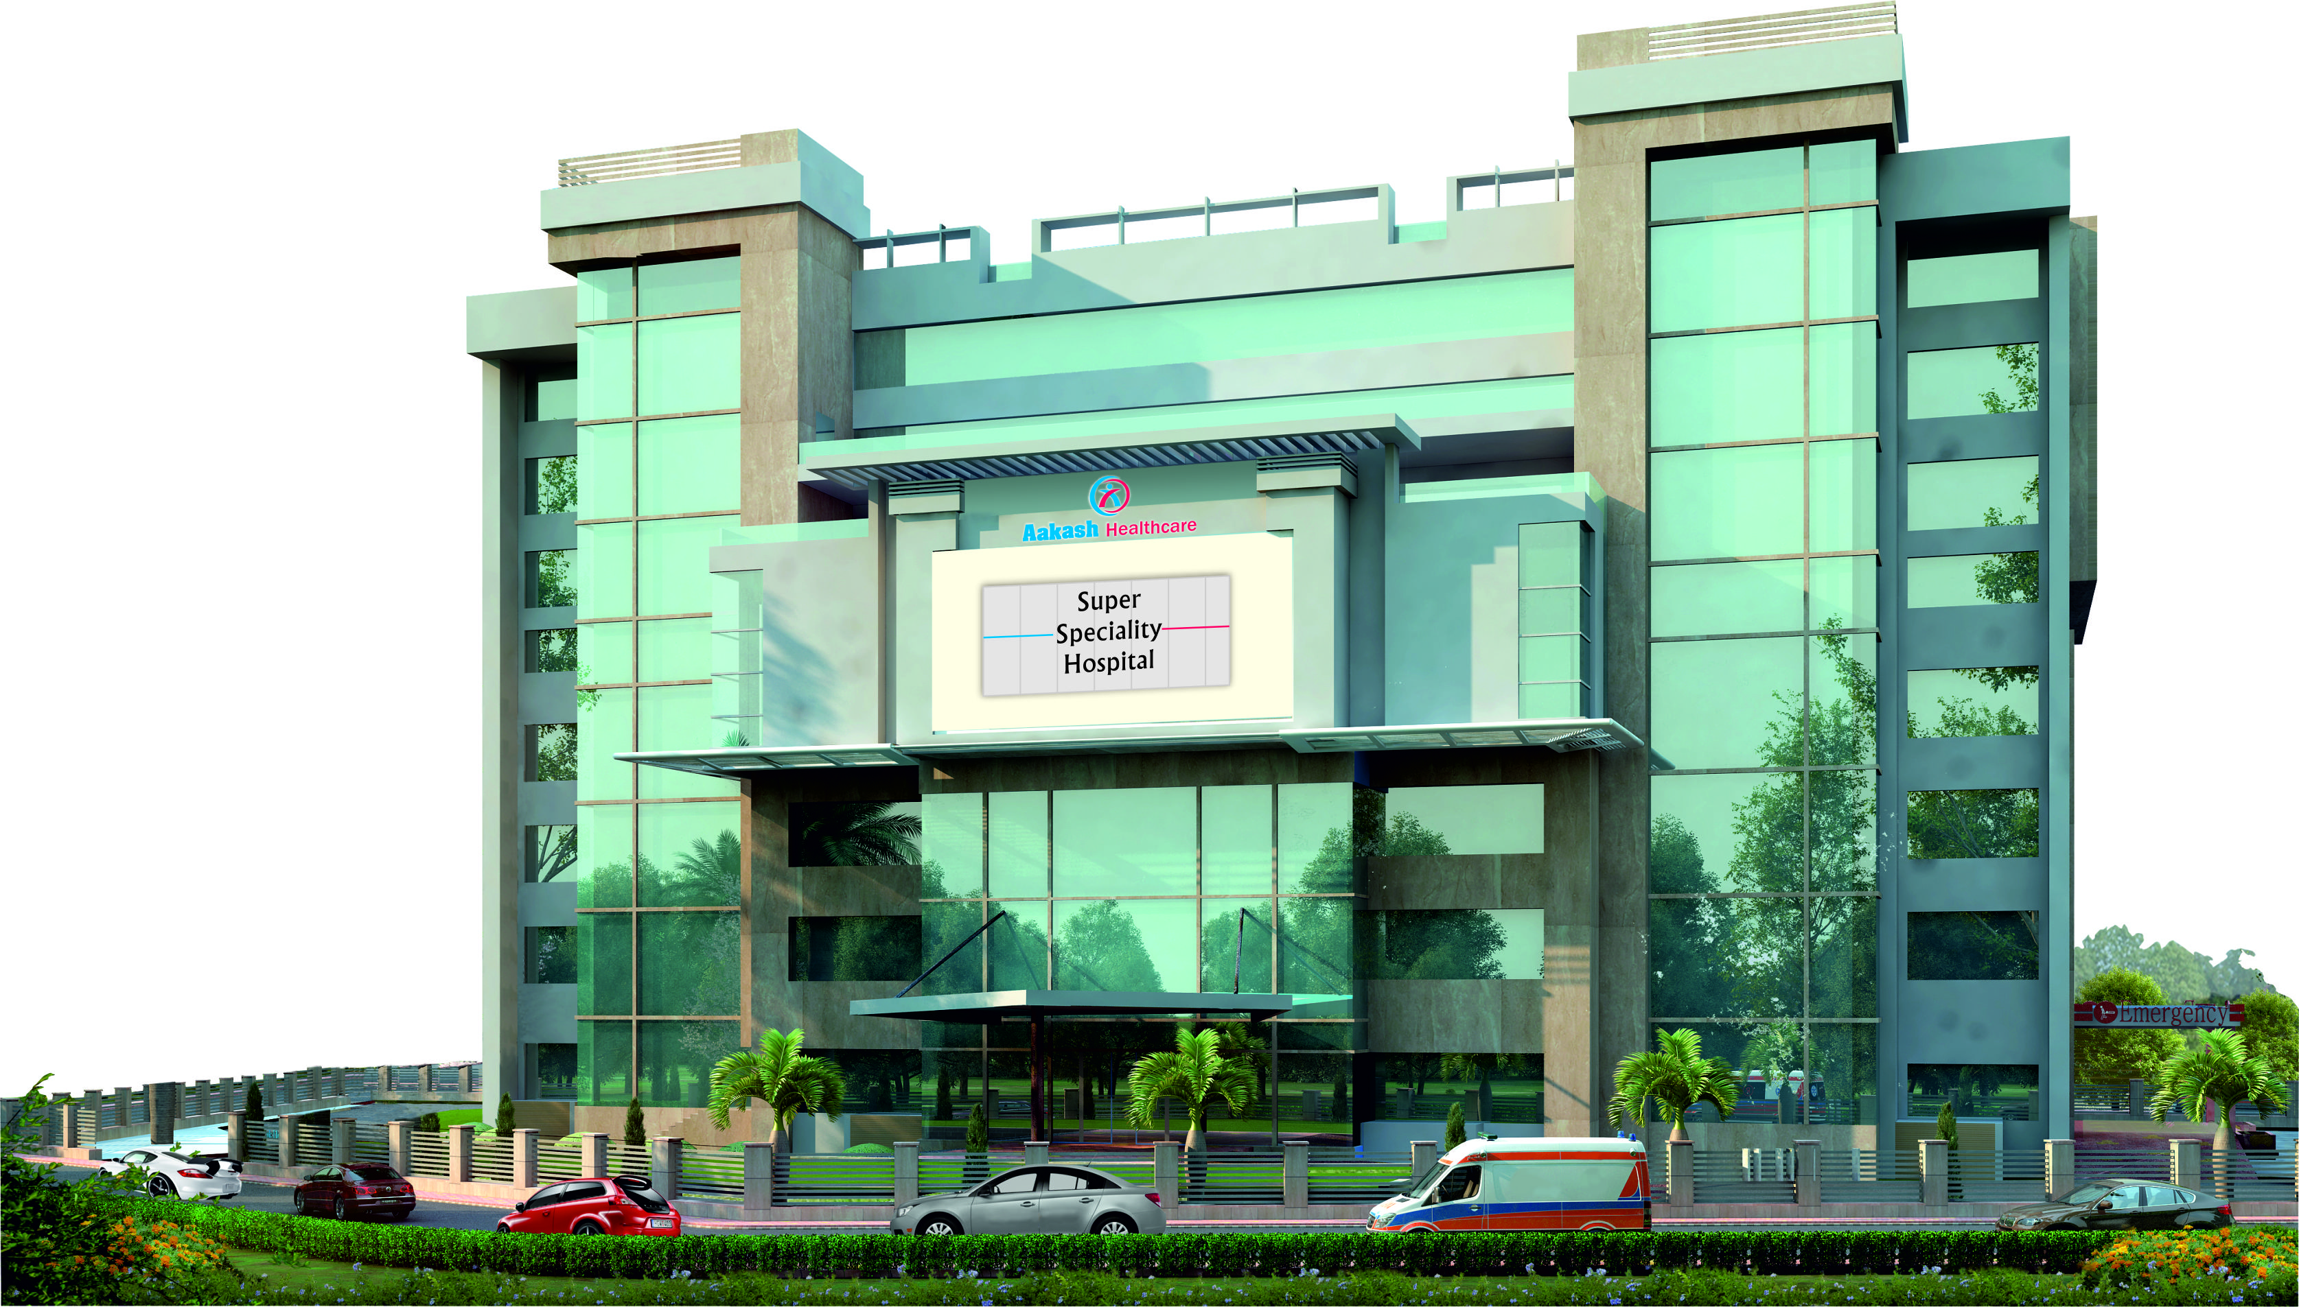
ABOUT AAKASH HEALTHCARE - SECTOR 3 , DWARKA

Slide 3
INTRODUCTION
Aakash Healthcare is a Private Limited Company (AHPL). It was incorporated on 19th November, 2013, and is a subsidiary of the prestigious Aakash Group (AESPL). It is a state of the art healthcare facility and the first smart hospital in South – West Delhi.
Dr. Aashish Chaudhry the founder and Managing Director of Aakash Healthcare is a celebrated orthopaedic surgeon, having performed innumerable successful orthopaedic surgeries, giving agility and the ease of movement to the incapacitated. Dr. Chaudhry aims to make Aakash Healthcare ‘the healthcare destination’ for all health concerns.
Aakash Healthcare is ready to set new milestones in the healthcare segment, offering unrivalled healthcare services for the people of Dwarka and surrounding areas.

Slide 4
CORE VALUES
I
C
E
EXCELLENCE
A
R
INTEGRITY
COMPASSION
ACCOUNTABILITY
RESPECT

Slide 5
SCOPE OF SERVICES
Key Specialties
ORTHOPAEDICS & JOINT REPLACEMENT | GENERAL & MINIMAL ACCESS SURGERY | MOTHER & CHILD
CARDIOLOGY & CARDIAC SURGERY | OPHTHALMOLOGY & REFRACTIVE SURGERY
Other Specialties
INTERNAL MEDICINE | UROLOGY | LAB MEDICINE
DERMATOLOGY | COSMETOLOGY & PLASTIC SURGERY | HEARING AND SPEECH
GASTROENTEROLOGY & HEPATOBILLIARY SCIENCES | OBSTETRICS | PULMONOLOGY & RESPIRATORY MEDICINE
PHYSIOTHERAPY & REHABILITION | ER & TRAUMA | ENDOCRINOLOGY/DIABETES & METABOLIC DISORDERS
MENTAL HEALTH & BEHAVIORAL SCIENCES | DENTAL SCIENCES | INTERVENTIONAL RADIOLOGY
RHEUMATOLOGY | NEUROSURGERY | NEUROLOGY
PREVENTIVE HEALTH CHECK UP | SURGICAL ONCOLOGY | MEDICAL ONCOLOGY
G I SURGERY | GYNAECOLOGY | RADIOLOGY
CRITICAL CARE | ENT | BLOOD BANK & TRANSFUSION MEDICINE

Slide 6
INFRASTRUCTURE DETAILS
230 bedded tertiary care facility
8 state-of-art Operating Rooms
70 Medical and Surgical Critical Care beds
Flat panel Cath Lab
10 Bedded Dialysis Unit
AWLS – Automated Waste & Laundry Management System
PTS – Pneumatic Tube System
Overall Motorized Beds

Slide 7
FLOOR STACKING PLAN
Seventh Floor | Cafeteria | Kitchen |  |  | Ophthalmology
 | EHC |  |  |  | Dental
Sixth Floor | IP Wards
Fifth Floor | IP Wards
Fourth Floor | IP Wards
Service Floor | Library | Cafeteria |  |  | Dr.'s Office
 | Seminar Hall |  |  |  | Dr.'s Lounge
 |  | Admin Office
Third Floor | CCU | Cath Lab |  | C – Sec OT | LDR
 | OT Complex |  |  |  | Pre & Post OP
Second Floor | Relative Waiting | Laboratory |  |  | Medical ICU
 | PICU
 | NICU – III | Nursery
 | NICU – II | ICU |  | SICU
First Floor | Dialysis | Endoscopy |  | Gynecology | Pediatrics
 | MD Room | NIC |  |  | ENT
Ground Floor | OPD | Cafeteria |  |  | ER – Observation
 | Pharmacy |  | Cafeteria | International Waiting Lounge | ER – Triage
Basement – 1 | Radiology |  | IP Billing | Blood Bank | Fire Pump Room
 | Parking
Basement – 2 | Gas Manifold | Pharmacy, Linen & HK Stores | Change Rooms | CSSD | AC Plant/ Boiler Room
 | Data Center | BMS | PTS Control Room
 | Mortuary |  |  | Parking
Basement – 3 | BMW Room | Trash & Linen PTS Room | Parking

Slide 8
DISSERTATION REPORT
To project the operational cost savings for a period of five years and hence analyze the cost and manpower benefit by effective utilization of PTS and AWLS when compared to human based transport.

Slide 9
BACKGROUND
Introducing efficiency into an existing system is the key function of all managers and its applicability to administrators in a healthcare scenario is no different. India is one of the few locations in the world with the latest in healthcare technologies including automation, surgical robotics, modular operating theatres, minimal access surgery systems, telemedicine and radiology. Although Indian hospitals and healthcare providers excel in the fields mentioned, intra-facility logistics and material-management remains untouched by latest innovations like automation of healthcare logistics, materials transportation and supply chain.
Traditional method used by the hospital for such Spontaneous transport is Human Based Transport (HBT) viz. using Ward Boys / Orderlies, Patient's Attendants / Relatives. There are several risks and problems that entail Human Based Transport logistics: Delays, Theft, Exposure, Bio-hazard, Personnel and energy etc.

Slide 10
RATIONALE
Most of the total transport system within the hospital is spontaneous in nature viz. Transport of Drugs, Blood Samples, Organ & Tissue Samples, Imaging Documents, Analysis Reports, Surgical materials and other samples. In-efficient and inadequate intra-facility logistics may increase costs on human resources, healthcare delivery costs and energy costs. This in turn causes several problems, increases risks and difficulties and consequently reduces the quality of patient care in the facility.
With Budgetary constraints and fledgling competitive situation hospitals are now facing new challenges: reduction of time patients spend in the hospital without loss in quality of care, reduction in staff costs and at the same time increasing results and efficiency. For these reasons the optimization of hospital logistics becomes more and more important.
Therefore, in order to know the cost and manpower benefit by installing PTS & AWLS in hospital over human based transport, this study was a must.

Slide 11
BENEFITS OF PTS
Carrier tracking
Improved efficiency by fast, accurate transport without time loss
No loss of sample quality by gentle and shock free transport
More safety-hermetically sealed carriers minimize the risk of contamination
Higher throughput by multiple sending and receiving stations that are able to send and receive more carriers
No delays for priority transports

Slide 12
BENEFITS OF AWLS
Improves infection control and Cross Contamination Risk
Improved efficiency by fast, accurate transport without time loss
Require less labour and space
Improved space utilization
Aesthetic improvement
Increased efficiency and productivity

Slide 13
OBJECTIVES
Primary Objective:
To project the operational cost savings for a period of five years and hence analyze the cost and manpower benefit by effective utilization of PTS and AWLS when compared to Human Based Transport (HBT)
Specific Objectives:
To study the benefits of PTS & AWLS over human based transport (HBT).
To calculate the capital cost involved in installation and commissioning of PTS and AWLS.
To calculate the operational cost involved in operating, training and maintenance of PTS and AWLS.
To calculate the operational cost involved in recruitment of manpower, their training and operating without PTS and AWLS.
To compare the cost and time involved in operating via PTS and AWLS v/s operating via manpower.

Slide 14
METHODOLOGY:
Study Design - Descriptive Study
Study Area - Aakash Healthcare Pvt. Ltd.
Study Time Period - 1st Feb - 30th April 2017 (3 months)
Mode of Data Collection – Secondary Data
A self administered informal interview was conducted with the key informants of Aakash healthcare to gauge the reasons for gaps recognized in various different phases of the project. Key informants who were the source of information included-
Mr. Jaideep Narula- Vendor - PTS
Mr. Rajender Sharma- Sr. Manager – Engg. & Maintenance
Ms Anita Ryder- Head of department – Housekeeping
Ms. Sabita Subramanian – Head of department - Nursing
The respondents gave a verbal consent.

Slide 15
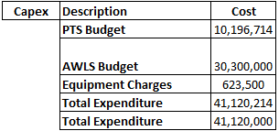
Results
1. AUTOMATED TRANSPORT
1.1 Capital Expenditure

Slide 16
1.2 Operational Expenditure

Slide 18
2. Manual Transport

Slide 19
Results
S. No. | Description | Total Cost(Over next five years)
Automated Transport
 | PTS
 | Capex
1 | Equipment and installation | 10,196,714
 | Opex
2 | Electricity | 360,053
3 | Maintenance | 1,028,760
 | AWLS
 | Capex
4 | Equipment and installation | 30,300,000
5 | Manpower | 116,369,794
 | Opex
6 | Electricity | 184,680
7 | Trolleys and bags | 623,500
 | Total | 159,063,501
Manual Transport
 | Capex
8 | Trolleys and bags | 4,175,000
 | Opex
9 | Manpower | 242,221,571
10 | Electricity | 2,178,931
 | Total | 248,575,503
 | Cost benefit | 89,512,002
 | Percentage of cost saved over 5 years | 36.01%

Slide 20
CONCLUSION
Pneumatic transport system (PTS) and Automated Waste & Laundry System (AWLS) are valuable alternative to conventional human dependant transport. The study shows there is cost benefit of 36% over next five years. Automated transport makes the intra logistics transportation processes faster, reduces manpower cost & operational cost and saves time and energy. With increasing emphasis on effective utilization of resources available in order to cut operational cost in hospitals, it is beneficial for modern hospitals and healthcare settings to implement these systems.

Slide 21
LIMITATIONS
The patient load and PTS, AWLS transaction load is based on assumptions because no real time data could be obtained.
PTS and AWLS equipment and installation cost is approximate because the data was confidential.
Time factor is not taken into consideration.

Slide 22
RECOMMENDATIONS
Training: A critical aspect of utilizing a PTS to transport specimens is in-service training. All employees using the system must be knowledgeable about proper packaging procedures and system use. It is recommended that facilities distribute clear procedural information for proper use of their pneumatic tube systems and automated waste and laundry system. Training may be conducted during monthly nursing in-services, new employee orientations and other similar situations.
In addition to training, simple procedure guidelines and relevant contact information should be located in each department describing effective system use and recommended maintenance to ensure compliance with best practices for infection control.
PTS to be made live on day zero and the end user must be well acquainted with the system. There should be zero manual transport of items intended to be transported via PTS.

Slide 23
REFERENCES
1. http://www.expresshealthcare.in/200901/valueadd02.shtml
2. "Gone with the wind: Tubes are whisking samples across hospital". Stanford School of Medicine. 2010-01-11
3. www.swisslog.com/index/hcs-index/hcs-systems/hcs-pts.htm
4. http://www.hse.gov.uk/pubns/misc186.pdf
5. Weaver DK, Miller D, Leventhal EA, Tropeano V, Evaluation of a computer-directed pneumatic-tube system for pneumatic transport of blood specimens, American Journal of Clinical Pathology. 1978 Sep; 70(3):400-5.
6. Innovative Methods to Improve Hospital Efficiency - Study Of Pneumatic Transport Systems (Pts) In www.iosrjournals.org |
7. A Literature Review on the Potential for Microbial Liberation from Textiles From Residual Paths Common To Modern Healthcare Settings,” Mark Hernandez, Ph.D., P.E., Alina Handorean, Ph.D., Bharath Prithiviraj, Ph.D.)
8. https://mcdmag.com/2014/10/hospital-waste-management-automated-systems-sustainable-operations-and-infection-control/#.WRROneWGOM8
9. http://trends.medicalexpo.com/project-4203.html

Slide 24
THANK YOU

