Slide 1
Dissertation training At Aakash Healthcare Delhi On PRICE POSITIONING OF OBS. & GAYNAE DEPT. IN AN UPCOMING HOSPITAL IN DWARKA REGION Under the guidance of Dr. Sumesh
Submitted by:- Dr. Jigisha Chawla PG/15/036

Slide 2
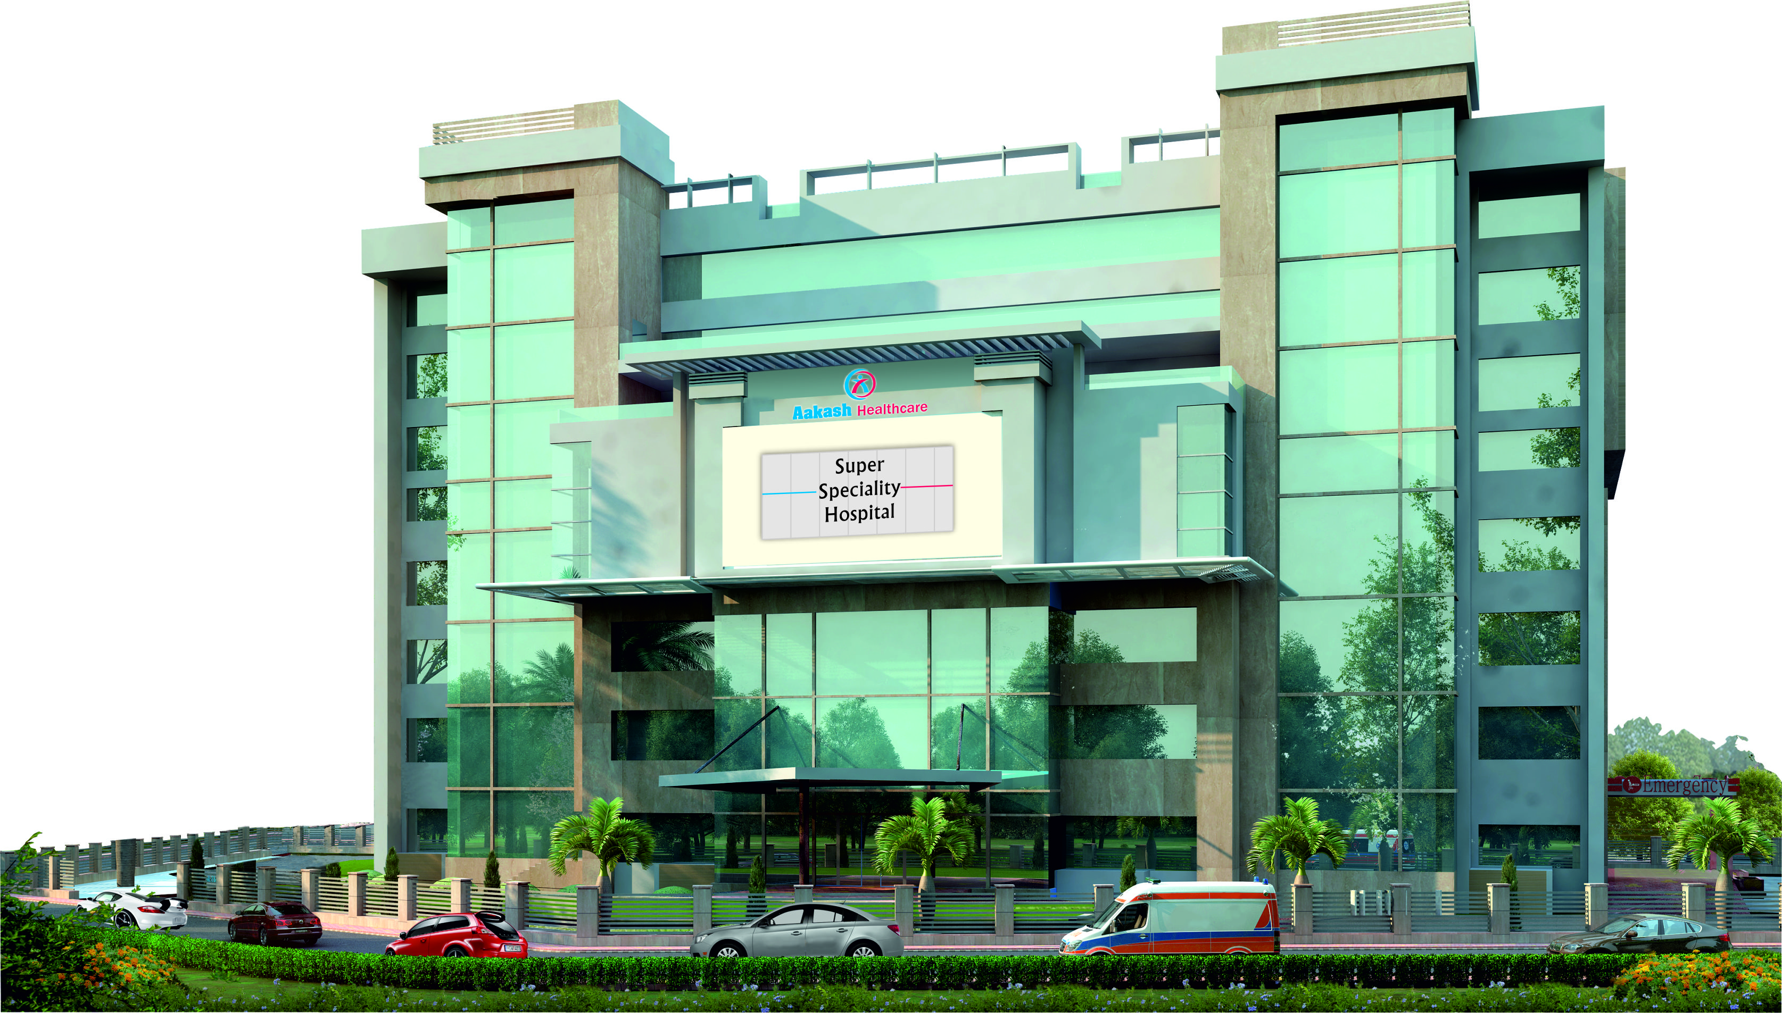
About the Organization:-
Aakash Healthcare is a Private Limited Company (AHPL) is a subsidiary of the prestigious Aakash Group .

Slide 3
Aakash Healthcare
It was incorporated on 19th November, 2013 by Dr. Aashish Chaudhry who is the founder and Managing Director of Aakash Healthcare.
It is a state of the art healthcare facility and the first smart hospital in South – West Delhi
It is build on a plot area of 600 sq. meter with a parking area for about 240 vehicles.

Slide 4
Vision & Mission:
Vision:-
To become the most desired healthcare brand by providing compassionate, caring and world class services with the help of talented team of doctors, professionals and latest technology
Mission:-
To achieve highest patient satisfaction index by delivering patient centric, best healthcare services amongst the local and extended community

Slide 5
Core Values:-
I- Integrity
C- Compassion
A- Accountability
R- Respect
E- Excellence
Key Specialties-
Orthopaedics & Joint Replacement
Cardiology & Cardiac Surgery
Mother & Child
General & Minimal Access Surgery
Ophthalmology & Refractive Surgery
Nephrology

Slide 6
Study Title-
To devise price positioning strategy for Obstetrics and Gynaecology department of an upcoming 230 bedded super Specialty hospital in Dwarka region.

Slide 7
Introduction:-
Price is the quantity of payment or compensation given by one party to another in return for goods and services.
Pricing is the process you need to go through to figure out what price to attach to each unit. Therefore, pricing is a strategic process.
Pricing strategy refers to method companies use to price their products or services.

Slide 8
In terms of healthcare industry, it can be defined as the expenses incurred by a healthcare provider in providing care.
In today’s scenario, there are various pricing strategies used by the healthcare providers such as-
Mark Up Pricing
Rate of Return Pricing
Perceived Value Pricing
Competitive Pricing
Penetration pricing

Slide 9
Problem Statement
Price positioning is a critical activity during the launch of any product or service because of a very simple reason that it helps the customer relate with the product on various levels. It defines the market segment it caters to, It specifies the client base it targets, so on and so forth.
Price positioning is a relatively uphill task if the product is new or the market is virgin. For an existing product/ service, all that needs to be taken care of is the competitor segment, their offerings and their respective price positioning.
Here, we are in the process of launching a 230 bedded facility, price positioning for its Obs & Gynae department has to be in lines with current market trends of nearest competitors. In order to ensure the same, we need to identify a pricing strategy.

Slide 10
Rationale Of Study:-
Pricing plays an important role in positioning an upcoming brand in the market .
It defines the segment of population to which it caters in the market and defines how a new brand will position itself in the market and how it stands in relation to its competitors who are offering similar services in the market.
In a good price positioning strategy, the brand stands out from rest of its competitors and it also confers its ability to charge a higher price for their services and at the same time stave’s off the competition from the other competitors.
Therefore pricing is one of the major pillars for brand establishment for any organization.

Slide 11
Objectives:-
General Objective-
Define price benchmarking of obstetrics and gynecology department for an upcoming 230 bedded hospital with similar catchment area.
Specific Objectives-
To identify current market players and their packages.
Suggesting pricing strategy for this department.
Draft an exhaustive SOC for Obs & Gynae. department

Slide 12
Research Methodology
Study Design- Analytical Study
Study Area- Dwarka, Delhi
Duration of Study- 3 Months( 1st Feb-1st May).
Type of data Collection- Quantitative Secondary Data was collected.
Data Analysis- Excel Spreadsheet

Slide 13
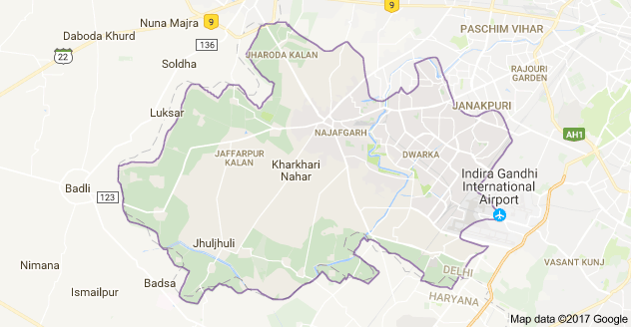
Results:- Demographic & Social profile of Dwarka
Dwarka is the headquarter of South West District of Delhi in India.
Dwarka
It is the largest residential suburb in Asia, with a total of 1718 residential enclaves, and a net population of 1,100,000.

Slide 14
It has an area of about : 56.48 km² (21.81 sq m.)
The languages spoken in this region are mainly Hindi and English.
Education- Dwarka is home to many primary and secondary schools along with engineering and law institutes like Netaji Subhash Institute of Technology, National Law University etc .It has a literacy rate of about 88.3% by the year 2011.
It has a sex Ratio of about 840( females per thousand of men)

Slide 15
Current Market Players:-
There are various healthcare facilities providing treatment for obstetrics and gynaecology patients in Dwarka region and its vicinity.
These facilities cater to the vast population residing in this region. These healthcare facilities include various private and government hospitals such as – VPS Rockland, Bhagat Chandra Hospital, Venkateshwar etc.
The current market players that have been taken into consideration for this study are:-
Venkateshwar Hospital
Artemis Hospital
FMRI

Slide 16
Pricing Strategy for Obs & Gynae department:-
While taking into considerations the current major market players, we have proposed to use a competitive pricing strategy since our hospital is a new entrant in the market.
Competitive pricing can be defined as setting the price of a product or service based on the prices competition is charging for their services.
It involves setting a price based upon analysis and research compiled from the target market .

Slide 17
According to competitive pricing we have placed our pricing in relation to Venkateshwar Hospital since it is our immediate competitor and not with other two organizations since –
Artemis is a 50 bedded hospital.
& FMRI is an established brand and therefore have higher prices for its treatments.
In this study we have placed our rack rates below the prices of venkateshwar hospital and for the rest of the room categories, an increment is added to the base rack rates.

Slide 18
Schedule Of Charges
The Schedule of Charges of certain major procedures (with assumed figures due to confidentiality issues) are shown below

Slide 19
Conclusion:
After carrying out this study we can conclude that for any organization which is entering a mature market, it is important to understand the current market trends, current market segmentation & competitors positioning so that they can place themselves in the market at such a position where they can provide affordable treatment to the patients as well as survive in the market.

Slide 20
In this study we have compared the pricing of three market players i.e. Venkateshwar Hospital, Artemis Hospital and FMRI Hospital. After comparing them, we have proposed our pricing strategy in such a way that our rack rates are below the venkateshwar’s rack rate.

Slide 21
Recommendation:-
In this study, competitive pricing strategy is recommended since this strategy is made for an upcoming hospital in an mature market where we already have strong market players who are providing the same services.
.

Slide 22
Limitations:-
In this study the pricing strategies of only three hospitals have been taken into consideration.
The data used in this study is secondary in nature.
Due to confidentiality issues real data is not presented here.

Slide 23
References
(htpp://www.ncbi.nlm.nih.gov/pmc/articles/PMC2761791/)(Articles from Journal of Health, Population, and Nutrition, courtesy of BioMed Central)
https://www.ncbi.nlm.nih.gov/pmc/articles/PMC2865678/
http://www.urban.org/sites/default/files/publication/50116/2000212-Addressing-Pricing-Power-in-Health-Care-Markets.pdf
www.healthcarepricingproject.org/sites/default/.../pricing_variation_manuscript_0.pd
https://papers.ssrn.com/sol3/Delivery.cfm?abstractid=2526066
www.investopedia.com/terms/c/competitive-pricing.asp
https://en.wikipedia.org/wiki/Price
work.chron.com/defining-competitive-hourly-rate-29501.html
extension.psu.edu/food/entrepreneurs/starting-a-business/price-and-pricing

Slide 24
References (Contd.)
economictimes.indiatimes.com/definition/pricing-strategies
http://smallbusiness.chron.com/definition-pricing-strategy-4686.html
https://www.lokad.com/competitive-pricing-definitions
http://economictimes.indiatimes.com/definition/rate-of-return-pricing
http://www.businessdictionary.com/definition/going-rate-pricing.html
https://en.wikipedia.org/wiki/Rate_of_return_pricing
http://www.investopedia.com/terms/p/penetration-pricing.asp

Slide 25
Thank You

