Slide 1
FUTURE TOWARDS SMART HOSPITALS: Perception and acceptance of using technology to assist healthcare in the hospitals, Bangalore
Presented By:
Diksha Sharma
Intern, NTT Data
Guided by:
Dr. Anandhi Ramachandran

Slide 2
AGENDA
Introduction
Objective
Methodology
Data Analysis
Conclusion
Recommendation
References

Slide 3
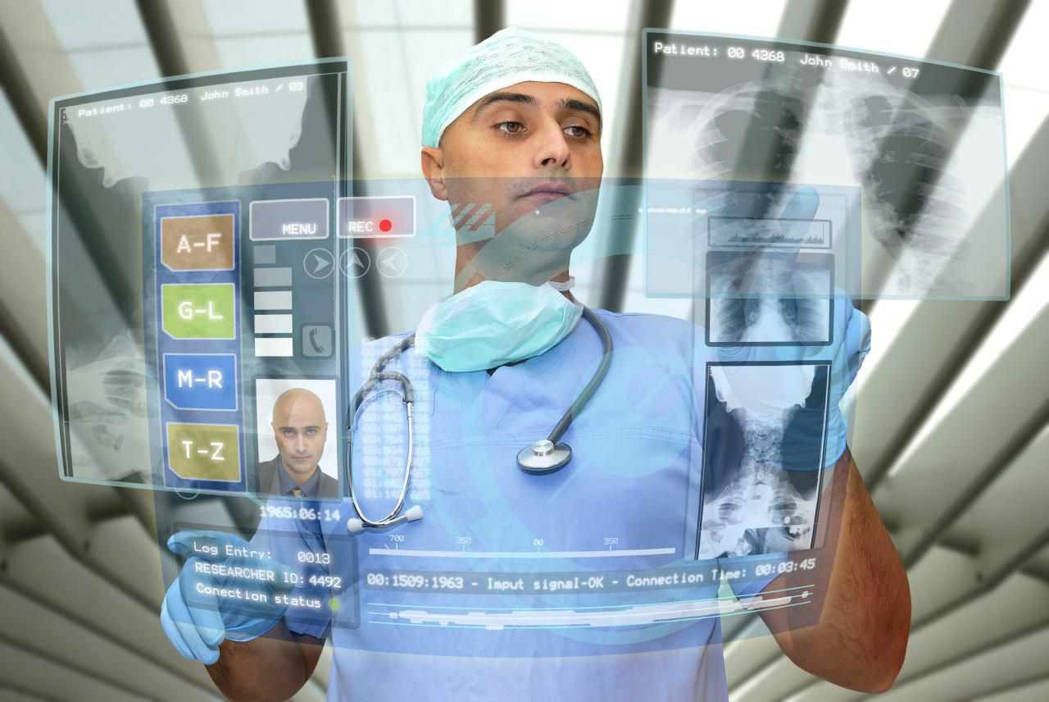
What is a Smart Hospital?

Slide 4
A Smart Hospital is…
‘A place where technology and design converge to enhance patient care’
The fundamental principle of being a ‘Smart’ hospital is that it has to cover four essential dimensions.
It has to be:
Patient experience focused
Employee focused
Organization focused
Innovation focused

Slide 5
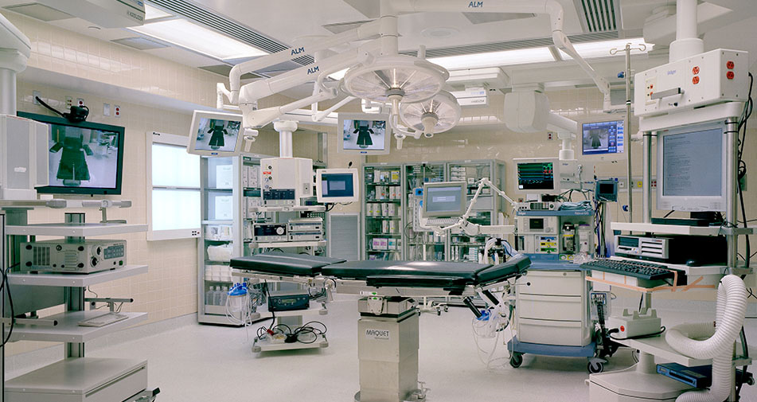
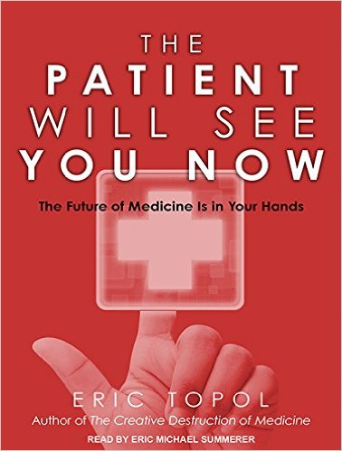
Key Stakeholders
Healthcare providers
SMART Hospital
Patients

Slide 6
Why hospitals must be smart?
To Streamline the workflow through automation
To improve the Quality of Service
To reduce the medical errors
To reduce the waiting time
Interoperability
Provide care to remote areas
Data Security

Slide 7
Objectives of the study
To understand the functioning of Smart Hospitals.
To Assess the healthcare provider’s (i.e. Doctors, Nurses, Physiotherapists, Pharmacists, Lab Technicians and Dentists) perception towards Smart Hospitals and use of IT in the hospitals.
To analyze the challenges and barriers in adoption of latest technology in Hospitals.
To determine the patient’s perception towards Smart Hospitals.

Slide 8
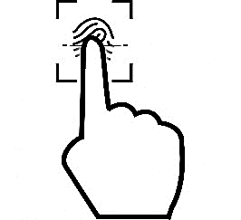
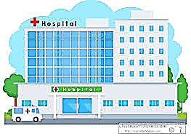
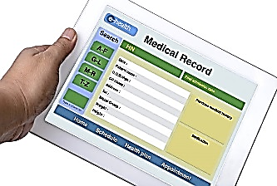
Functioning of Smart Hospitals (Objective 1)
Remote care system
Mobile client system
Biometrics Sensors
Closed-circuit system
Security
Power Regulation
Climate Regulation
Smart Rooms
Identification system
Building
Mobile Devices
Wearable devices
Implantable devices
Networking equipment
Medical devices
EMR
Pharmacy information System
Blood Bank
Research Information System
Research Data
Tracking and monitoring
EMR
Interconnected CIS
Data

Slide 9
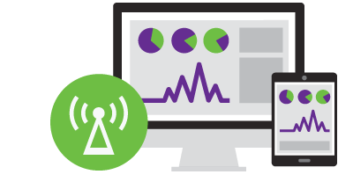
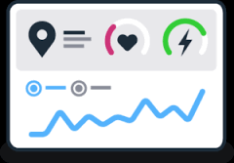
Functioning of Smart Hospitals (Continued…)
Ability to manage any number of devices
Automated device to- analytics data flow
Remote monitoring for Patient’s health statistics
Hospital asset management
Remote device configuration and tuning
Data analytics applications for clinicians and patients
Predictive device maintenance
Data Security

Slide 10
Methodology (To achieve Objective 2 and 3)
Descriptive cross-sectional study for Three months ( Feb’17 to April’17)
Data is collected from primary and secondary sources.
Sample Size was calculated using the formula:
Necessary Sample Size = (Z-score)2 * Std. Dev*(1-StdDev) / (margin of error)2
384 (192 Healthcare providers and 192 Patients) from various Multispecialty hospitals* in Bangalore was collected and analyzed on SPSS and Microsoft Excel.
192 Doctors, Nurses, Physiotherapists, Pharmacists, Lab Technicians and Dentists (32 each).
Purposive Sampling for healthcare Providers and Convenient sampling for the patients.
Survey Method (Questionnaire) using 6-point and 5-point Likert scale Based on Technology Acceptance model (TAM).
*Sakra World Hospital, Santosh Hospital, Columbia Asia, Cloud nine, Manipal Hospital and Sparsh Hospital

Slide 11
Questionnaire based on…
Perceived Usefulness
Ease of use
Behavioral Intention
Facilitating conditions
Technology acceptance model (TAM)

Slide 12
A Pilot Study
Inclusion criteria
Exclusion criteria
Limitations
Males and Females
20-60 years of Age
General Population is considered as patients those who have visited Hospital once in Life.
Administrative Staff of the Hospitals.
Patients with Mental Illness and severe Injuries.
The study is limited to Multispecialty Hospitals of Bangalore only.
Time was Less.
Pilot Study was successfully done to check the reliability of the Questionnaires.
Healthcare providers and Patients (50 each)
Cronbach’s Alpha for Patient = 0.716 (Reliable)
Cronbach’s Alpha for Healthcare providers = 0.727 (Reliable)

Slide 13
Data Analysis (For Patients)
Sociodemographic Characteristics | No. of Patients | Percentage
GENDER Male Female Total | 115 77 192 | 59.9% 40.1% 100%
AGE 20-30 30-40 40-50 50-60 | 115 53 12 12 | 59.89% 27.60% 6.25% 6.25%

Slide 14
Data Analysis (For Patients)
CONSTRUCTS | VARIABLE ITEMS | CRONBACH’S ALPHA
Perceived Usefulness (PU) | PU1 PU2 PU3 PU4 | 0.79
Perceived Ease of use (PEOU) | PEOU1 PEOU2 PEOU3 PEOU4 | 0.76
Behavioral Intention (BI) | BI1 BI2 | 0.75
Facilitating Conditions (FC) | FC1 FC2 | 0.81
Acceptance (ACC) | ACC1 ACC2 ACC3 ACC4 | 0.91

Slide 15
Data Analysis (For Patients)
CONSTRUCTS | VARIABLE ITEMS | Mean | Avg. Mean | Std. dev | T-Value | df | Sig (2-tailed)
Perceived Usefulness (PU) | PU1 PU2 PU3 PU4 | 5.42 5.32 5.18 5.27 | 5.29 | 0.6454 | 93.084 | 189 190 191 190 | .000
Perceived Ease of use (PEOU) | PEOU1 PEOU2 PEOU3 PEOU4 | 5.34 5.04 5.38 5.17 | 5.23 | 0.7145 | 87.148 | 190 187 191 190 | .000
Behavioral Intention (BI) | BI1 BI2 | 5.01 5.18 | 5.09 | 0.6948 | 82.845 | 190 190 | .000
Facilitating Conditions (FC) | FC1 FC2 | 5.17 5.17 | 5.17 | 0.7964 | 78.947 | 190 186 | .000
Acceptance (ACC) | ACC1 ACC2 ACC3 ACC4 | 5.48 5.48 5.30 5.32 | 5.39 | 0.7249 | 89.289 | 191 190 187 187 | .000

Slide 16
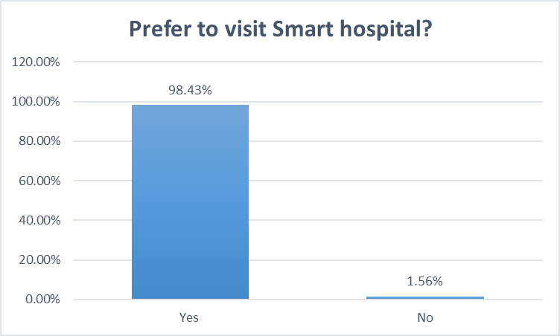
Data Analysis (Continued…)
Figure 1. is showing the percentage of patient’s Preference to
Visit a smart hospital than a normal Hospital.
Figure 2. is the Percentage of Patients
using healthcare Apps (Age-group wise bifurcation)

Slide 17
Data Analysis (For Healthcare providers)
Sociodemographic Characteristics | No. of Healthcare providers | Percentage
GENDER Male Female Total | 111 81 192 | 57.8% 42.2% 100%
AGE 20-30 30-40 40-50 | 67 105 20 | 34.9% 54.7% 10.4%

Slide 18
Data Analysis (For Healthcare providers)
CONSTRUCTS | VARIABLE ITEMS | CRONBACH’S ALPHA
Perceived Usefulness (PU) | PU1 PU2 PU3 PU4 | 0.81
Perceived Ease of use (PEOU) | PEOU1 PEOU2 PEOU3 PEOU4 | 0.82
Behavioral Intention (BI) | BI1 BI2 | 0.92
Facilitating Conditions (FC) | FC1 FC2 | 0.79
Acceptance (ACC) | ACC1 ACC2 ACC3 ACC4 ACC5 | 0.85

Slide 19
Data Analysis (For Healthcare providers)
CONSTRUCTS | VARIABLE ITEMS | Mean | Std. dev | T-Value | df | Sig (2-tailed)
Perceived Usefulness (PU) | PU1 PU2 PU3 PU4 | 5.23 | 0.9747 | 75.189 | 191 | .000
Perceived Ease of use (PEOU) | PEOU1 PEOU2 PEOU3 PEOU4 | 5.30 | 0.8911 | 82.911 | 191 | .000
Behavioral Intention (BI) | BI1 BI2 | 5.23 | 0.9326 | 77.847 | 191 | .000
Facilitating Conditions (FC) | FC1 FC2 | 5.26 | 1.0895 | 67.129 | 191 | .000
Acceptance (ACC) | ACC1 ACC2 ACC3 ACC4 ACC5 | 5.43 | 0.8206 | 93.928 | 191 | .000

Slide 20
Data Analysis (Continued…)
Figure 1. Percentage of patient’s response
Figure 3. is showing the percentage of patient’s results on the various Parameters i.e. Perceived Usefulness, Perceived ease of use, Behavioural intention, Facilitating conditions and total acceptance.

Slide 21
Data Analysis (Continued…)
Figure 4. Percentage of Healthcare provider’s response
Figure 4. is showing the percentage of Healthcare provider’s results on the various Parameters i.e. Perceived Usefulness, Perceived ease of use, Behavioural intention, Facilitating conditions and total acceptance.

Slide 22
Challenges in adoption of technologies in the hospitals (Objective 4)
Cost of care
Lack of technical skills among the healthcare providers
Lack of accessibility as internet connectivity is not available in all the geographical areas especially
in rural areas
No defined policies and standards
Rapid change in the technology.
Lack of strategic IT plans

Slide 23
Conclusion
Recommendations
The Factors of Technology acceptance model i.e. Perceived Usefulness, Perceived ease of use, behavioral intention and Facilitating conditions were found to influence Healthcare provider's and Patient's acceptance towards Smart hospitals.
The result of this study indicates that Healthcare providers and the patients exhibited a strong Perception towards the acceptance of Smart Hospitals with the Average score of 5.43 for healthcare providers out of 6 and 4.34 for the patients out of 5.
Awareness
Training
Cost Reduction
Data Security and Privacy
Accuracy
Development of Standards
Integration
Government Funding
Installation of Infrastructure
Fully Automated
Risk assessment
Sufficient Resources

Slide 24
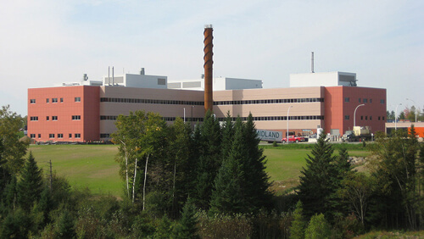
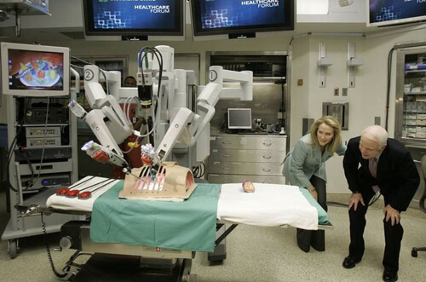
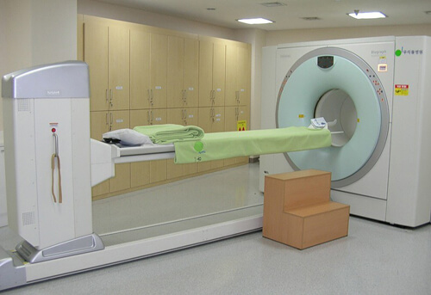
University Hospital – Columbia,
Missouri
Online Questionnaire Links:
For providers=https://goo.gl/forms/mRQ47nmMyXMhPwZq1
For Patients=https://goo.gl/forms/os3ZNUDqlmx98t9T2
Upper River Valley Hospital, Canada
References:
https://www.enisa.europa.eu/publications/
http://www.topmastersinhealthcare.com/
www.iotsworldcongress.com/congress/
www.igi-global.com/dictionary/technology-acceptance
stats.stackexchange.com/.../cronbachs-alpha-in-pilot-study
https://www.qualtrics.com/blog/determining-sample-size/
Wooridul Spine Hospital –South Korea
Cleveland Clinic –Ohio
Source: TMIHEditor

