Slide 1
Potential Risk Factors Attributed to Occurrence of Brucellosis in Dairy Farmers of Peri-urban Area of South-west Delhi
Dr. Navita Yadav
IIHMR Delhi
Mentors
Dr. Sanjiv Kumar
Director, IIHMR
Dr. Dhananjay Srivastava Dr. Divya Aggarwal
Associate professor, IIHMR Assistant professor, IIHMR

Slide 2
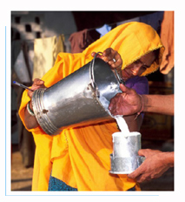
This study is supported by
PUBLIC HEALTH FOUNDATION OF INDIA
&
INTERNATIONAL LIVESTOCK RESEARCH INSTITUTE
KENYA
UNDER THE PROGRAMME
ROADMAP TO COMBAT ZOONOSIS IN INDIA INITIATIVE
SOURCE: WHO

Slide 3
Contents
Introduction
Rationale
Objective
Methodology
Limitations
Results
Recommendations
Conclusion

Slide 4
Introduction
One World One Health approach:
Collaborative efforts of multiple disciplines working locally, nationally, globally to attain optimal health for people, animals, plants and our environment.
Vision:
A world capable of preventing, detecting, containing, eliminating and responding to animal and public health risks attributable to zoonoses and animal disease with an impact on food security through multi sectorial corporative and strong partnership.
People
animals
Environment

Slide 5
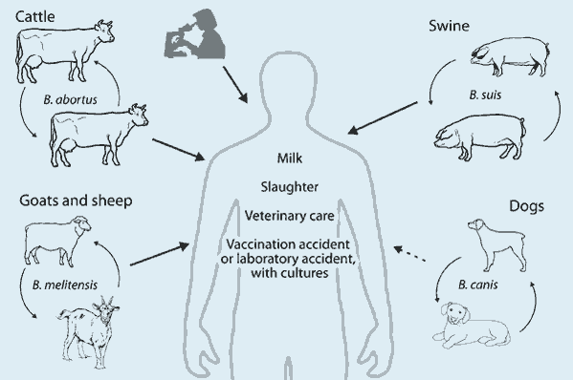
Human brucellosis
Also known as Malta fever, contagious abortion, rock fever or undulant fever.
Listed as neglected zoonotic disease by WHO.
Causation
SOURCE: www.google.co.in

Slide 6
Signs and Symptoms in Humans
General symptoms of brucellosis are often vague and similar to the flu. They may include:
Fever (the most common symptom, with high "spikes" that usually occur in the afternoon)
Back pain
Body-wide aches and pains
Poor appetite and weight loss
Headache
Night sweats
Weakness
Abdominal pain
Cough

Slide 7
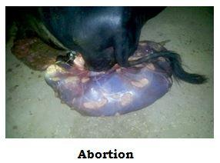
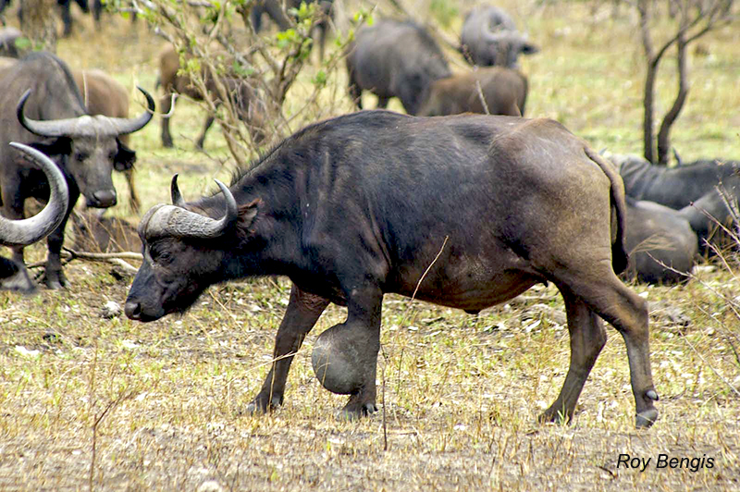
Sign And Symptoms In Animals
Third trimester abortion
Endometritis
Birth of dead and weak calves
Low milk yield
Retained placenta
Once expelled will have a leathery appearance
Source : www.google.co.in

Slide 8
Map of distribution of brucellosis worldwide
SOURCE: www.google.co.in

Slide 9
Rationale
Human brucellosis has a wide clinical spectrum, presenting various diagnostic difficulties because it mimics many other diseases.
Increased demand for dairy products accompanied with changing and intensified farming practices has raised the concern for increased spread and intensified transmission.
The disease may be overlooked and misdiagnosed because of the difficult diagnosis and the absence and lack of experience with laboratory testing.
Alertness of medical staff is needed to recognize and diagnose the disease.
Awareness of risk groups is needed to take appropriate preventive measures and to accept control measures.

Slide 10
General Objective :
To identify the exposure to potential risk of brucellosis among dairy farmers of South-West Delhi.
Specific Objectives :
To identify the animal husbandry practices that contribute to risk of infection of brucellosis in small dairy farmers of south west Delhi.
To identify the behavioural practices that contribute to infection of brucellosis in humans in human in small dairy framers of south west Delhi.

Slide 11
Methodology

Slide 12
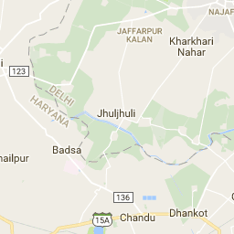
STUDY DESIGN
A cross sectional , descriptive study was done in village jhuljhulii of Najafgarh division of south west district , Delhi during the month of February and April.
STUDY AREA
Out of three divisions of south-west Delhi, Najafgarh division is comprised of population keeping livestock at their households , hence among the 39 villages of Najafgarh division one village was selected randomly for data collection.
Village Jhuljhuli is situated near Delhi Haryana border with a population of around 1600 people and 300 households(census 2011).
SOURCE: www.google.co.in

Slide 13
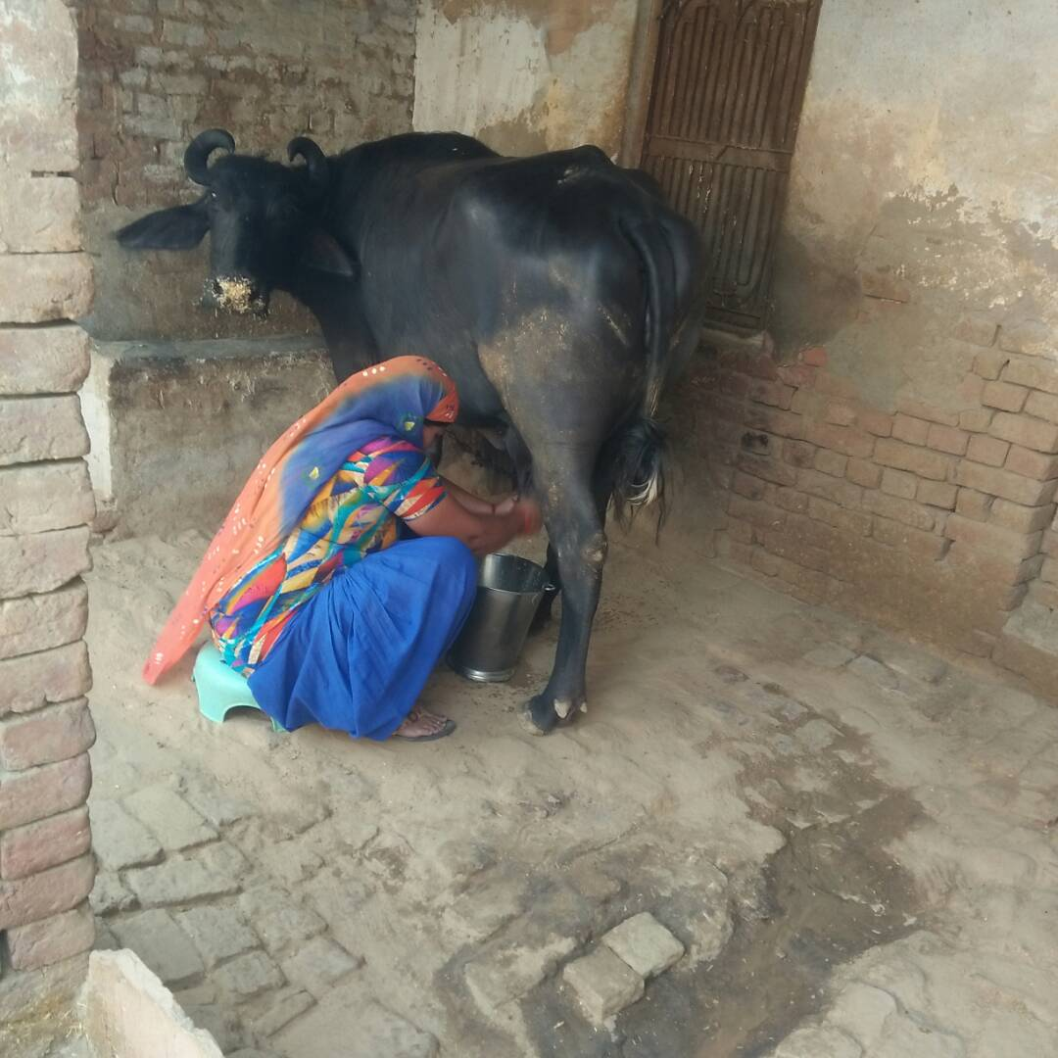
Study population
The study population is those who are keeping livestock at their houses
Inclusion criteria
The one who spend maximum time with livestock
The one who do maximum work related to livestock
Those who are willing to participate in this study and gave consent for the same
Adults are more focused

Slide 14
SAMPLE SIZE AND SAMPLING METHOD
Sample size was 100 taken conveniently.
One participant from each household was selected
Sampling method was snowball sampling where in the interviewer visited those houses which were suggested by the villagers that they keep livestock at their house

Slide 15
DATA COLLECTION
Data collection tool was a semi structured questionnaire which comprised of both open ended and close ended questions.
Questionnaire was divided into 3 parts:-
socio-demographic characteristics such as, name, age, sex, marital status, religion, occupation, education level and socioeconomic status (using Kuppuswamy scale of socioeconomic status) .
Animal husbandry practices such as, pre-purchase tests before buying new animal, vaccination of animals, handling of aborted material, assistance of animals during reproduction, use of protective gloves, milking of animals, contact with animals.
Risk factors of brucellosis such dietary habits (consumption of raw milk, consumption of animal urine, sharing of water source with animals).

Slide 16
Analysis
Quantitative data was analyzed through SPSS using:
Frequencies
Proportions
Risk score:
Scoring was calculated manually.
Ranging from 0-14
Where every question was scored 0 and 1, 0 for non risky practice and 1 for risky practice.

Slide 17
Ethical consideration
Consent was taken from the respondents before taking interview.
Explanation was given to the respondents concerning confidentiality before the interview commenced.
After taking interview participants were made aware about what is brucellosis and what are the risk factors which may cause brucellosis.

Slide 18
Limitations
The sample size calculation was conveniently taken also the sampling method was also non probability sampling hence the results can’t not be generalized.
The study only included questionnaire there was no observational checklist for checking the practices really done or not, hence there may be chances of bias.

Slide 19
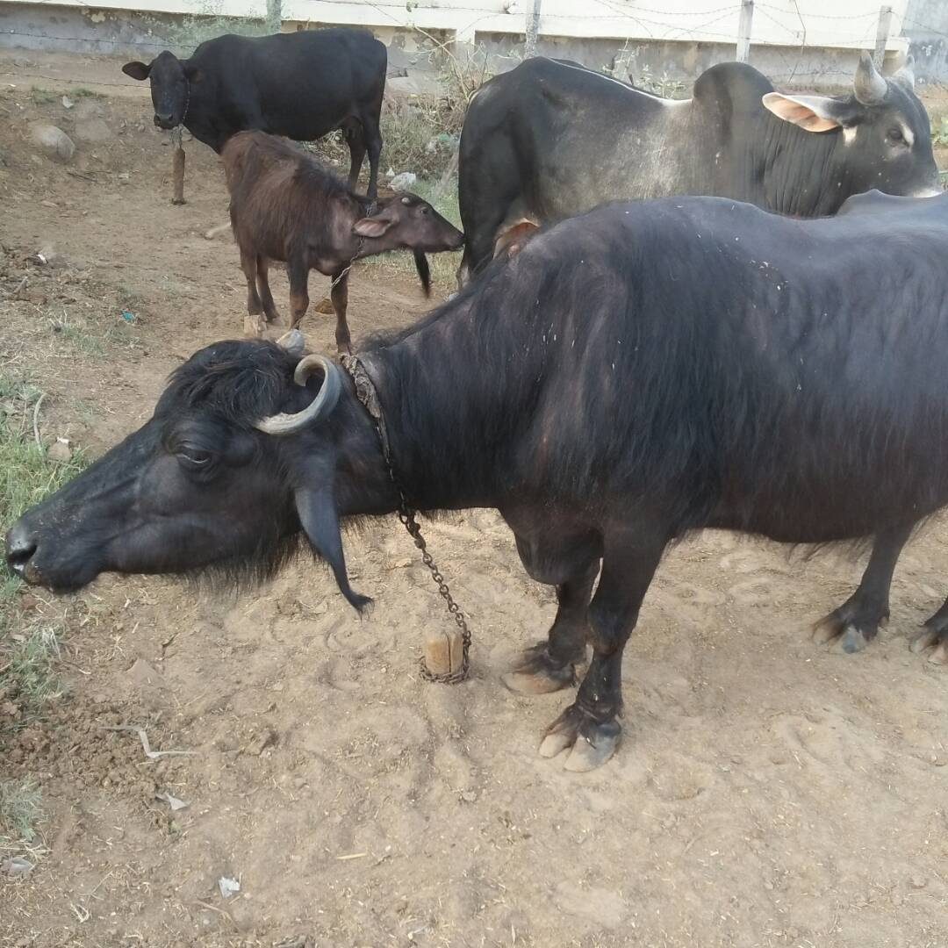
RESULTS

Slide 20
Response rate:
To target the sample size of 100, 107 households were targeted out of which 7 denied for giving interview.
Hence response rate was 93.74%.
Socio demographic features:
There were 86 females and 14 males in the study.
Age distribution:
From 20-30 18 respondents
31-40 36 respondents
41-50 29 respondents
51-60 15 respondents
61-70 2 respondents

Slide 21
Socio demographic features cont’d
Education level
Occupation
Farmer 5
Homemaker 80
Laborer 1
Milkman 10
Tailor 4
None 24
Primary incomplete 14
Primary complete 28
Secondary incomplete 11
Secondary complete 21
Tertiary 2

Slide 22
Risk score
Classification of risk score:
Category | Percentage range
Category I | 0%-50%
Category II | 50.01%-75%
Category III | 75.01%- 100%

Slide 23
Compare means where maximum score was 12, minimum 3 and mean score 8.08
Age
sex

Slide 24
occupation
Socioeconomic status

Slide 25
Frequency table
s.no. | Questions | Expected answer | N=100 | Percentage
1 | If you buy new cattle, do you take any action to assure it is healthy? | Yes | 45 | 45
2 | If yes for above question, what action do you take for assuring that cattle is healthy? | Use more experienced people in village | 44 | 44
3 | Do you get your cattle vaccinated regularly? | Yes | 34 | 34
4 | Who mainly does the milking of animals in your household? | Men | 21 | 21
 |  | Women | 79 | 79
5 | What action do you take if your cattle are sick/shows signs of disease? | Always call veterinarian | 19 | 19
6 | Have you had cases of abortions in your cattle in the last 1 year? | Yes | 72 | 72
7 | How do you handle aborted material? | Buried | 84 | 84
8 | What do you do with dead cattle foetuses? | Bury | 72 | 72

Slide 26
s.no. | Questions | Expected answer | N=100 | Percentage
9 | In the last 1 year, have you had any cases of retained placenta after abortions? | Yes | 9 | 9
10 | Do your livestock have contact with other peoples’ livestock during grazing and/or watering? | No | 53 | 53
11 | Do we have occasions when raw milk is taken? | No | 43 | 43
12 | If yes, on what occasion raw milk is taken | Daily | 16 | 16
 |  | When gastric problems | 8 | 8
 |  | Dot know | 33 | 33
13 | For what reason do you consume raw milk? | For good taste | 23 | 23
 |  | For gastric complaints | 8 | 8
 |  | Don’t know | 26 | 26
14 | Do you keep your animals close to your sleeping area overnight? | No | 56 | 56
15 | Do you assist your animal during reproduction? | No | 0 | 0
16 | Who assist your animal during reproduction? | Always call doctor | 0 | 0
17 | During assistance of reproduction in your animals do you put on protective gloves? | yes | 0 | 0
18 | Do you share water source with animal’s water source? | No | 91 | 91
19 | Do you consume animal urine? | No | 80 | 80

Slide 27
Conclusion
The study concludes that animal husbandry practices such as:
keeping animals in close proximity of humans during sleep,
irregular vaccination of cattle,
contact of animals with other animals during grazing or watering,
treating animals on their own when they fall sick and
assistance during reproduction without wearing protective gloves
are contributing to risk of brucellosis among the community of village Jhuljhuli.
Dietary practices such as:
consumption of raw milk
is contributing to risk of brucellosis among the community.

Slide 28
Recommendations
A study should be carries out with appropriate sample size calculation and probability sampling method, so that generalization of results can be done.
Another study can be conducted using a standardized tool to access the risk factors can be conducted.
Socio cultural and behavioral facts of human brucellosis should be incorporated into IEC material of currently running programs of zoonotic diseases.
The sensitization and awareness creation campaigns that includes potential risk factors of human brucellosis as well as other zoonotic diseases should be carried out in the community.

Slide 29
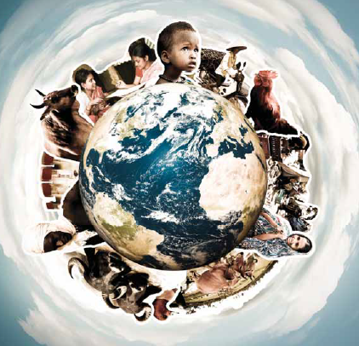
THANK YOU

