Slide 1
Knowledge of Zoonoses???
Presented by
Dr. Priya Chinchwadkar
PG/15/059
Mentors
Dr. Sanjiv Kumar
Dr. Dhananjay Srivastava
Prof. Divya Aggarwal

Slide 2
This study is supported by Public Health Foundation of India and International Livestock Research Institute, Kenya.

Slide 3
Zoonoses??
Zoonoses
Animal
Diseases
Rudolf Virchow first used this term(1855) -“Handbook of Communicable Disease” - the animal diseases secondarily transmissible to man.
Concept of zoonoses- complex- epidemiological triad

Slide 4
Zoonoses: Triad
Human- Host
Environment
Vector (anthropod)- Agent
Zoonoses are diseases and infections that are naturally transmitted between vertebrate animals and humans.
Total 7 diseases of importance- eg- 1) Brucellosis
2) Rabies
3) Bovine tuberculosis
4) Cysticercosis
Globally- emergence & re-emergence of zoonoses – gaining attention

Slide 5
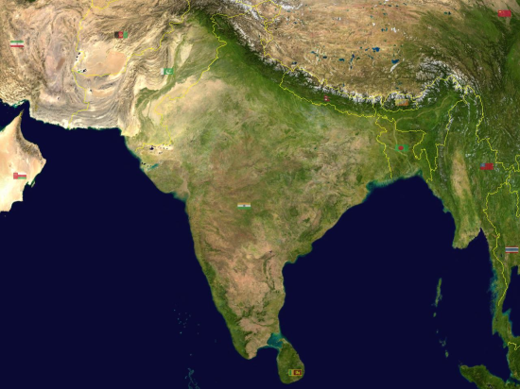
Why is zoonoses important to India?
India is a land of villages- 71.6 percent population- rural areas.
Main occupation- Agriculture and agro-related occupations
Indian subcontinent - one of the four global hot-spots at increased risk for emergence of new infectious diseases
India- largest milk producer - highest population of cattle- 134 million cows and 124 million buffalos

Slide 6
Why zoonoses is important?
Disease
Social Well being
Effect on animal production
Less milk production
Economic Loss

Slide 7
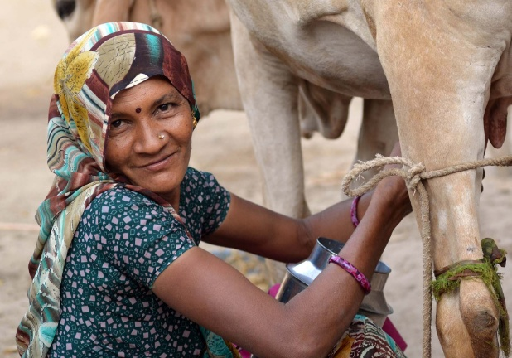
Role of females
Women -93 per cent of total employment in dairy production
Role of female population – important- handling of the livestock
Involved activities like - Care of new-born calf, cleaning of animal shed, care during pregnancy and care of sick animals
About 75 million women as against 15 million men are engaged in dairying in rural India
Understanding their knowledge about the disease becomes critical

Slide 8
Is it possible to control Zoonosis?
Short answer…… YES!
HOW?
HOW?
Awareness, Teaching and Training programs -dairy farmers -diseases control in animals &reduce the public health risk of milk-borne zoonosis
Public health promotion on education and inter-disciplinary one-health collaboration -vets, public health practitioners and policy makers- diagnosis and control of zoonoses
WHO conducted a program on RABIES in India - number of cases reduced to a certain extent -economic losses

Slide 9
An assessment of knowledge regarding the risk of zoonoses and hygiene practices among females with livestock in South-West, Delhi, India: A cross – sectional study

Slide 10
Aim & Objective
AIM:
To assess the knowledge level regarding the risk of zoonoses and hygiene practises among female population with livestock in South-West Delhi
OBJECTIVE:
To assess the knowledge regarding risk of zoonoses and hygiene practices among females in small holder dairy farms
To assess the actual status of practices adopted in the small holder dairy farm

Slide 11
Conceptual Framework

Slide 12
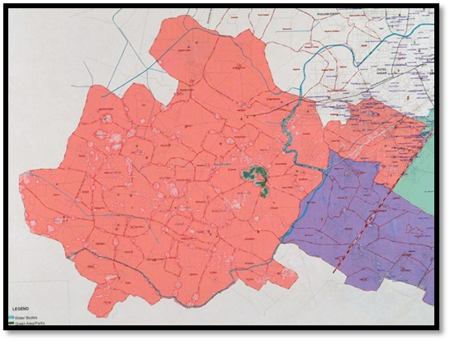
About the Study- I
Study Area:
South-West Delhi
Area - 420 km²
Population of 2,292,363 (2011 census)
The district is divided as-
Dwarka, Najafgarh and Kapas Hera
Study Population:
Female population from the House-Hold (HH)

Slide 13
About the Study- II
Sample Size: The total sample size was of 60 HH, the sample size was selected as per convenience.
Sampling Method: Quota sampling was used to select female population according to age
Three age groups were taken- young female population (15-24 Yrs), middle age (25-54 Yrs), senior age (55-64 Yrs).
Snowball sampling method was used for gaining the desired number.

Slide 14
About the Study- III
Data Collection Method: After selection of the participant, Informed consent was taken.
Structured questionnaire was used as a tool for data collection
3 broad sections i.e Demographics, Awareness about zoonotic diseases and hygiene practices including- general hygiene practices, specific hygiene practices
Checklist- to observe the actual way of handling.

Slide 15
Pilot test
Response Rate- 100%
Few questions-dichotomous- Likert scale.
One question was found to be sensitive to their social and cultural belief, as a result the language of the question was changed to get the desired response
Questions regarding animal husbandry, vaccination of the cattle, specific disease management etc were not included in the questionnaire

Slide 16
Results
Demographic Characteristics
Age of the respondent
Age Groups | Frequency | Percent
15-24 | 18 | 30
25-54 | 20 | 33.3
55-64 | 20 | 33.3
Kuppuswamy socio-economic status
 | Frequency | Percent
26-29- Upper | 4 | 6.7
16-25- Middle Upper Middle | 21 | 35.0
11-15- Lower Middle | 23 | 38.3
5-10- Lower Upper lower | 9 | 15
less than 5- Lower | 1 | 1.7
Occupation
 | Frequency | Percent
Housewife | 49 | 81.7
Working | 9 | 15

Slide 17
Assessment of knowledge regarding hygiene practices and zoonotic diseases
Majority of the respondent didn’t have knowledge – 45/56 (75%)
Nearly half- disagreed that few diseases can be transferred from man to animal or vice-versa 32 (53.3%)
Knowledge of specific zoonotic diseases- None
The respondents actively helped the cattle during reproduction (49/58; 81.7%) but didn’t wear any protective gloves (54/58; 90%).

Slide 18
Knowledge score and hygiene practices related to zoonoses
Sr.No. | Knowledge about practices | Obtained mean score | Expected total score
1. | General practices | 7 | 9
2. | Specific practices | 11 | 18
3. | Total score | 18 | 28
The total score for the questions was 28
The scoring range of the questions was 28 to be maximum while 0 minimum
< 18 was considered as low score and >18 as considered high score.

Slide 19
Knowledge towards General and Specific Practices about zoonotic diseases
The sample is divided in two groups – i) Low score ii) High score
Distribution of knowledge scores

Slide 20
Assessment of Highest level of education and Knowledge
To evaluate if education has an effect on knowledge level
Crosstab and Fisher’s Exact test
 |  | Knowledge score |  | Total
 |  | Low | High
Highest level of education | None | 14 | 11 | 25
 | Primary incomplete | 10 | 13 | 23
 | Secondary Incomplete | 3 | 7 | 10
Total |  | 27 | 21 | 58
Fisher’s Exact test: 2.028 (p=.35) Cramer’s V(.190)

Slide 21
Assessment of Age and Knowledge scores
To evaluate if age has an effect on knowledge level
Crosstab and Chi Square- Test Output (N=58)
 |  | Knowledge score |  | Total
 |  | Low | High
Age of the respondents | 15-24 | 10 | 8 | 18
 | 25-54 | 8 | 12 | 20
 | 55-64 | 9 | 11 | 20
Total |  | 27 | 31 | 58
Pearson Chi-square: 0.951 (p=.622) Phi (.128)

Slide 22
Assessment of socio-economic condition on knowledge scores for hygiene practices
To see the effect of socio-economic status with knowledge level
Socio-economic status and scores
Sr.no | Category | N | Score (considered) | Mean | Standard deviation
1. | Upper | 4 | Total | 19.2 | 1.50
2. | Middle | 44 | Total | 18 | 2.74
3. | Lower | 10 | Total | 17 | 3.17
“The knowledge about practices might be due to better accessibility and affordability to education.”

Slide 23
Assessment of actual practices (observation) viz-a-viz knowledge
The respondents were assessed based on the actual way of practicing while dealing with livestock
 |  | Mean | N | Std. Deviation
Pair 1 | sum_know | 7.7069 | 58 | 1.32465
 | sum_obs | 6.6897 | 58 | 1.21694
Mean: Knowledge and observation
This shows there was a gap between the respondents’ knowledge about the practices and the actual practice
Paired t-test: Knowledge and observation
 | Paired differences
Sum_know-Sum_obs | Mean | Std. Deviation | t | df | Sig.
 | 1.01724 | 1.6489 | 4.698 | 57 | .000*
*Statistically significant at 95% confidence level (p<0.05)
A paired t test was done to see the significance

Slide 24
Discussion
India is suffering from the triple burden of diseases:
The unfinished work of communicable diseases
The non-communicable diseases and emergence of new pathogens
Overstretched health infrastructure
The interaction between animals and men is an old concept
Hence awareness and knowledge about zoonoses becomes critical
Knowledge level of the respondents (75%) about zoonotic diseases was low

Slide 25
Discussion
Important step to control the spread of disease is caring of animals.
To minimise the risk of zoonoses use of protective clothing, appropriate vaccination becomes important
The risk of development of a zoonotic disease can be reduced –
i) Early recognition of infected animals
ii) Proper animal handling
iii) Personal hygiene
The respondents scored maximum -7/9 in general hygiene practices and specific practices -11/19.
Low knowledge- i) Lack of awareness camps& health facilities
ii) Low trainings on handling of animals
iii) Low literacy

Slide 26
Discussion
Gap in actual handling practices might be- i) Ignorance
ii) Thoughts like nothing happened over generations in family.
Recommendations-
There is a need to increase the knowledge about zoonoses, hence awareness camps to enhance the knowledge about practices should be held in the community.
Need of One-health approach - as other stakeholders majorly, veterinary doctors holds a major role in bringing a change in the safe handling of the livestock.

Slide 27
Conclusion
Lack of knowledge - impact on both the animal and human health- economic impact on the social wellbeing
Government is taking efforts on few diseases through different National programs by organising animal health check-up camps, vaccinations etc
Importance to - increase the knowledge and conveying the importance of correct practicing.
Female population plays one of the crucial role in educating the family
Hence, their upliftment in knowledge about these diseases becomes important.

Slide 28
References
1.Hundal, J. S., Sodhi, S. S., Gupta, A., Singh, J., &Chahal, U. S. (2016). Awareness, knowledge, and risks of zoonotic diseases among livestock farmers in Punjab. Veterinary World, 9(2), 186–191. http://doi.org/10.14202/vetworld.2015.186-191
2.Quigley MA. Shifting burden of disease-epidemiological transition in India. Int J Epidemiol.2006;35:1530–1. [PubMed]
3.Himanshu, Nicholas Stern, India and an Indian village: 50 years of economic development in Palanpur, ASIA RESEARCH CENTRE WORKING PAPER
4.Kumar R, Singh SP, Savalia CV (2015) Overview of Emerging Zoonoses in India: Areas of Concern. J Trop Dis 3: 165. doi:10.4172/2329891X.1000165
5.Message from Chairperson, RCZI. [cited 2017 Mar 31]; Available from: http://zoonoses.phfi.org/pdf/RCZI_Newsletter_Jan-Mar.pdf
6.Dikid, T., Jain, S. K., Sharma, A., Kumar, A., &Narain, J. P. (2013). Emerging & re-emerging infections in India: An overview. The Indian Journal of Medical Research, 138(1), 19–31.
7.Emanuel S. Swai, LuukSchoonman, Chris J. Daborn. Knowledge and attitude towards Zoonoses among animal health workers and livestock keepers in Arusha and Tanga, Tanzania. Tanzan J Health Res. 2010 Oct; 12(4): 280–286

Slide 29
8.Agencies Commit to Strengthening One Health Research Capacities at Consultation Organised by RCZI;http://perimilk.phfi.org/agencies-commit-to-strengthening-one-health-research-capacities-at-consultation-organised-by-rczi/
9.JeannaBryner, Live Science Managing Editor | July 6, 2012 09:45am ET http://www.livescience.com/21426-global-Zoonoses-diseases-hotspots.html
10. K. V. Sundaram, M. Moni, Mrityunjay M. Jha, Natural Resources Management and Livelihood Security
11.S R Lahoti, Chole S R, Rathi N S. Role of Women in Dairy Farming .Vol 65, No 5 (2012)
12.NishantSaxena, Dr.Jagdish Vyas, ANM Strategic &amp; Management Consultants Pvt. Ltd. - ANM Consultants [Internet]. [cited 2017 Apr 8]. Available from: http://www.anmconsultants.com/changing-role-women-indian-agrarian-economy
13.Asokan G.V, Vanitha A, Prathap T. One Health National Programme across species on zoonoses: A call to the developing world. Infect. Ecol. Epidemiol. 2011;1:8293. [PMC free article] [PubMed]
14.Rajkumar, K., Bhattacharya, A., David, S., Balaji, S. H., Hariharan, R., Jayakumar, M., & Balaji, N. (2016). Socio-demographic study on extent of knowledge, awareness, attitude, and risks of zoonotic diseases among livestock owners in Puducherry region. Veterinary World, 9(9), 1018–1024. http://doi.org/10.14202/vetworld.2016.1018-1024

