Slide 1
STUDY ON USAGE OF CONTRACEPTIVES AMONG ELIGIBLE COUPLES IN PANCHKULA, (HARYANA)
Guided by-
Dr. Preetha G.S.
Prepared by-
Dr. Garima Bharti
PG/13/020

Slide 2
BACKGROUND
India to become word’s most populous nation around 2028 : UN (JUNE 2013)
India is the first nation in the world to initiate its family planning program in 1951.
Period of Stagnant Population (1901-1921) High death and birth rates, low growth rate.
Period of Steady Growth (1921-1951) decline in death rate and continued high birth rate
Period of Rapid High Growth (1951-1981) rapid decline in birth rate and continued death rate
Period of High Growth with Definite Signs of Slowing Down (1981-2011)
(Low death and birth rates, low growth rate.)

Slide 3
The National Population Policy (NPP) adopted by the Government of India in 2000 states that ‘the long-term objective is to achieve a stable population by 2045;
National Population Policy, 2000 aimed to achieve a replacement level TFR of 2.1 by year 2010
The TFR of India as per NFHS III data is 2.68, while the TFR of the rural areas is 3.0 and that of the urban areas is 2.1.
The TFR of Haryana as per NFHS III data is 2.69, while the TFR of the rural areas is 2.9 and that of the urban areas is 2.1

Slide 4
Status of fertility indicators- haryana – NFHS III
Current usage | 56.3%
TFR | 2.69%
Any method using contraceptives | 58.3%
Female sterilization | 38.2%
Male steriilization | 0.7%
Modern spacing method | 19.4%
pill | 2.8%
IUD | 4.7%
Condoms | 11.8%
Other methods | 0.1%
Traditional methods | 1.6%

Slide 5
High Focus States for FP
State | SRS-2009 (TFR) | SRS-2010 (TFR) | Point change
Assam | 2.6 | 2.5 | -0.1
Gujarat | 2.5 | 2.5 | -0.0
Haryana | 2.5 | 2.3 | 0.2
Odisha | 2.4 | 2.3 | -0.1
Except Gujarat, rest of the high focus states has shown a decline of 0.1 point; Haryana has shown a decline of 0.2 points.

Slide 7
objectives
Main objectives of the study are-
To determine the usage of contraception and determinants of contraception among the women of age group 15-49 years residing in Panchkula District of Haryana state.
To determine the factors associated with contraception usage.
To determine the reasons for using contraception

Slide 8
Methodology
Study Area: study has done in district Panchkula (HARYANA)
Study Design: Descriptive, Cross-sectional study
Sampling Technique: Stratified purposive random sampling
Sample size: 75 currently married women between
15-49 years of age
Respondent: Currently Married women of reproductive age (15-49 years)
Study Tools and Technique:
Quantitative data was collected
Quantitative data collection using semi-structured in-depth interview schedule.

Slide 9
Data Analysis:
Data was collected and entered into Excel spreadsheets
Analysis using SPSS 17.0 – Frequency tables, Cross Tabulations,

Slide 10
Study findings
Profile of respondents
Socio-economic characteristics | Total(%) | Awareness level (%) | N=75
Religion
Hindu | 74.6 | 49 (87) | 56
Muslim | 18.6 | 12 (85) | 14
others | 6.66 | 4 (80) | 5
Educational qualification
Primary | 26.6 | 11 (55) | 20
Secondary | 22.6 | 16 (94) | 17
Senior secondary | 28 | 21 (100) | 21
Graduate and Post graduate | 22.6 | 17 (100) | 17
Age group
20-24 | 28 | 13 (61) | 21
25-29 | 46.6 | 32 (91) | 35
30-34 | 16 | 12 (100) | 12
35-39 | 9.33 | 7 (100) | 7
40-44 | 2.66 | 2 (100) | 2

Slide 11
Age at marriage | total %age | awareness level (%age) | n=75
15-19 | 12 | 5 ( 55.5) | 9
20-24 | 68 | 45 (88.2) | 51
25-29 | 20 | 15 (100) | 15
Currently pregnant | 18.7 | 12 (85) | 14

Slide 12
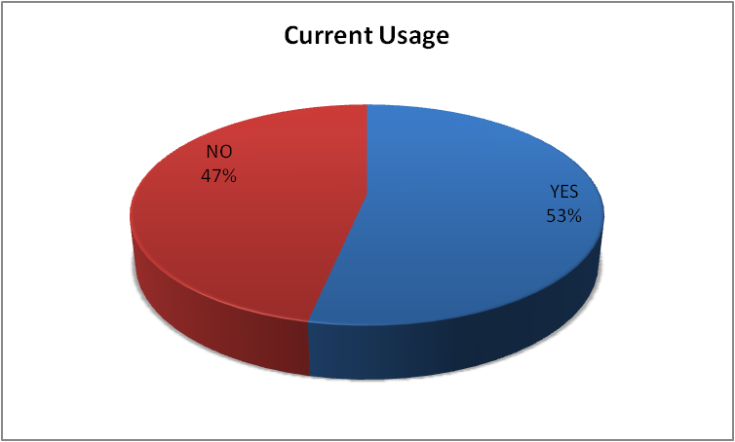
Contraceptive prevalence was about 53.33%.
Modern permanent method-9%
Modern spacing method-37.33%
Of the various methods, sterilization (9%), followed by condoms (18.33%), oral pills (11%). Cu-T was used by only 8% women in the study group. The use of traditional or natural method was 7%.

Slide 13
Reason for contraceptive usage
Restrict family size
Birth spacing
Easy to use

Slide 14
Reason for never using of contraceptives
side effects
Not aware regarding contraceptive methods
Husband using contraceptives

Slide 15
Factors which affected the contraceptive use
Educational qualification
Age
Age at marriage
Delivery place

Slide 18
Switching of contraceptive method (12%)
Most common switching methods are male condoms and female sterilization
Common reasons of side effects
Abdominal pain
Vaginal discharge
Irregular menses
Bleeding

Slide 19
Findings
The majority of the women were aware about the contraceptives (75, 86.67%)
The current usage of family planning methods among 75 married women are 53.33%.
Majority of the women were aware about Sterilization, Condom, Oral pills, Copper-T. Out of which oral contraceptive was widely used followed by Copper-T and condoms.
Determinants of contraceptives are-
Education level
Age
Place at delivery
Age at marriage

Slide 20
discussion
In the current study about 87 percent respondents were aware about contraceptive methods, which are almost similar to the general awareness of contraception is almost universal (98% among women and 98.6% among men: NFHS-3).
Current use of different methods of family planning among currently married women is 56.3% ( NFHS-3) which is almost equal to the current study findings (53.33%)
The study done by Dr. Rakesh et al reason for never sing contraceptives are side effects (4.3%) and not aware regarding contraceptives(1.3%) which is similar to the current study which is 3% for both reasons.

Slide 21
Internet (40%), Television/ radio (34%) and Friends (29%) government doctors (24%)were the most common source of knowledge about family planning methods.
And other sources are like NGO/field workers (1.33%) and private doctors(5.33%) were uncommon sources of knowledge about family planning.
Among men the most common method is condoms (40%) and very less percentage men having permanent method (1%).

Slide 22
conclusion
Women’s level of education, their age at marriage, age at first birth and the number children were the major factors that affected the preference of contraception.
Special need to focus on permanent sterilization specially towards male sterilization.
Strengthen to Various Schemes under Family Welfare Programme like-
Copper-T375
Post Partum Sterilisation (PPS) and PPIUCD
Home Delivery of Contraceptives (Condoms/OCPs, ECPs) by ASHA at the door step of the beneficiaries.

Slide 23
SUGGESTIONS
Contraceptive education to be given to mothers with less education or especially in rural areas. ( according to NFHS 3 The contraceptive prevalence rate is 11 percentage points higher in urban areas than in rural areas.)
Male sterilization should be encouraged. Couples should be educated about male sterilization.
Use of Cu-t should be encouraged and any myths about it to be cleared.
State has launched home delivery of contraceptives (HDC Scheme) need to educated regarding this to the population.
Home Delivery of Contraceptives (Condoms/OCPs, ECPs) by ASHA at the door step of the beneficiaries

