Slide 1
International Institute of Healthcare Management Research
Post Graduate Diploma in Healthcare Management
Submitted by -Dr. ARCHANA DHAKA
Guided by- Dr. PREETHA GS

Slide 2
NATIONAL HEALTH MISSION HARYANA
CHILD HEALTH DEPARTMENT
Dr. Suresh Dalpath (DD)
Topic
Maternal knowledge , attitude & practices
regarding immunization of children of age group 0-5 years in Haryana

Slide 3
Study of Maternal Knowledge, Attitude & Practices Regarding Immunization of Children of Age Group 0-5 years in Haryana

Slide 4
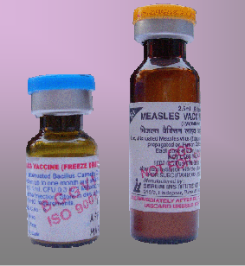
INTRODUCTION
Vaccines provide active immunity to the body by stimulating the immune system which produces antibodies against disease-producing organisms.
Types :
live attenuated and
killed formulations.

Slide 5
Routine Immunization Programme
Immunization Programme is one of the key interventions for protection of children from life threatening conditions, which are preventable
Under the Universal Immunization Programme, Government of India is providing vaccination to
prevent seven vaccine
preventable diseases
i.e. Diphtheria, Pertussis,
Tetanus, Polio, Measles,
severe form of
Childhood Tuberculosis
and Hepatitis B.

Slide 7
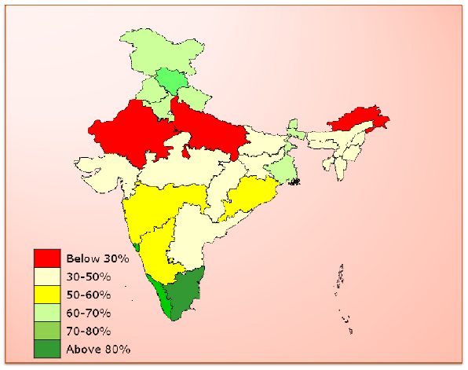
Situation Analysis
The National Family Health Survey (2005-06) reports that only 43.5% children in India received all of their Primary vaccines by 12 months of age.

Slide 8
Coverage of immunization in Haryana

Slide 9
Factors affecting mothers’ KAP on immunization
Mother KAP on immunization
Socioeconomic status & Practices
Perception of immunization
Level of education
Age of mother
Availability of immunization service

Slide 10
RATIONALE
This study was undertaken to assess mother’s knowledge, attitudes, and practices in a community setting so that identified gaps should be fulfilled in order to achieve the immunization targets.
It helps to evaluate and create awareness among mothers of children aged 0-5 years.
This study can be helpful for development partners, researchers, policy makers and program planners to review and build up various policies and programs related to immunization .
Also, no similar study has yet been conducted at Haryana.

Slide 11
OBJECTIVES OF THE STUDY
General objective:
To assess the maternal knowledge , attitude & practices regarding immunization of children of age group 0-5 years
Specific objectives:
To identify the degree of knowledge of immunization among the respondents.
To analyze the attitude and practices of immunization among the respondents.
To determine the association between the knowledge and practice regarding immunization schedule with selected variables among mothers in selected rural area at Haryana.

Slide 12
RESEARCH QUESTIONS
The research questions of this study are given below:
What is the degree of knowledge about immunization among the respondents.
What is the status of attitude and practices of immunization among the respondents.
What is the association between the knowledge and practice regarding immunization schedule with selected variables among the respondents.

Slide 13
METHODOLOGY
Study area – various districts of Haryana (Jind, Karnal, & Panchkula)
Type of study – Cross Sectional Descriptive study
Study period – April 2015- May 2015
Study population – Mothers of the children of age group 0-5 years
Sample size – 100 ( p=50%, q= 50%, CI= 90%, e= 5% )
Sampling method – Convenience non probability sampling method

Slide 14
DATA COLLECTION
Tool – a structured questionnaire consisting of 25 questions was framed and asked in the form of personal interview sessions.
(all close ended)
6 questions were regarding demographic characteristics, 7 were regarding knowledge of mothers, 5 were regarding attitude & 7 were based on practices.
Technique – personal interviews were taken from the clients and responses were then analyzed on SPSS.

Slide 16
OBSERVATIONS

Slide 17
Demographic characteristics
Age group of the respondents
4% of women were in the age group 15-20 years & 60% of women were in the age group 26-30 years.
Age formed an important deciding factor for determining mothers’ knowledge , attitude & practices regarding immunization.

Slide 18
Religion of the respondents
Mothers from Muslim religion had comparatively lesser knowledge & worse attitude as compared to other religions. Religion, hence, played a role mothers’ knowledge attitude & practices.

Slide 19
Educational status of respondents
43% of the women had intermediate level of education.
22% were graduate & 28% were metric or less.
7 were illiterate.

Slide 20
Vaccinations' knowledge

Slide 21
Source of information

Slide 22
People don’t get their children immunized because

Slide 23
Practices

Slide 24
Educational status versus knowledge

Slide 25
Educational status vs Source of information

Slide 26
Other findings:
100% mothers had heard about immunization
20% of respondents had 3 children. 56% had 2 children & 24% had 1 child.
Vaccines’ route of administration; 90% of them agreed that vaccines are injections given orally or otherwise to people to protect them from diseases. 72% of the respondents disagreed for all vaccines are given in one dose only. 44% of them disagreed that only children can be immunized against diseases.
When asked that if children do not receive all their vaccine doses for vaccine preventable diseases, the vaccine may not work to prevent diseases, 90% of mothers agreed.
Also they were interviewed about children developing fever after immunization, which 77% of women found true.

Slide 27
Other findings(continued..)
Around 89% of them felt that immunizations are beneficial for children. 71% agreed that immunizations should be made compulsory for all children. 53% of respondents agreed that some diseases cannot be prevented by immunizations, still immunizations are necessary to keep them healthy throughout life. 46% felt that all vaccines are expensive and 70% supported the statement that the government should provide free vaccines for all children. 5% agreed that vaccines are harmful for children considering the side effects.
75% agreed about occurrence of adverse effects following immunization. 99% of mothers affirmed that they would advise immunization to others

Slide 28
Conclusions
Majority of the respondents were housewives.
93% of respondents were found literate.
Knowledge of immunization was found not so satisfactory with considerably positive attitude & fair practices.
Some of the mothers were found immunizing their children without understanding the importance of immunization.
Attitude and practices of mother’s were found better than degree of knowledge regarding immunization.
Education had a remarkable impact on the knowledge , attitude & practices of the mothers.
Health workers were the most important source of information.

Slide 29
Recommendations
Health education campaign should target mothers to improve the child health status and to achieve the targets of immunization.
Community participation, and sustained public awareness are needed to erode fears of AEFI.
The focus of immunisation awareness activities should be immunisation providers i.e. ANMs
Promote the timely & regular updating of MCP cards along with counter foils.
Specific counseling of parents to overcome fear of AEFI.
VHND counseling sessions for mothers.

Slide 31
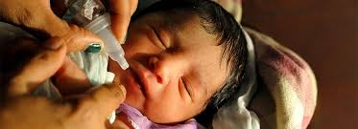
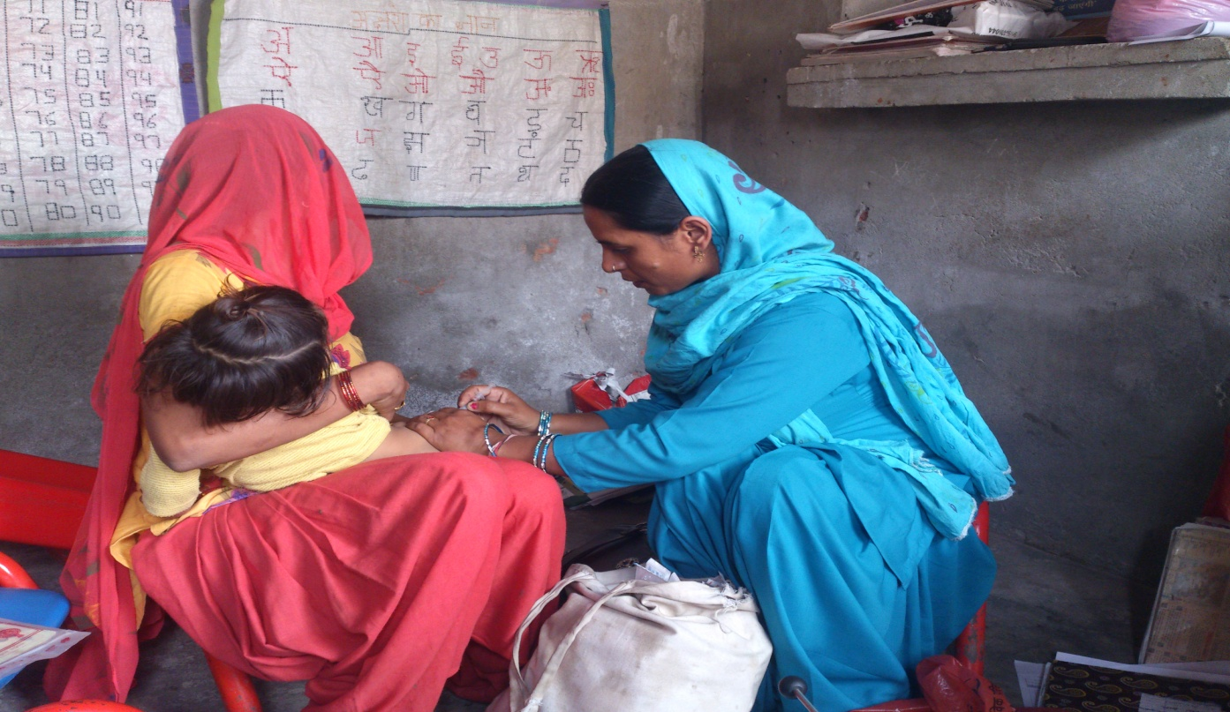
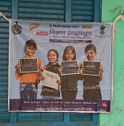

Slide 32
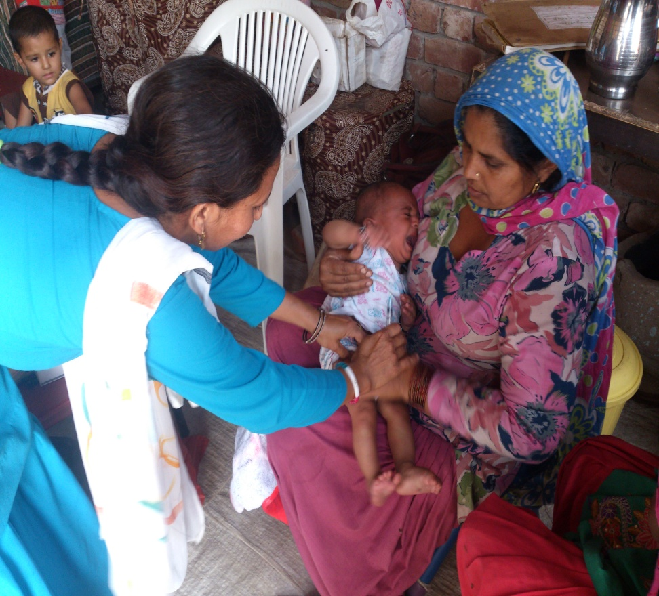
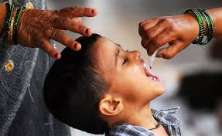

Slide 33
