Slide 1
“Pre-Implementation phases during implementation of Apex EMR at a multispecialty Hospital at Amsterdam”
Presented by-
Priyanka Yadav
PG 10/093

Slide 2
Organization profile
21st Century Informatics is a global healthcare informatics solutions company.
Major Projects are(HIS, LIS, Enterprise solution, EMR)

Slide 3
Introduction
ABOUT THE PROJECT
OBJECTIVE OF THE STUDY
PROJECT BACKGROUND
METHODOLOGY
PRE-IMPLEMENTATION PHASES COVERED FOR APEX
RESULTS & FINDING
CONCLUSION
RECOMMENDATIONS
REFERENCES

Slide 4
Abstract
This dissertation is based on covering the pre-requisite pre-implementation phases for the Apex- EMR to prepare it for the final Go-Live phase, to reduce the risks and to increase the probability of implementation success.
EMR
Electronic Medical record is a comprehensive clinical information system that allows providers to electronically create, store, organize, edit, and retrieve patient medical records.

Slide 5
Research shows that roughly 73% of all EMR implementations fail.
Top 2 reasons-
Requirements remained unmet(Ranked 1)
Style of implementation
Lack of useful clinical content in its design
The failure risks lies in the mostly ignored pre-implementation phase and not just the adoption rate among doctors.
A systemized planned and controlled pre-implementation phase makes sure to track down the errors and probable risks during the Go-Live phase.

Slide 6
Objectives of the study
General Objective
To successfully cover the pre-implementation phases for the Apex to be implemented for KNO (ENT- Ear, Nose & Throat) & MKA (OMS-Oral Maxillofacial Surgery)
Specific objective
To gather and map Apex EMR acc to client-specific requirement. (As-IS, To-Be process)
To accurately configure masters & master data for Apex
Conduct detailed functional testing with the help of test board and test scenario
Early detection & correction of major errors before Go-live

Slide 7
Limitations- Completely Descriptive & theoretical Study
Patient view was not taken
Requirement gathering was offsite process via Skype, Phone calls, mails etc
Apex is not yet implemented so could not able to comment on the success factor but till parallel run the entire pre-implementation phase showed better results and reduced errors with client’s appreciation with the system

Slide 8
Project Background
Client’s Objective- Implementation of Apex EMR
To achieve greater treatment success rate via a tool called PROM.
Patient Outcome Research Measurement
An online form
Patient history available prior to visit
Variables in system
Expected Benefits
on the basis of variables and previous results predict which treatment is most effective.
doctors can also collect data so that they better understand what works best course of care.

Slide 9
Expected Deliverables from Apex EMR
To distribute work between patient, Nurse and Doctor
All complaints and treatment plans should be linked to the Diagnosis.
Reports to show success rate per treatment plan for a diagnosis depending upon the patient age, alcoholic and smoking habits and BMI
Decrease the time for diagnosis via PROM
A PHR experience for patients.
Doctor should be able to analyze the medical data and export analyzed data for Random Survival Forest modeling. Once the modeling is done, it should be possible to incorporate the formula in the system to derive the possible outcome for a given treatment

Slide 10
Methodology- Pre-Implementation Phase
Waterfall
The waterfall model that is a sequential implementation process, in which progress is seen as flowing steadily downwards (like a waterfall) through various phases.
Solution mapping
Development
Configuration
Testing & debugging
Parallel Run

Slide 11
Methodology-Data collection, analysis
Study Design
Descriptive, Quantitative(Testing phase)
Data Sources
Primary
Interview(Skype & phone sessions)
Observations
Discussion with development & configuration team
Interviews & discussions(Onsite)

Slide 12
Secondary Data
Reviewing of the articles on web
21 CI website
Implementation documents of 21 CI
Client Hospital’s website
Apex Brochure
Reviewed Literature;
Various forms at hospital
Documents & master data from Hospital.
Solution Mapping Documents for Apex
Data Analysis
Only for testing phase- Excel 2007

Slide 13
Workplan
Stages | Time Period | Location | Team
Solution Mapping-Requirement gathering | 1 week( Feb 3rd-Feb 8,2012) | Onsite/offsite | Implementation
Solution Mapping –Documentation | 5 Days(Feb 11- Feb 15,2012) | Offsite | Implementation
Development of Test Scenario & Test Board | 3 Days(Feb 16- Feb 18,2012) | Offsite | Implementation
Apex Configuration & customization | 1 Month(Feb 20- March 14,2012) | Offsite | Development
Import of mater Data & master’s configuration | 3 Day (March 15 -17March 2012) | Offsite | Configuration
b. Manual addition of Masters for Treatment plan & configuration of medicine masters | 4 Days (19-22nd March,2012) | Offsite | Implementation
Functional Testing | March 24th - Still continuing) | Offsite | Implementation
Installation at site & training | 23th April- 25th April,2012) | Onsite | Implementation
Parallel Run | 25th April- Still continuing | Onsite | Implementation

Slide 14
OBSERVATIONS

Slide 15
Implementation
PSC & PSCC
Formation
Project team Formation
& orientation
Solution
Mapping
PSC/PSCC Review
To finalize solution
GO LIVE
Master data
preparation
Configure
system
Data migration
Testing & debugging
Parallel Run
End user
Certification
End user
Training
User Confirmation
Test & sign off
Key user
training
Delivery of
Configured system
Jointly Done
21 CI
Client
15

Slide 16
Implementation Roadmap
Phase 1: Project Preparation
Prepare & Finalize Project Plan and Team Organization
Phase 2: Solution Mapping
Definition of Organizational structures and Business Process & Policies
Definition of Reporting and Interfacing Requirements
SOPs
Phase 3: Configuration
Policy & Outputs Configuration
Phase 4: Training & Parallel Run
Training of Key users & End Users
Master Data Creation & UCT
Parallel Run
Phase 5: Go Live and Support
Hand Holding and Post Live Support
1
Continuous Improvement
4
5
Project Preparation
3
Training & Parallel Run
2
Go Live & Support
Configuration
Solution Mapping
16
Notes:
16
Value-topics have been inserted within the structure of the Implementation Roadmap.
The main topics are defined above.
The topics enhance the Roadmap with elements ( Work packages, Activities, Tasks ) to
improve business processes
measure the improvement
Value Instruments
Working off the Roadmap you use the defined ‘Value’-instruments ( Tools, Content ) in order to improve business processes and to measure the improvement
Value Content of Implementation Roadmap

Slide 17
Pre-Implementation Phase
Solution mapping
Development(If required)
Application Configuration
Testing & debugging
Parallel run

Slide 18
Solution Mapping
“To Be”
Processes
To find correspondences between solutions and requirements in order to compare expectations and requested solutions.
Business needs = Solution

Slide 19
Objectives of solution mapping
Capture AS-IS process
Arrive to the TO-BE process
Identify gaps w.r.t best practices, if any, and customization requirements
Define Reporting Requirements
Define Interface requirements

Slide 20
Solution mapping- Stages
Requirement Gathering
Mater Data Preparation & collection
Development of solution mapping documents

Slide 21
Requirement Gathering
To analyze every function of every job to understand how tasks
were accomplished with the old system
Objective
To measure the gap in client’s expectations and the solution

Slide 22
Requirement Gathering- Sampling
Technique
Random Sampling
Sample Details
Respondents | KNO | OMS
Doctors | 5 | 4
Nurses | 5 | 7-10
Receptionist | 4
Challenge
To get time to schedule meeting and interviews with the Doctor

Slide 23
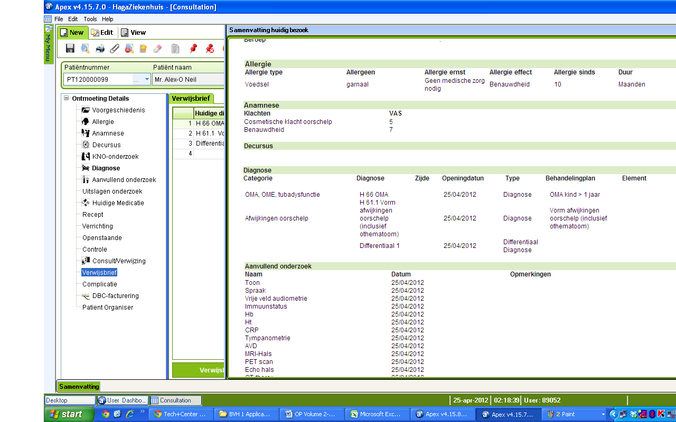
Techniques used
Discussions Prototype
Brain Storming

Slide 24
Information captured
End Users Details
Templates & Outputs formats
Web- Portal Data & information
Interfacing Details
Hardware configuration Details
Normal & exceptional scenarios
User Role & authentication Data
No. of End users | Types of End Users
25 | Doctors, Nurses

Slide 25
Mater Data Preparation & collection
Master Data- Data which is uniform for a long period of time and does not change very often.
Master Data Preparation
Pre-Defined format
Dissertation\Consolidated master KNO 05012012 HBJPK.xlsx

Slide 26
Development of solution mapping documents
Solution Mapping doc-Volume 1-Processes & Policy
Time- based
Even-Based
Exceptional
As-Is
To-Be
Doc-Dissertation\13092011 Haga ENT Solution Mapping - Volume 1 Version 3.doc

Slide 27
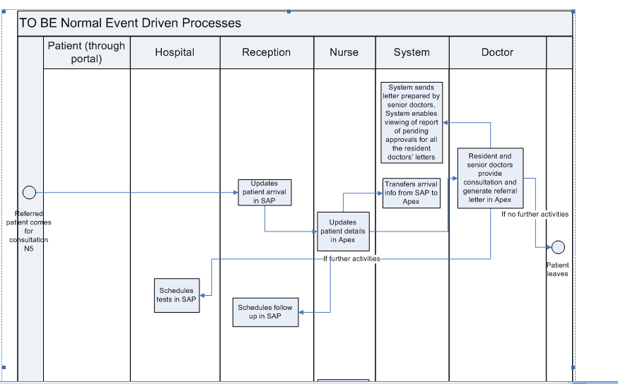

Slide 28
Other Details
Reports
Interfacing Details
Hardware Configuration
Transition Plan
Solution Mapping Doc-Volume 2- Activity Details
This Volume is focused on the Application or
the solution to be implemented.
Doc -Dissertation\15092011 Hagaziekenhuis ENT EMR Volume 2 Version 3.doc

Slide 29
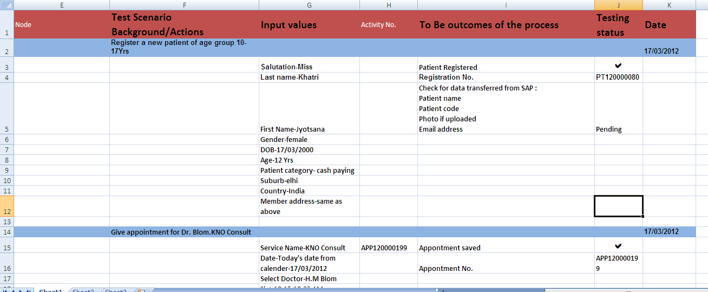
Test Board & Test scenarios

Slide 30
Configuration
Configure System
Configure System for ‘To-Be’ processes
Develop Reports, Interfaces and Conversion programs
Application Configuration
Master Data import
Manual addition of specific master data(Medicine master, order set)
Master’s Configuration
30
Notes:
30

Slide 31
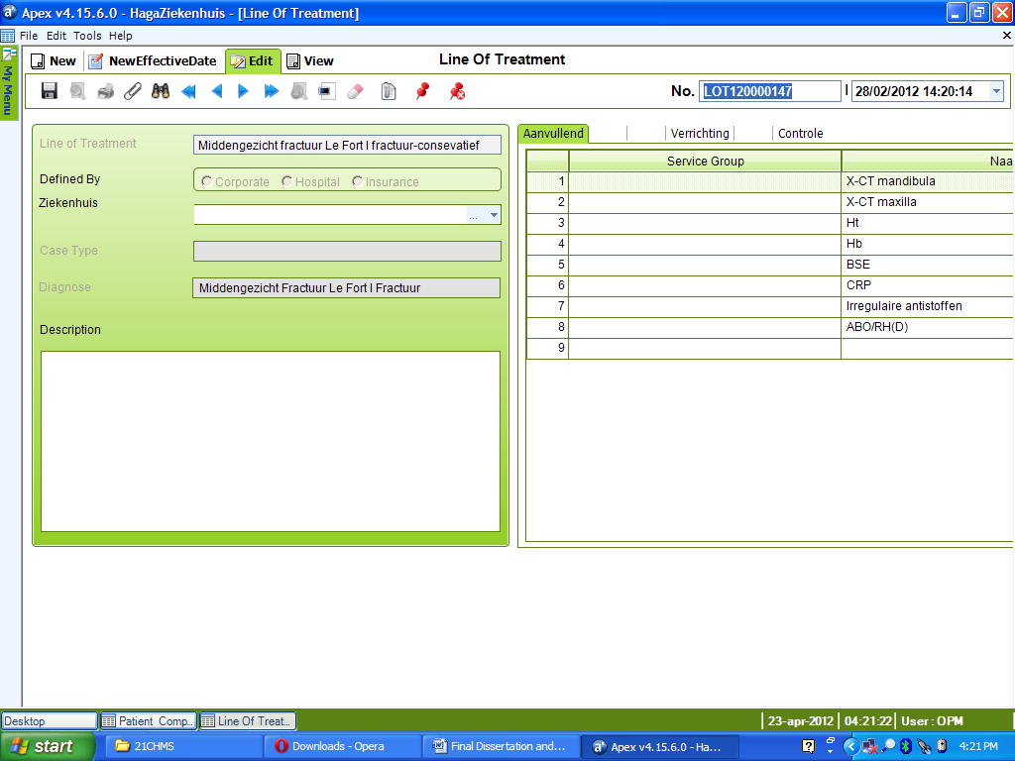

Slide 32
Testing and debugging (Validation) & release
Main Objective
Software testing can be stated as the process of validating and verifying that a software program/application/ product:
meets the requirements that guided its design and development;
works as expected; and
Can be implemented with the same characteristics as required.

Slide 33
Testing was done at three levels-
Development Level
Sanity testing
Testing to determine if a new software version is performing well enough to accept it for a major testing effort
Black Box testing
Internal system design is not considered in this type of testing. Tests are based on requirements and functionality.
End result-
Acceptance testing Log
Testing report

Slide 34
Implementer’s level
Functional Testing
This type of testing ignores the internal parts and focus on the output is as per requirement or not
Customer level
Acceptance testing
Normally this type of testing is done to verify if system meets the customer specified requirements.
Parallel testing –Testing with live database

Slide 35
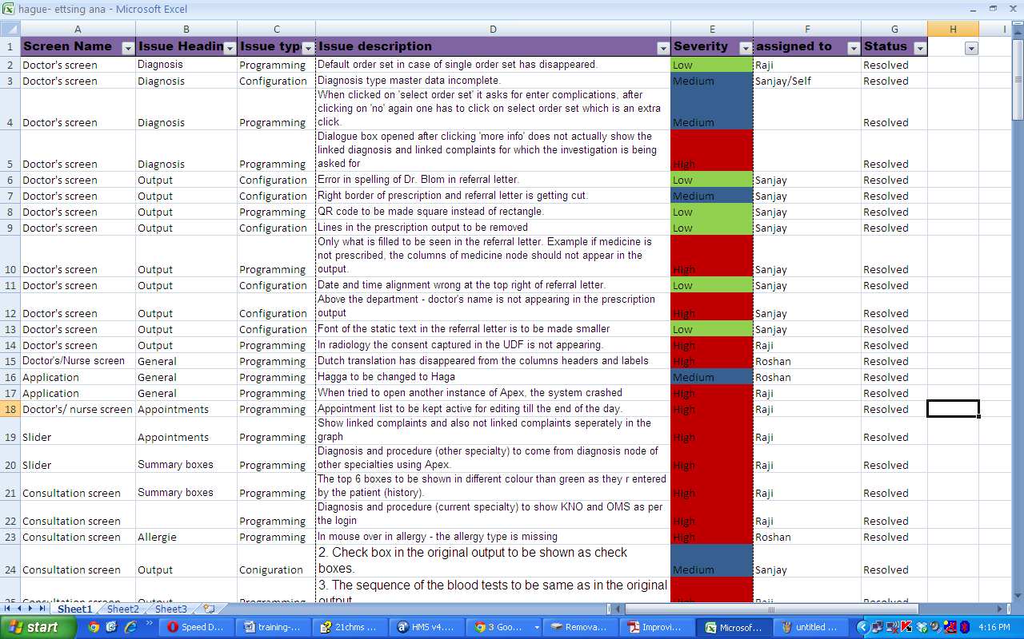

Slide 36
Defects, bugs and configuration errors
A software bug is the common term used to describe an error, flaw, mistake, failure, or fault in a computer program or system that produces an incorrect or unexpected result, or causes it to behave in unintended ways.
Types-
Programming/coding Errors
Master data configuration errors
Severity wise
High
Medium
Low

Slide 37
Results (Testing Phase)
Issue severity | No. of issues
High | 60
Medium | 23
Low | 63
Total | 146
Figure Breakup of errors w.r.t severity (1st week of testing)

Slide 38
The graph showing the percentage of issues reported w.r.t the severity

Slide 39
Graph showing trend of issue occurrence for the testing phase

Slide 40
Results & findings
At the end of the testing phase it was found that
Apex met all the major requirements given during Solution mapping
No major gaps were present
Issue that were reported were more of master configuration like spelling mistakes, data missing etc
Issues correction required lesser time during parallel run as with rigorous testing the resolution were figured out during testing.
Considerably less issues were reported than expected during parallel run
Client satisfaction and acceptance was more

Slide 41
Conclusion
As per the results & observations from testing and parallel run phase ,the pre-implementation phase was covered in controlled & structured way
Apex as met all the user’s expectations.
The parallel run was a smoother process with less no. of issues with lower severity and lesser time was required for issue correction
The chances of implementation success are high for Apex

Slide 42
Recommendations
Consider a variety of stakeholder perspectives (organisation, instructor and most importantly, the end‐user or learner)
User involvement in the design process should be there for the entire process of EMR implementation
A complete documentation process during this phase will help to monitor and control the process and help in mitigation of risks involved
Find bugs as early as possible and make sure they get fixed before the software goes live, that no bugs arises in front of end-user and will doubt their acceptance of the system.
The on-site implementer should know customization and configuration of Apex to some extnt.
Front-end configuration training should be provided to at least one person at the client site

Slide 43
References
Akkoyunlu, B., and Yilmaz‐Soylu, M. (2008). Development of a scale on learners' views on blended learning and its implementation process
Best Practices in EMR Implementation: A Systematic Review
Implementing an System: One Clinic’s Experience
Eight steps for successful implementation- 2009,Mike Sappington, CEO of gloStream
http://help.utest.com/testers/participation/submit-reports/classifying-bugs
Development of a scale on learners' views on blended learning and its implementation process((2008).

