Slide 1
Medical Tourism in India and Strategies to increase flow of International Patients at
Park Hospital
Submitted to
Ms Anupama Sharma
Submitted by
Dr. Yashpal Fauzdar

Slide 2
ORGANIZATIONAL PROFILE
Park Group Of Hospitals
Dr Ajit Gupta(Chairman)
Mission: Quality Health Care at Affordable cost
Vision: Deliver High Quality Personalised care to all ages and Every Stage of life
Units: Park hospital South Delhi
: Park Hospital West Delhi
: Park Hospital Gurgaon
: Park Hospital Faridabad
: Park Hospital Panipat

Slide 3
REFLECTION FROM DISSERTATION
Core Knowledge of Various Departments of Hospital
Hospital Functioning Process
Business Terms
Networking
Domestic and International market
Various activities like Conducting health Camps, CME’s.
Strategies Design, Planning And Implementation

Slide 4
OBJECTIVES
General: To Overall Increase the International Patient count in Park Hospital
Specific:
1) To Identify the Needs of International patients
2) Devise the Measures and suggest strategies to fulfil those needs
3) Factors affecting Medical Tourism
4) To study cost difference in procedures in other countries as compared to India

Slide 5
RESEARCH METHODOLOGY
STUDY DESIGN- DESCRIPTIVE
STUDY AREA- Gurgaon and Delhi
SAMPLE SIZE- 100
STUDY TOOL- Primary data collected through interview.
STATISTICAL TOOL- MS- EXCEL
Secondary Data: Periodical articles (refer to magazines, journals, and newspapers.)
:Internet resource site

Slide 6
The Service Spectrum in India
 | Wellness Tourism | Alternative Systemof Medicine | Cosmetic Surgery | Advanced and Life Saving Healthcare
Services Offered | Spas, Stress Relief, Rejuvenation Centres | Ayurveda, Siddha, Treatment for Arthritis, Rheumatism etc | Dental Care, Plastic Surgery, Skin Treatment | Organ Transplant, Cardio-Vascular Surgery, Eye treatment, Hip Replacement, IVF
Profit Margins | Low | High | Medium | High
Key Competitors | Thailand, South Africa |  | South Africa, Cuba and Thailand | Singapore, Jordan, Thailand and Malaysia
India’s Strength | Low – Thailand significant share.Although South Indian cities (Chennai) are catching up fast. | High – Kerala is popular for this service. | Low – South Africa and Thailand lead in plastic surgeries. Cuba specializes in skin treatments | High – India has strong brand equity. Jordan has a strong presence in middle-eastern market.

Slide 7
Procedure charges (USD)
Procedure | US | UK | Bangkok | India | Singapore
Angioplasty | 30000 | 21000-27000 | 4000-5000 | 4000-5000 | 5000
Angiography | 2500 - 3000 | 2000 | 1100 | 400 | 800
Hip replacement | 19000 | 13000-16000 | 7000 | 6000 | 6600
Knee replacement | 27000-32000 | 16000-18000 | 7000 | 6000 | 7000
CABG | 30000 | 20000 | 7500 | 6400 | 9500
Lasik | 4000 | 2500-3000 | 750 | 700 | 800

Slide 8
Cost Difference in IC
Procedure | Park Hospital | Artemis
Angioplasty | 1,65,000 | 1,85,000
Angiography | 12-15000 | 15-18000
Hip Replacement | 2,50,000 | 3,00,000
Knee Replacement | 2,50,000 | 2,90,000-3,50,000
CABG | 1,60,000+ Pump | 2,65,000

Slide 9
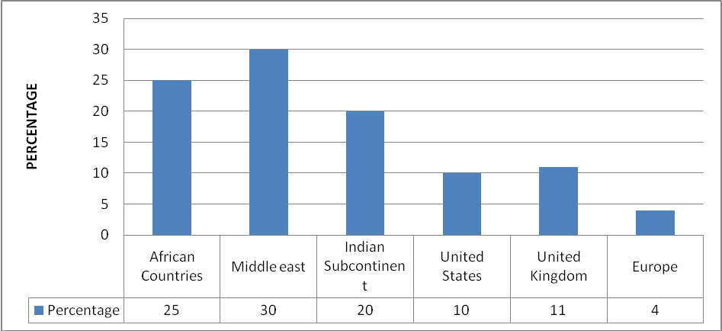
ANALYSIS AND DISCUSSION
COUNTRIES

Slide 10
SOURCES OF INFORMATION

Slide 11
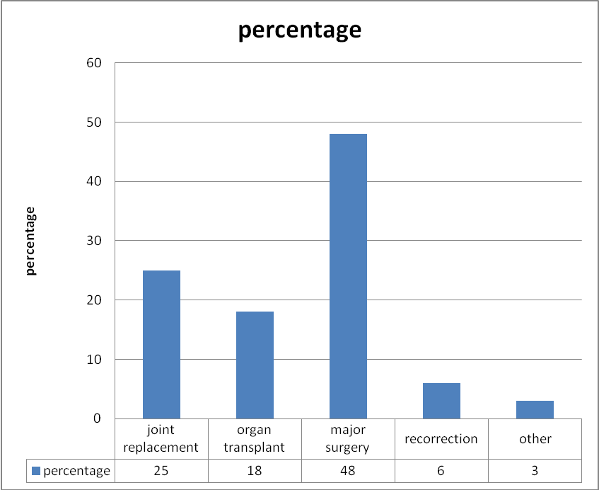
PROCEDURES

Slide 12
Major Surgeries (out of 48 Cases)

Slide 13
Through Internet Website

Slide 14
Important factors before seeking treatment

Slide 15
Reasons for seeking treatment abroad

Slide 16
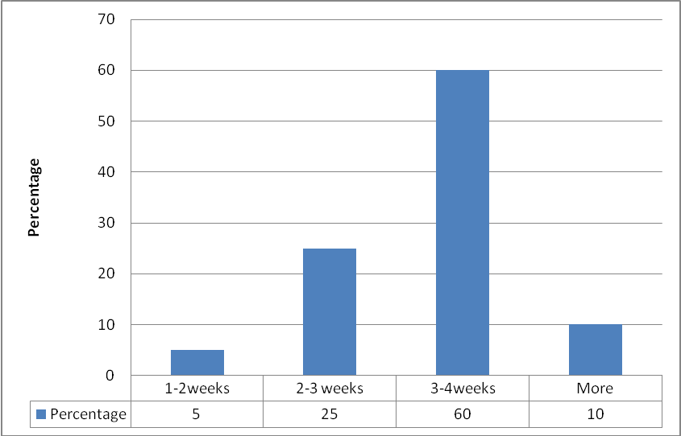
Time taken to Procure Visa

Slide 17
PREFERENCE OF PATIENTS

Slide 18
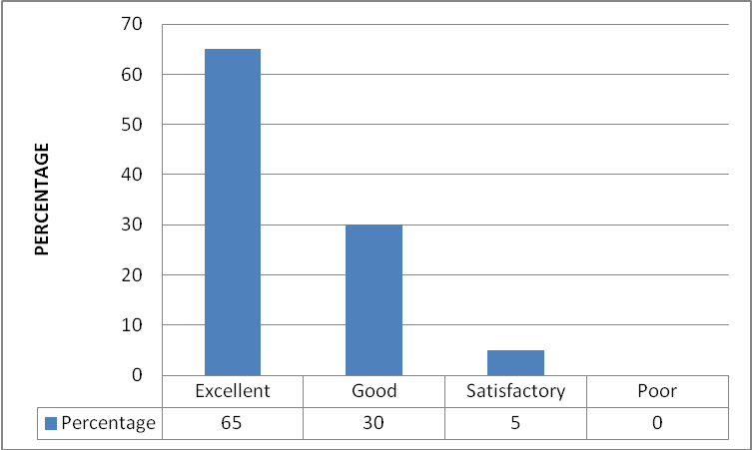
RECEPTION/HELP DESK

Slide 19
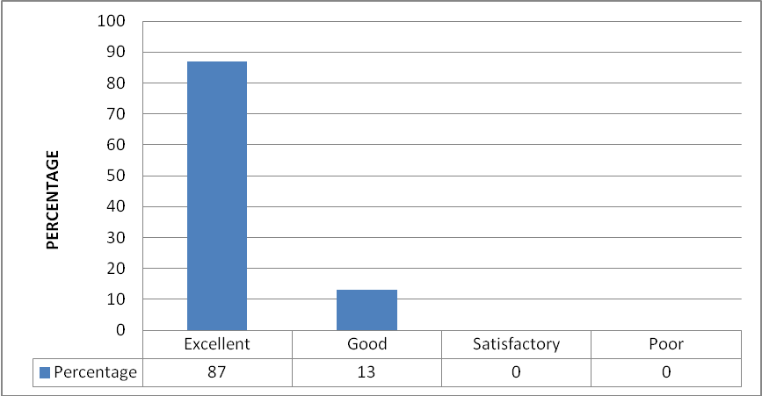
International Patient Coordinators

Slide 20
DOCTORS

Slide 21
COUNSELLORS

Slide 22
Cost Of Treatment

Slide 23
RECOMMENDATIONS
Tie up with Medical Tourism Facilitators
Dedicated staff to coordinate patient’s treatment and other services.
Comprehensive information on ailments, treatment options and cost.
Advertise in International Print Media catering to NRIs
Use Website as a marketing tool
Tie-ups with Foreign Insurance Companies
Strategies to increase patients flow (US/ UK) must be implemented for Major Procedures.
Other sources to get patients must be implemented (Agents).
Doctors Presenting CME’s in Other countries.
Cost of treatment

Slide 24
REFERENCES
http://en.wikipedia.org/wiki/Healthcare_in_India
http://www.nature.com/nm/journal/v9/n4/full/nm0403-377a.html
http://www.cbc.ca/news/background/healthcare/medicaltourism.html
http://timesofindia.indiatimes.com/More_options_for_health_insurance/articleshow/1982238.cms
http://www.who.int/mediacentre/factsheets/fs172/en/index.html
http://www.indiatogether.org/2007/jan/hlt-hltcare.htm
http://www.deloitte.com/dtt/whitepaper/0,1017,sid%253D34239%2526cid%253D71669,00.html
http://www.saharamedicaltourism.com/2008/Oct/medicaltourism.html
http://www.bumrungrad.com/news/2009/News/healthcare.html
Medical Tourism: Global Competition in Health Care by Devon M. Herrick NCPA Policy Report No. 304; November 2008
Mueller H and Kaufmann E L, ‘ Wellness Tourism: Market Analysis of a Special Health Tourism and Implications for Hotel Industry’, Journal of Vacation Marketing, Vol 7(1), Pg 6 – 17, July 2008
Opportunities in Health Tourism- Learnings from International Experience by: B K Ong - General Manager (India), Singapore Airlines
Alvarez, David P.; “Connecting people to the promise of healthcare”, No. 15 (2000)
Hautea, Dr. Randy A.; Krattiger, Dr. Anatole F. And Van Zanten, Ir. Jasper E; “Healthcare costs comparisons”, No. 18 (2000)

