Slide 1

To Study the Process of implementation and adoption of Clinical information system at RGCI&RC
  Submitted by
  Dr Shuchi Sharma
  (IIHMR
  Healthcare IT)

Slide 2
INTRODUCTION

Slide 3

Rajiv Gandhi Cancer Institute & Research Centre
A visionary project of Indraprastha Cancer Society & Research Centre
Aimed at providing the best of Oncological Care
All the facilities for diagnosis and treatment available under one roof
Initiated at 152 bedded now a 238 bedded hospital

Slide 4
From Paper To Computer
VENDORS
FUJUFILMS
PACS
OHUM
clinical transformation
SRISHTI
non clinical transformation
MEDTECH
scanning of documents

Slide 5

Current state
PHASED CLINICAL TRANSFORMATION
RADIATION DEPT-POST IMPLEMENTATION PHASE
OPD-IMPLEMENTATION PHASE
IPD-PRE IMPLEMENTATION PHASE

Slide 6
OPD ADOPTION
12 Medical Assistants in 18 OPD's to facilitate the adoption.
During non OPD hrs they accompany the consultants in daily rounds and complete the IPD notes.
The medical assistants enter clinical notes and investigation requests during OPD.

Slide 7
PROJECT OBJECTIVES

Slide 8
To study the phases of Implementation and Adoption of CIS
To study the implementation phase in OPD
To study the process of Adoption of CIS
To study the pre implementation phase in IPD

Slide 9
Phases of EHR implementation
Implementation phase
Post implementation phase
Pre implementation phase

Slide 10
PRE IMPLEMENATION

Slide 11
COMMUNICATION
REDESIGNING
ESTABLISHMENT
CONTINUOUS TRAINING
People – staff and patients
CPRS
Workflows
Project plan

Slide 12


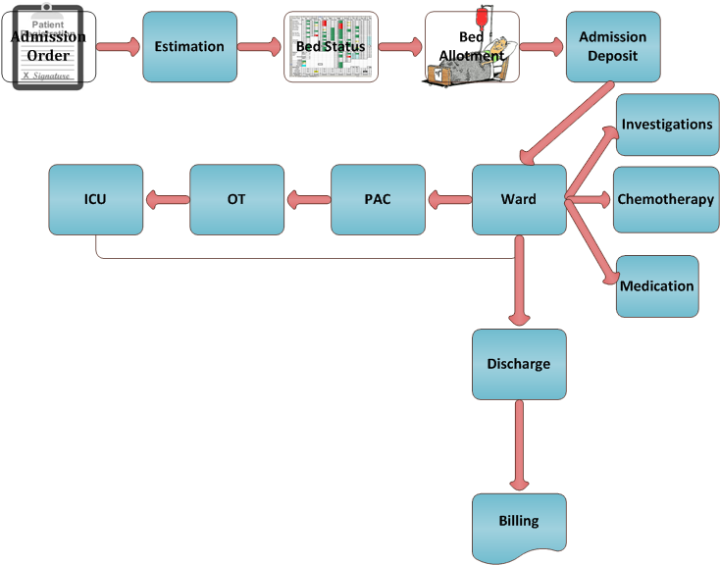



PRE CIS IMPLEMENTATION WORKFLO -IPD

Slide 13


Post CIS Implementation

Slide 14
Study Design
Type of study :: Analytical Study
Sampling technique :: Random Sampling
Population :: Nursing staff
Sample Size :: 40
Type of Data :: Primary Data
Primary Data Collection technique ::
Structured questionnaires.

Slide 15
Variables used:
Communication between staff and patient
Patient Care
Patient safety
Job satisfaction
Turn around time for documentation and patient care processes.
Training on CPRS

Slide 16
Methodology
Data collection through Questionnaires
Data ported in Microsoft Excel Format for further analysis
The questionnaires were analyzed using Likert scale.

Slide 17
Communication between hospital staff and patients

Slide 18
Patient care

Slide 19
Patient Safety

Slide 20
Job satisfaction

Slide 21
Turn around time for patient care processes

Slide 22
Training on CPRS
Approx. 100% of the nurses found that there is a need for more training and an on job training would be helpful

Slide 23
IMPLEMENATION

Slide 24
ASPECTS OF IMPLEMENTATION
Engaging the patient
Making changes and managing change
Implementing rapidly and supporting extensively
And encouraging the practice

Slide 25

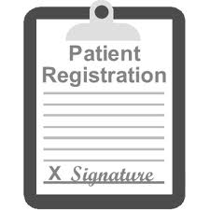
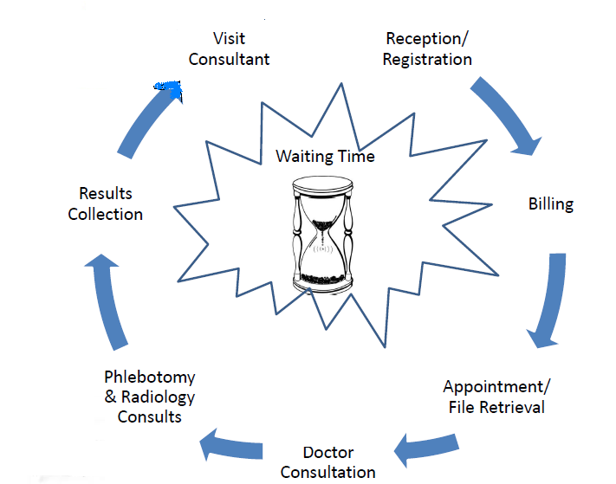






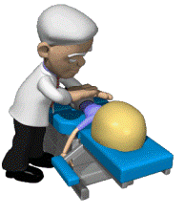
PRE CIS IMPLEMENTATION WORKFLOW --OPD

Slide 26



Post CIS Implementation

Slide 27
Study Design
Type of study :: Analytical Study
Sampling technique :: Random Sampling
Population :: Doctors/ consultants
Sample Size :: 30
Type of Data :: Primary Data
Primary Data Collection technique ::
Through Discussions and Structured questionnaires.

Slide 28
Variables
Communication between staff and patient
Patient Care
Patient safety
Job satisfaction
Turn around time for documentation and patient care processes.

Slide 29
Methodology
Data collection through Questionnaires
Data ported in Microsoft Excel Format for further analysis
The questionnaires were analyzed using Likert scale.

Slide 30
Communication between hospital staff and patients

Slide 31
Patient care

Slide 32
Patient safety

Slide 33
Job satisfaction

Slide 34
Turn around time for documentation and patient care processes

Slide 35
CIS ADOPTION

Slide 36
ADOPTION
The adoption concentrates on the challenge of getting clinicians to use electronic applications and information networks:
To keep medical records
To access relevant information about a patient’s data and illness
And to offer patient safety and better decisions

Slide 37
In RGCI&RC, the Adoption is approximately 40% in March.
The adoption is calculated by comparing the lab and radiology orders placed in CPRS and Billed in PARAS.
Orders placed in CPRS
Formula used = ------------------------------------- *100
Orders billed in PARAS

Slide 38
Methodology
Data of orders fed in CPRS was collected through OHUM VistA query tool
Data of orders billed in PARAS was collected through RGCI Query tool
The data was then ported in Microsoft excel for further analysis

Slide 39
OPD ADOPTION BY CONSULTANTS

Slide 40
Clinical adoption at OPDs

Slide 41
ADOPTION IN JANUARY

Slide 42
Adoption status in each OPD

Slide 43
ADOPTION IN FEBRUARY

Slide 44
Adoption status in each OPD

Slide 45
ADOPTION IN MARCH

Slide 46
Adoption status in each OPD

Slide 47
TOTAL ADOPTION IN HOSPITAL

Slide 48

SWOT ANALYSIS OF CIS ADOPTION

Slide 49

STRENGTHS
Trained Medical Assistants
Co operative staff
Strong IT Support
Superior capabilities of improved operational efficiency
Management Support

Slide 50

WEAKNESSES
Hectic schedule of doctors
Non computer savvy staff
Attrition among nursing staff
Lack of defined processes
Increased Chances of errors due to data entry by data entry operators

Slide 51

OPPORTUNITIES
To Become a fully computerized hospital.
Instant availability of Patient record.
Significant degree of paper reduction.
Significant reduction in the hospital cost.
Better Patient Care

Slide 52

THREATS
Patient resistance due to :
Initial time consumption
Reduction in ‘human touch’
Security Concern
Failed attempts could result in financial losses and negative sentiment toward effort
Electronic records are not recognized in Court of Law.

Slide 53
RECOMMENDATIONS

Slide 54

pre implementation

Slide 55

Management
Select Clinician leader for change management.
Select a User Champion for each department.
A super user to resolve the first line of problems for the end users.
Create a clear vision regarding the new system
Notes:
Management must clearly articulate, to team members, how this project fits in its broader plans and can help team members in their career growth.

Slide 56

PEOPLE
Awareness programs for employees
Kiosks/Banner/ Posters to generate awareness among the employees as well as visitors/ patients.
An easy handbook.
Training workshops for employees on monthly basis
Training of the user groups should be ensured for successful implementation of HIS

Slide 57

PROCESS
Motivation of employees to participate in process.
Rewards for the best user.
Certificate at the end of each training program.
Weightage for system usage to be linked with yearly performance appraisal of an employee.
Training to be performed outside the clinical sessions.
Requirements of stockholders
Employee’s satisfaction

Slide 58

INFRASTRUCTURE
Hardware infrastructure planning must be effective.
There should not be any shortage of hardware at the end user level.
Provision of training room for users.
Test server should be available for practicing for the end users

Slide 59

IMPLEMENTATION
Phased implementation keeping in mind:
Patient load
Infrastructure availability
CPRS trained nurses
Appointment of Change Manager among doctors
Presence of an IT support team member in wards 24*7.
Contact information display chart.

Slide 60
Post implementation and adoption phase

Slide 61
MANAGEMENT
Use of CPRS to be made mandatory for all consultants.
Change Manager to report the progress regularly
IT team should support him completely
Periodic Post Go-Live Assessment should be done

Slide 62
PEOPLE
EHR training to be included in induction program based on their user group.
Ongoing training support and training of new updates and enhancements to be provided for the users.

Slide 63
PROCESS
Motivate employees to participate in process
Rewards :-employee of the month’s best user batch.
Medical assistants to be given a regular yearly appraisal
Regular feedback to be taken from user champions.
Employees requirement should be attended and replied back based on their feedback given.
Evaluate the Go-Live with Staff.

Slide 64
INFRASTRUCTURE
Medical assistants to be properly staffed in OPD to reduce the human errors due to over work.
Systems to be installed in doctor’s lounge to practice in their leisure time.
There should not be any shortage of any hardware at the end user level.

Slide 65
conclusion

Slide 66
Benefits of CIS implementation
Better management control
Standardization of operations and functioning
Decrease in cost
Better quality of patient care
Development of a good brand image
Reduce errors and corresponding litigations

Slide 67
References
US department of veterans affairs. vista monograph [internet]. washingtondc):va;2010 mar5 [cited2010 mar 8]. available from: http://www4.va.gov/vista_monograph/.
US department of veterans affairs. vista [home page on the internet].washington (dc): va; [cited 2010 mar 8]. available from: http:// www.ehealth.va.gov/ehealth/vista.asp.
Jha ak, perlin jb, kizer kw, dudley ra. effect of the transformation of the veterans affairs health care system on the quality of care. n engl j med. 2003;348(22):2218–27.
Health information technology : a new world for pharmacy. lisa webster and rachelle f. spiro
Bizovi ke, beckley be, mcdade mc, adams, al, lowe ra, zechnich ad, hedges jr.the effect of computer-assisted prescription writing on emergency department prescription errors. academic emergency medicine 2002; 9:1168-1175.
Bates dw. using information technology to reduce rates of medication errors in hospital.bmj 2000; 320:788-91.
Leape ll, bates dw, cullen dj, cooper j, demonaco hj, gallivan t, hallisey r, ives j, laird n, laffel g, nemeskal r, peterson la, porter k, servi d, shea bf, small sd,sweitzer bj, thompson bt, vlier mv. systems analysis of adverse drug events. jama.july 5, 1995; 274(1):35-43.
Summerfield mr. unit dose primer. bethesda, md: american society of hospital pharmacists; 1983.
American society of hospital pharmacists. ashp technical assistance bulletin on hospital drug distribution and control. am j hosp pharm. 1980; 37:1097–1103.

Slide 68
"Fact Sheet: Facts About the Department of Veterans Affairs". VA Administration (Jan 2009). http://www1.va.gov/opa/fact/vafacts.asp.
"NEJM: VA VistA nearly doubles proportion of computerized hospitals.". LinuxMedNews (Mar 2009). http://linuxmednews.com/1238189242.
Use of Electronic Health Records in U.S. Hospitals. New England Journal of Medicine (Mar 25, 2009). http://content.nejm.org/cgi/content/full/NEJMsa0900592
http://en.wikipedia.org/wiki/Hospital_information_system
http://en.wikipedia.org/wiki/VistA
The perceived benefits of healthcare information technology adoption: construct and survey development by So-Ra Jung
Giampaolo P. Velo, Pietro Minuz1. (March 18, 2009) “Medication errors: prescribing faults and prescription errors” , PubMed, 1-2.
Minal Thakkar ,Diane C Davis. (2006) “Risks, Barriers, and Benefits of EHR Systems: A Comparative Study Based on Size of Hospital” , PubMed, 24:1, 2-9
.Daijin Kim, Steven Labkoff, Samuel H. Holliday. (June 6, 2008) “Opportunities for Electronic Health Record Data to Support Business Functions in the Pharmaceutical Industry—A Case Study from Pfizer, Inc” , PubMed, 4.
Carolyn P. Hartley, Edward D. Jones III, Newt Gingrich. (Feb. 28, 2005) “ EHR Implementation: A Step-by-Step Guide for the Medical Practice” ,American Medical Association, 24:2, 1-5
Jerome Carter. (Paperback - Mar. 15,2008) Electronic Health Records, (2nd Edition), London, DP Publications Ltd.

Slide 69


