Slide 1
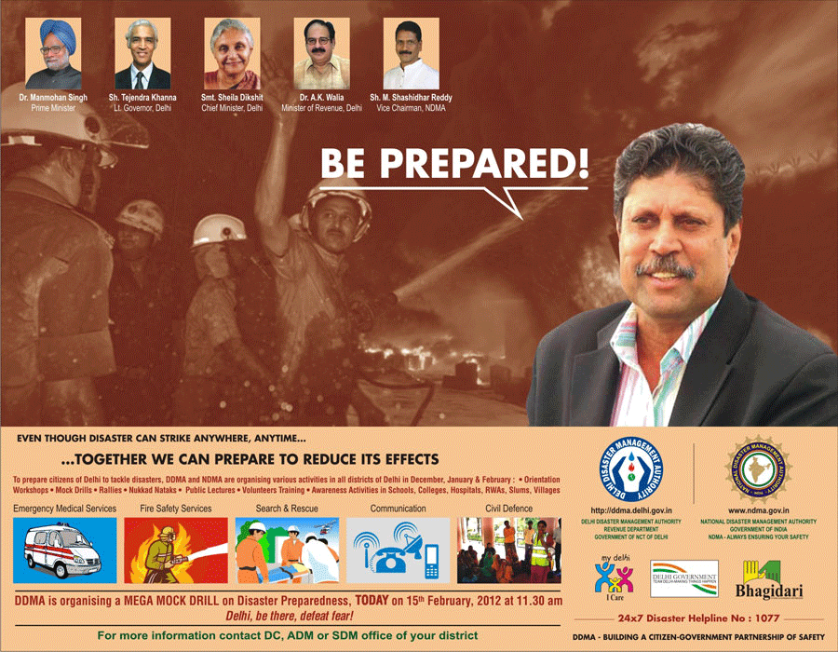
Preparedness of Healthcare Facilities for Disasters in three districts of Delhi
Dr. Shilpa Jain

Slide 2
United Nations Development Programme
an organization advocating for change and connecting countries to knowledge, experience and resources to help people build a better life
In India, the focus is on:
Poverty Reduction
Democratic Governance
Crisis Prevention and Recovery
Environment and Energy
HIV and Development

Slide 3
Disaster Risk Reduction (DRR) Programme
aims to proactively reduce disaster risk and implement timely, sustainable and locally relevant recovery activities in post disaster scenario.
Implemented by NDMA and UNDP,
focuses on strengthening of SDMAs/DDMAs to effectively undertake activities that can reduce risk and integrate issues of inclusion, gender equity and empowerment in community led interventions to disaster risk.

Slide 4
CAPACITY BUILDING FRAMEWORK

Slide 5
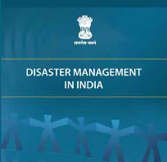
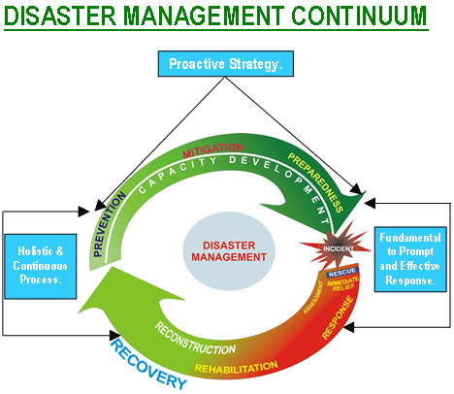
Disasters
"Disaster" means a catastrophe, mishap, calamity or grave occurrence in any area, arising from natural or manmade causes, or by accident or negligence which results in substantial loss of life
or human suffering or
damage to, and destruction of,
property, or damage to, or
degradation of, environment,
and is of such a nature or
magnitude as to be
beyond the coping capacity of
the community of the
affected area.
(According to DMA)

Slide 6
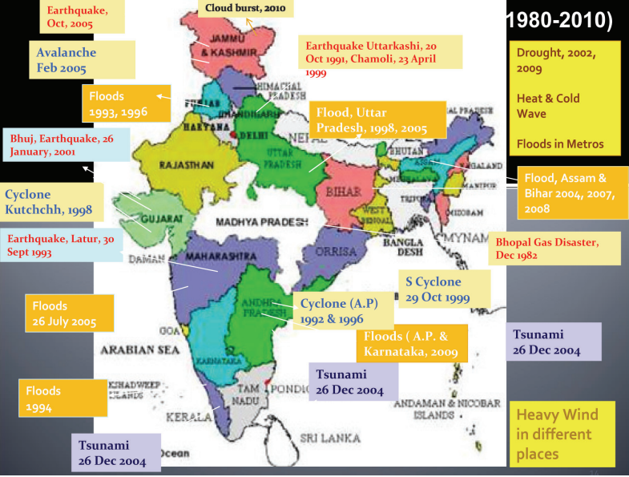
Hazard Profile of India
India has always been vulnerable to natural disasters because of its unique geo-climatic conditions. During the last thirty years the country has been hit by 431 major disasters resulting into enormous loss to life and property.
Earthquakes
Floods
Drought

Slide 7
Hazard Profile of Delhi

Slide 8
Importance/Components of Preparedness of Health Facilities
Three factors play an important role
Structural & Non-Structural factors
Hospital Disaster Management Plan
Capacity Building of healthcare providers.
Components:
ICS
Hospital disaster planning committee or group
Communication
Training and exercise Component
Hospital’s surge capacity
Security

Slide 9
Obstacles To Adequate Preparedness
Planning Assumptions
Cost Versus Benefit
Data Systems and Measurement Tools
Legal Issues
Staff Training
Human/Resources
Lack of Command
Communication

Slide 10
Objectives of the Study
General Objective- To determine the level of preparedness of Public & Private Health Facilities for disasters in Delhi
Specific Objectives:
To determine the level of preparedness of Public Health Facilities (PUHC, CHC, Government Dispensaries) for Disasters in three districts of Delhi.
To determine the level of preparedness of Private Hospitals for disasters in three districts of Delhi.
To suggest for bridging out various gaps found while conducting this study

Slide 11
Methodology
Research Design- Survey
Sample Design- Non-Random Convenience Sampling
Sample Size- 14 Healthcare Facilities in 3 districts (South/South West/West) of Delhi
9 PHC/DGD
2 CHC
3 Pvt Hospitals
Target Population- senior hospital managers, CMOs, staff nurses, MO I/C of DM.

Slide 13
Tools- Self administered Questionnaire named “Preparedness of Health Facilities for Disasters” developed on the basis of guidelines named “Guidelines For Hospital Emergency Preparedness Planning”.
Both closed/open ended questions.
Other Means- Direct observation/ Email/ Interview with Key respondents
Analysis- MS Excel, SPSS

Slide 14
Results
Planning Assumptions
Data Management
Staff Training
Human/Resources
Command and Coordination
Communication

Slide 17
Recommendations
Capacity Building
Standard Operating Procedures
Budget Allocation
Strong Incident Command System
Management of Database
Twinning/City Pairing
Management of Human/Resources
Media

Slide 18
Limitations of Study
Limited time period
Small sample size
No physical verification of the response given by the respondents
In-depth analysis could not be conducted.

Slide 19
Conclusion
Disaster Management is still an understudied topic in Delhi till date.

Slide 20
References
GOVERNMENT REPORTS
Report on Disaster Management in India, Ministry of Home Affairs, Government of India, 2011 [1]
Report on Disaster Management in India, Ministry of Home Affairs, Government of India[2]
The Disaster Management Act, 2005[4]
Delhi Disaster Management Draft Plan, Chapter II, National Capital Territory– Delhi, 2010[5]
Delhi Disaster Management Draft Plan, Chapter-III, Hazard and Risk Assessment, 2010[6]
Delhi Disaster Management Draft Plan, Chapter–V, Disaster Preparedness and Mitigation Plan, 2010[8]
Guidelines for Hospital Emergency Preparedness Planning: GOI-UNDP DRM Programme, 2002-2008[9]
Disaster Management Existing Framework and New Initiatives: Ministry of Home Affairs (NDM division)[10]

Slide 21
ARTICLE IN A JOURNAL
Challenge of Hospital Emergency Preparedness: Analysis and Recommendations: Joseph A. Barbera, Dale J. Yeatts, Anthony G. Macintyre, 2009[11]
Are hospitals ready to response to disasters? Challenges, opportunities and strategies of Hospital Emergency Incident Command System (HEICS) : Mohammad Hossein Yarmohammadian, Golrokh Atighechian, Lida Shams, Abbas Haghshenas,2011[12]
Policy Development in Disaster Preparedness and Management: Lessons Learned from the January 2001 Earthquake in Gujarat, India: Rannveig Bremer, 2003[13]
Prehospital Preparedness for Pediatric Mass-Casualty Events: Steve Shirm, Rebecca Liggin, Rhonda Dick, James Graham, 2006[14]
Hospital Preparedness for Emergency Response: United States: Richard W. Niska, Iris M. Shimizu, 2011[15]
Hospital Preparedness for Radiation Emergencies and Medical Management of Multiple Combined Radiation Injury Victims: Hoon Chin Steven Lim, Keng Sin Ng, Hock Heng Tan, Kok Wah Gabriel Leong, 2011[16]
Public health preparedness: a systems-level approach: Spencer Moore, Al Mawji, Alan Shiell, Tom Noseworthy, 2007[17]
Hospital preparedness for chemical and biological incidents in Hong Kong, JTS Chan, RSD Yeung, SYH Tang, 2002[18]
Hospital planning for acts of terrorism and other public health emergencies involving children: S Chung, M Shannon, 2005[20]
Primary Health Centre disaster preparedness after the earthquake in Padang Pariaman, West Sumatra, Indonesia: Ahmad Fuady, Trevino A Pakasi and Muchtaruddin Mansyur, 2011[21]
Major Influences on Hospital Emergency Management and Disaster Preparedness: Lauren M. Sauer, Melissa L. McCarthy, Ann Knebel, and Peter Brewster, 2009[22]
Hospital-related incidents; causes and its impact on disaster preparedness and prehospital organizations: Amir Khorram-Manesh, Annika Hedelin and Per Örtenwall, 2009[23]

Slide 22
ELECTRONIC PUBLICATIONS
Hospital planning for weapons of mass destruction incidents: Ronald W Perry, MK Lindell: Volume 52, 2006[19]
WEBSITES
NDMA: http://ndma.gov.in[3]
DDMA: http://www.delhi.gov.in/wps/wcm/connect/doit_dm/dm/home[7]
WORKSHOPS
IRP Workshop on Disaster Recovery and Planning, 2012 [24]

Slide 23
THANK YOU

