Slide 1
Dissertation Report
Presented by
Dilip Kumar Prajapat
PG/12/027

Slide 2
Organization Profile
Genesis-The National Rural Health Mission (NRHM) is an initiative undertaken by the government of India to address the health needs of underserved rural areas. Founded in April 2005 by Indian Prime minister Manmohan Singh, the NRHM was initially tasked with addressing the health needs of 18 states that had been identified as having weak public health indicators.
Address BAYS NO.55-58, SECTOR-2, PANCHKULA, HARYANA
Child Health Division
JSSK
FBNC
IYCF
F-IMNCI
NRC
MSP
IMNCI
NSSK
HBPNC

Slide 3
Activities Done during dissertation

Slide 4
Title
Assessment of cold chain maintenance Practices and knowledge of cold chain handler among district of Mewat, Haryana

Slide 5
Problem
Child Mortality
7.6 million children under the age of five die every year, according to 2010 figures (WHO, 2011)
Over two-thirds of these early child deaths are due to conditions that could be prevented or treated with access to simple, affordable interventions. (WHO, 2011).
Approximately 40% of child deaths occur in infants under one month old. (WHO, 2011).
Children in low-income countries are nearly 18 times more likely to die before the age of five than children in high-income countries.
Source: WHO. (2011). Children: Reducing Mortality. Retrieved January 2012, from World Health Organization

Slide 6
Impact of Vaccines
Vaccines are cost-effective and life-saving. In 2010, 109 million children were immunized with three doses of tetanus, diphtheria and pertussis vaccine (WHO, 2011)
Vaccines prevent 2.5 million deaths every year in all age groups (WHO, 2011).Expanding coverage of vaccines at the national and sub national level could prevent 2 million additional deaths in children under 5 (WHO, UNICEF, World Bank, 2009)

Slide 7
Cold Chain?
Cold chain is a system of storing and transporting vaccine at the recommended temperature range from the point of manufacturer to the point of use.

Slide 8
Why Cold Chain is required?
Vaccines lose their potency due to exposure to:
Excessive heat (all vaccines)
Excessive cold (Hepatitis B, DPT and TT)
Light (BCG, Measles and JE)
Sensitivity to heat
OPV
Measles
DPT
BCG before recon.
TT,Pentavalent,HeP.B
Sensitivity to cold
Hepatitis B
Pentavalent
DPT
TT
Most
Most
Least
Least

Slide 9
What are the Cold Chain equipments?
Electrical equipment
At state/regional/divisional level
Walk in Cooler and Walk in Freezer
At district/sub district/PHC level
Ice Lined Refrigerator and Deep Freezer
Non electrical equipment
Cold boxes
Vaccine Carriers
Voltage Stabilizers

Slide 10
What is Storage Temperature?
Maintain following storage temperatures inside equipment
ILR: +2 to +8^{O}C for storing all vaccines
DF: -15 to -25^{O}C for preparing frozen ice packs
Monitor temperature twice daily (morning and evening) using alcohol thermometers
Remember:
Place a functional thermometer in every equipment
Hang it vertically in center away from direct
contact with vaccine boxes and walls.
Read it where it is placed – do not take it out

Slide 11
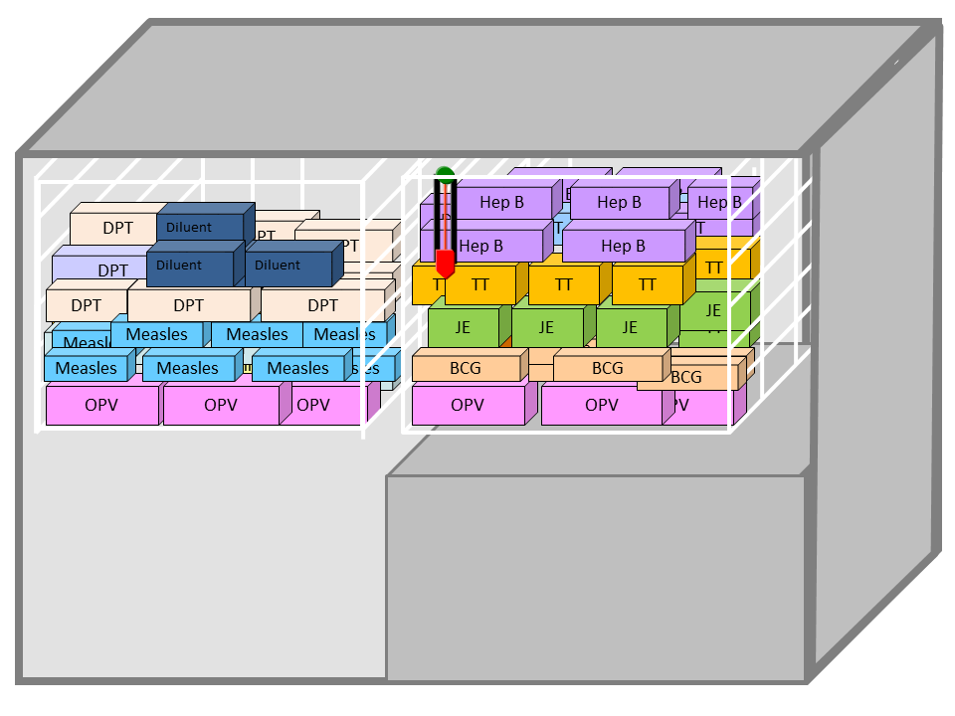
How to use Ice Lined Refrigerator?
At PHC level use ILR to store all UIP vaccines only
Store all vaccines along with diluents in the basket along with diluents
Place vaccines away from direct contact with ILR walls and keep space between boxes
Order of vaccines from top to bottom
Hep B
Pentavalent
DPT, TT
JE
BCG
Measles
OPV
Follow Early Expiry First Out (EEFO)
Store diluents in baskets, for 24 hours before next session
Monitor twice daily and ensure that all vaccines and diluents are stored at
+2 to +8^{O}C
ILR can keep vaccine safe with 8 hour
electric supply in 24 hour period

Slide 12
How to use Ice Lined Refrigerator?
If baskets are not available, store vaccines over 2 rows of empty ice packs kept on platform
OPV & Measles can be kept over 2 rows of empty ice packs on floor of ILR
If ILR baskets are full..
If ILR baskets are unavailable..
DPT
Hep B
DPT
Hep B
Hep B
DPT
DPT
Hep B
Hep B
Hep B
DPT
DPT
Hep B
Hep B
Hep B
Penta
Hep B
DPT
DPT
DPT
Penta
DT
DPT
DPT
DPT
Penta
DPT
Penta
HeP B
DPT
DPT
DPT
DPT
DPT
DPT
DPT
DT
DT
DT
TTT
TT
DPT
DPT
TT
TT
TT
TTT
DT
DPT
TT
TT
TT
TT
JE
TT
TT
DT
TT
TT
TT
TT
JE
JE
Diluent
BCG
JE
JE
JE
JE
JE
JE
BCG
BCG
BCG
BCG
BCG
BCG
BCG
BCG
BCG
BCG
BCG
Measles
Measles
Measles
Measles
Measles
Measles
Measles
Measles
Measles
Measles
Measles
Measles
Measles
Measles
Measles
Measles
Measles
Measles
Measles
Measles
OPV
OPV
OPV
OPV
OPV
OPV
OPV
OPV
OPV
OPV

Slide 13
How to monitor vaccine damage?
Potency of vaccines once lost cannot be restored
Physical appearance of vaccine may remain unchanged even after it is damaged.
For checking heat damage – use VVM
Vaccine can be used if it is within expiry date and the colour of inner square of VVM is lighter than the colour of outer circle.
✓
✓
Usable stages
Vaccine cannot be used if the colour of inner square of the VVM either matches or is darker than the colour of outer circle, even if expiry date has not passed


Unusable stages
Cold damage: if DPT/TT/Hep B vials are found frozen or contain floccules, discard the vials

Slide 14
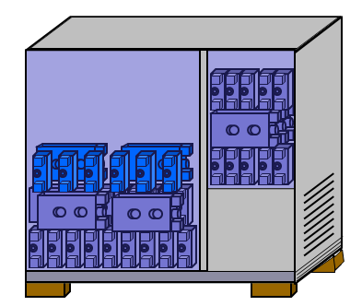
How to use Deep Freezer?
At PHC level, DF are used only for the preparation of ice packs and are not to be used for storing UIP vaccines.
Store frozen icepacks only up to half the height of the large compartment
Large compartment
Wipe dry and arrange 20-25 unfrozen icepacks vertically (never flat) in a crisscross pattern with space for air circulation
Small compartment
Arrange and store frozen icepacks vertically, in layers.
Also store in cold boxes
About 20-25 ice packs can be prepared by a
140 Liter DF in 24 hours

Slide 15
Why defrosting of ILR/DF is required?
Temperature in ILR/DF can rise if there is a thick layer of ice along the walls and bottom of equipment.
ILR/DF must be defrosted periodically or when ice lining is more than 5 mm.

Slide 16
How to pack Vaccine Carrier?
Place 4 conditioned ice packs against the sides of the carrier
Put required number of vaccine vials, diluent
ampoules and dropper for OPV in zipper
lock polythene bag and place in center
of carrier.
Close the lid securely
For conditioning, keep frozen ice packs in open till sound of water can be heard by shaking the ice pack.
Unconditioned ice packs may damage freeze sensitive vaccines (Hepatitis B, DPT and TT)

Slide 17
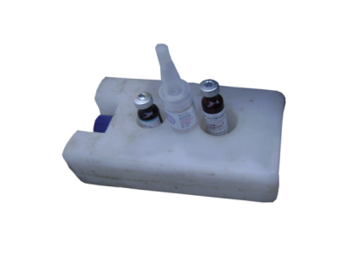
How to manage cold chain at session site?
Collect all vaccines in the vaccine carrier on the session day.
Vaccine carrier may not store vaccine effectively beyond 12 hours.
During immunization session take one ice pack out of the carrier and keep OPV and reconstituted vaccines (BCG, Measles and JE) on it.
Never put freeze sensitive vaccines (DPT, TT
and Hepatitis B) on ice pack.
Ice pack once taken out should not be put
back into the carrier till the end of session.

Slide 18
What are the uses of cold boxes?
Cold boxes are mainly used for transportation of vaccines.
In emergency they can be used for storing vaccines as well as frozen ice packs.
Vaccines should be transported/stored in cold boxes only with sufficient number of conditioned ice packs.
Packing vaccines in the cold box:
Place conditioned ice packs side by side against the inside walls and floor
Load vaccines and diluents in cartons or polythene bags.
Place conditioned ice packs on top of vaccines and diluents and cover them with plastic sheet.
Keep thermometer inside and monitor temperature twice daily.
Secure the lid tightly

Slide 19
Why Voltage Stabilizers are required?
Voltage Stabilizer checks and correct the range of fluctuations in the main voltage of 150-280 V.
It incorporates high and low voltage cut off with 3-6 minutes time delay.
Every electrical equipment must be connected to stabilizer.
Proper earthing should be available and connected and by passing of stabilizers must not be done.
Emphasize on repairing stabilizers immediately

Slide 20
What is Preventive Maintenance?
ILR and DF
Check daily: Exterior is clean Temperature is within prescribed limits (twice daily) Seal is tight and door shuts No water collection at bottom
Check weekly: Frost is less than 5 mm
Check monthly: Equipment is defrosted and cleaned
Cold boxes and vaccine carriers
After every use: Keep latches open and free from load and tension Clean with detergent and dry Examine inside and outside surface for cracks Check that rubber seal around lid is not broken (replace if broken) Hinges and locks are lubricated with machine oil

Slide 21
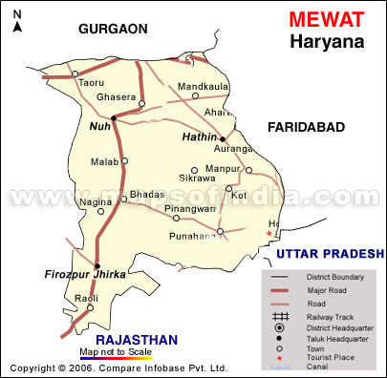
Introduction
District Mewat has a population of 10,89,263 according to the 2011 census.
Fully immunized status of the district is 12% according to DLHS-III and 24.57% as per WHO coverage evaluation 2010-11.
It has 3 CHCs, 10 PHCs,
13 ILR points and 84 sub centres.

Slide 22
Objectives
To assess the cold chain maintenance practices among facilities of Mewat as per cold chain guideline.
To check the knowledge of cold chain handler regarding cold chain in district Mewat.

Slide 23
First round of RAPID was conducted in October 2012. The observations were dismissal and poignant.
The district was handed over action points with a timeline for improvement and the second round was conducted 4-6 March 2013.

Slide 24
Rationale
Cold chain needs continuous supervision and assessment at different levels to prevent the loss of vaccine potency during storage and handling. This is important as new and expensive vaccines that require different approaches to storage are introduced. This study was done to assess the cold chain maintenance practices and knowledge of cold chain handler among cold chain points of Mewat district.
The purpose behind study to check the consistency of improvement from RAPID first round, second round and third round there was tremendous improvement to see in the cold chain status of Mewat under various constraints.

Slide 25
Limitations of the study
Lack of manpower
Time constraint
Limited sample size

Slide 26
Review of Literature
S Mallik (et al), Dept of Community Medicine, Midnapur Medical College, West Bengal (March 2011)- Assessing cold chain status in a metro city of India: An intervention study
Ashish K. Naik (et al), Dept of Community Medicine , Surat Municipal Institute of Medical Education and Research , Surat , Gujarat (Dec 2013)- Evaluation of Vaccine Cold Chain in Urban Health Centres of Municipal Corporation of the Surat City, Western India
Goel NK (et al), Dept of Community Medicine, Govt. Medical College, Chandigarh (Oct- Dec 2004)- Evaluation of cold chain system in Chandigarh during PPI campaign 2001-2002.
Rogie B (et al) Addis Continental Institute of Public Health, Addis Ababa, Ethiopia. (July 2013)- Assessment of cold chain status for immunization in central Ethiopia
Ateudjieu J , Kenfack B (et al) Department of Biomedical Sciences, University of Dschang, Cameroon, Dschang, Cameroon.( March16, 2013)- Program on immunization and cold chain monitoring: the status in eight health districts in Cameroon.
Ortega Molina P( et al), Department of Preventive Medicine and Public Health, Faculty of Medicine, Complutense University of Madrid, Madrid, Spain. (July- August, 2007)- Cold chain maintenance in vaccines: a systematic review

Slide 27
Methodology
Study area- Mewat district, Haryana
Study design- Cross sectional study
Study respondent- Cold chain handler
Sample Size- 9
Data collection tools
Pre-tested RAPID tool for health facility.
Knowledge assessment questionnaire for cold chain handler.
Technique-
Interview
Review of records/documents- Stock register, temperature log book, vaccine issue register etc.
For analysis- SPSS tool kit, Excel.

Slide 28
Sampling
BLOCK NUH
BLOCK PUNAHANA
FIROZPUR ZIRKHA
Block PHC
PHC Ghasera
Block PHC
PHC Singar
Block PHC
PHC Bhiwan
far
PHC UJhina
PHC Tigaon
PHC Nagina

Slide 29
Findings

Slide 30
Programme Management

Slide 31
Cold chain 1

Slide 34
Round wise progress report of Mewat district

Slide 35
Knowledge of cold chain handler regarding cold chain among Mewat district

Slide 37
Good Practices observed
Map of the PHC with distances from the cold chain point
Contingency plan for cold chain displayed

Slide 38
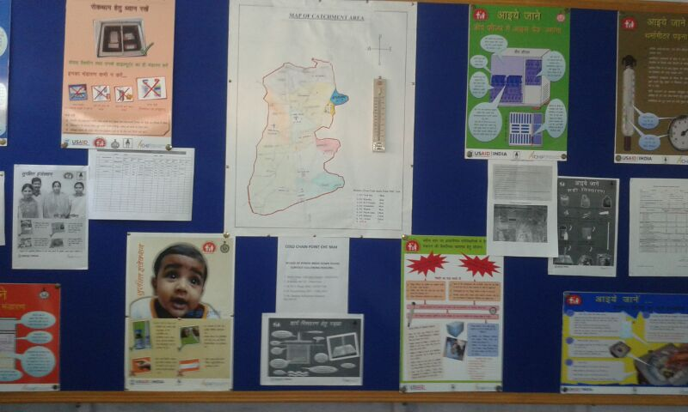
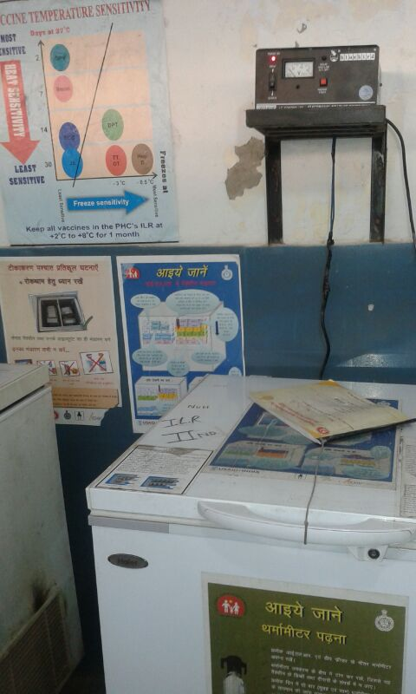
Well IEC DISPLAYED IN COLD CHAIN ROOM
Stabilizer placed at the Platform at eye level

Slide 39
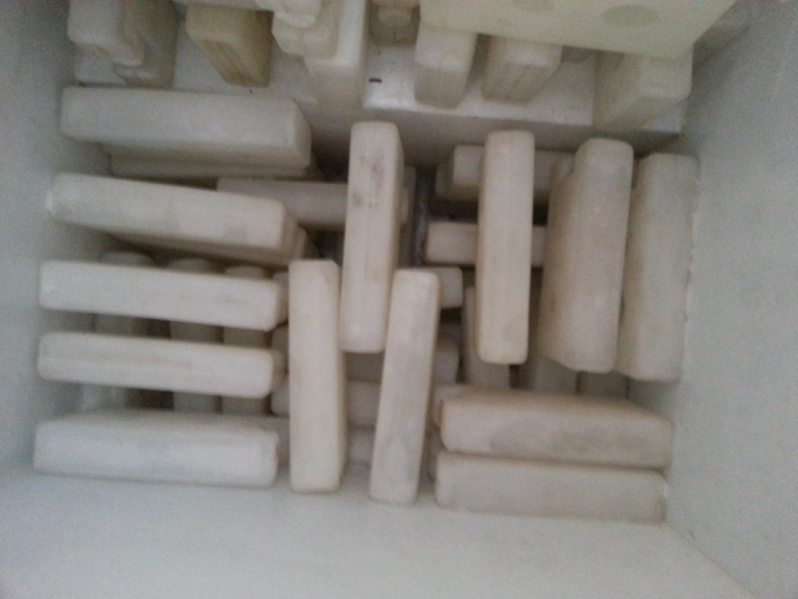
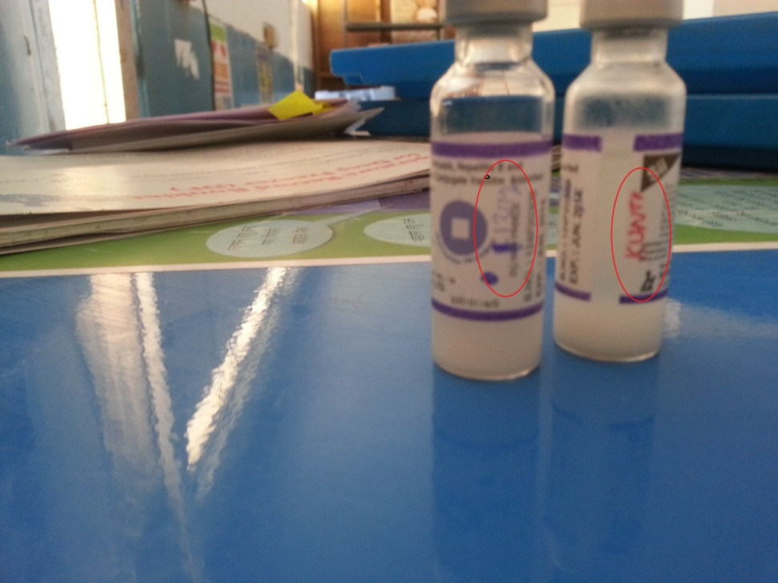
Criss cross pattern on icepacks
Open vials placed in ILR with zipper lock bag with tagging of ANM Name
Dots, Date & Name of ANM mentioned for implementing open vial policy for LPV

Slide 40
Practices requiring improvement
Open Hepatitis vaccine in ILR without date
Incorrect arrangement of icepacks in Deep Freezer

Slide 41
Daily Monitoring of Temperature Log Books not being done, no record of defrosting, power cuts

Slide 42
ACTION POINTS

Slide 43
S.No. | ISSUES | RECOMMENDATIONS | KEY PERSON RESPONSIBLE
1 | Block meeting was conducted but not documented | Ensure the conduction of block meeting by district officials. Block meeting should be documentated in register with date and minutes of meeting. | DIO/CMO MO/SMO
2 | No documentation of supervisory visit | There should be maintain supervisory visitor register with attached the compliance report. | MOIC
3 | ANM roster/ immunization calendar not displayed at the facility. | MOIC Should inform about it and ensure the availability and display of ANM roster. | MOIC

Slide 44
S.No. | ISSUES | RECOMMENDATIONS | KEY PERSON RESPONSIBLE
4 | Coverage monitoring Chat not displayed at the facility | Ensure the availability and display of coverage monitoring chart at the facility. | MOIC
5 | Open vial of hepatitis B vaccine in ILR was found expired. (After opening of Vial exceed the 28 days of usable limits) | Strict & regular supervision by MOIC. Regular follow up visit by district officials need to be done. | CMO/DIO/MOIC
6 | Stock register for vaccines was not being properly maintained and up to date. | Block and district officials should check the updation & maintenance of stock register. | DIO/SMO/MOIC

Slide 45
S.No. | ISSUES | RECOMMENDATIONS | KEY PERSON RESPONSIBLE
7 | Broken vials of hepatitis and measles were found in ILR | Cold chain handler ensure the care about the handling of vaccines and store properly. | Cold chain handler/MOIC
8 | Thermometer for DF not available still there is twice recording of temperature in log book. | MOIC should ensure the availability of thermometer and check the twice daily recording of temp. in log book. | MOIC
9 | Open vial policy not being properly followed | Permanent marker should recommended to ANM to mark date on open vial vaccine. | Cold chain handler

Slide 46
S.No. | ISSUES | RECOMMENDATIONS | KEY PERSON RESPONSIBLE
10 | Poor temperature recording practices | Twice daily recording of temperature, record of power failure and defrosting to be maintained, MOIC counter sign log book | MOIC/ Cold Chain handler
11 | Cold chain equipments of Bhiwan placed in Firozpur zirkha(block) facility which needs to be transfer back to bhiwan PHC. | District official should ensure the Bhiwan cold chain equipments placed in Firozpur zirkha block facility that should be transfer back to Bhiwan PHC.(ensure the availability of separate cold chain room at bhiwan PHC) | CMO/DIO/SMO

Slide 47
S.No. | ISSUES | RECOMMENDATIONS | KEY PERSON RESPONSIBLE
12 | Review meetings not conducted in most of health facilities | Block meeting to be conducted every month & that should be documented with minutes of Discussion with action points | MOIC
13 | Knowledge regards open vial policy and shake test needs to be improved | MOIC or district officials make arrangement of refresher training regarding knowledge of open vial policy and shake test. | CMO/DIO

Slide 48
Conclusion
The study conclude that the present cold chain status of Mewat district had substantially improved after three round of RAPID in cold chain maintenance practise and knowledge of cold chain regarding practice was good but still there is some scope of improvement regarding shake test, open vial policy and other issues like temperature recording practices, temperature maintenance of ILR and DF etc. which can be improved by district official by increase in supportive supervision on periodic basis so these issues can be resolve.

