Slide 1
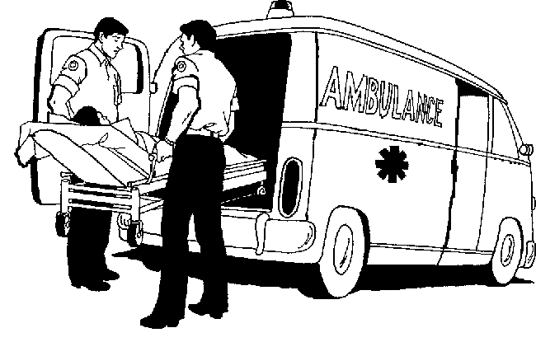
STUDY ON AMBULANCE SERVICES ACROSS HOSPITALS IN BANGALORE
PRESENTED BY:
Dr. SONAM PATNI
PG/11/096

Slide 2
SAKRA WORLD HOSPITAL,BANGALORE

Slide 3
INTRODUCTION
Heart Disease is one of main reasons of mortality in India.
Trauma related death occurs in India every 1.9 minutes².
Bangalore has about 30,000 emergency cases per month, just 10% are serviced by ambulances.
Notes:
India, by virtue of statistics, is a country that needs high-quality ambulance services nationwide. Cardiovascular diseases are major cause of mortality and disease in the Indian subcontinent, causing more that 25% deaths. The IT boom has made Bangalore city to grow at an unimagined speed. There was sudden over-night demand for every kind of infrastructure. The city of Bangalore has recorded unprecedented motorization, infrastructure expansion and increasing mobility of people in the last decade, this change is likely to continue in the coming years. Consequently there has been an increase in road crashes, deaths, injuries (RTIs) and disabilities. In addition, greater reliance on motor vehicles also results in many direct and indirect health effects leading to some non communicable diseases (cardiac diseases) The Ratio of RTA in the world is 0.75 accidents/1000 vehicles while in India it stands at a staggering 16 accidents/1000 vehicles (21.3 times higher than the world average)³

Slide 4
PROBLEM STATEMENT
Organized ambulance services are scanty in India and even if they exist, their existence is no more than merely patient transport vehicles.
Patient who receives prompt medical treatment from trained professionals and is transported within 15-20 minutes of an emergency has greatest likelihood of survival.(Golden period)
30% of victims die due to delay in transportation or during transportation.
This happens because of non availability of ambulances, not well equipped ambulances ,lack of professionally trained personnel, lack of integration of ambulances with IT and emergency response centre.

Slide 5
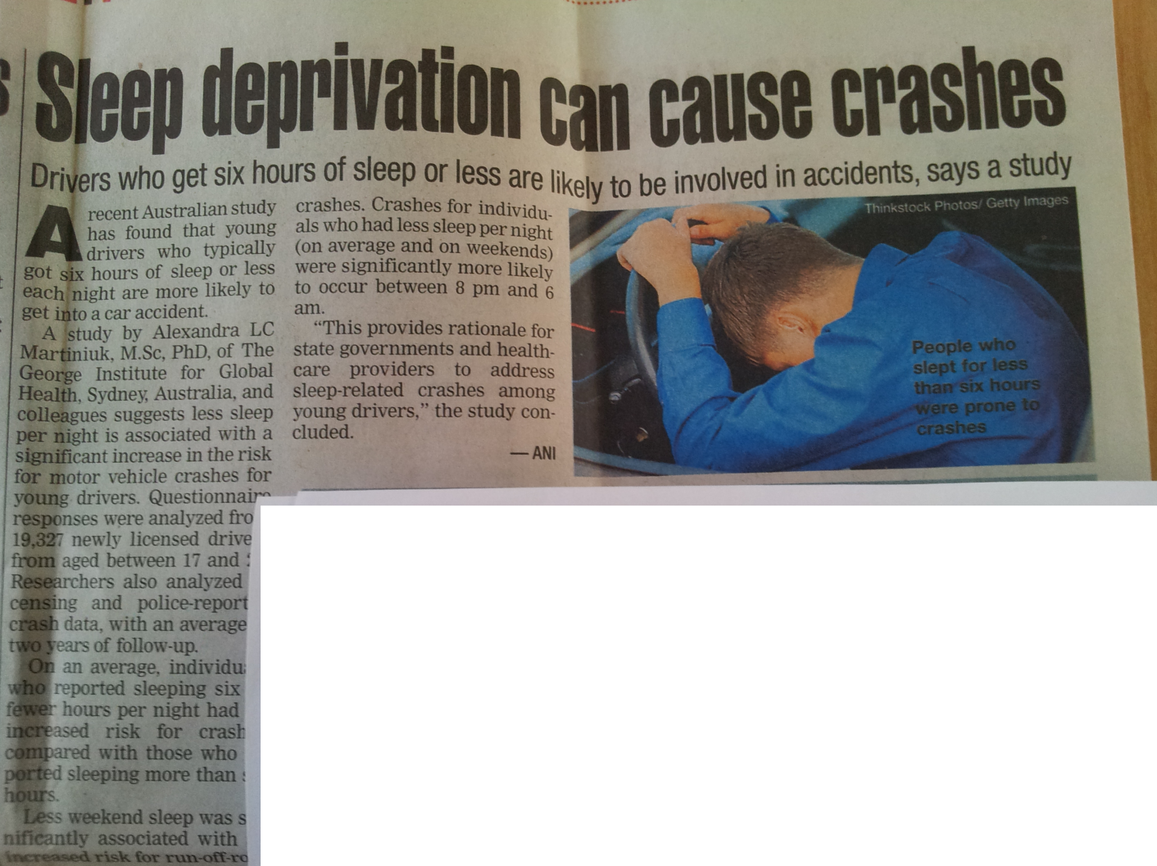
Published in Times of India (Bangalore times)
Many of the ambulance drivers were seen misusing their rights and blaring sirens when not needed and making way
12 hours shift timings for ambulance drivers is a common practice, which may lead to sleep deprivation resulting into ambulance crashes

Slide 6
RESEARCH QUESTION
What is the current scenario of ambulance services in Bangalore with special focus on the response time, catchment area and service utilization?
Is there a difference between the perception of service providers and expectations of the users?
Does a well equipped ambulance staffed with adequately trained manpower have an impact on delivery of effective medical care?

Slide 7
GENERAL OBJECTIVE
To identify and analyze the existing scenario of ambulance services across hospitals in Bangalore and design an advance care ambulance model complementing high end trauma centre of an upcoming 300 bedded hospital in Bangalore.

Slide 8
SPECIFIC OBJECTIVES
To understand and compare ambulance services provided by various health care providers in Bangalore
To understand public perception towards the ambulance services
To identify key components in an advanced life support ambulance in line with the expectations from the users to make recommendations for an ideal ambulance based on this understanding
To formulate a plan for building up an ideal ambulance services based supporting a high end trauma centre considering future requirements

Slide 9
METHODS AND DATA
STUDY DESIGN | Cross-sectional Analytical
STUDY AREA | Bangalore
SAMPLE SIZE | 12 Hospitals (Ambulance managers) 48 Patients / Attendants
STUDY DURATION | April 12-May 17,2013
DATA COLLECTION TOOL | Questionnaire (Managers & Patients)
METHOD OF SAMPLING | Convenient Sampling
PRIMARY DATA | Interviewing ambulance managers and patient /attendant
SECONDARY DATA | Reports, journals, studies on ambulance

Slide 10
ANALYSIS
7 ACLS, 3 BLS, AND 2 PATIENT TRANSPORT
Majority of ambulances cover a distance beyond 15 kms

Slide 11
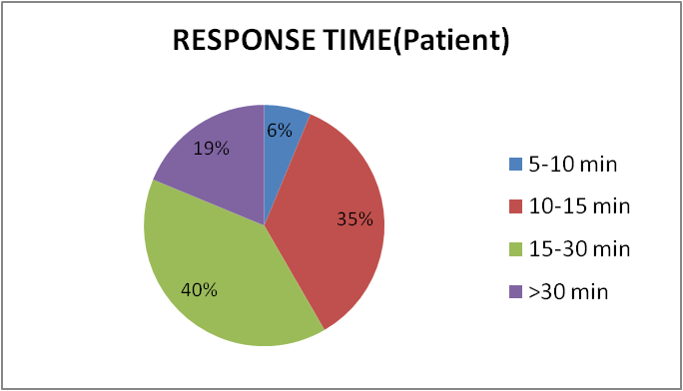
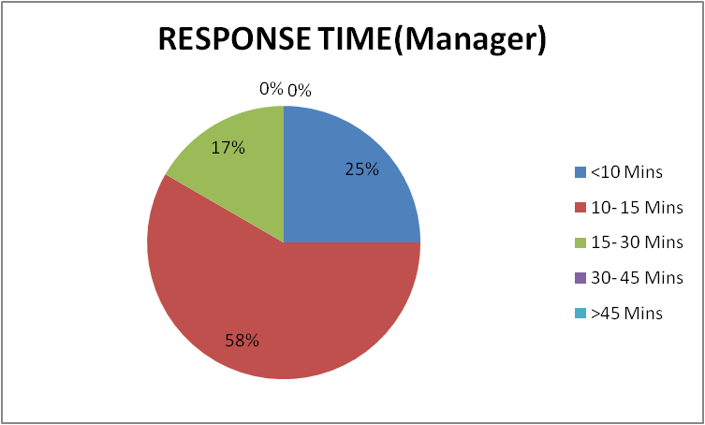
Manager V/S Patient perspective (Average response time)
~20% of patient experienced that ambulance response time was more then 30min. Covering about 20kms
Managers are too optimistic and suggested the response time does not exceed beyond 30min
Notes:
Ambulances claim to have good response time

Slide 12
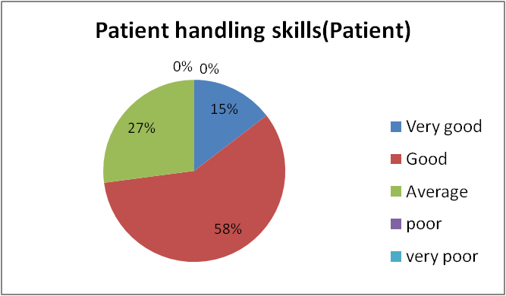
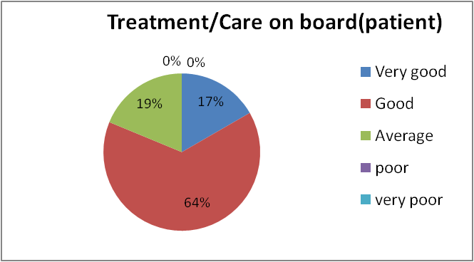
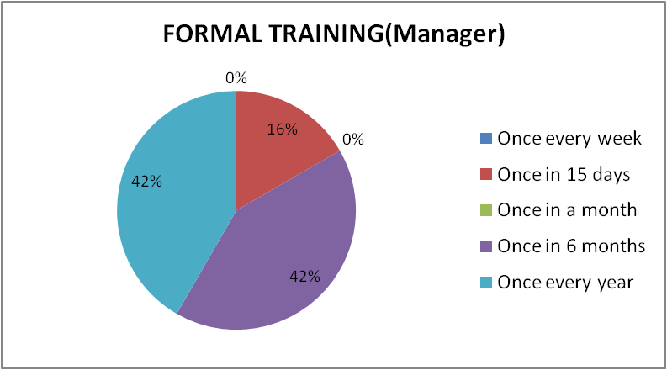
Patient’s Experience
Training scenario
When patient experience was compared with training approximately 27% of the patients feels that handling skills are not appropriate while 19% feet average care on board which is a major gap
This gets clarified from manager’s perspective where 84% provide training in 6 months/year gap hence this again emphasize on robust training system & importance of paramedical staff in patient care

Slide 13
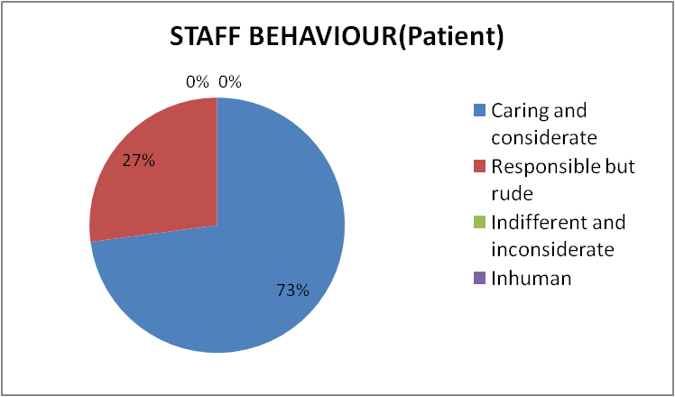
Preference Order
Patient’s preference is Hygiene & Cleanliness (44%) followed by Staff Behavior (38%)
Rude behavior of staff is an area of concern for ambulance service managers
It has revealed a completely new finding as per patients expectations hence major emphasis should be on staff training & maintaining Hygiene & Cleanliness

Slide 14
Compared with the patients expectations ambulances had all the infection control requirements with them but not highlighted to the patients
Components like spillage kit & waste management is the key area of concern to be incorporated in the ACLS ambulances

Slide 15
Preference order (patients)
None of the Ambulances have 100% compliance to all infection control practices, on the other hand 44% of the people prefer hygiene & cleanliness over other features of an ambulance

Slide 16
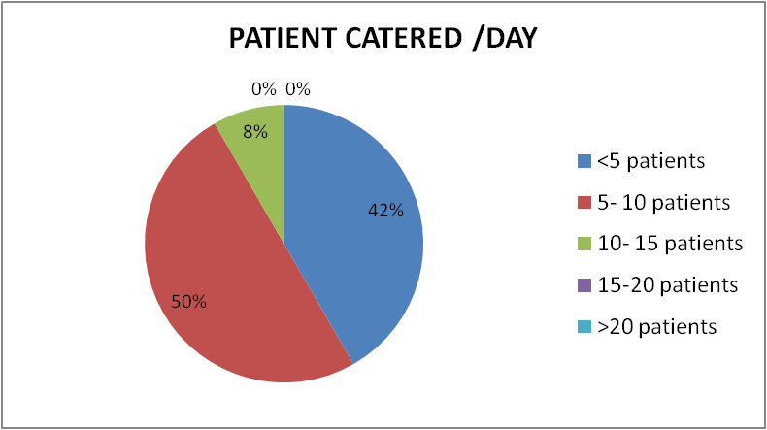
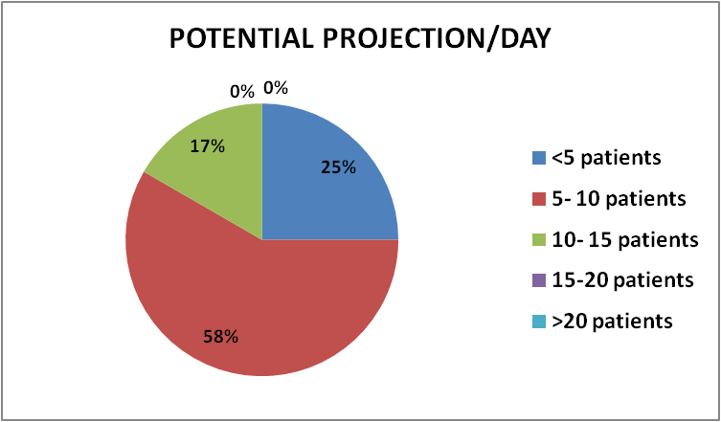
Only 8% of the hospitals cater to 10-15 patients/day
While 17% Hospitals believe that they have the potential to cater to 10-15
patients in a day.

Slide 17
TYPE OF EQUIPMENTS

Slide 18
Out of 12 ambulances 7 ambulances were ACLS
Of these 5 ambulances had 80%-90% compliance
No Ambulance had more than 90% compliance
MRI compatible spine board, resuscitation kit & portable X-ray were rare equipments

Slide 19
Only 1 ambulance provided 80% of the advance care services
Capnography was not performed in any of the ACLS ambulances

Slide 20
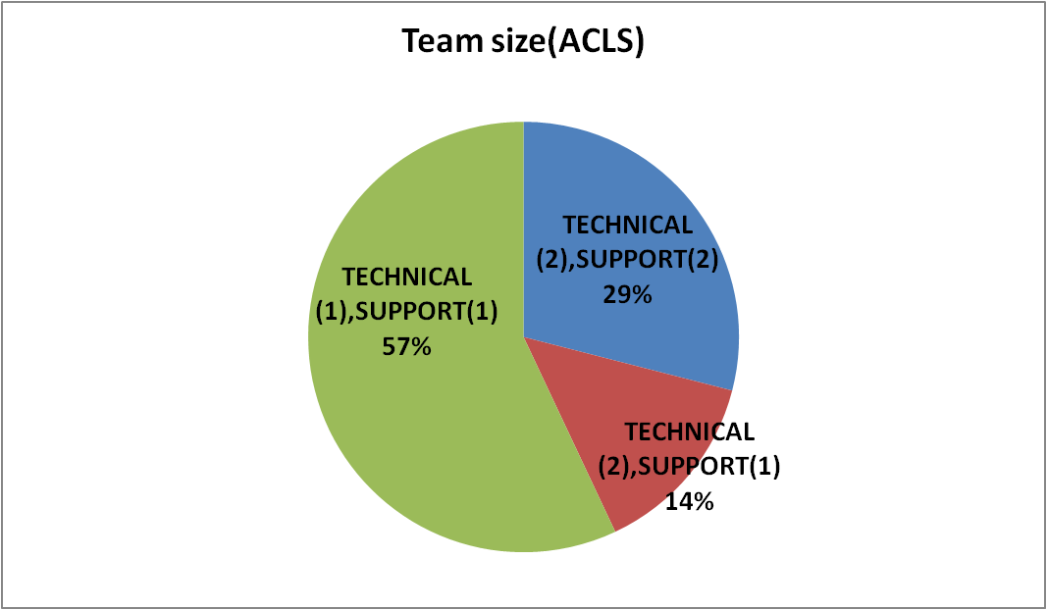
TEAM SIZE (TECHNICAL:SUPPORT) FOR ACLS AMBULANCE
The ideal complement of staff in an ACLS Ambulance is 2:2 (technical: support). Such a combination was seen only in 29% of ACLS ambulances

Slide 21
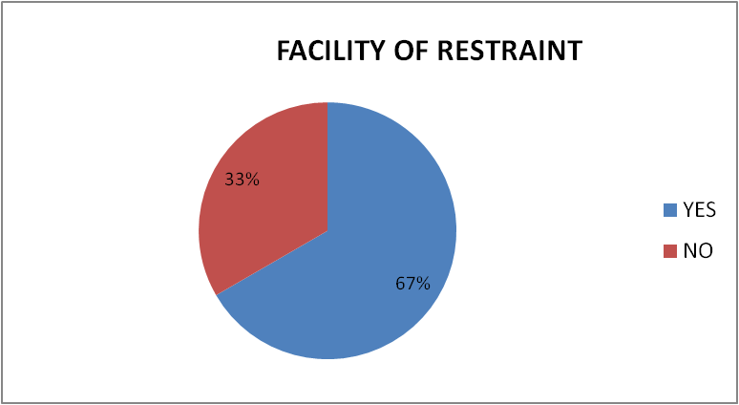
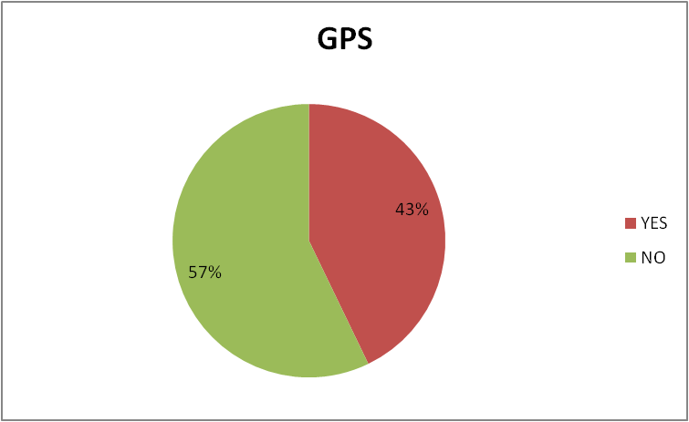
67% of ambulances have the facility of restraints to ensure the safety of relatives & staff
Only 43% of the ACLS ambulances are GPS enabled

Slide 22
RECOMMENDATIONS
All the equipments for providing advance care life support in place
A proper combination of technical and support staff should be deployed.
Training Related
Formal training sessions on advanced care life support (CPR, endotracheal intubation, ventricular defibrillation etc) workshops and hands on trainings should be undertaken periodically.
Resource Related
Training on general conduct and behavior.

Slide 23
Advance services related
Proper Infection control
Performance Related
Monitoring response time(for every visit)
GPS enabled ambulances should be encouraged to ensure quick response, timely interventions
Regular and surprise audits
Feedbacks from patients/attendants in emergency department
Checklists for ensuring availability of equipments, consumables and medicines
The ambulance should be well connected with mobile phones/wireless

Slide 24
CONCLUSION
It can be concluded that effective ambulance services can only be provided by right personnel in the right place at the right time with the right equipment (CHAIN OF SURVIVAL).
Study has revealed that currently the ambulance services are highly fragmented in Bangalore.
Some ambulances had the best of equipments in place; while some had adequate manpower and IT Integration. But none of them was able to deliver the best of ACLS Services
Best of ambulance services can be delivered only when real time information can be relayed to the professionally trained manpower for timely intervention, and deliver care and treatment with the best of equipments

Slide 25
First phase of Implementation
Designing ACLS ambulance called Mobile ICU

Slide 26
COMPONENTS
FABRICATION
EQUIPMENTS
IT INTEGRATION
MANPOWER
IDEAL AMBULANCE

Slide 27
FABRICATION
Minimum Patient Compartment¹¹
Length:2700 mm,Height:1500 mm,Width:1500 mm
Fiber reinforced plastic (FRP) internal paneling
Anti Bacteria Paint
Layout of the patient treatment space:
Centrally positioned stretcher-(360° access)
Working Wall- to position everything ergonomically
Standardization of equipment place

Slide 28
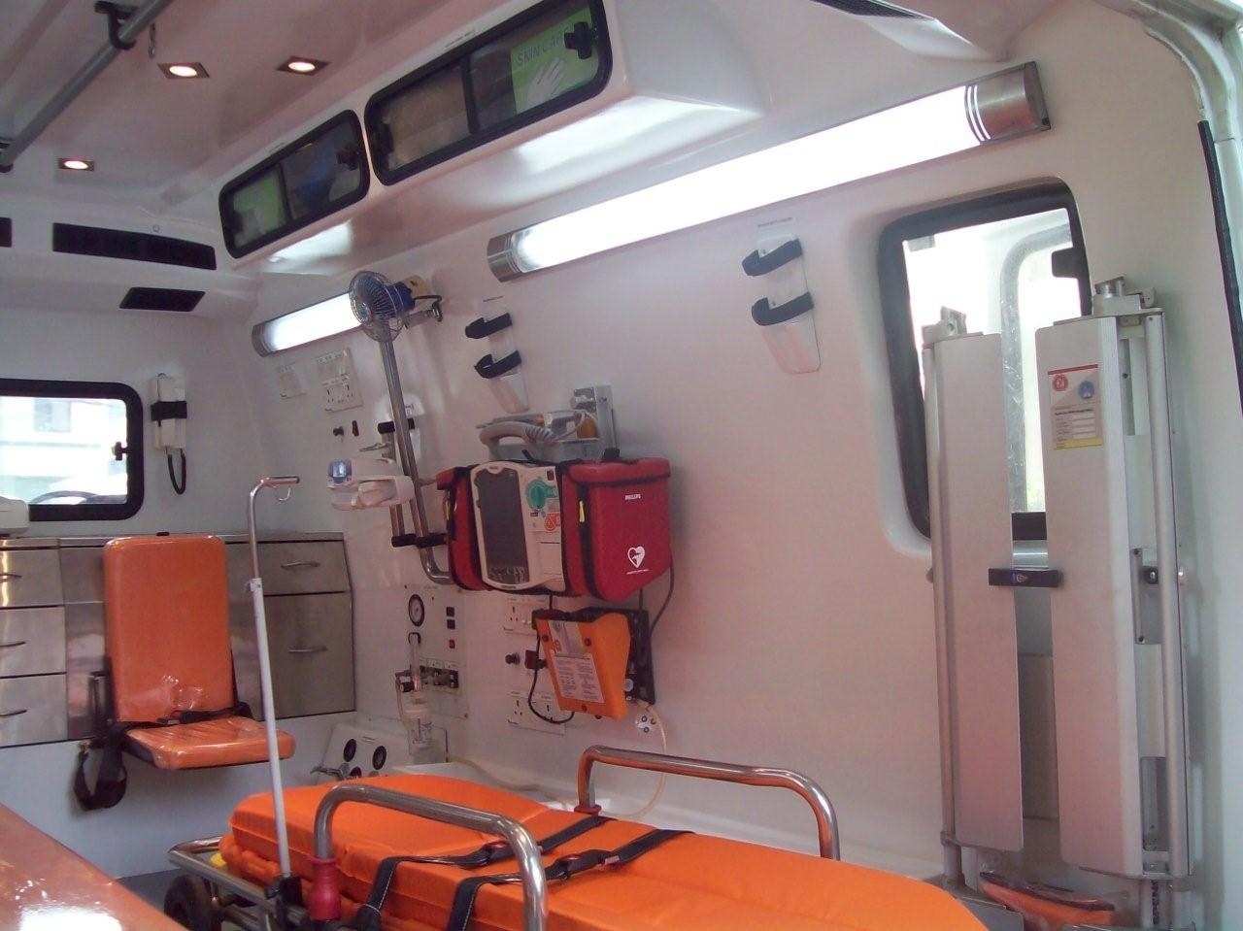

Slide 29
Powerful siren
Integrated AC & DC+240V AC Inverter with additional backup battery
Additional 135 Amps 12 V Alternator for running Air Condition and charging of Inverter batteries.

Slide 30
EQUIPMENTS
1.VENTILATION/AIRWAY EQUIPMENT
Transport ventilator
Portable suction Apparatus
Portable and fixed Oxygen equipment
AMBU Resuscitation bags(adult and pediatric)
Pocket mask with one way valve
Intubation equipments
Airways
2. MONITORING /DEFIBRILLATION
Multi Parameter Monitor
Automatic external defibrillator
Syringe Infusion Pump
I.V. lines
3.IMMOBILIZATION DEVICES:
Head immobilization device
Cervical collars
Lower extremity traction devices
4. STRECHERS AND SPLINTS
Automatic Loading Stretcher
Spine board
Scoop stretcher
Wheel chair stretcher
Pneumatic splints
5.COMMUNICATION
6. MISCELLANEOUS:
Sphygmomanometer
Stethoscope
Restraints

Slide 31
MEDICINES
Inj.Adrenaline
Inj.Atropine
Inj.Calcium carbonate
Inj.Dopamine
Inj.Dobutamine
Inj.Noradrenaline
Inj.Nitroglycerine
Inj.Sodium carbonate
Inj.Hydrocortisone
Inhaler Beclomethasone
Inhaler Salbutamol
Inj.Furosemide
Inj.Diazepam/Midazolam
Inj.Deriphyllin
Inj.Phenytoin sodium
Inj.Avil
Inj.Metrochlorpropamide
Inj.ondansterone
Inj.Kcl
Inj.Lignocaine (2%)
Inj.Amiadorone(50 mg/dl)
Inj.Magnesium sulphate 25% 2 ml
Inj. Mannitol 20%
Inj.Morphine/Inj.Pethidine
Inj.Noradrenaline
Inj.Naloxone Hcl
Inj.Fentanyl
Bacteriostatic water for injection
Inj.Sodium Valproate
Inj.Voveran
Inj.Paracetamol

Slide 32
EMERGENCY RESPONSE CENTRE
Emergency response centers/ Call centre supported by technology integration with Automatic vehicle location and tracking system, GPS
Better road navigation
Quickly arrive to the scene of an accident
Live tracking
Provide the knowledge of the exact moment when a patient will arrive.
Enable video links(via vide conferencing), discussion with hospital colleagues and specialists.

Slide 33
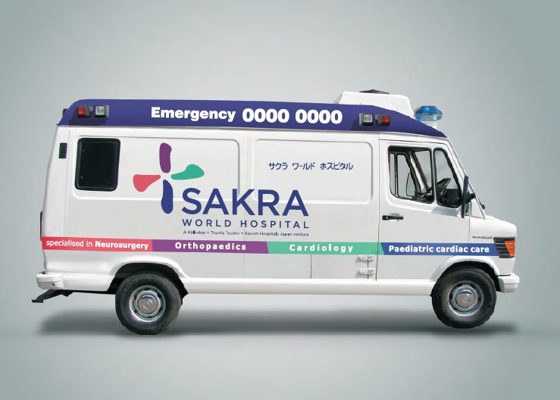

Slide 34
REFERENCES
1. Aasha Kapur Mehta, Andrew Shephard, Shashaka Bhide, Amita Shah. India. India Chronic Poverty Report: Towards solutions & New Compacts in a dynamic content [thesis], Indian Institute of Public Admin, New Delhi, 2011.
2. M. Neelam Kachhap. Trauma an untamed evil, Express healthcare, 6 Aug 2012
3. Shaffi Mather. Entrepreneurship Making a Social Impact Microsoft Leadership Conclave 2011
4. World Report on Road Traffic Injury Prevention, WHO/World Bank: 2004.
5. “Study of Emergency Response Service – EMRI Model” by National Health Systems Resource Centre (NHSRC), Ministry of Health & Family Welfare, Government of India; 2009
6. Can IT improve Emergency Health services in India Sanjeet singh, R.S.Uppal (BBSB engineering college)?
7. National Patient Safety Agency and the Helen Hamlyn Research Centre: Designing future ambulance transport for patient
8. Government of national capital territory of Delhi (health & family welfare department) Registration of Ambulances; http://www.delhi.gov.in/DoIT/Health/cat.pdf
9. Employees state insurance hospital: Bid System for “Fabrication and Modification of 02 nos. Of existing swaraj mazda ambulances”

