Slide 1
DISSERTATION PROJECT AT SADAR HOSPITAL PURNEA STATE HEALTH SOCIETY, BIHAR
SUBMITTED & PRESENTED
By
SAGNIK ROY
Enrollment No PG/11/083

Slide 2
CONTENTS
About the Hospital
Rationale & Study Objectives
Methodology
Study Findings
Discussion
Recommendations

Slide 3
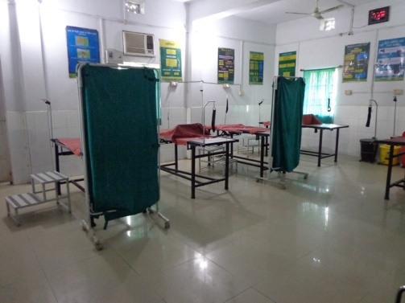
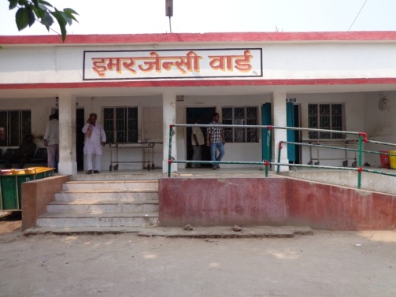
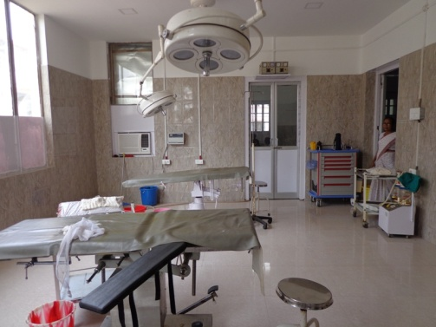
SADAR HOSPITAL – PURNEA
AN ISO 9001:2008 CERTIFIED HOSPITAL
262 Functional beds
8 Speciality
5 Separate O.T
2 Dialysis unit
Blood bank –1500 units
24*7 Emergency services
6 bed Labour Room
500 deliveries (80 C-section)
1500 Foot Fall/day - OPD
LABOUR
ROOM
EM. DEPT
GENERAL OT

Slide 4
DISSERTATION PROJECT
TITLE
“An Institution based Study of Knowledge, Attitude & Practice (KAP) of Intra-partum women regarding Family Planning at Sadar Hospital, Purnea-Bihar”

Slide 5
Rationale of study
National TFR 2.4, Bihar 3.6, Purnea 4.3
Contraceptive usage ( any method) rate 34.1 per cent in Bihar
Knowledge of contraceptive methods is 100 percent ( NFHS 3)
80.1 per cent never used contraceptives before sterilization in Bihar.
Female literacy 43.19 per cent as per census 2011

Slide 6
Literature Review
Number of studies both national & abroad in developing countries reflects the lack of knowledge part regarding FP. The studies also showed that which ever community, having favourable attitude towards FP with fare amount of awareness, bring changes to their practice regarding family planning.

Slide 7
GENETAL OBJECTIVE
To assess knowledge, attitudes and practices regarding family planning among the intra-partum women (age not more than 30 years) admitted for delivery at Sadar Hospital Purnea, Bihar in the month of March’13.

Slide 8
SPECIFIC OBJECTIVES
To assess the knowledge of family planning & awareness regarding the modern methods of contraception among the intra-partum women admitted for delivery at Sadar Hospital Purnea
To find out attitude towards family planning among the intra-partum women admitted for delivery at Sadar Hospital Purnea
To learn about the various practices regarding family planning among the intra-partum women admitted for delivery at Sadar Hospital Purnea

Slide 9
METHODOLOGY
Study design – Cross sectional, Descriptive.
Study area – Sadar Hospital, Purnea.
Study population – Intra Partum Women admitted at SH during March’13.
Sample Size – 184
Sampling design – Complete enumeration following the inclusion criteria.
Tools /Technique – Semi structured questionnaire, interview method.

Slide 10
STUDY APPROACH
Inclusion Criteria for sampling
1. Pregnant women admitted to Sadar hospital Purnea, for delivery in March’13.
2. The age of the pregnant women should not be beyond 30 years.
3. The patient should not have more than three children.
The interviews were conducted after safe delivery at Maternity Ward prior to discharge.

Slide 11
STUDY FINDINGS
General & demographic Information
Demographic Variables | Category | Frequency (184) | Percentage (100%)
Age | less than 16 year. | 4 | 2
 | 16-20 year | 17 | 9
 | 21-25 year | 127 | 69
 | 26-30 year | 36 | 20
Religion | Hindu | 112 | 61
 | Muslims | 72 | 39
Education | No School- literate | 59 | 32
 | No School - Illiterate | 94 | 51
 | Primary | 26 | 14
 | Secondary | 5 | 3
Occupation | House Wife | 134 | 73
 | Kheti wadi | 39 | 21
 | Self Employed | 7 | 4
 | Job | 4 | 2

Slide 12
General & demographic Information
Demographic Variables | Category | Frequency (184) | Percentage (100%)
Monthly Family Income | Less than Rs 5000 | 59 | 32
 | Rs 5001-10000 | 88 | 48
 | Rs 10001-15000 | 24 | 13
 | More than 15000 | 13 | 7
No of members in the family | Up to four | 26 | 14
 | Four to six | 108 | 59
 | More than six | 50 | 27
No of child you have | One | 48 | 26
 | Two | 65 | 35
 | Three | 71 | 39
Desire for more child in Future | Yes | 53 | 29
 | No | 22 | 12
 | Not decided | 109 | 59

Slide 13
STUDY FINDINGS
(knowledge)
Knowledge of Post Partum Family Planning | YES | NO
Knowledge regarding Post Partum Family Planning | 61% | 39%
Knowledge regarding birth spacing | 23% | 77%
Knowledge regarding access to Family Planning Centres | 47% | 21% - No 32%- Don’t Know

Slide 14
STUDY FINDINGS
(knowledge)

Slide 15
STUDY FINDINGS
(Attitude)
Attitude towards PPFP of respondents | 23% favorable | 31% unfavorable 46% don’t know
Attitude of husbands towards PPFP of respondents | 34% favorable | 66% unfavorable
Attitude towards discussing FP matters with husbands | 46% yes | 54% no.
Attitude towards incentives for adopting FP | 66% - (+) ve | 6% - no 28% - may be
Attitude towards male sterilization ( NSV) | 69% favorable | 31% unfavorable

Slide 16
STUDY FINDINGS
(Attitude)

Slide 17
STUDY FINDINGS
(Attitude)

Slide 18
STUDY FINDINGS (Attitude)
Attitude towards FP services provided by SH : Purnea | Frequency | Per cent
Fully satisfactory | 20 | 11
Partially satisfied | 74 | 40
Unsatisfied | 24 | 13
Can be improved | 66 | 36
Total | 184 | 100
Reason behind not using any contraceptive methods ( Total 97) | Frequency | Per cent
Religious factor | 38 | 39
Pleasure factor | 20 | 21
Fear of side effects | 24 | 25
Desire for more child | 45 | 46
Pressure from husband/relatives | 62 | 64
Don't have proper knowledge | 19 | 20

Slide 19
STUDY FINDINGS (Practice towards fp)
Use of Contraceptives (contraceptive prevalence rate) | Frequency | Per cent
Yes | 87 | 47
No | 97 | 53
Total | 184 | 100

Slide 20
STUDY FINDINGS (Practice towards fp)
No. of respondent under gone PPIUCD/Tubectomy | Frequency | Per cent
PPIUCD | 25 | 14
Tubectomy | 10 | 5
Total | 26 (184) | 19

Slide 21
DISCUSSIONs
&
OBSERVATIONS
Poor knowledge and awareness towards PPFP and birth spacing.
Oral Contraceptive Pills and condoms are mostly known & practiced contraceptives.
Family Planning Info. Centres, female friends & TV/Radio are the main source of information related to PPFP.
Unfavourable attitude towards PPFP.
Low level of contraceptive prevalence rate.

Slide 22
RECOMMENDATIONS
Give more emphasis and millage to ‘Adarsh Dampati Yojana’
Arrange regular meetings between Family planning counselors and Block Community Mobilizers and involve ASHA & AWW to motivate the beneficiaries.
ASHA to do house listing on the basis of number of children per couple. Therefore she can select target & mobilize them towards family planning

Slide 23
RECOMMENDATIONS
To increase monitory incentives against complete sterilization both for patients & health workers.
Give compensation to the women if the birth spacing between G1 and G2 is of 2 years or more and she was using PPIUCD
Increase and regularize ASHA incentives against each case of NSV/tubectomy

Slide 24
Reference

