Slide 1
Jaypee Hospital, Noida Dissertation Report
Kanishak Gautam
Batch – D
February - April
2011 - 2013

Slide 2
Jaypee hospital
1100 Bedded planned
Greenfield Project
550 Beds – Phase I
Starting Quarter 3 - 2013

Slide 3
Project
“To carry out a detailed study on setting-up of Pathology Services in a 100 Bedded Hospital and also proposing the best model for equipment acquisition”

Slide 4
Rationale
“The initial cost of purchase of equipment is very high and involves a huge capital investment. Options now days are available with Hospitals to by pass this high initial cost and set up pathology laboratories to provide good and timely diagnostic services. One of the methods of bypassing this cost is installing the equipment through a rental reagent model rather than purchasing it.”

Slide 5
Limitations of the Study
Conducted in a non operational unit
Assumptions regarding Operational costs
Depreciation not taken into account
Cost of consumables not accounted for
Assumed that Pathology services would be working at a 100% capacity

Slide 6
Contents
Objectives
Methodology
Study findings
Discussions
Recommendations

Slide 7
Objectives
General Objective:
To carry out a detailed study on setting-up of Pathology Services in a 100 Bedded Hospital and also proposing the best model for equipment acquisition

Slide 8
Objectives
Specific Objectives:
To define the scope of services of the Hospital
To define the scope of Pathology Services
To map the resources requirement for the department and to calculate the Capital cost involved in setting up the Pathology Services

Slide 9
Objectives
Specific Objectives:
To calculate the Break Even Point for the lab with Rental Reagent agreement and all out purchase model
To study the advantages and disadvantages of rental reagent agreement and purchase of equipments
To recommend the model for acquiring equipments for the hospital

Slide 10
Methodology
Study Design: Descriptive Study
Study Population: Hospital staff, Clinicians, Pathology Laboratory Equipment Vendors
Sample & Sample Design: 4 Vendors, Convenience Sampling
Data Collection tools & techniques: Checklist, In-depth Interviews of clinicians, Vendors and Laboratory staff

Slide 11
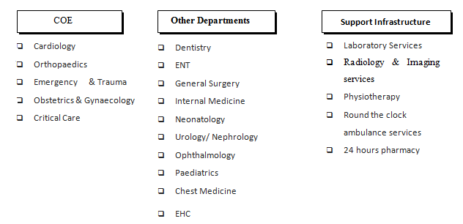
Scope of Services

Slide 12
Scope of Pathology Services
Biochemistry
Histopathology
Haematology
Microbiology

Slide 13
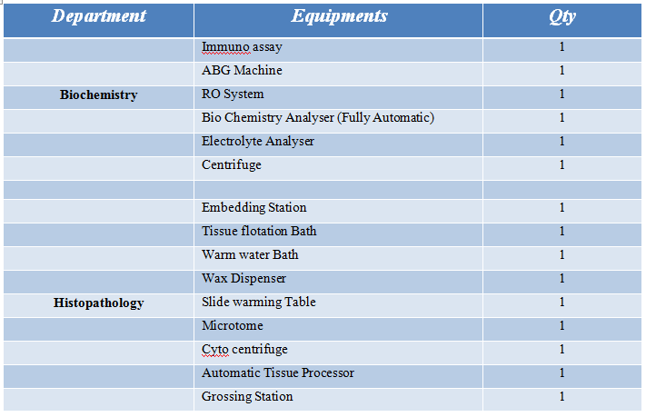
Resource Requirement & Capital Cost

Slide 14
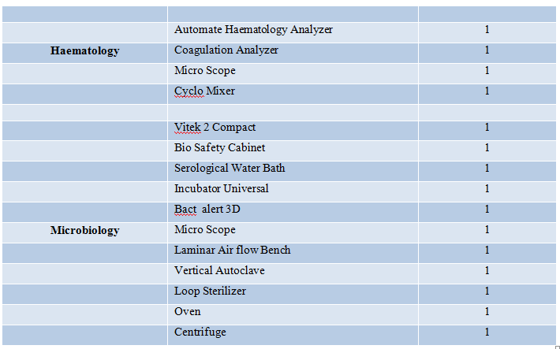
Resource Requirement & Capital Cost

Slide 15
Resource Requirement & Capital Cost
Capital Cost Rental Reagent Agreement: 91.62 Lakhs
Capital Cost All out Purchase: 214.12 Lakhs

Slide 16
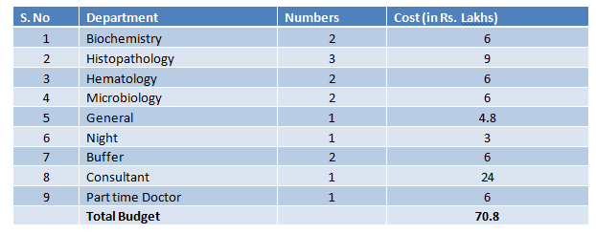
Manpower Cost

Slide 17
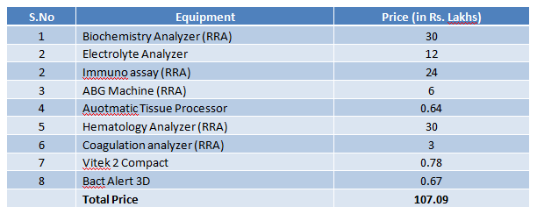
Reagent Cost (RRA)

Slide 18
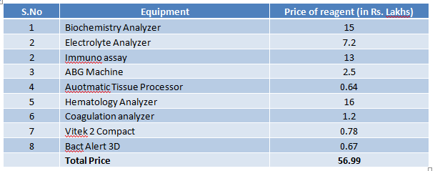
Reagent Cost (Capital Purchase)

Slide 19
Utility Cost
Cost of Electricity:
Wattage x Hours Used /1000 x price per unit = Cost of Electricity
Total Cost of Electricity = 13.34 Lakhs

Slide 20
Total Cost - RRA

Slide 21
Total Cost – Capital Purchase

Slide 22
Projected Sales Mix

Slide 23
Breakeven Point – Capital Purchase
Total Fixed Cost: Rs. 22746000
Total Variable Cost: Rs. 12779000
Total Sales @ 100% Capacity: Rs. 34100000
PV Ratio = 63%
BEP = Rs. 36379091.04
Payback Period: 1.7 years (approx)

Slide 24
Breakeven Point – RRA
Total Fixed Cost: Rs. 10496000
Total Variable Cost: Rs. 17789000
Total Sales @ 100% Capacity: Rs. 34100000
PV Ratio = 48%
BEP = Rs. 21943081
Payback Period: 1.07 years (approx)

Slide 25
Rental Reagent Agreement
Saves capital cost
Will place the Hospital in a position where profit could be made far more early rather than for capital purchase
A lesser amount of sales would help achieve the Breakeven which makes it easier for the organization to conduct business in the early phases.

Slide 26
Thank You…!!! Acknowledgements: Dr. Rajesh Bhalla (Dean Academics) Mrs. Meenakshi Gautam (Assistant Professor – Mentor) Mr. Gaurav Anand (Mentor – Jaypee Hospital, NOIDA) Dr. Vikram S. Raghuvanshi (C.E.O – Jaypee Healthcare)

