Slide 1
Dissertation At Referral Hospital Nathnagar in Bhagalpur District in Bihar “Gap Analysis of The Referral Hospital Nathnagar as per Indian Public Health Standards ” Presented By: Narendra Naga PG/11/056

Slide 2
INTRODUCTION
Referral Hospital Nathnagar is 30 bedded referral unit situated in block campus of Nathnagar. It caters 1.58 lac population.
One of the major component of NRHM was to establish the quality healthcare services in public hospitals as per standards. For this purpose Indian Public Health Standards (IPHS) were released to provide optimal specialized care within a define parameters of quality in public hospitals.
In this study the gap analysis of referral hospital Nathnagar is done by using IPHS standards.

Slide 3
Rationale of the study
In order to provide Quality of Care in FRUs, Indian Public Health Standards (IPHS) are being prescribed to provide optimal expert care to the community and achieve and maintain an acceptable standard of quality of care. These standards would help monitor and improve the functioning of the Referral Hospital.
To facilitate the above goals, comprehensive study of Referral Hospital was carried out on the current process, practices and existing infrastructure with other available resources to identify the major gaps based on Indian Public Health Standards as applicable to Referral Hospital to enhance the service quality level.

Slide 4
OBJECTIVE
General Objective:-
Study of the Gap Analysis of the Hospital as per IPHS guidelines.
Specific Objective:-
Describes the process flow of all the departments in the Referral Hospital with the identification of process owners, Input(s), Output(s) and process flow with the relevant records.
Identifies the significant gaps observed on all the processes in each section and explanation of the gap statement with document evidences and photographs. The gaps are analyzed based on IPH standards.

Slide 5
DATA AND METHODS
Both primary & secondary data collection was carried out to assess the current system and potential improvement. The study was completed with the help of two stages:-
Stage 1.
IPHS checklist was used for a total survey of the hospital. The survey was done to understand the scope of services, status of manpower, physical infrastructure, status and availability of equipments and diagnostic services.
Stage 2.
Observations were used to map the various processes of the hospital and to know the functioning of the each department.

Slide 6
Cont..
Study Area: Referral Hospital Nathnagar in Bhagalpur District in Bihar
Study Design: Observational study to analyse the gaps within the facility by using IPHS standards.
Data Collection Tool: Checklist
Duration of the Study: February 12 to 25 April , 2013

Slide 7
OBSERVATION & FINDINGS
1.0) OUTPATIENT DEPARTMENT

Slide 8
A.) For Process Flow:
Process Group | OPD | Sub-Process | OPD Registration
Process Location | Registration counter | Process Owner | Registration clerk
Input(s) | Patient coming to the hospital | Output(s) | No. of OPD registration per day
Process Flow/Process Description: OPD patient’s registration takes place from 8:00am to 2:00 pm. There are separate registration counters for male and female patients. The registration clerk at the registration counter writes the patient name, age, sex & address in a register and allocates a number to him/her on first cum first serve basis. After registration patient waits for his/her turn to be called by security personnel for consultation with medical officers. Registration fee is one rupee which is valid for one month. Old registration holder patients directly go to the OPD.
Patients Records |  | Outpatient Register, Registration Slip.

Slide 9
B.) Gap Analysis:
Gap ID No. | OP001
Gap Statement: Registration counter is in the open.
Rationale/Explanation: For registration the patient has to stand outside in the open. The area is not covered and patients have to stand in adverse weather condition. There is no chair or bench available for the patients to sit.
Gap Classification Structure | *Gap Severity Rating Medium
Gap Reference | IPHS Standards (4.1.3.)
Supporting Annexure | Photograph

Slide 10
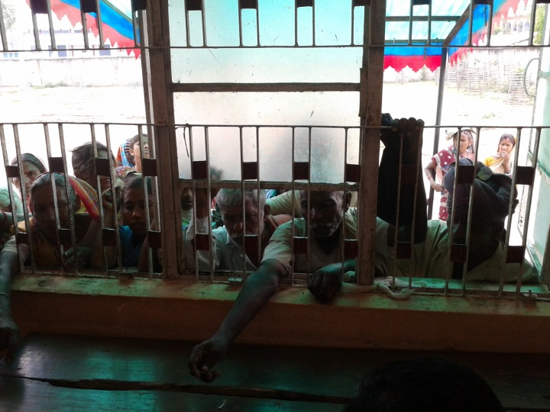
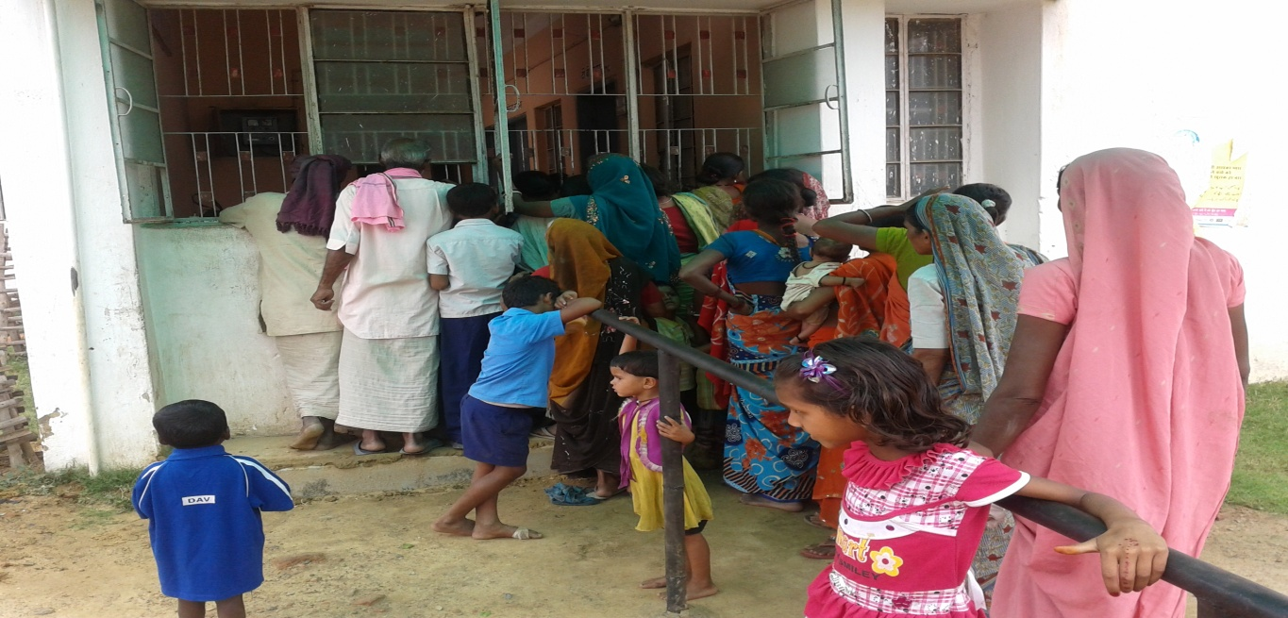
OPD Registration Counter..

Slide 11
C.) GAP ANALYSIS:
Gap ID No. | OP002
Gap Statement: Space for patient waiting area is a narrow corridor.
Rationale/Explanation: There is no designated waiting area for the patients. The patients wait outside the consulting chamber in the corridor. There is no sufficient space for waiting of the patients. No supporting facilities (like wheelchair, ramps, handrails & trolleys) for disabled patients. Rights of the patients/ Patients Charter are not displayed.
Gap Classification Structure | *Gap Severity Rating Medium
Gap Reference | IPHS (4.1.4 & 4.1.5, 4.1.6)
Supporting Annexure | Photograph

Slide 12
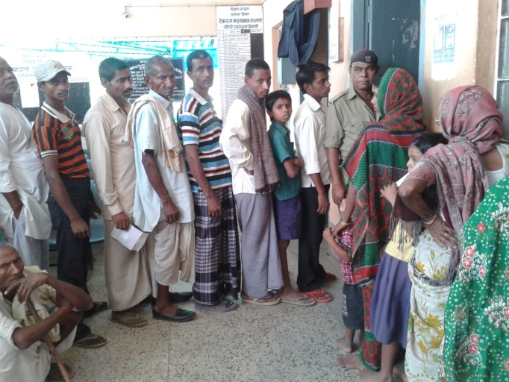
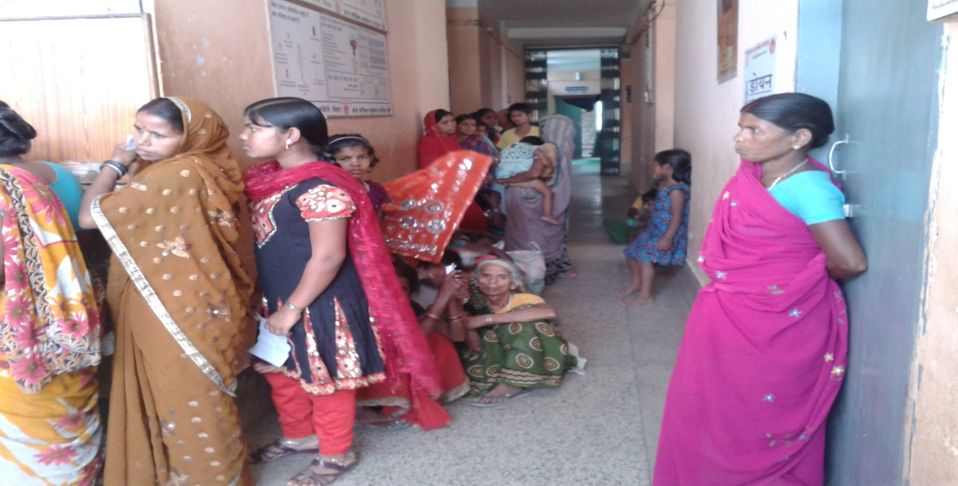
Patient’s waiting area..

Slide 13
1.2) OP Consultation

Slide 14
A.) For Process Flow:
Process Group | OPD | Sub-Process |  | Consultation
Process Location | Consultation Chamber | Process Owner |  | Medical Officer
Input(s) | Patients with OPD Registration Slip | Output(s) |  | >300/day of OPD consultations. 15/day of investigation prescribed. 250 of patients advised for follow up. 10 of patients referred.
Process Flow/Process Description: Medical Officer examines the patients as per their turn. Assess vitals and prescribe medication/investigations/admission/refer to higher centers on OPD Registration form. Medical Officer maintains the register and writes the patient’s serial number, registration number, patient’s name, age, sex, address and treatment. MO gives the information about dose, time and site of medication and also educate on diet if required.
Patient Records |  |  | OPD Register.

Slide 15
B.) Gap Analysis:
Gap ID No. | OP003
Gap Statement: Hospital services, Citizen charter are not displayed in the OPD waiting area.
Rationale/Explanation: Citizen Charter is not displayed. Posters imparting health education are not displayed in adequate number and all places. Booklets/Leaflets are not available. Available services, Name of the doctors, User Fee details and list of members of RKS/Hospital management committee are not displayed.
Gap Classification Structure | *Gap Severity Rating Medium
Gap Reference | IPHS (4.2.5, 4.1.6)

Slide 16
C.) Gap Analysis:
Gap ID No. | OP004
Gap Statement: Basic facilities are not available in the OPD
Rationale/Explanation: There is no waiting area. The doorway leading to the entrance not has a ramp facility easy access for handicapped patients; wheelchairs and stretchers are also not available. Toilets with adequate water supply separate for males and females are not available. Drinking water is not available in the patient’s waiting area. There are in-adequate chairs for patients and attendant in waiting area.
Gap Classification Structure | *Gap Severity Rating Medium
Gap Reference | IPHS (4.1.4 & 4.1.5)
Supporting Annexure | Photograph

Slide 17
D.) Gap Analysis:
Gap ID No. | OP005
Gap Statement: Patient privacy is not maintained during examination.
Rationale/Explanation: Curtains are not available in OP consultation room. During consultation time, a number of patients are present in consultation room.
Gap Classification Structure | *Gap Severity Rating High
Gap Reference | IPHS (4.1.7)

Slide 18
1.3) Dispensing of Medicines

Slide 19
A.) For Process Flow:
Process Group | OPD |  | Sub-Process | Dispensing of Medicines
Process Location | OP Pharmacy |  | Process Owner | Staff Nurse
Input(s) | OPD Registration Ticket |  | Output(s) | No. of Medicines dispensed per day No. of stock out per day
Process Flow/ Process Description: Patients come pharmacy after the consultation and go directly to pharmacy and shows the prescription. Staff Nurse checks the availability of drugs and if it is not available then advice some drugs is not available in the pharmacy, then patients are bound to purchase drugs outside the campus. Staff Nurse enters the name of the medicine in Medicine Dispensing Register; in register mention the reg. no. and quantity given to the patients.
Patient Records |  | Medicine Dispensing Register

Slide 20
B.) Gap Analysis:
Gap ID No. | OP006
Gap Statement: Dispensing of medicine is not as per standard dispensing practices.
Rationale/ Explanation: Post of Pharmacist is vacant. Racks for storage of medicines are not available. Medicines are kept on floor and during dispensing are laid down on a table which is too small. All patients are not described briefly about the intake of medicine. Medicines dispensed are not handed over to the patients in packets. Dosages and timing of medication is not written
Gap Classification Process | *Gap Severity Rating Medium
Gap Reference | IPHS (4.1.7)
Supporting Annexure | Photograph

Slide 21
Drug Dispensing Window..

Slide 22
2.0) IN-PATIENT DEPARTMENT

Slide 23
A.) For Process Flow:
Process Group | IPD | Sub-Process |  | Registration
Process Location | Registration Counter | Process Owner |  | Registration Clerk
Input(s) | Registration Form | Output(s) |  | 10 IPD Registrations per day
Process Flow/ Process Description: In case the patients needs admission the doctor writes down the instruction in the OPD ticket. The patient is advised to report the staff nurse in the inpatient ward. The staff nurse collects the OPD ticket and admits the patient and allots the bed according to the severity of the patient condition. After admitting the patient, nurse enters the detail of the patients in the case sheet register. During night, only the staff nurse admits the patients.
Patient Records |  |  | Registration Form

Slide 24
B.) For Gap Analysis:
Gap ID No. | IP001
Gap Statement: Wards are not fully equipped for patients care.
Rationale/ Explanation: Nursing station is not available in ward area. Patient transport facility (from OP consultation room to ward) is not adequate for vulnerable patient. Bed side lockers are not provided to keep medicines. Bed railings are not available in the wards. Pillow and blanket not provided to patient. Waste segregation bins are not available near the patient’s bed. Drinking water facility is not available in ward area. Waiting area for patient’s attendant is not available in front of wards. The cots and mattresses are in bad condition and need immediate repair. All the drugs are not available in the hospital and some have to bought from outside. Wards are not clean. No washing area is designated for washing of badly soiled linen.
Gap Classification Structural | *Gap Severity Rating High
Gap Reference | IPHS (4.1.8)
Supporting Annexure | Photographs

Slide 25
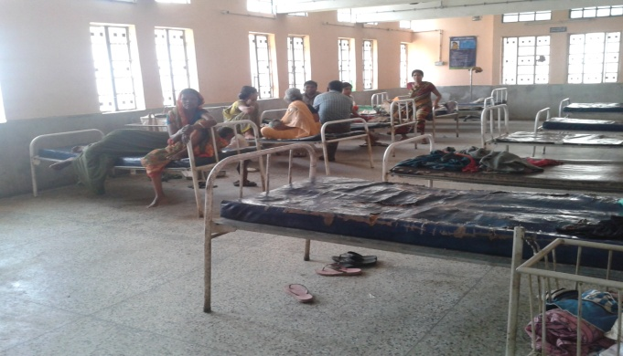
Hospital Ward..

Slide 26
3.0) Maternity & Child Health Care (Delivery)

Slide 27
A.) Process Flow:
Process Group | In Patients Service |  | Sub-Process | Conduction of Delivery
Process Location | Labour Room |  | Process Owner | MO/ Staff Nurse
Input(s) | Patient with Labour Pain |  | Output(s) | Delivery conducted
Process Flow/ Process Description: The patient comes with Labour Pain. The attendant, who comes with patient, goes to registration counter and takes the registration slip. Staff Nurse/ ANM examines the patient’s condition. If signs for labour are confirmed, then patient is admitted. If not confirmed then the patient is sent home and advised to come back during the consent of labour pain. After checking of vitals, the patient transferred to Labour Room. After delivery, vitals are again checked and the mother is shifted to the ward. Neonatal Care is provided to the baby in NBCC unit. Breast feeding is initiated within half an hour of delivery. Staff Nurse/ ANM maintains the Labour Register and JBSY Register. In Labour Register, ANM writes the name of the patient, serial number, OPD/ ER number, ASHA name and patient’s address. In JBSY Register ANM writes serial number, OPD/ ER number, name and address., age, child M/F, weight of child, ASHA name, list of medicine and signature. In JBSY Register photo of delivery patients should be pasted.
Patients Records |  | Case Sheet/ Bed Head Ticket, Delivery Register, JBSY Register.

Slide 28
B.) Gap Analysis:
Gap ID No. | IP003
Gap Statement: Essential facility for labour room is not available.
Rationale/ Explanation: There are no separate areas for septic and aseptic deliveries. The labour room is not well-lit and ventilated with an attached toilet facilities. No scrub room for doctors and nurses. No sterile supply in labour room.
Gap Classification Structure | *Gap Severity Rating Medium
Gap Reference | IPHS (4.1.10)
Supporting Annexure | Photograph

Slide 29
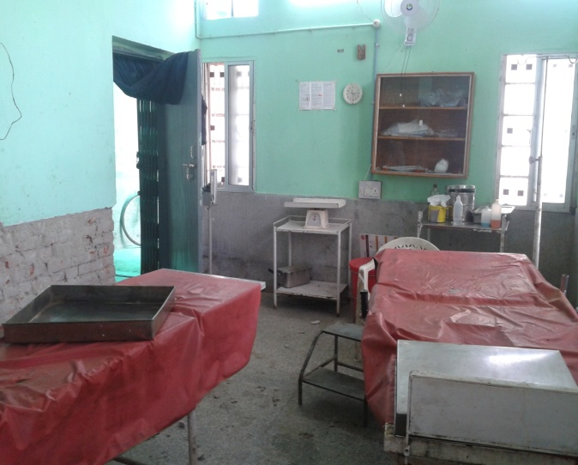
Labour Room..

Slide 30
4.0) OPERATION THEATER

Slide 31
A.) For Process Flow:
Process Group | OT | Sub-Process | OT Booking
Process Location | OT | Process Owner | OT Nurse
Input(s) | OPD Slip/ BHT | Output(s) | No. Of cases booked per day/ month
Process Flow/ Process Description: Patient is examined in OPD/ Ward. Doctor advice for surgery. Case is posted in OT and entry made in OT Register. The consent is taken in the ward by the staff nurse.
Patient Records |  |  | Registration Form

Slide 32
B.) Gap Analysis:
Gap ID No. |  | OT001
Gap Statement: OT is not designed as per standard guidelines.
Rationale/ Explanation: No concept of zoning exists at present. There is no separate dress change area in the OT. There are windows which are not sealed. Scrubbing Room is inside the Operating Room.
Gap Classification Structure |  | *Gap Severity Rating High
Gap Reference | IPHS (4.1.9)
Supporting Annexure |  | Photograph

Slide 33
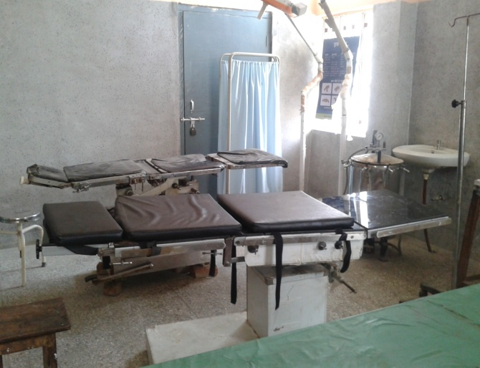
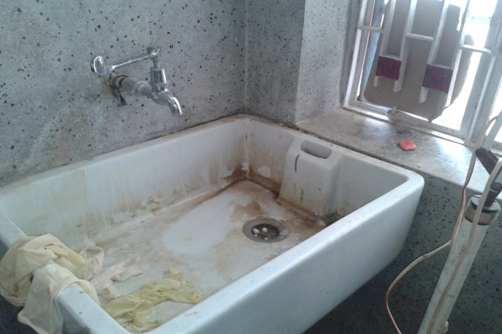
Operation Theatre…

Slide 34
5.0) Medicine/ Drug Store/ Store Room

Slide 35
A.) Process Flow:
Process Group | Administration (Procurement) |  | Sub-Process | Procurement of drugs and kits, Lab equipments & stationary.
Process Location | Store room |  | Process Owner | Store keeper
Input(s) | Indent |  | Output(s) | Medicine issued from District Health Society.
Process Flow/ Process Description: Hospital pharmacy store raise indent to district pharmacy store. Indent is raised with the approval of MOIC. Hospital pharmacy store receive the drugs and disposables from District Pharmacy Store against the indent. The medicines for the whole block including the Sub-Centers are received by the storekeeper and distributed accordingly. If the medicines are not adequate, medicines are bought through scheme. Local purchase of drugs also done and the amount is taken from RKS and untied funds.
Patient Records |  | Service Registers

Slide 36
B.) Gap Analysis:
Gap ID No. | MS001
Gap Statement: There is less space and facilities for storage of medicines.
Rationale/ Explanation: Racks are not available to properly arrange the medicine. Hence all the medicines are stored together. No Labeling of medicine is being done. All the equipments and stationary material lying here and there in store and mixed up with medicine, looks like a garbage store.
Gap Classification Structure | *Gap Severity Rating Medium
Gap Reference | IPHS (4.1.14)
Supporting Annexure | Photograph

Slide 37
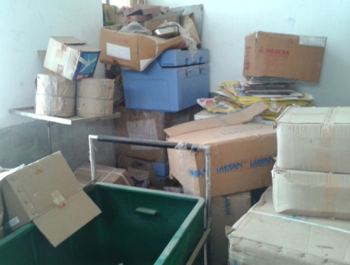
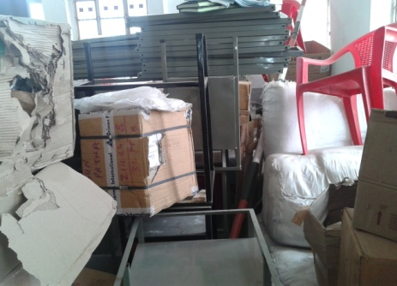
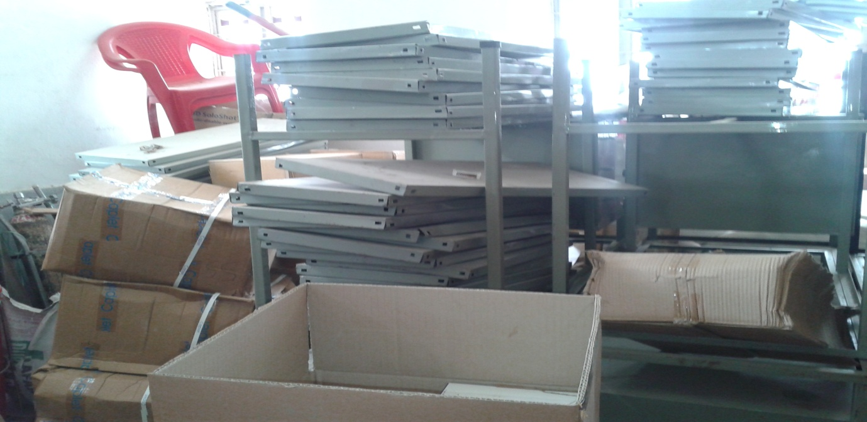
Store Room..

Slide 38
6.0) HOUSE KEEPING

Slide 39
A.) Process Flow:
Process Group | Housekeeping Services | Sub-Process | Cleaning & Mopping
Process Location | Hospital premises area | Process Owner | Housekeeping service provider
Input(s) | Unclean Referral Hospital | Output(s) | Clean Referral Hospital
Process Flow/ Process Description: The housekeeping staff does dusting and mopping in the hospital area. Male housekeeping staff cleans the wards, OPD area, OT, Lab & x-ray and washroom three times in a day. Female housekeeping staff cleans the labour room. Housekeeping staff do the mopping with the solution of phenyl and water.
Patient Records |  | -

Slide 40
B.) Gap Analysis:
Gap ID No. | HK 01
Gap Statement: Cleaning and mopping practice is not being carried out as per hospital requirements.
Rationale/ Explanation: Broom is used for dusting in OT and Labour room before mopping. The ratio of phenyl and water is not defined and they do mixing as per availability of materials. Scrubbing is not being done daily in all areas. Cobwebs are not cleared at last once in a month. Toilets are not cleaned in each shift and patient load. Hence they stink most of the time.
Gap Classification Structure | *Gap Severity Rating Medium
Gap Reference | IPHS 4.1.8 (g)

Slide 41
7.0) DIETARY SERVICES

Slide 42
A.) Process Flow:
Process Group | Dietary Services |  | Sub-Process | Dietary
Process Location | Hospital Kitchen room |  | Process Owner | Staff Nurse
Input(s) | No. Of in-patients required for diet. |  | Output(s) | Diet provide to the patient.
Process Flow/ Process Description: Nursing staff inform to the contractor (NGO) about the number of diets are required. The space for kitchen is provided in hospital building near ward rooms. The diets are provided to the ward patients by a lady. The diet is provided to those patients only who admitted in hospital for delivery or family planning operation; remaining patients are not able take the advantage of dietary services. Diet is given three times as breakfast, lunch and dinner.
Patients Records |  | Patient Diet Register

Slide 43
B.) Gap Analysis:
Gap ID No. | DTS 01
Gap Statement: Diet is not provided as per the requirements of patients.
Rationale/ Explanation: Nutrition assessment is not done. Quality of the food is not checked. There is no monitoring of food making process. Food hygiene is not maintained. Only single gas stove is used for preparing the food. The condition of kitchen room is very poor.
Gap Classification Process | *Gap Severity Rating Medium
Gap Reference | IPHS (8)
Supporting Annexure | Photograph

Slide 44
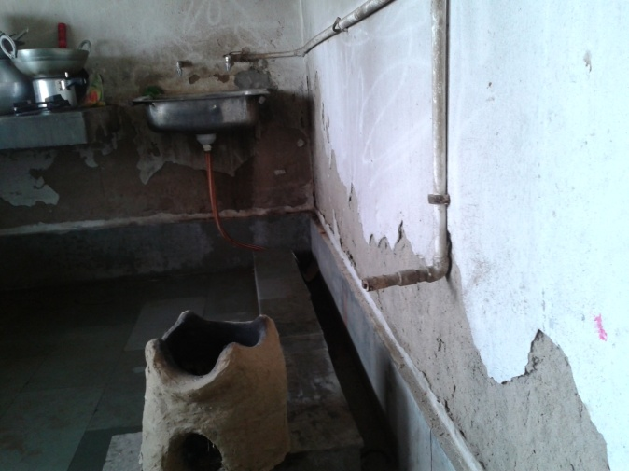
Hospital Kitchen Room..

Slide 45
8.0) LAUNDRY SERVICES

Slide 46
A.) Process Flow:
Process Group | Laundry | Sub-Process |  | Cleaning the linen
Process Location | Outsourced | Process Owner |  | MOIC/ HM
Input(s) | Dirty Linen | Output(s) |  | Cleaned Linen
Process Flow/ Process Description: Dirty linen is collected from OT and labour room. Outsourced service provider (NGO) receives the dirty linen and washed it outside of the Referral Hospital. The washed linen is received by the hospital staff.
Patients Records |  |  | Linen Receiving Register.

Slide 47
B.) Gap Analysis:
Gap ID No. | LS 01
Gap Statement: Laundry service is outsourced to traditional Dhobi.
Rationale/ Explanation: All dirty linen are mixed up during collection. There is no fix timing for receiving the dirty linen and dispatch the washed linen. Washing procedure is not proper. They use the water of open pond to wash the linen. Washer man uses the normal detergent for washing the linen.
Gap Classification Structure | *Gap Severity Rating Medium
Gap Reference | IPHS (8)

Slide 48
SWOT ANALYSIS
STRENGTHS
It is located in the centre of the block and easily approachable.
Commanding and well informed Medical Officer In-charge.
MOIC interested in overall development of Referral Hospital.
1.58lac population covered by it.
>300 OPD per day and 10 Delivery per day the figure itself indicates that the Referral Hospital serves good number of health care to the community.

Slide 49
Cont..
Involvement of PRI (Panchayti Raj Institute) in the hospital functioning is working very efficiently and effectively.
Patient who can not be treated at the centre are referred to the district hospital in Ambulance.
The hospital has 24 hours Ambulance facility.
Round the clock water availability.

Slide 50
WEAKNESSES
Trained manpower requirements are not filled as per patient load and IPH standard.
Centralized decision making at the state level leads to delay in approval and implementation.
Non-availability of essential laboratory services.
There is water logging in the hospital which needs to be rectified at the earliest.
BMW is not followed as per BMW guidelines 1998 (2001).

Slide 51
Cont..
Equipments are inadequate and often out of order. Annual maintenance is also not carrying out.
Supply of drugs and consumables are irregular and there are shortages from time to time.
Training is poor and lacks skill development, team building and motivational components i.e. continuous medical education or Training Program is not periodically conducted to update the clinical staff and managerial staff.
Lack of security services.

Slide 52
OPPORTUNITIES
It has great potential to be brought up to a model CHC.
Proper planning and coordination with DHS, NRHM and RKS can lead to development of services and better delivery of health care in an integrated way.
Free space available which can be utilized for improved construction or future expansion of the hospital.
Willingness of Government to empower the leadership.

Slide 53
PERCEIVED CHALLENGES
Decentralization of decision making at the hospital level.
Following all legal requirements such as AERB, BARC etc.
Adherence to BMW management rules 1998.
Following infection control practices.
Upkeep and sanitation of hospital building and environment.
Providing laboratory services.

Slide 54
Conclusion & Recommendations
As evident from the study, all the departments of Referral Hospital are not adhering to the IPHS norms in terms of quality parameters, human resource, infrastructure or services. In order to improve the functioning of the health facilities according to IPHS, the following recommendations are made:

Slide 55
A. Recommendations for Wards
Separate wards for male & Female
Facilities for drinking water & clean toilets for men & women
ward should be easily accessible from the OPD & separate nursing staff in the ward and OPD
Nursing station should be located in such a way that health staff can be easily accessible to OT and labour room
Clean linen should be provided and cleanliness should be ensured

Slide 56
B. Waiting area
Adequate space and seating arrangements
The walls should carry posters imparting health education
Toilets with adequate water supply separate for males and females

Slide 57
C. Operation Theatre
It should have a changing room, sterilization area operating area and washing area.
Separate facilities for storing of sterile and unsterile equipments / instruments
OT should be well connected to the wards.
The OT should be well-equipped with all the necessary accessories and equipment
Surgeries like laparoscopy / cataract / Tubectomy / Vasectomy should be able to be carried out in these OTs.

Slide 58
D. Equipment and Furniture
The necessary equipment to deliver the assured services of the CHC should be available in adequate quantity and also be functional.
Equipment maintenance should be given special attention.
Periodic stock taking of equipment and preventive/ round the year maintenance will ensure proper functioning equipment. Back up should be made available wherever possible.

Slide 59
E. Labour Room
There should be separate areas for septic and aseptic deliveries.
The LR should be well-lit and ventilated with an attached toilet and drinking water facilities. Plan has been annexed.
Dirty linen, baby wash, toilet, Sterilization not to interfere with the work during peak hours and also during times of eating.

Slide 60
F. Outpatient Department
The outpatient room should have separate areas for consultation and examination.
The area for examination should have sufficient privacy.
G. Entrance:
It should be well-lit and ventilated with space for Registration and record room, drug dispensing room, and waiting area for patients.
The doorway leading to the entrance should also have a ramp facilitating easy access for handicapped patients, wheel chairs, stretchers etc.

Slide 61
H. Minor OT/Dressing Room/Injection Room/Emergency
This should be located close to the OPD to cater to patients for minor surgeries and emergencies after OPD hours.
It should be well equipped with all the emergency drugs and instruments.
I. There should be proper notice displaying wings of the centre, available services, names of the doctors, users’ fee details and list of members of the Rogi Kalyan Samiti / Hospital Management Committee.
J. A locked complaint / suggestion box should be provided and it should be ensured that the complaints/suggestions are looked into at regular intervals and the complaints are addressed.

Slide 62
References
Indian Public Health Standard (IPHS); Community Health Centre Level: Draft guidelines; Directorate General of Health Services, Ministry of Health and Family Welfare, Government of India
The National Population Policy 2000. http:// www. populationcommission.nic.in/npp.htm
Devika Biswas and Vivekanand Ojha; Adhering to IPHS Guidelines; A study of the health facilities in Sheikhpura District of Bihar; BVHA, Patna; Bihar Public Health Study; October 2012
Analysis of community health centres in Rajasthan, SIHFW: An ISO 9001:2008 Certified Institution; State Institute of Health & Family Welfare, Jaipur
P.R.sodani and Kalpa Sharma , Assessing Indian public health standards for community health centers: A case study with special reference to essential new born care services Indian journal of public health , volume 55, issue 4, October-December, 2011.

Slide 63
Cont..
Indian Public Health Standards (IPHS) Guidelines for Community Health Centres Revised 2012; Directorate general of health services, ministry of health & family welfare, Government of India.
Ministry of Health and Family Welfare. National Rural Health Mission (2005-2012): Mission Document. New Delhi: Ministry of Health and Family Welfare; 2005.
Ministry of Health and Family Welfare. Indian Public Health Standards (IPHS) for Community Health Centers (Revised 2010). New Delhi: Ministry of Health and Family Welfare; 2010.
Ministry of Health and Family Welfare. Rural Health Statistics in India. New Delhi: Ministry of Health and Family Welfare; 2010.
Ministry of Health and Family Welfare. Indian Public Health Standards (IPHS) for Community Health Centers (Draft Guidelines). New Delhi: Ministry of Health and Family Welfare; 2006.
Ministry of Health and Family Welfare. Indian Public Health Standards (IPHS) for Community Health Centers (Revised 2007). New Delhi: Ministry of Health and Family Welfare; 2007.

Slide 64
THANK YOU

