Slide 1


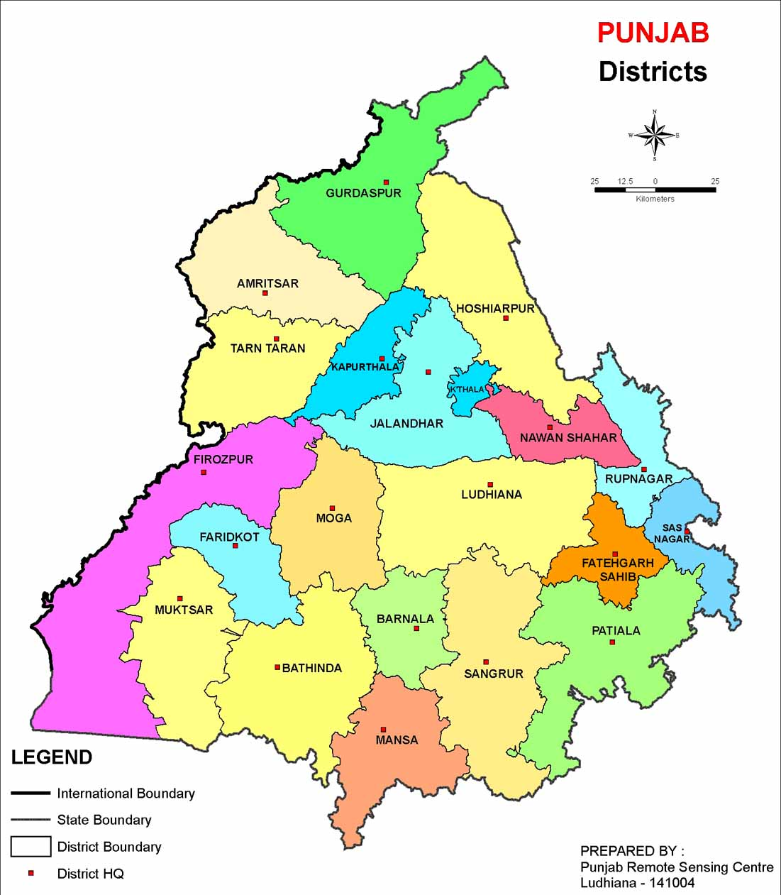

Data Analysis of
Punjab Cancer Awareness Campaign
Presented by-
Dr. Gitika Arora
PG/11/029

Slide 2
Contents
Organization Profile
Tasks Performed
Introduction
Review of Literature
Objectives
Data and Methods
Results and Findings
Discussion
Limitations of Study
Recommendations
References

Slide 3
Organization Profile
HISP India is a not-for-profit NGO specializing in designing and implementing solutions in health informatics for the public health sector in Indian states, and also recently in Bangladesh and Sri Lanka.
multi-disciplinary organization concentrating on the domains of public health and informatics
has a strong commitment to free and open source technologies

Slide 4
Tasks Performed
OpenMRS Testing for Mandi and Kullu districts
Cold Chain Equipment Management (CCEM) Manual Designing
Data Quality Assessment (DQA) Application Customization
Rationalisation of Formats for District Health Information Software (DHIS) Haryana
Documentation of feedback on ASHA Portal for Haryana
Data Analysis for Cancer Awareness Campaign (CAC) Punjab

Slide 5
Reflective Learning during Internship
Development of my analytical skills while analysing the data for CAC Punjab.
Testing and customizing applications and documentation.
Working on DHIS Haryana, gave me a deeper insight into challenges faced while reporting health data.

Slide 6
Dissertation on-
Data Analysis
Of
Punjab Cancer Awareness Campaign (CAC)

Slide 7
Introduction
Punjab State started a survey on total population of Punjab (urban and rural both) for cancer prevalence in the state where cancer cases for the last five years were reported.
Urban population survey was covered by Medical College and nursing college students while rural population survey was covered by ANM’s, ASHA’s male health workers & LHV’s.
Two performa were designed
  Performa 1- basic information, demographics
  Performa 2- disease specific based on findings of performa 1

Slide 8
Performa 1

Slide 9
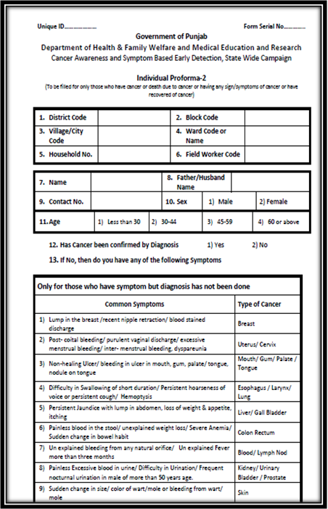
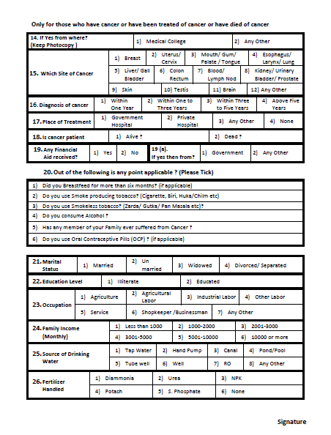
Performa 2

Slide 10
Role of HISP India
Developing SMS based application for reporting through mobile phone
Integrating mobile reporting with the State DHIS2 online application for facility reporting and analysis
Data Reporting
  rural data via sending reports through mobile
  urban data via direct entry on DHIS2 tracker by data entry operator
  Rationale of Study
  Estimating cancer load in the state is essential to plan for necessary actions as well as early detection and awareness will help prevent the increasing future cancer load.

Slide 11
Review of Literature
According to an Epidemiological Study of High Cancer among Rural Agricultural Community of Punjab, Cancer of female reproductive system, i.e., breast, uterus/cervix and ovary were more common in Talwandi sabo whereas cancer of blood and lymphatic system, esophagus, and bones were more common in Chamkaur Sahib.
According to a research article, Breast cancer is the second most while cervical cancer is the third most common form of malignancy in female population of Punjab.
More than 5,56,000 cancer deaths occurred in India in 2010 and 71.1 per cent of those who died were aged between 30 and 69 years, says a report on cancer mortality in India, published in the March 28 issue of The Lancet.

Slide 12
Objectives
General Objective
To analyse the cancer data reported through DHIS2 tracker in cancer awareness campaign in Punjab State, identify the gaps and assess the quality.
Specific Objectives
To analyse the cancer deaths, confirmed cases and suspected cases reported in CAC in Punjab.
To analyse the district wise cancer data reported gender wise, age group wise, organ wise and urban rural wise.
To identify the gaps between the cancer data reported in DHIS2 and that reported by Govt. of Punjab through their survey.
To assess the quality of data reported in DHIS2.

Slide 13
Data and Methods
Study Design- Analytical Study
Data Analysis- Quantitative analysis of CAC data
Analytical tool- SPSS
Use of SQLyog to extract data from database

Slide 14
Results and Findings
Data collected from December 2012 to March 2013.
From all 20 districts of Punjab.
Total population covered – 27067539.
Total Cancer Cases recorded in DHIS till March 30th, 2013 - 78807.

Slide 15
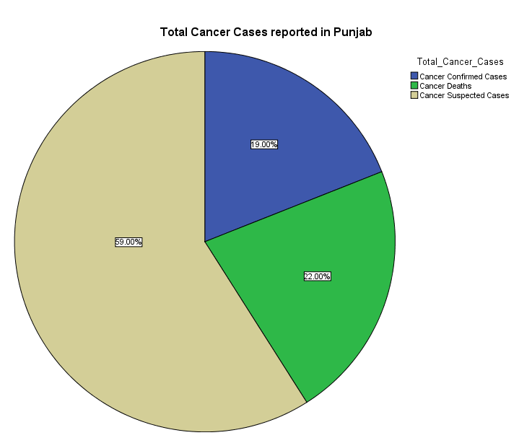
Analysis for Cancer Deaths, Confirmed & Suspected Cases

Slide 16
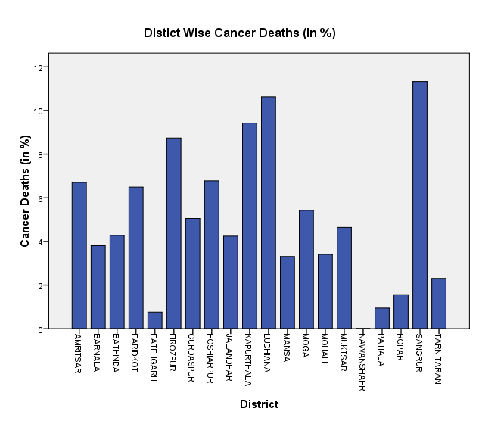
District Wise Cancer Deaths

Slide 17
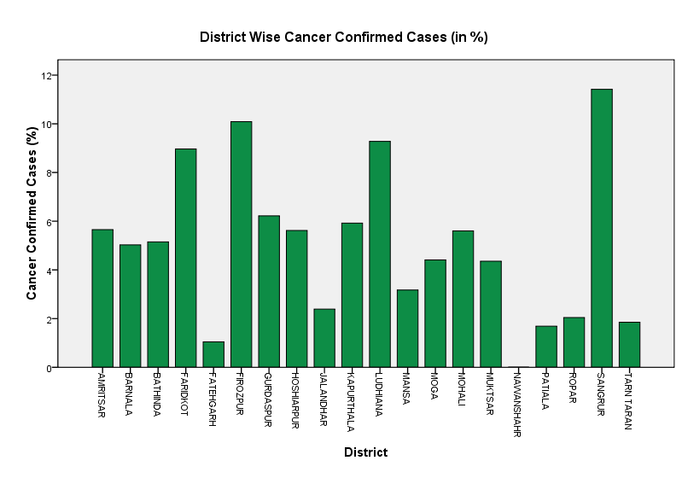
District Wise Cancer Confirmed Cases

Slide 18
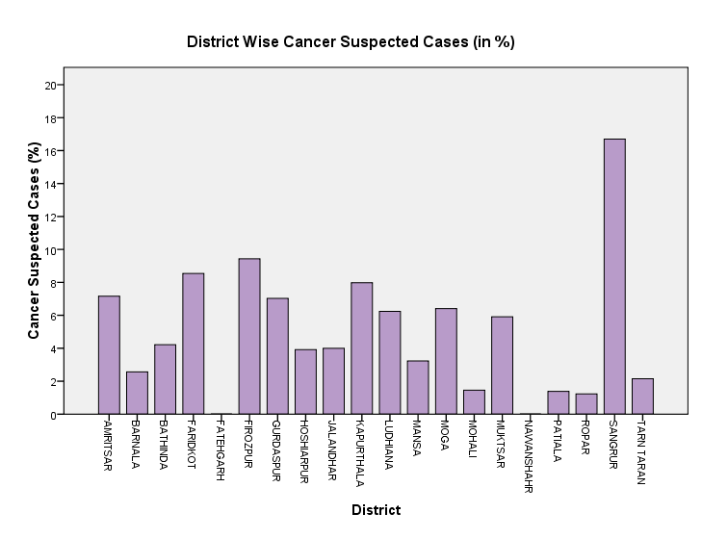
District Wise Cancer Suspected Cases

Slide 19
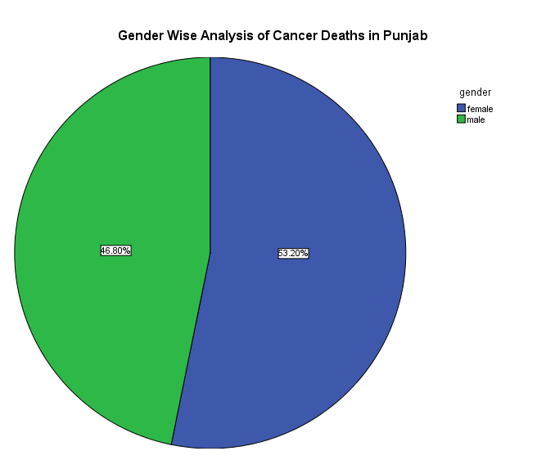
Gender Wise Analysis- Cancer Deaths

Slide 20
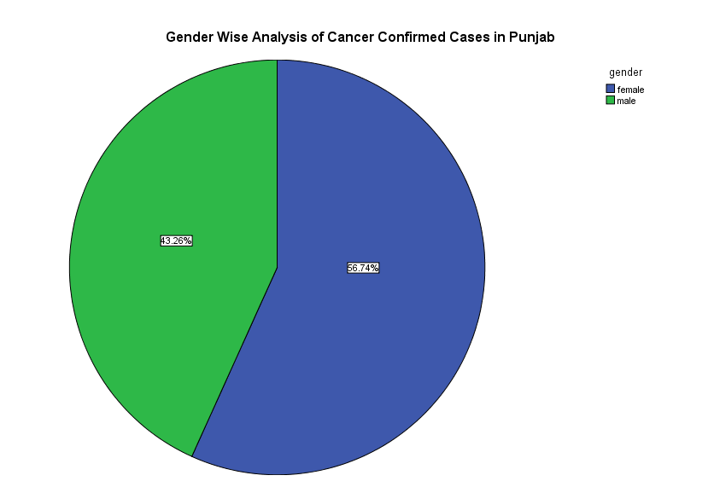
Gender Wise Analysis- Cancer Confirmed Cases

Slide 21
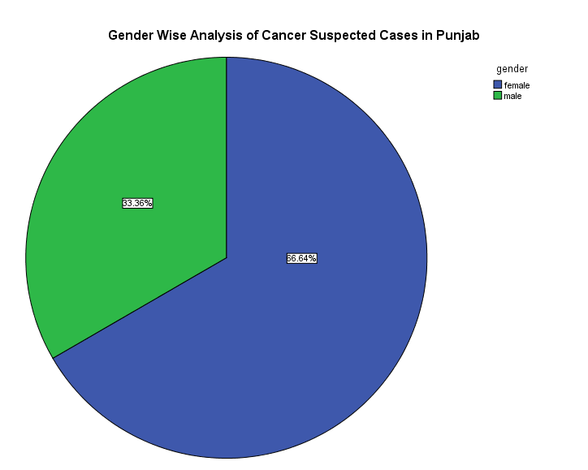
Gender Wise Analysis- Cancer Suspected Cases

Slide 22
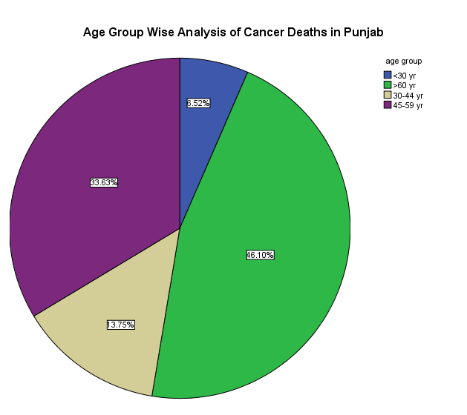
Age Group Wise Analysis- Cancer Deaths

Slide 23
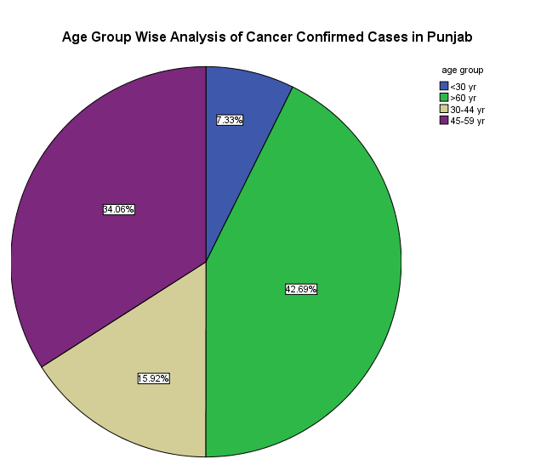
Age Group Wise Analysis- Cancer Confirmed Cases

Slide 24
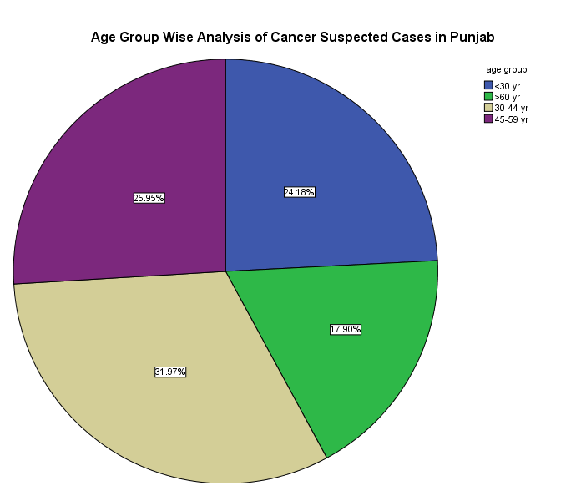
Age Group Wise Analysis- Cancer Suspected Cases

Slide 25
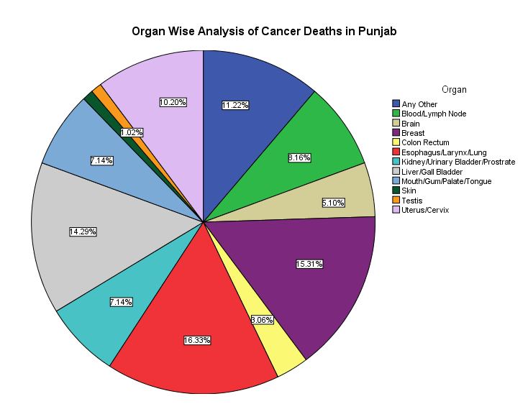
Organ Wise Analysis- Cancer Deaths

Slide 26
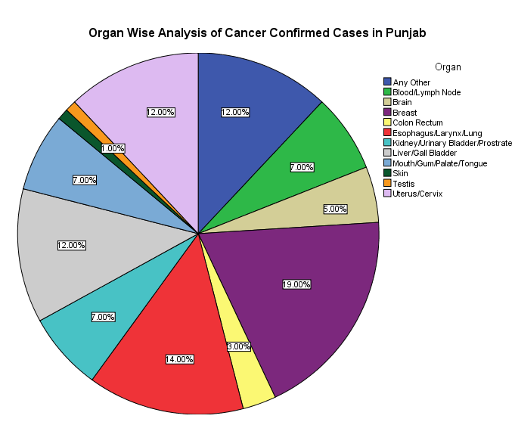
Organ Wise Analysis- Cancer Confirmed Cases

Slide 27
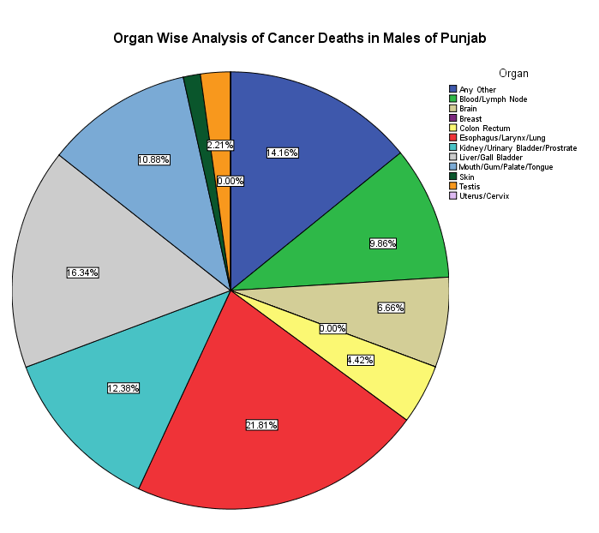
Organ Wise Analysis- Cancer Deaths in Males

Slide 28
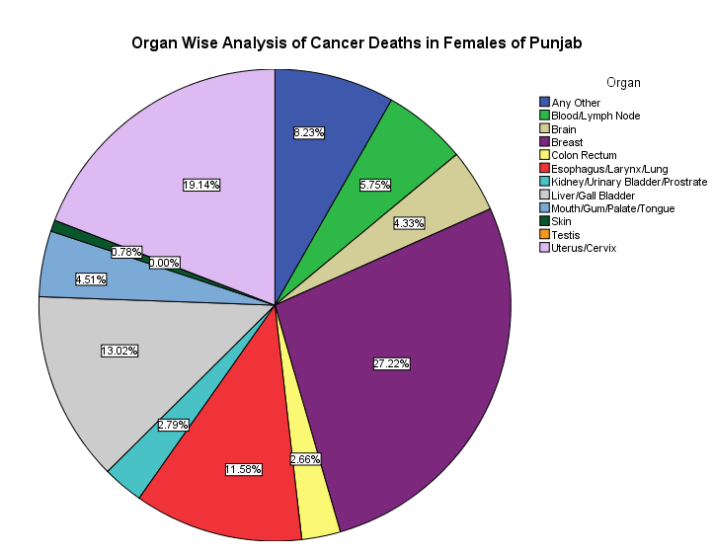
Organ Wise Analysis- Cancer Deaths in Females

Slide 29
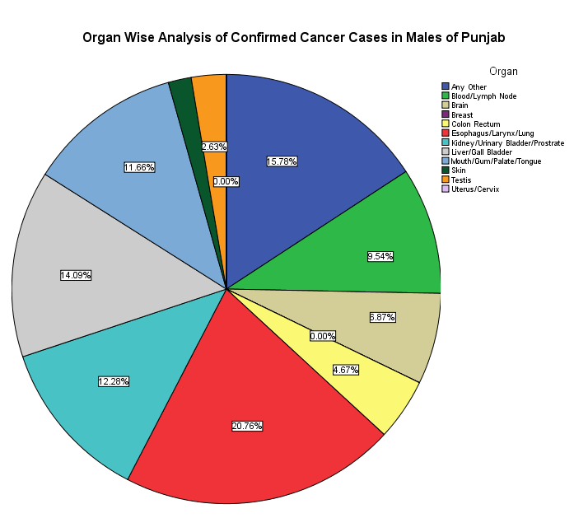
Organ Wise Analysis- Cancer Confirmed Cases in Males

Slide 30
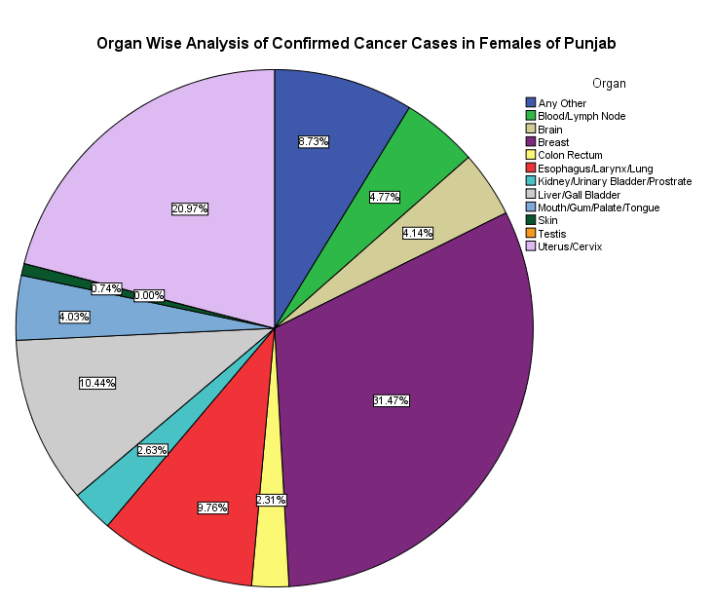
Organ Wise Analysis- Cancer Confirmed Cases in Females

Slide 31
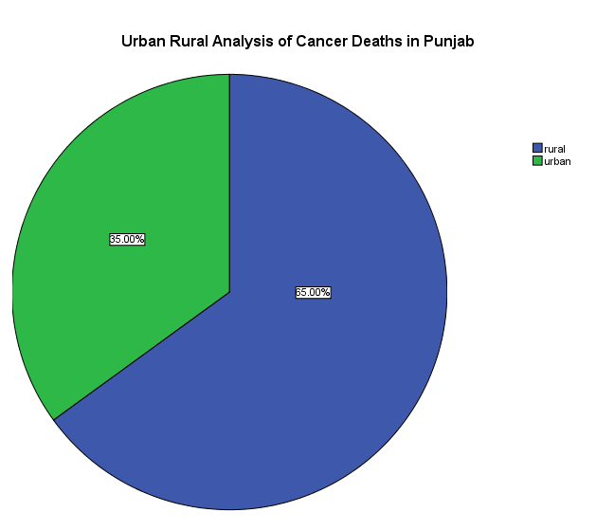
Urban Rural Analysis- Cancer Deaths

Slide 32
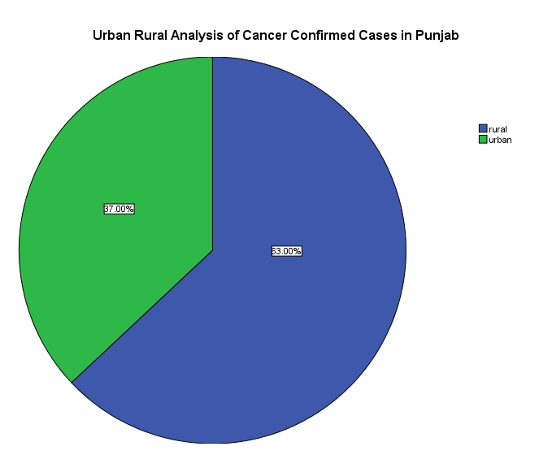
Urban Rural Analysis- Cancer Confirmed Cases

Slide 33
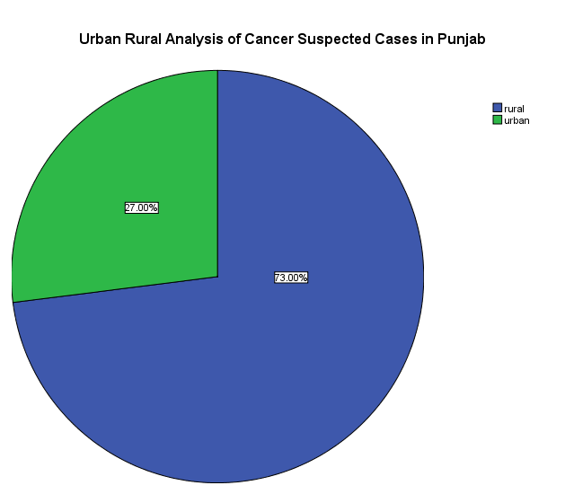
Urban Rural Analysis- Cancer Suspected Cases

Slide 34
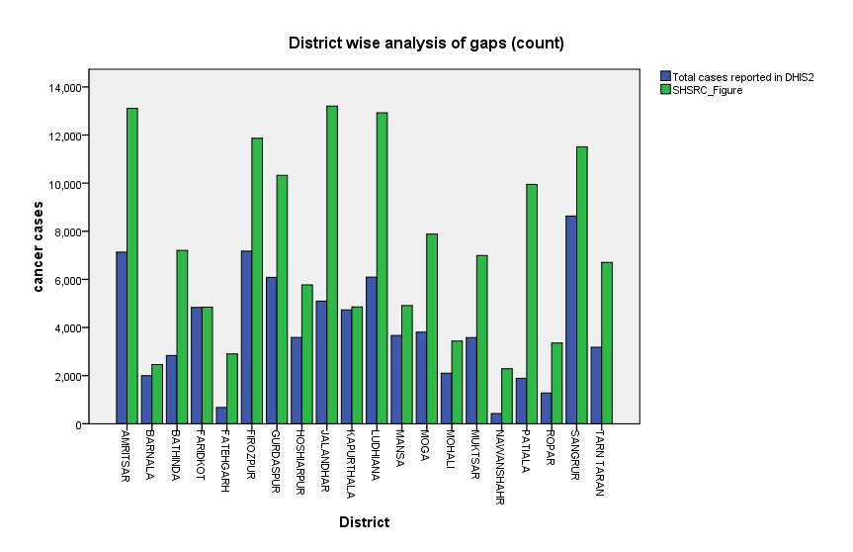
District Wise Analysis of Gaps in data reported

Slide 35
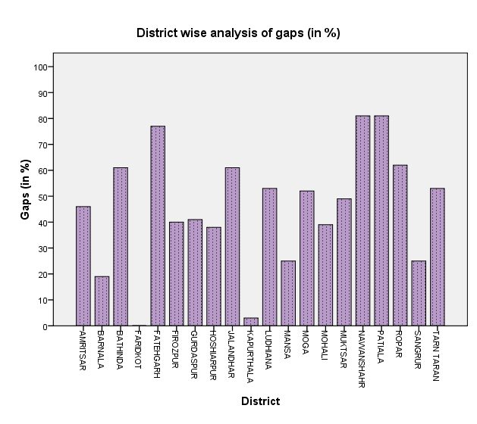
District Wise Analysis of Gaps in data reported (in %)

Slide 36
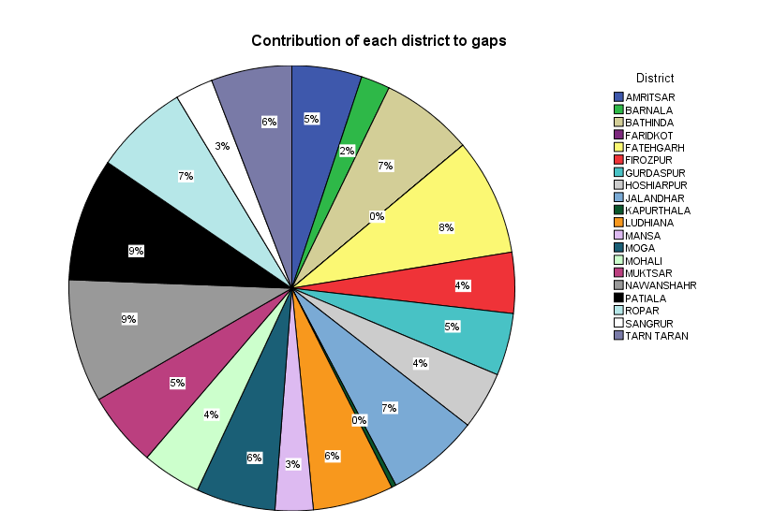
Contribution of each district to gaps

Slide 37
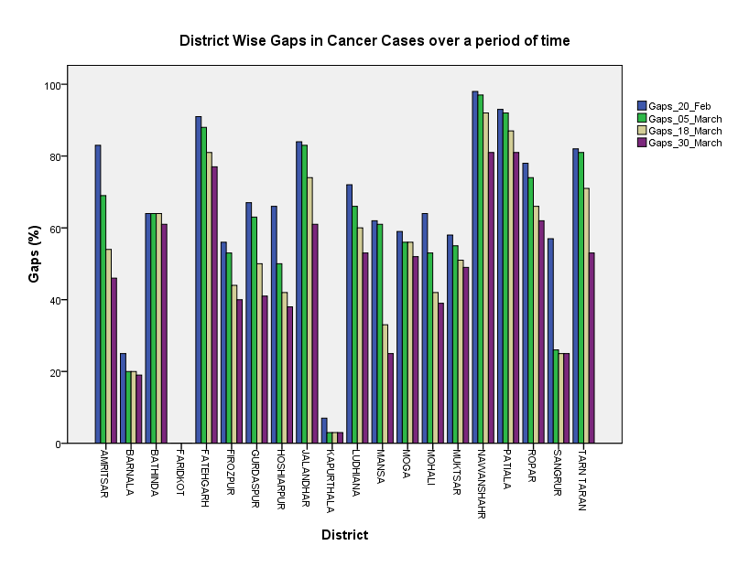
District wise gap in cancer cases over a period of time

Slide 38
Discussion
A large population is suspected to have cancer.
In most of the districts, of the total cases reported more than 20% have died because of cancer and number suffering from cancer is mostly below from those dying of it.
There is high prevalence of cancer in females. The difference is particularly high in suspected cases directing to further increasing trend in cancer among females in future.
main organs diagnosed with cancer in females are breast and uterus/cervix and in males are Oesophagus/Larynx/Lung Cancer followed by Liver/Gall Bladder Cancer.

Slide 39
Discussion (contd.)
Cancer deaths and confirmed cases are more among the older age groups while suspected cases are more in age group of 30-44 years.
Rural areas have a higher cancer prevalence as compared to urban areas.
For few records, male was diagnosed with breast or uterus cancer and females diagnosed with testis cancer.
A large amount of data was not reported in DHIS and there was a large difference in the DHIS and SHSRC figure.
Identified reasons were-
  Technical issues- Server down time which was because of poor UPS back up and long power cuts in DIT, Punjab.
  Training issues- Changes in human resources concerned leading to need for re-training.

Slide 40
Limitations of Study
The data analysed is limited to data available and compiled till March 30th, 2013.
The data for fertilizer handled and risk factors could not be analysed as these fields were not entered in most of the records.

Slide 41
Recommendations
Growing need for symptom based early detection of cancer.
Follow up for the cancer confirmed and suspected cases.
Motivating patients for follow up and allocating funds to them for their treatment.
More campaigns should be organised on awareness of females to follow precautions and prevent risk factors leading to cancer.
Need to provide more health facilities and awareness campaigns in rural areas.
For accelerating reporting by districts, should perform retraining and motivational workshops where required to keep all human resources informed and involved.
There is a crucial need to upgrade server as well as UPS for server.
Fields for risk factors and fertilizer handled should be made mandatory as analyzing these elements is essential in identifying the cause and trend of cancer.

Slide 42
Case Study-
Cold Chain Equipment Management(CCEM) Manual Designing

Slide 43
Introduction
CCEM is being developed as a module in DHIS for following purposes-
  To manage the cold chain equipment requirements from health facilities and to monitor the working status of the equipments by tracking, thereby enabling timely action in cold chain supply management.
  To collect, process and analyze facility wise routine data from cold chain equipment.
The manual was designed for training the user on working of CCEM. Screenshots were used for better understanding by user.

Slide 44
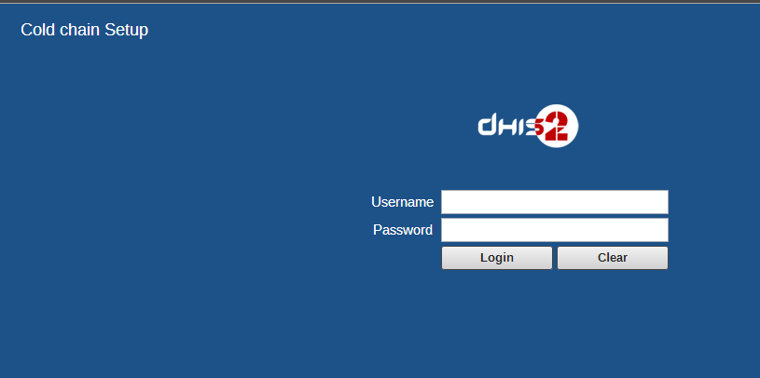
Login Screen

Slide 45
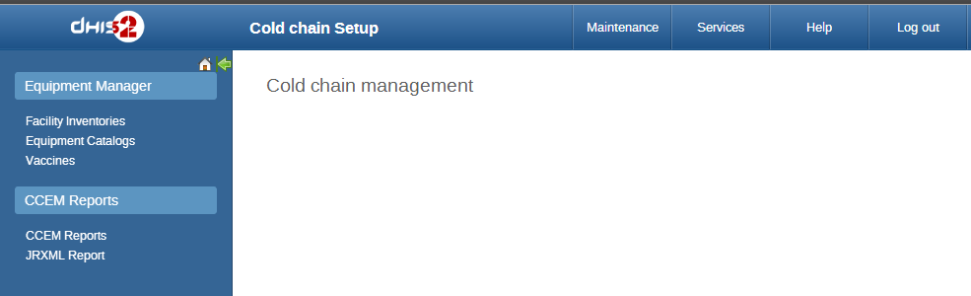
Managing Facility Inventories

Slide 46
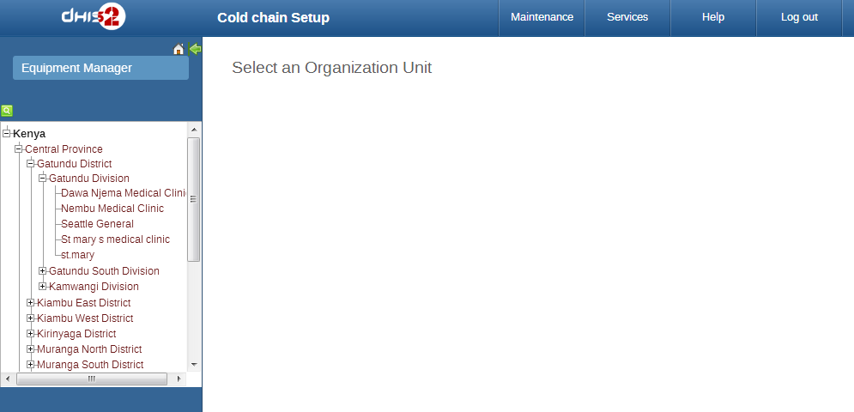
Organization Unit Selection

Slide 47
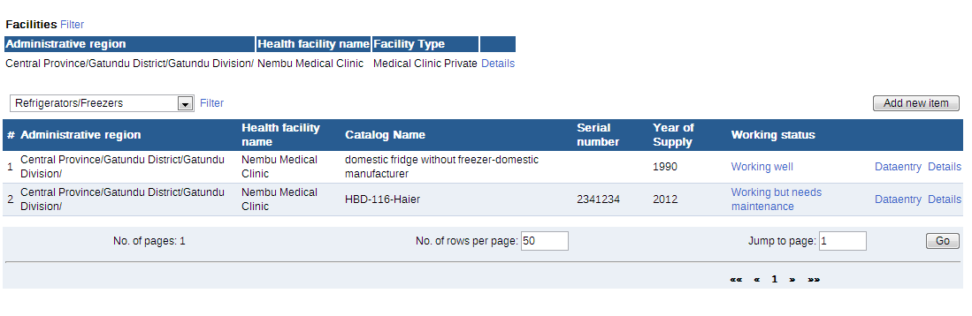
Managing Inventories

Slide 48
References
HISP India, www.hispindia.org
Epidemiological Study of High Cancer among Rural Agricultural Community of Punjab in Northern India, J. S. Thakur, B. T. Rao, Arvind Rajwanshi, H. K. Parwana and Rajesh Kumar, Int. J. Environ. Res. Public Health 2008, 5(5) 399-407
Cancer Scenario in India with Future Perspectives, Research Article, Imran Ali, Waseem A. Wani and Kishwar Saleem, Cancer Therapy Vol 8, 56-70, 2011
Most cancer patients in India die without medical attention: study, Sonal Matharu, Mar 29, 2012, 'It is a myth that cancer is prevalent only in urban areas' (http://www.downtoearth.org.in/content/most-cancer-patients-india-die-without-medical-attention-study)

Slide 49


